Slide 1
Data - OT

Slide 2
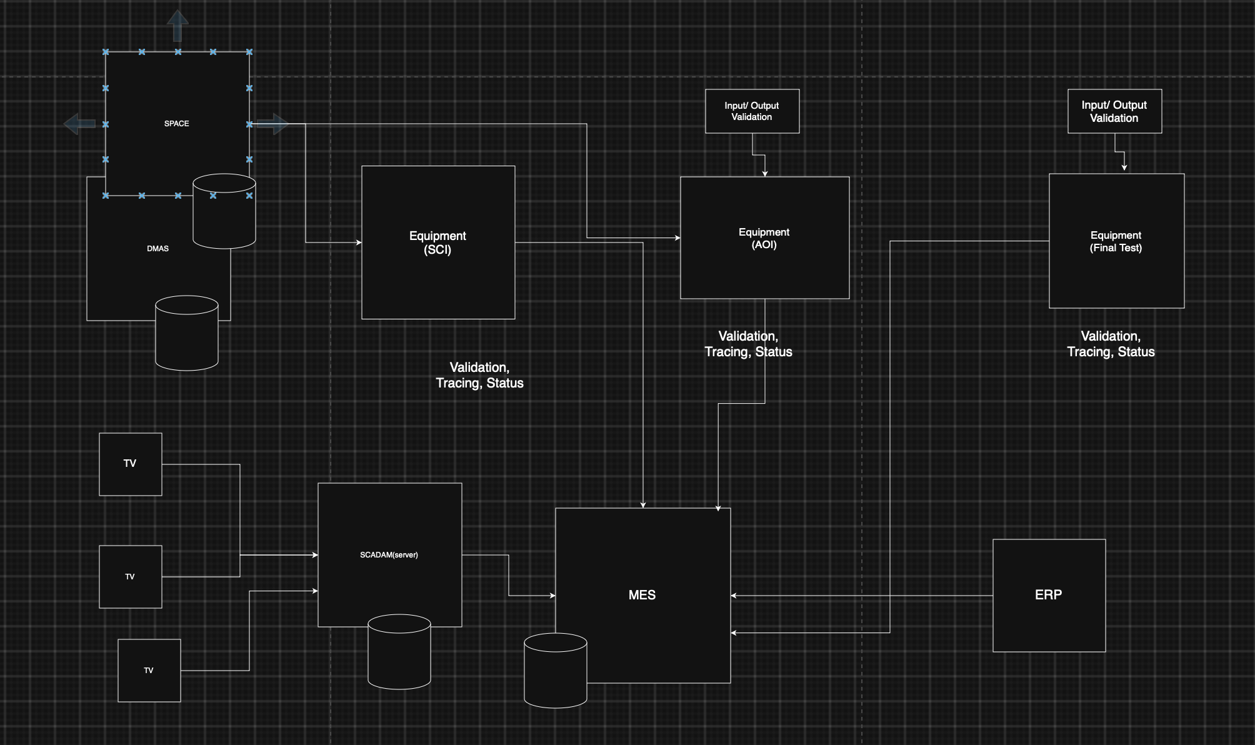
Tech Dependencies:
  SCADA/MES
    Validation
    Tracing
    Status
  SPACE
  MES
  ERP
  DMAS

Slide 3
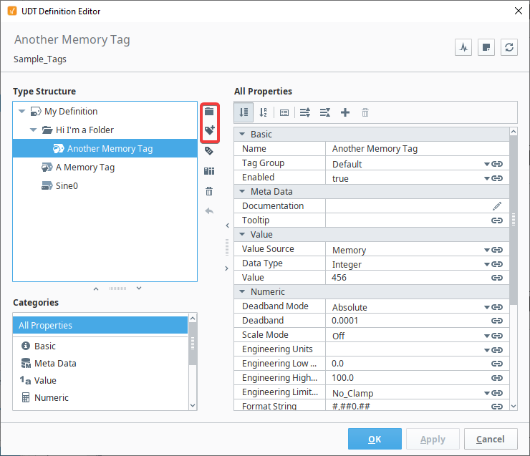

Slide 4
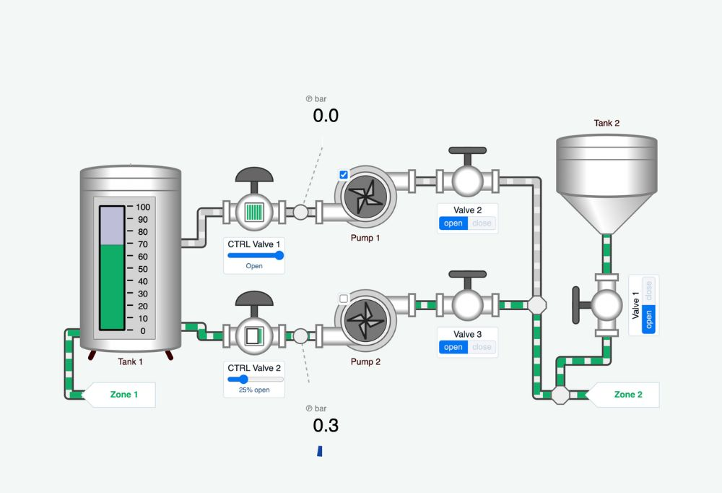

Slide 5
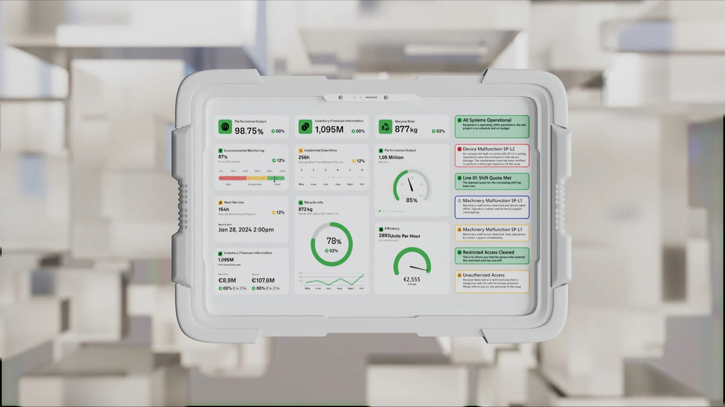

Slide 6
