Slide 1
MATLAB 教學講義_3

Slide 2
Stability analysis
波德圖: [mag,phase]=bode(num,den,omega); [gm,pm,wcp,wcg]=margin(mag,phase,omega);
尼可圖: [mag,phase]=nichols(num,den);
plot(phas,20*log10(mag));
ngrid(‘new’) %尼可圖網線
奈式圖: [realpart,imagepart]=nyquist(num,den)
plot(realpart,imagepart);

Slide 3
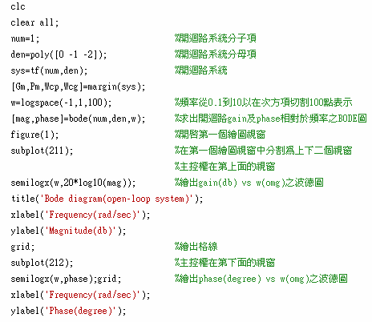
EX1：Bode plot

Slide 4
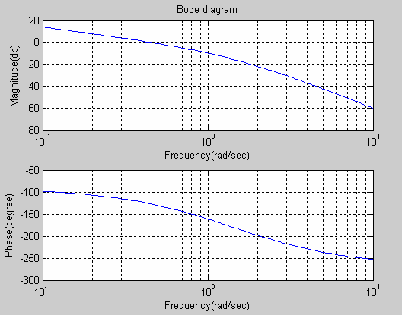
EX1：Bode plot

Slide 5
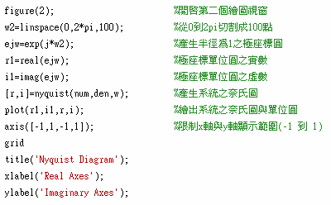
EX2：Nyquist Diagram

Slide 6
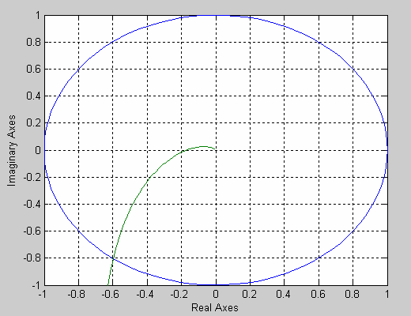
EX2：Nyquist Diagram

Slide 7
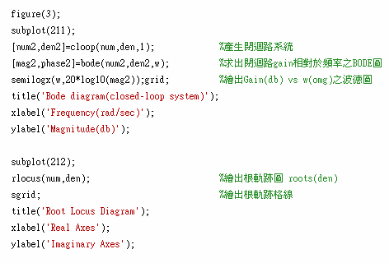
EX3：Root Locus Diagram

Slide 8
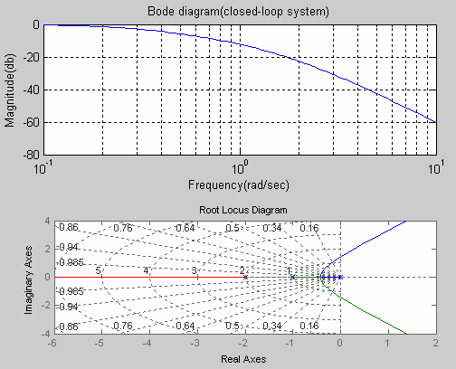
EX3：Root Locus Diagram

Slide 9
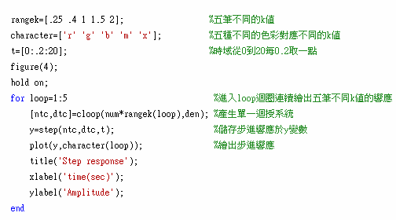
EX4

Slide 10
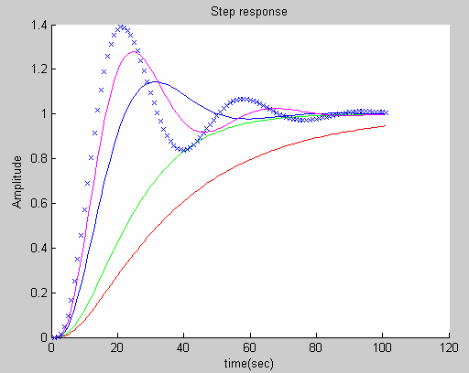
EX4

Slide 11
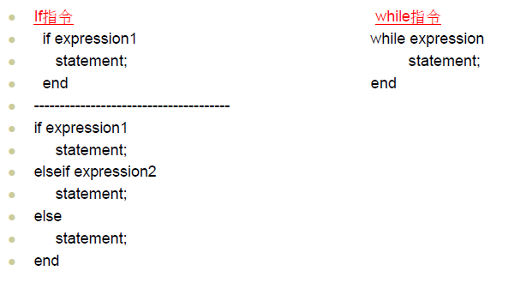
If , while 指令

Slide 12
Design controller
P controller, PI controller, PD controller
PID controller
Phase-Lead controller
Phase-Lag controller

Slide 13

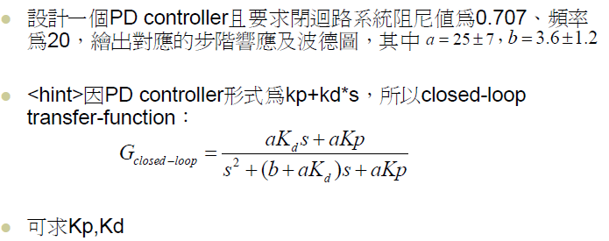

實驗練習3-1

Slide 14
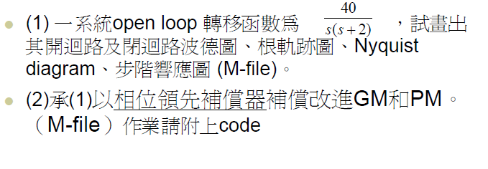
實驗練習3-2

