Slide 1
Audio Classification by RestNet50
盧柏翰 F14081088 / 周呈陽 F14081046 / 凌維璟 F94086157 / 沈俊維 F14086177 / 黃昱鑫 F94086018
林高進 F94086092 / 方炘源 F94086123 / 馬世常 F14086151 / 趙偉暠 F94081050 / 蘇 晃 F14086224
黃昭禓 F04086086

Slide 2
OUTLINE
Introduction
Training Process
Dataset Choosing
Model & Train
Deep Learning Structure
Architecture
Loss Function
Experiment
Future Work

Slide 3
OUTLINE
Introduction
Training Process
Dataset Choosing
Model & Train
Deep Learning Structure
Architecture
Loss Function
Experiment
Future Work

Slide 4
INTRODUCTION
Motivation
Rencently, the audio speech recognition is widely utilized in many fields.
Despite there being an improvement in the standard CNN architectures, there has been no work that has used these pre-trained ImageNet models for audio tasks.
People have ignored a strong ImageNet pretrained model baseline to compare the customized models against.
Objective
By simple pre-trained ImageNet models with a single set of input features for audio we can achieve good results
Contribution
Successfully using the pretrained models to achieve state-of-the-art results
For CNNs between different image tasks seem to hold for transfer learning between images and spectrograms.
Using Integrated Gradients to understand CNN learns the entire shape of the spectrograms.

Slide 5
OUTLINE
Introduction
Training Process
Dataset Choosing
Model & Train
Deep Learning Structure
Architecture
Loss Function
Experiment
Future Work

Slide 6
TRAINING PROCESS
DATASET CHOOSING
UrbanSound8k
This dataset contains 8732 labeled sound excerpts (<=4s) of urban sounds from 10 classes:
air conditioner, car horn, children playing, dog bark, drilling, engine idling, gun shot, jackhammer, siren, and street music.
GTZAN Dataset
The GTZAN audio dataset contains 1000 tracks of 30 second length
There are 10 genres, each containing 100 tracks which are all 22050Hz Mono 16-bit audio files in wav format. The genres are:
blues, classical, country, disco, hiphop, jazz, metal, pop, reggae, and rock.

Slide 7
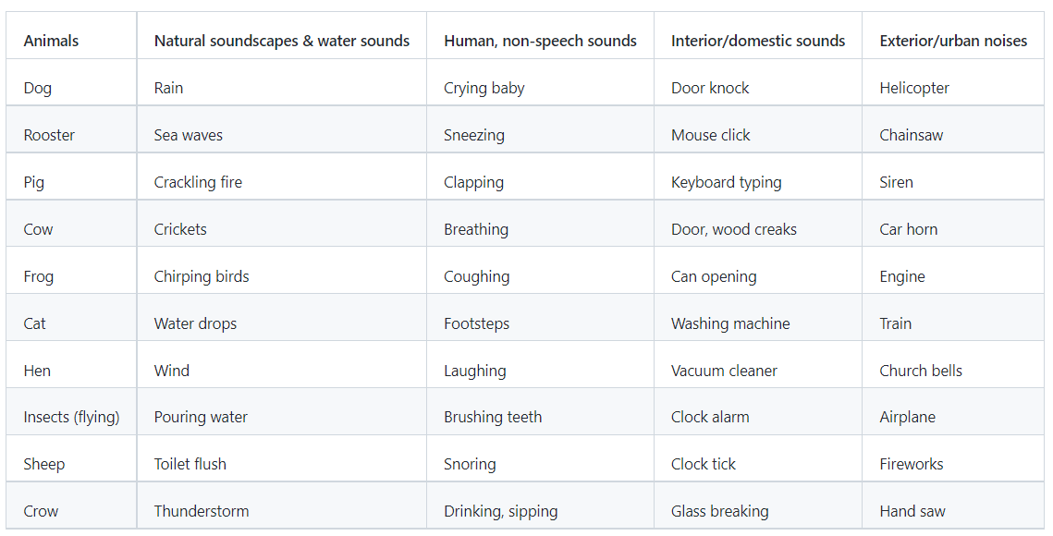
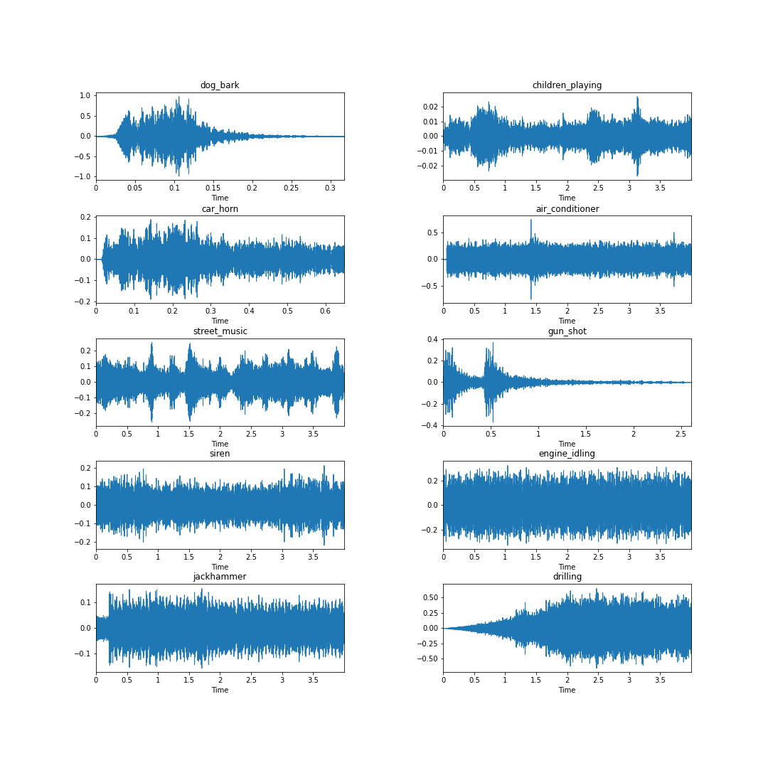
TRAINING PROCESS
ESC-50 ( the DATASETS which we choose to implement for this Final Project )
The ESC-50 dataset is a labeled collection of 2000 environmental audio recordings suitable for benchmarking methods of environmental sound classification, and each of length 5s
Besides,the dataset consists of 5-second-long recordings organized into 50 semantical classes (with 40 examples per class) loosely arranged into 5 major categories, sounds
ranging from sounds of Chirping Birds to Car Horn Sounds.
ESC-50
GTZAN

Slide 8
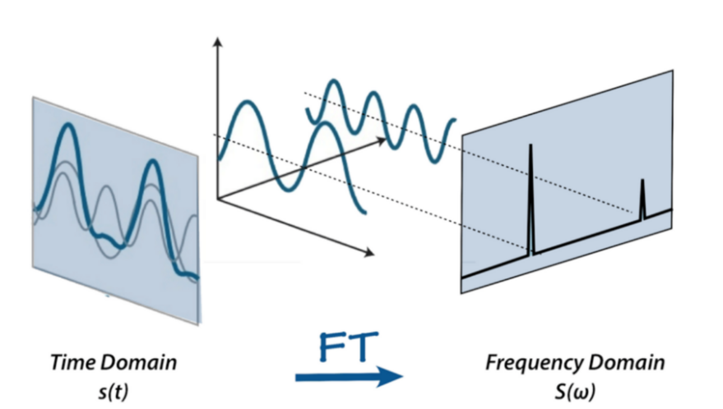
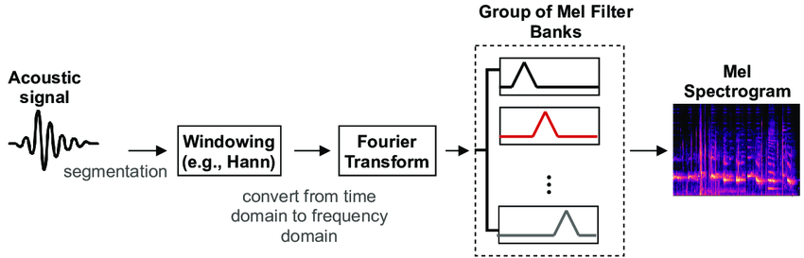
TRAINING PROCESS
DATA PREPROCESSING
Log-Spectrograms
The Fourier transform is a mathematical formula that allows us to decompose a signal into it’s individual frequencies and the frequency’s amplitude.
It converts the signal from the time domain into the frequency domain.The result is called a spectrum.
Log-MelSpectrograms
Humen are better at detecting differences in lower frequencies than higher frequencies. For example, we can easily tell the difference between 500 and 1000 Hz, but we will hardly be able to tell a difference between 10,000 and 10,500 Hz.
In 1937, someone proposed a unit of pitch such that equal distances in pitch sounded equally distant to the listener→ the mel scale.
A mel spectrogram is a spectrogram where the frequencies are converted to the mel scale.

Slide 9
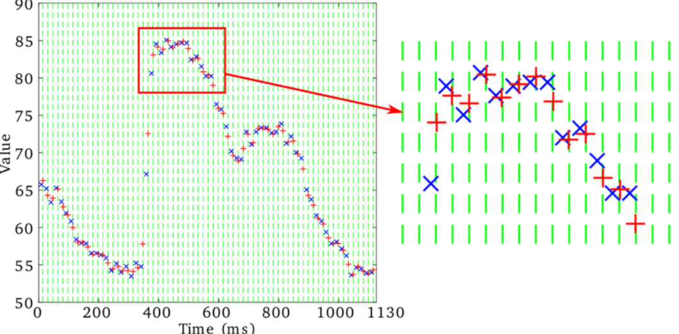
TRAINING PROCESS
MFCCs
Mel-frequency cepstral, inverse Fourier transform of the logarithm of the estimated signal spectrum, coefficients are coefficients that collectively make up an MFC.
In Music Information Retrieval it is often used to describe timbre or classify genre, since it represents short-duration musical textures.
They are a small set of features (usually about 10–20) which concisely describe the overall shape of a spectral envelope.
Gammatone-Spectrogram
Gammatone filterbank originally proposed by Roy Patterson and colleagues in 1992.
Gammatone filters were conceived as a simple fit to experimental observations of the mammalian cochlea, and have a repeated pole structure leading to an impulse response.

Slide 10
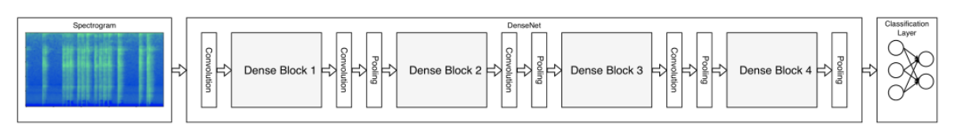
TRAINING PROCESS
MODEL & TRAIN
Inception
An Inception Layer is a combination of all the layers namely, 1x1 Convolutional layer, 3x3 Convolutional layer, 5x5 Convolutional layers with their output filter banks concatenated into a single output vector forming the input of the next stage.
A typical Inception network consists of several Inception layers stacked upon each other, with occasional max-pooling layers with stride 2 to halve the resolution of the grid.
DenseNet
Dense Convolutional Network (DenseNet), connects each layer to every other layer in a feed-forward fashion. For each layer, the feature-maps of all preceding layers are used as inputs, and its own feature-maps are used as inputs into all subsequent layers.

Slide 11
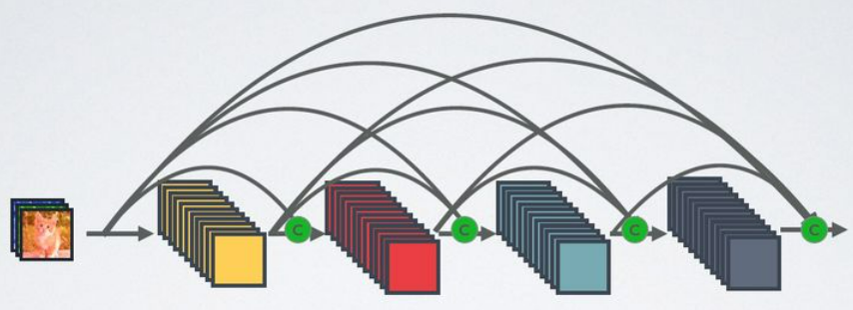
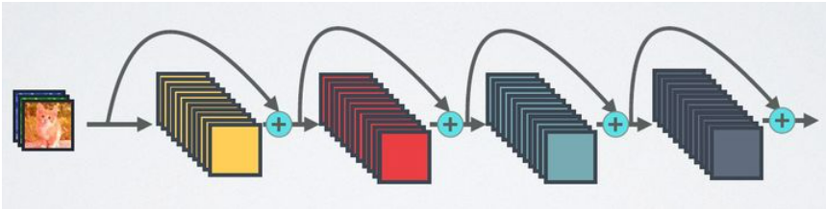
TRAINING PROCESS
Traditional convolutional networks with L layers have L connections one between each layer and its subsequent layer a dense network has L(L+1) / 2 direct connections.
DenseNet diminishes the vanishing gradient problem, and it requires fewer parameters to train the model. Dynamic feature propagation takes care of the seamless flow of information.
DenseNet
ResNet

Slide 12
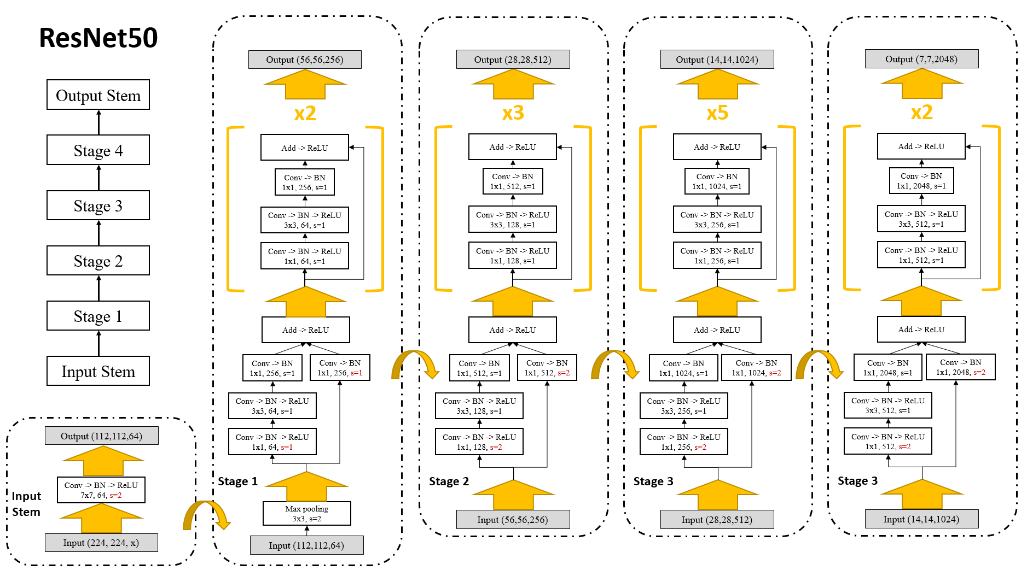
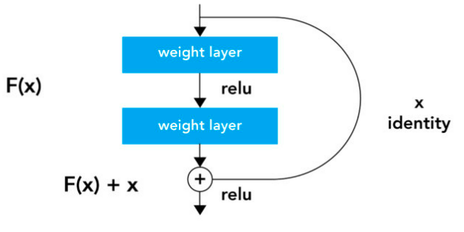
TRAINING PROCESS
ResNet
ResNet consists of several residual blocks stacked on top of each other. The residual block has two 3x3 convolutional layers with the same number of output channels. Each convolutional layer is followed by a batch normalization layer and a ReLU activation function. A skip connection is added which skips these two convolution operations and adds the input directly before the final ReLU activation function.
With adding more layers on top of a network, its performance degrades. This could be blamed on the optimization function, initialization of the network and more importantly vanishing gradient problem.This pproblem of training very deep networks has been alleviated with the introduction of ResNet.

Slide 13
OUTLINE
Introduction
Training Process
Dataset Choosing
Model & Train
Deep Learning Structure
Architecture
Loss Function
Experiment
Future Work

Slide 14
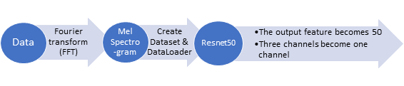
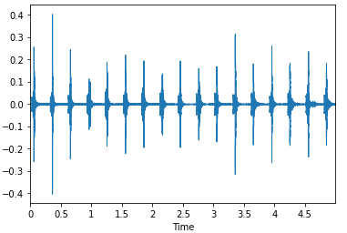
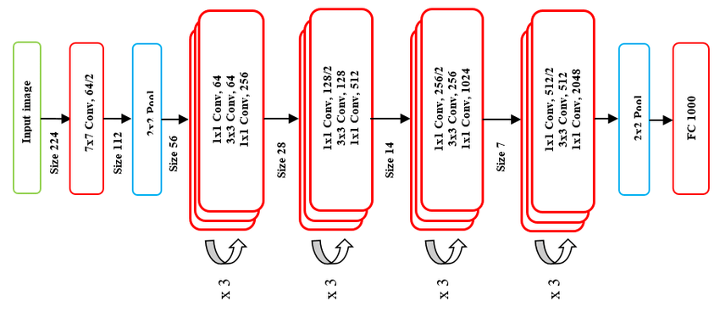
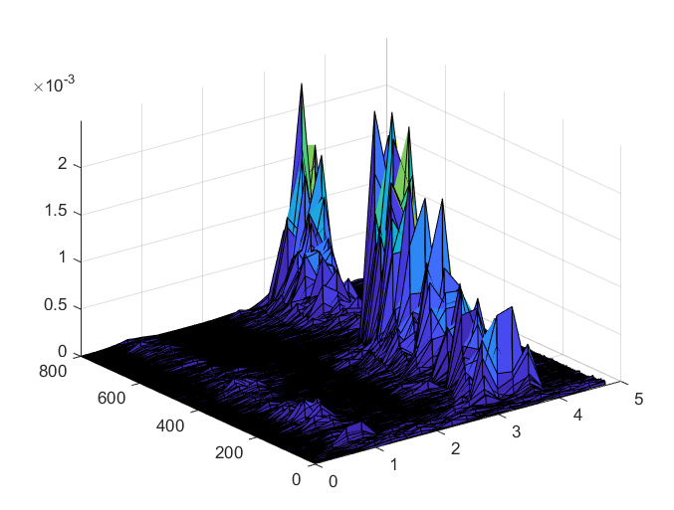
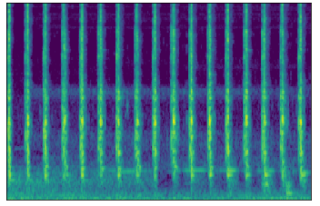
DEEP LEARNING STRUCTURE
ARCHI TECTURE
original audio data
(ESC50)
Fourier Transform (FFT)
Spectrogram
(frequency vs. time vs.amplitude)
Perspective rotation
MelSpectrogram
(frequency vs. time)

Slide 15
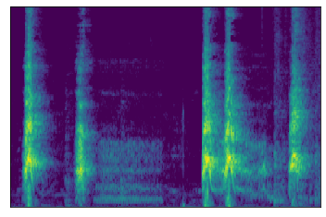

DATASET INTRODUCTION
ESC-50
The ESC-50 dataset is a labeled collection of 2000 environmental audio recordings suitable for benchmarking methods of environmental sound classification, and each of length 5s
Besides,the dataset consists of 5-second-long recordings organized into 50 semantical classes (with 40 examples per class) loosely arranged into 5 major categories, sounds
ranging from sounds of Chirping Birds to Car Horn Sounds.

Slide 16
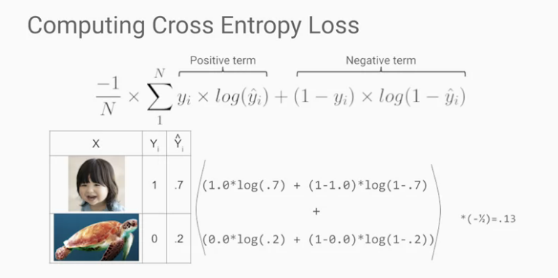
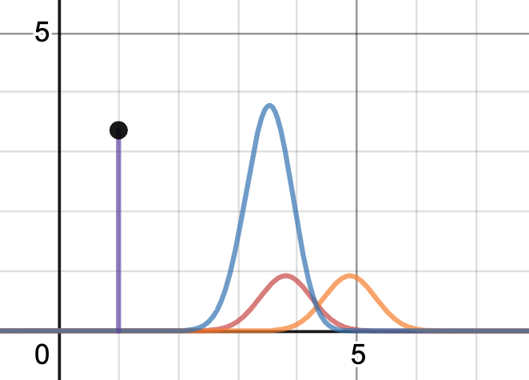
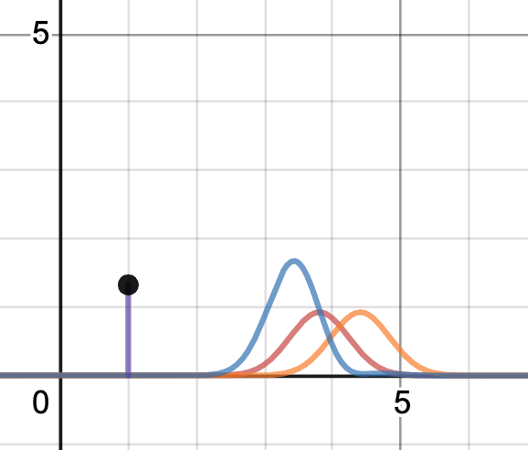
DEEP LEARNING STRUCTURE
LOSS FUNCTION: CROSS ENTROPY
Advantages: Cross Entropy is the most commonly used loss function for classification problems. Entropy is the average amount of information contained in all messages received. The more uncertain events, that is, the more information events, the more information they will have. With high Entropy, the probability of predicting success will also increase.
The predicted probability distribution is the orange block, the real probability distribution is the red block, the blue part is the cross-entropy block, and the purple is the calculated value. The more the difference between our predicted value and the actual value, the greater the amount of information representing the connotation, the more uncertainty, and the higher the cross-entropy.

Slide 17
OUTLINE
Introduction
Training Process
Dataset Choosing
Model & Train
Deep Learning Structure
Architecture
Loss Function
Experiment
Future Work

Slide 18
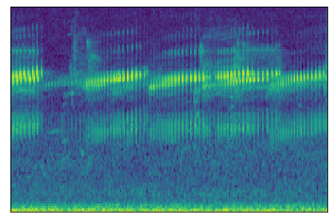
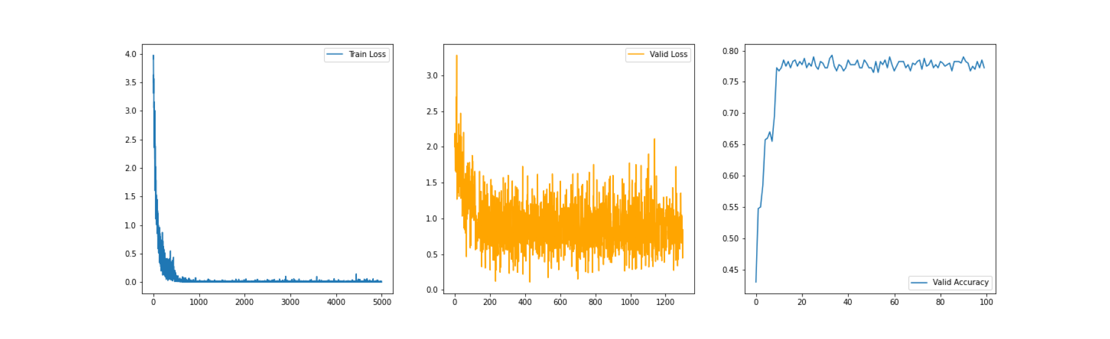
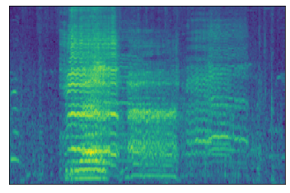
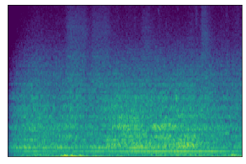
EXPERIMENT
TRAINING RESULT
Doing training with 100 epoch, we then have the result:
With the trained model, we can predict a result by given data. Here we put some prediction sample onh the right hand side.
frog
sheep
wind

Slide 19
EXPERIMENT
RESULT ANALIZE
Reason of success
By transforming the data from audio to frequency based image, each of the classes has a certain range of frequency, which can be classied into a certain class by CNN model.
Reason of failing
For two similar audios, they might be composed of very similar frequrncy, which will leads to failed classification as there is no difference between two images without good preprocessing.
On the other hand, without appropriate data preprocessing, there might be a lot of noise in the audio that caused a bad result.
Using a ResNet50, a very deep and large model, might leads too many parameters for this audio classification task.
frog
sheep
wind

Slide 20
EXPERIMENT
Conclusion
In order to increase the accuracy, augamentation is utilized. However, the results did not change with augamentation.
We try to simplify the model by using ResNet18 to get the better results, and it works with increasing the accuracy to 80 %.
From the above two results, we have a brief conclusion. First, the way we do data augamentation might be inappropriate for the classification task, which leads similar or worse results. Second, the parameter of ResNet50 might be too many for this case, which is improved by using ResNet18. Last but not the least, frequency based images tranformed from the audio datas can be used for a CNN model to do the classification task.
frog
sheep
wind

Slide 21
OUTLINE
Introduction
Training Process
Dataset Choosing
Model & Train
Deep Learning Structure
Architecture
Loss Function
Experiment
Future Work

Slide 22
FEUTURE WORK
Data Preprocessing
From the previous slides, we know we might need to find an appropriate way for data augamentation, in order to have more data for training while it’s hard to collect such a big number of datas.
On the other hand, we may try to do data denoise to see if this can improve the training result.
Real world audio classification
While getting better model, we are using the data from ESC-50 dataset. We may try to use the audio collected by ourselves to see if the model can work with the real world audio.

Slide 23
THANKS FOR LISTENING
Group 34

