Slide 1
Client Development of Classroom Attendance auto-taking System
课室自动点名系统前台开发
网络工程 林泽全
091402116

Slide 2
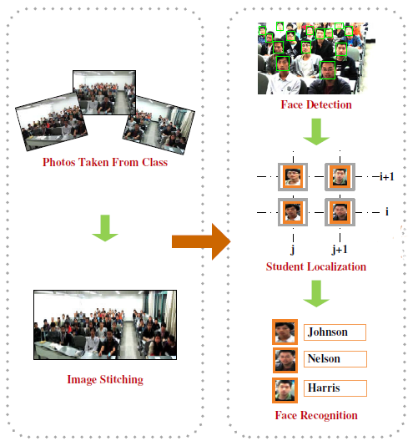
What the Project Does

Slide 3





My Work

Slide 4
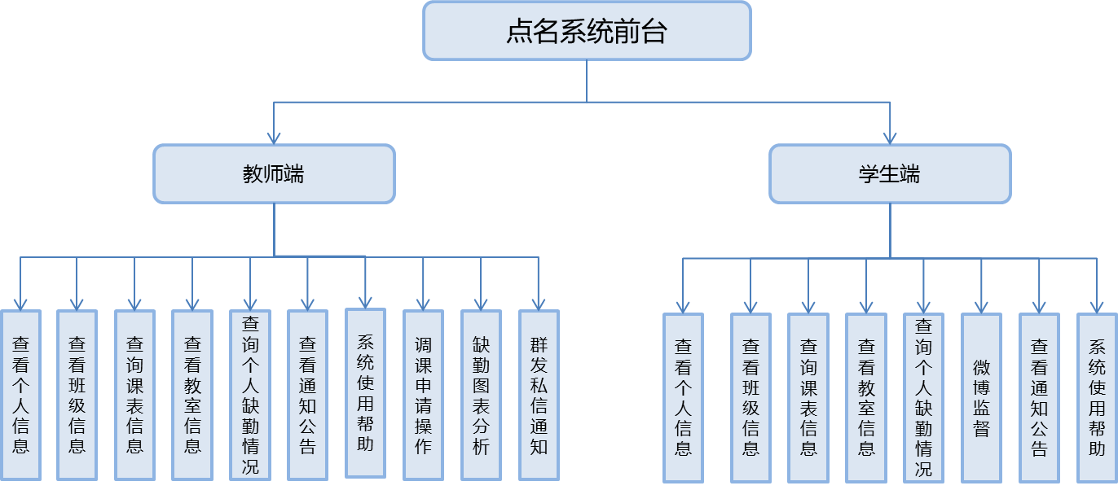
What System Client Does

Slide 5

Development Environment &
Technologies
LAMP & Git
ThinkPHP
ExtJS
Sina Weibo Open Platform
Sina App Engine

Slide 6
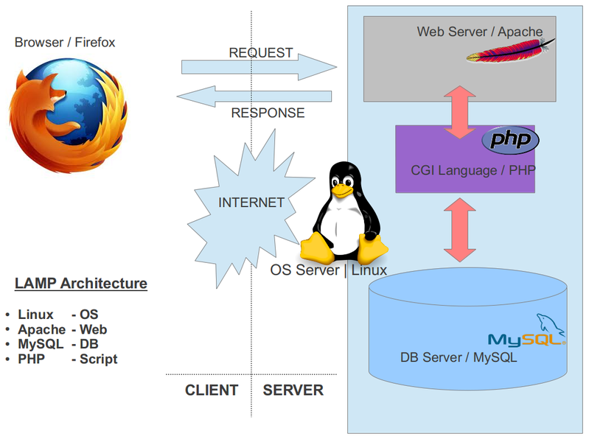
LAMP

Slide 7

Git

Slide 8
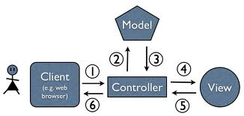
ThinkPHP

Slide 9

ExtJS

Slide 10
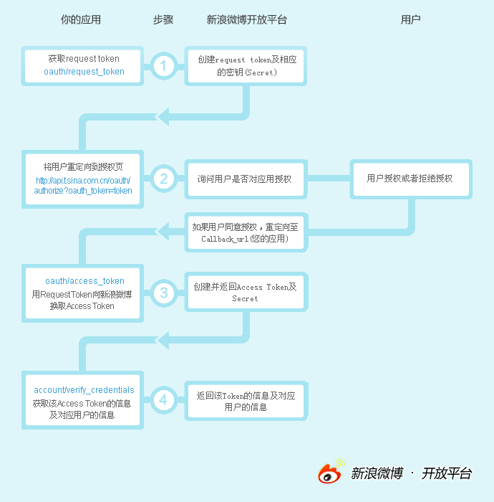
Sina Weibo Open Platform

Slide 11
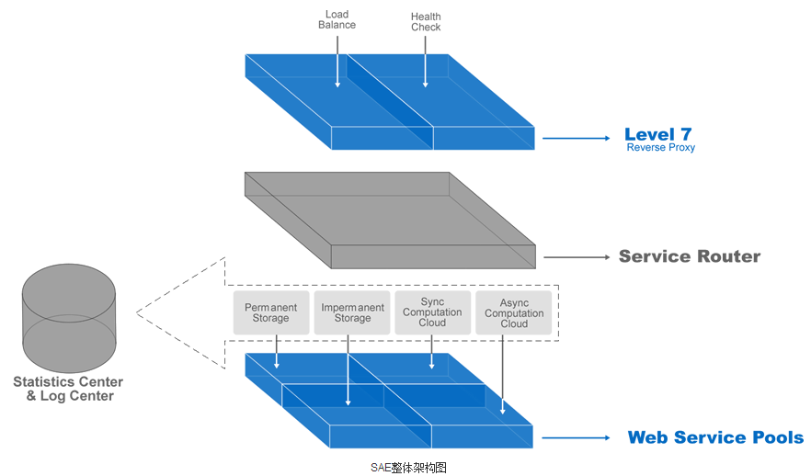
Sina App Engine

Slide 12
What are the Characteristics

Slide 13
完整
Complete

Slide 14
方便
Convenient

Slide 15

有效
Effective

Slide 16
直观
Intuitive

Slide 17
My Vision
Complete Admin Part and Camera Module
Deploy and Test the Project
Mobile Terminal ( IOS & Android)

Slide 18
End

