Slide 1

A Beginner's
Guide to HTML5
By: T34M N4M3_1
Alex Verellen(Leader), Katelyn ‘kat’ Williams,
Eric Grant, Nolan Yanick, and Shawn Lewin

Slide 2
IntroDuction
What every beginner should know about HTML5!
Setting Up HTML Doc
Creating A HTML Doc in Visual Studio
Metadata
Divs and Semantic Tags
Marking up Text
Closing code
Linking to CSS
Linking image
Linking html link
Comments
Mailto
ID and Class

Slide 3
Setting up an html doc
Creating Index.html file
Declaring version
Shortcuts (typing html:5 then clicking tab )
Notes:
Setting up an html doc in visual studio code. Creating a new document with the .html extension. Index is the usually name because that's what the website will always default to. The first thing we do in this file is declare we are using the current version of html. We can put the starter sections of the code by using a shortcut. Typing html:5 then tabbing with do this

Slide 4
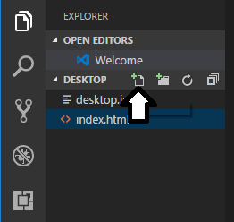
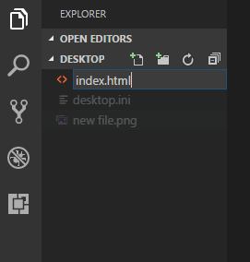
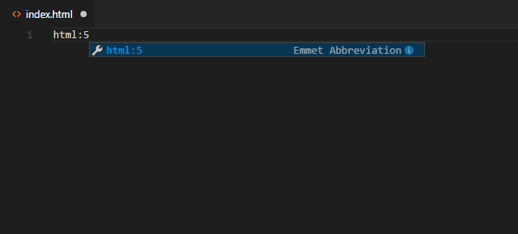
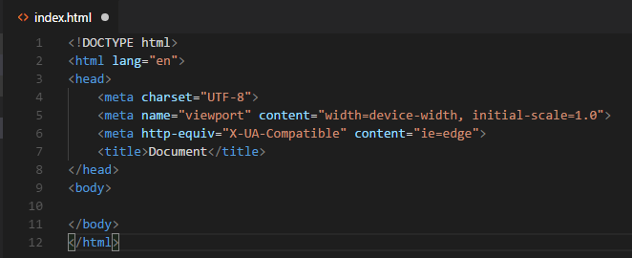
Creating html doc images
Notes:
These images show this.

Slide 5
Meta Tags
Meta tags do not display on the page.
Used to provide information about the page.
Used so that search engines can find your page with these keywords.
A website metadata about dogs would look like the following:
<meta name="description" content="Dog Website"> <meta name="keywords" content="Dogs,Breed,Adopt,Love">

Slide 6
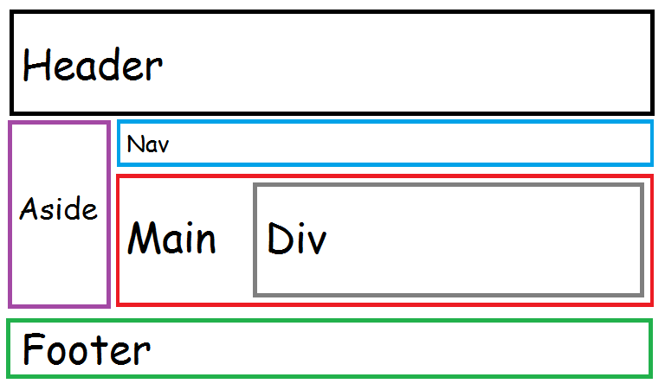
Divs & Semantic Tags
Notes:
Divs & Semantic Tags separate your page into different parts that you can then select and edit from the CSS and JS. They all do the same thing, the only difference is the name.

Slide 7
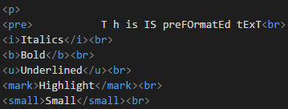
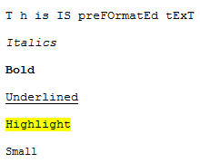
Marking up text
<pre> for pre-formatted text
<i> for italic
<b> for bold
<u> for underlining
<mark> for highlighting
<small> for smaller text
Notes:
Text inside of paragraphs that will show up on screen can be marked up. A few ways to do this include <Pre> ,<I> or <em>, <B> or <strong>, <U>, <Mark>, <Small>. On the right side it shows each of these tags in action.

Slide 8
Closing Code
Closing Code is an important habit to get into.
In HTML5 a majority of coding requires and end coding segment to tell the code to stop. This is very basic but can destroy hours worth of work. Placing the starting text in brackets with a ‘/’ ends the code. <Html> CODE </Html>
So let us see what broken code looks like.

Slide 9
Example
Code: <h1>It is a nice day out. I wish I could play outside. My mom told me to stay inside because I was <b>grounded. This makes me so mad. I could just cry. Output: It is a nice day out. I wish I could play outside. My mom told me to stay inside because I was grounded. This makes me so mad. I could just cry.
Problem: Code not closed

Slide 10
Linking an External CSS Page
To make editing the aesthetic of your website easier you may link an External CSS stylesheet to your HTML pages.
Create a styles.css page
Add <link rel=“stylesheet” href= “styles.css” to all your HTML pages
Have your css in the stylesheet and it will keep everything consistent throughout your site.

Slide 11
Linking Images
Link images into your document using the <img> element
The <img> element requires the src attribute
The src attribute specifies where the image is located
Additional attributes: width, height, alt
Example:
<img src=“picture.jpg” alt=“A photo” height=“50” width=“50”>

Slide 12
Links in HTML
Links can be used to connect documents within the same website or external websites.
The <a> element is used to create a hyperlink and requires the href attribute.
The text or image representing the link is included within the opening and closing tags
Example:
<a href=”index.html”>Home</a>

Slide 13
Adding comments
Because title of the story could fit into the text of the story. Adding a comment will help anyone look at the text know that the <h1> text was not a mistake and is different from the rest of the text.
You can comment out using <!-- the text comment -->

Slide 14
Adding comments Example
Code:
<!-- This is the title not part of story--> <h1>It is a nice day out.</h1> I wish I could play outside. My mom told me to stay inside because I was <b>grounded</b>. This makes me so mad. I could just cry. Output:
It is a nice day out. I wish I could play outside. My mom told me to stay inside because I was grounded. This makes me so mad. I could just cry.
Problem: Reading code
Notes:
Commenting is adding lines of text to a code that does not affect the program and is not visible unless looking at in in a code editor. Well if you do not see this in the HTML page why does it matter?
In cases where someone else other than you is editing or reading your code they need help figuring out why you wrote that line(s) of code.

Slide 15
Mailto Link
A mailto link lets you add an email link your your site.
Lets users go right to an email to send you a message.
<a href=”mailto:nmc@mail.edu”> Contact Us </a>

Slide 16
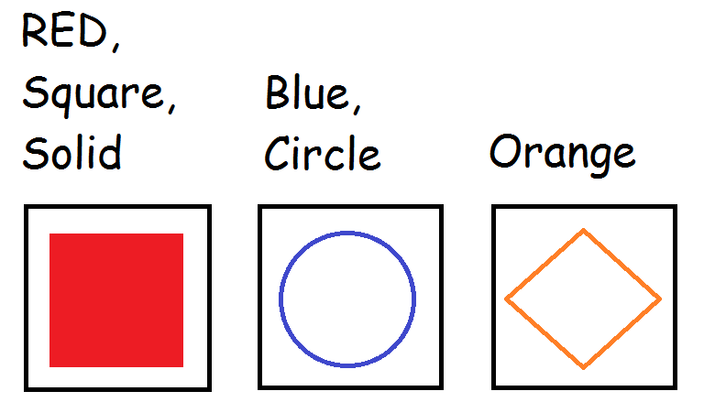
ID
Notes:
You can assign an ID to any single HTML element. This lets you interact with a specific element based on its ID. For example changing the way it looks in the CSS or performing an action on it in the JS.

Slide 17
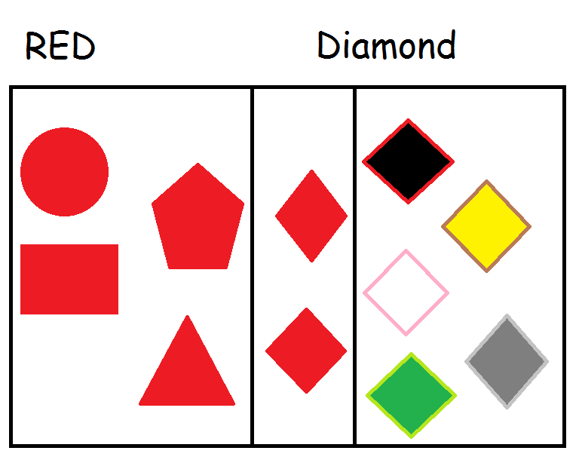
Class
Notes:
Classes work like IDs, the only difference is that they can apply to multiple elements. Letting you interact with many elements at the same time.

Slide 18
ID and Class Syntax
<p id=”pTag1”>Example Text</p>
<p id=”pTag2”>Also Example Text</p>
<p class=”bodyPTags”>Text</p>
<p class=”bodyPTags”>Text Also</p>

Slide 19
QUESTIONS AND COMMENTS?

Slide 20
Summary
Overview of the pages. We have gone over and recommend beginners to HTML to know these points.
Setting Up HTML Doc
Creating A HTML Doc in Visual Studio
Metadata
Divs and Semantic Tags
Marking up Text
Closing code
Linking to CSS
Linking image
Linking html link
Comments
Mailto
ID and Class

Slide 21
Work Cited
Gauchet, J.D. HTML5 for Masterminds, Revised 3rd Edition, Mink Books, 2017, pgs.36-41, Accessed 28 Sept. 2017.
“HTML Links.” W3Schools, www.w3schools.com/html/html_links.asp. Accessed 28 Sept. 2017.

Slide 22
The End

