Slide 1

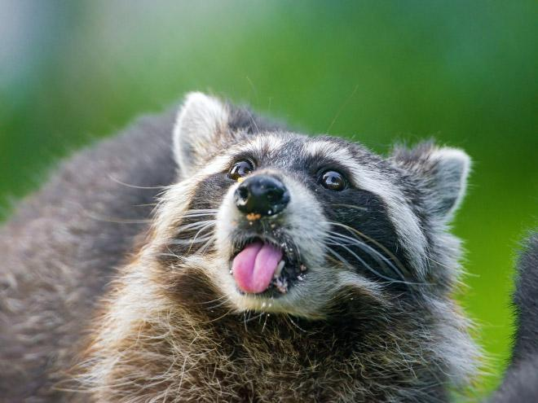

Search Engine Optimization
Team Sneaky Hands:
King Derrell,
Jester Ken Maleitzke,
White Mage Eric Grant,
Black Knight Nicole Andress,
Geomancer Hannah Crosby,
Dragon Knight Alex Verellen,
Summoner Desiree Morgan.

Slide 2

SEO… What is it?
SEO stands for Search Engine Optimization
Used to draw in an audience
Insures website are found by Google, Bing, etc...
Ken

Slide 3

Imagine owning a personal business without any signage, logos, or advertisement.
That’s essentially what SEO services provide for your website.
SEO services are essential to advertising your website on the highway of other businesses.

Slide 4
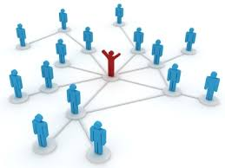
Linking Out
Linking is arguably the most important aspect of Search Engine Optimization. The term “Linking Out” refers to hyperlinks on your web page that send the user to another domain.
More links lead to more traffic
More traffic raises your SEO ranking
Higher SEO ranking means the search engines will trust your website and place it closer to the top of the results page
Notes:
Linking out to other high ranking sites with relevant information can raise your SEO rank.
The highest impacting factors on a web page is anchor tags and good keywords.

Slide 5
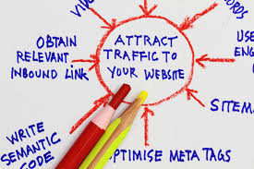
Linking In
The term “Linking In” refers to when your website is referenced from another website via hyperlink.
Anchor tags
Link Neighborhood
SEO ranking
Notes:
Having other sites linking back to you raises SEO

Slide 6
Algorithmic design
Top websites all look the same.
Search engines look at your site like a human would.
Standing out only hurts your rank.
Notes:
Your website needs to follow a format that robots can understand.

Slide 7
Backend Optimization
Search engines read the code too.
Using poor coding practices will lower your SEO rank.
Slow loading websites are no good.
Notes:
Your site needs to load fast and have names that match the content

Slide 8

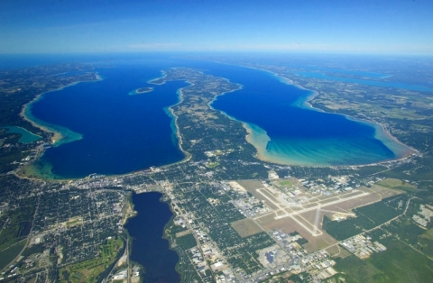
Location Mapping
-Alex Verellen
-Mapping is taking an image and designating it with a physical location.
-This is used to tell a search engine that when a user is looking for somewhere on the planet they can get images associated with that place.
This image of Grand Traverse bay appears when you search ‘Grand Traverse Bay’-->
Notes:
Images can be given locations

Slide 9
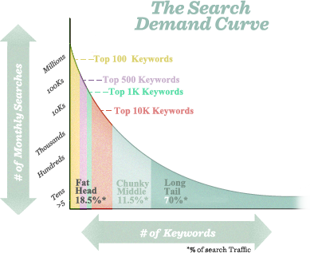
Keywords
Terms and phrases that target your market
Search engines look for specific words or phrases related to your website
Leads the right kind of visitors to your website
Ranking your keywords can make or break your website
Google Adwords - Tracks traffic, helps choose better words
“Long Tail” Keyword Demand-
Has more keywords
More specific
Search volume
Example: “Shoes” vs. “Best price on Air Jordan size 12”
https://moz.com/beginners-guide-to-seo/keyword-research
Notes:
Desiree
Search engines look for specific words related to your website.

Slide 10
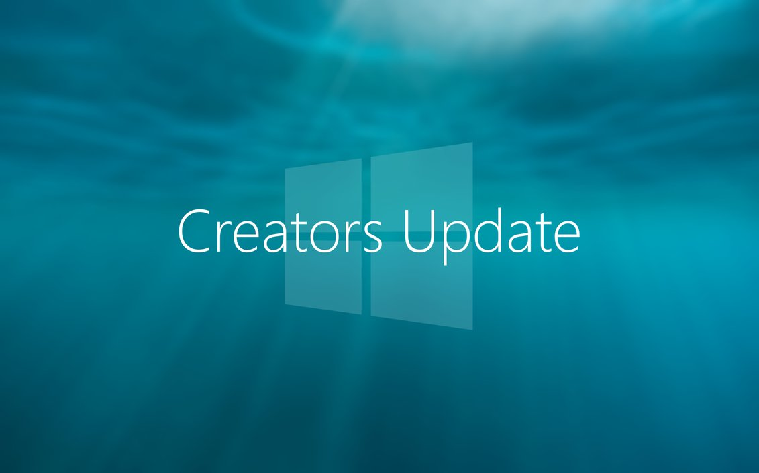
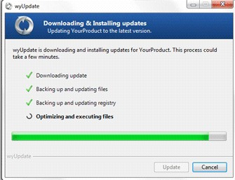
Updates
-Alex Verellen
-This is part of the search engine that looks to see when was the last time your site has been updated. This includes adding or removing content, applying a new layout, adding additional web pages, user generated content, and updating out dated information.
-After a certain period of time without changes being made to your website, search engines will ignore it completely
Notes:
Search engines forget about your site if it never changes

Slide 11

Social Media
Links on social media accounts does boost ranking. Sharing has no effect.
SEO includes items searched in social search engines.
Social media posts count towards your rank.
More followers, higher rank.
Notes:
Hannah
Social Media is a major boost to SEO when regularly updated and properly run.

Slide 12

Search Engines: humans vs computers
Website names/ URLS
Page content
Meta tags
The page design
All of these affect saleability
Computers aren’t HUMAN, they are ran heavily through how well a programmer works their code! It’s the little things that promote the website.
Notes:
Different search engines have different algorithms and SEO ranks.

Slide 13
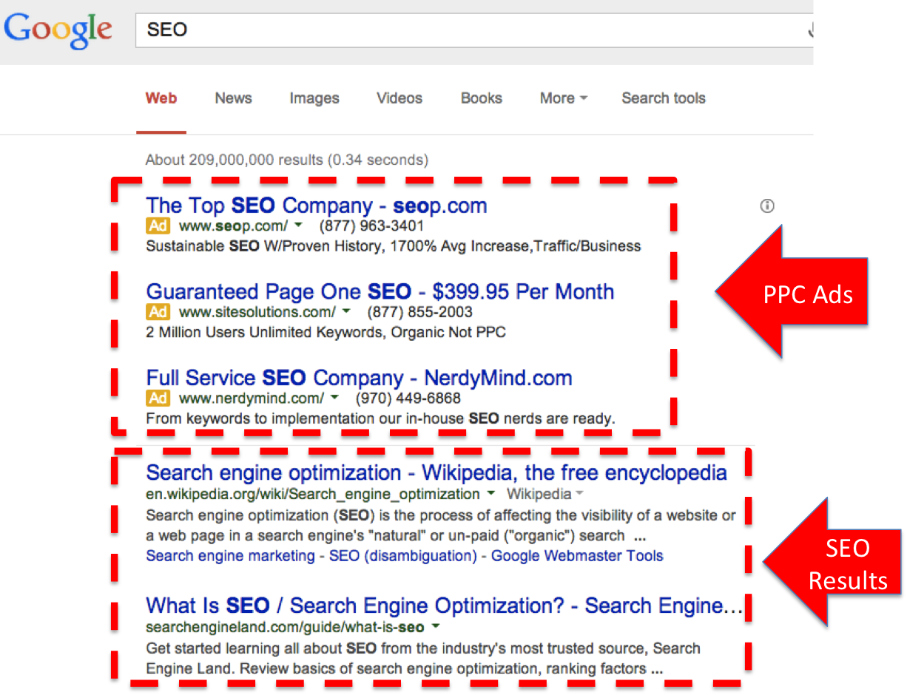
Paid Advertising
Pay-Per-Click advertisements bypass SEO.
Ads can boost your presence faster.
Easy access in different and more places.
New companies get their name out.
Notes:
Hannah
Paying an advertising firm to show ads for your site that bypass SEO

Slide 14
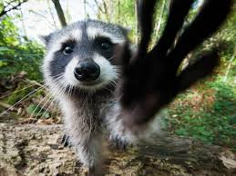
Sneaky Advertising
Search Engine Marketing (SEM) - Purposefully directing traffic to specific website and product
Manipulate web code and website to direct traffic
Incorporate keywords into the code and scattering them throughout text can significantly boost internet presence, web site visibility and brand name
Can be used to steer potential customers to websites that weren’t searching for that to begin with
Notes:
Desiree
Going out and making posts on forums about your website pretending to be a user.

Slide 15
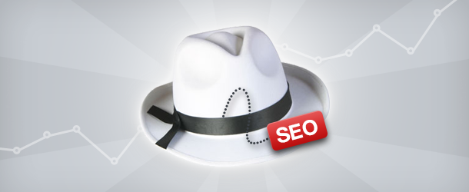
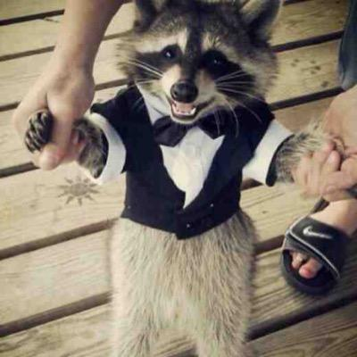
White Hat SEO
Refers to optimization strategies and tactics
Used by people to make long term investments
The legal way
Notes:
Following standard good practise to get higher SEO rank

Slide 16

Black Hat SEO
-Alex Verellen
-Black hat SEO refers to the use of aggressive strategies, techniques and tactics that focus on search engines, and usually does not obey search engines guidelines through sneaky methods.
-Some examples of black hat SEO techniques include keyword over stuffing, invisible text, doorway pages, adding unrelated keywords to the page content or page swapping (changing the webpage entirely after it has been ranked by search engines).
Notes:
Abusing search engines algorithms to raise rank

Slide 17
Summary
Search engines use the websites SEO rank when organizing the result page of a search query.
You can raise your SEO rank by linking, keywords, paid advertising, etc.
The higher your rank, the further up the result list your web page will be.

Slide 18


Slide 19
References
https://moz.com/beginners-guide-to-seo
https://www.educba.com/seo-in-digital-marketing/
http://www.webopedia.com/TERM/S/SEO.html
https://moz.com/beginners-guide-to-seo/growing-popularity-and-links
http://www.directoryone.com/articles/sneaky-seo.html
https://moz.com/beginners-guide-to-seo/keyword-research
http://www.webopedia.com/TERM/B/Black_Hat_SEO.html

Slide 20
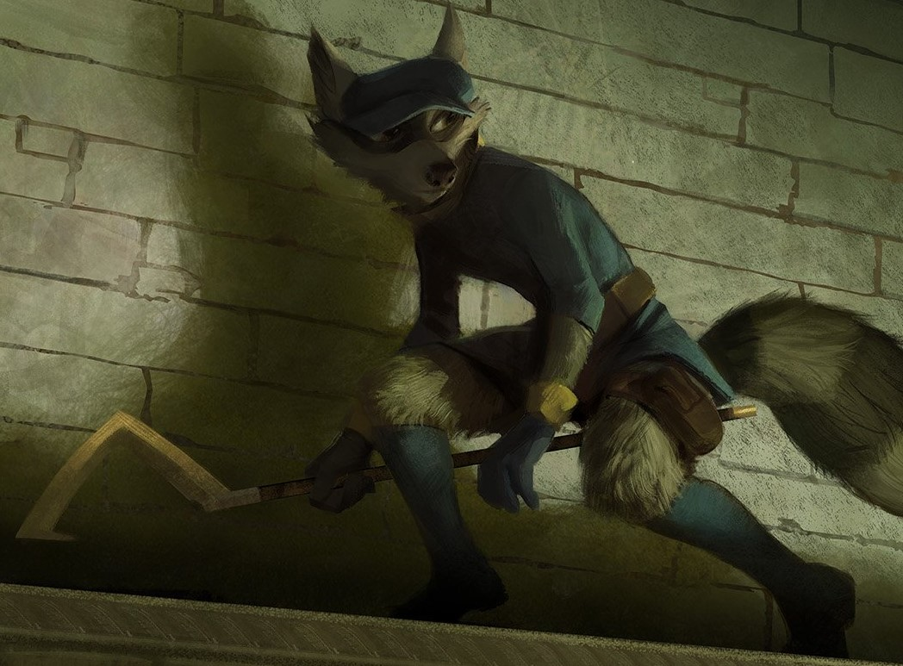
The End,

