Slide 1
PBL GROUP4
YUKI,TAKERU
PETE,BRUCE,ERIC,PONNIE,SHIN

Slide 2
WORK PROGRESS
SOFTWARE
SERVOMOTOR
CAMERA
HARD WARE
BALL CATCHER
CAR STRUCTURE

Slide 3
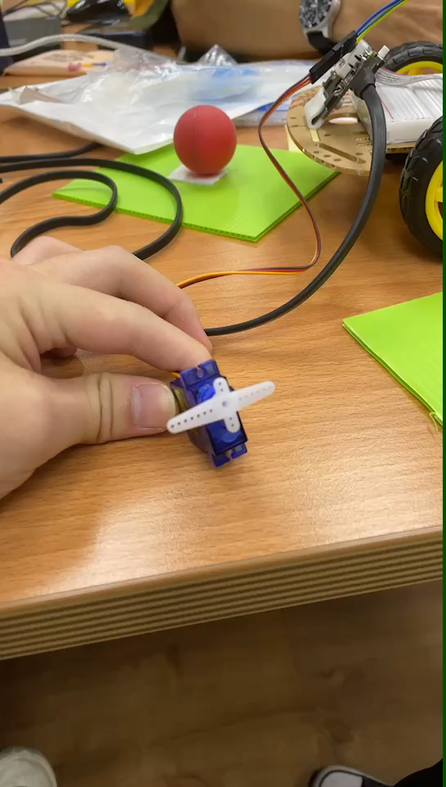
SERVOMOTOR

Slide 4
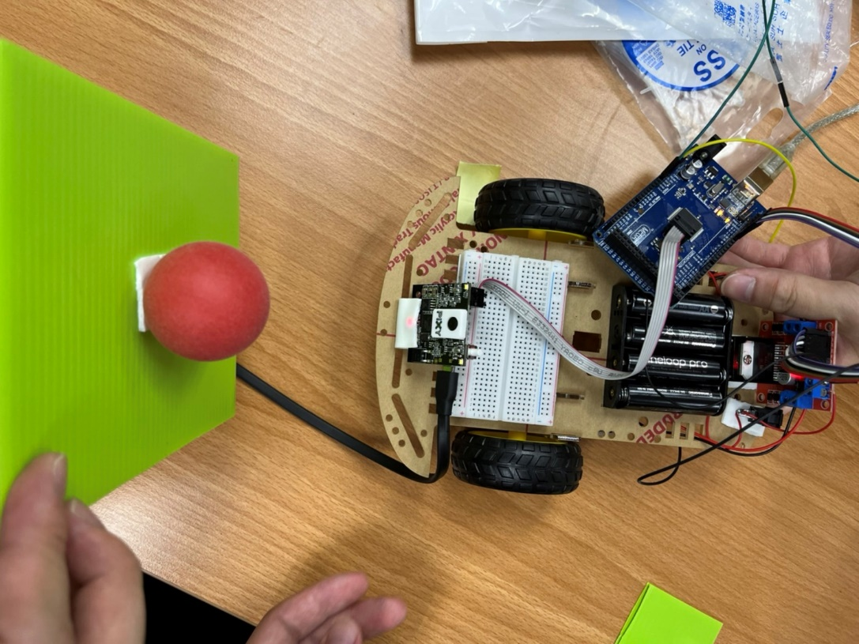
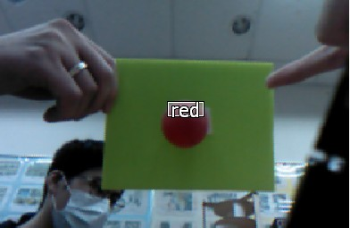
CAMERA
RECOGNIZE THE RED BALLS
FOLLOW THE RED BALLS OR CHANGE THE DIRECTION

Slide 5
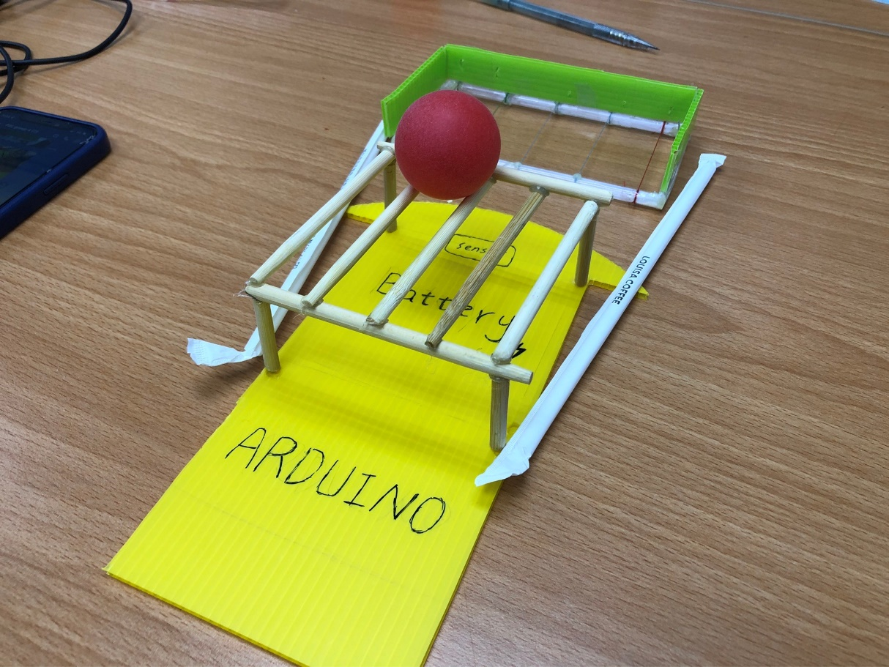
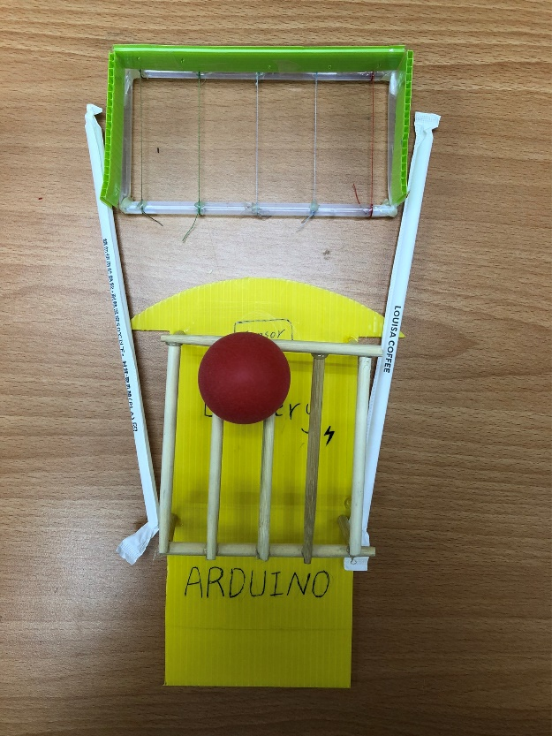
BALL CATCHER & CAR STRUCTURE
MODEL FINISHED

Slide 6
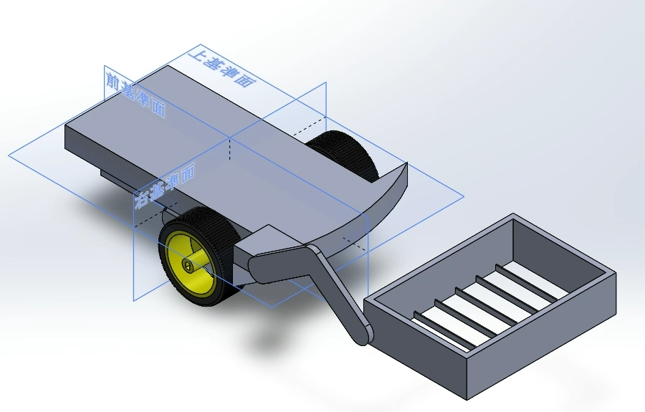
BALL CATCHER & CAR STRUCTURE
MODEL FINISHED

Slide 7
TOMORROW PLAN
ARM AND COMBIN IT WITH SERVOMOTOR
WHEEL
UPGRADE BATERY
ENHENCE THE ABILITY OF RECOGNIZATION OF THE CAMERA

