Slide 1
AFDM Transceiver Design
for Underwater Acoustic
Communication Systems
A Low-Complexity Joint OMP–LS/MP Receiver,
Augmented with a Deep-Unfolded Support-Refinement Head
Final Year Project Defense
Bachelor of Engineering — UESTC × University of Glasgow
Presenter: Yikun Guo
GUID: 2840210g
Academic Year: 2025 – 2026
Long delay spread • fractional Doppler • sparse chirp-domain channel

Slide 2
1
Outline
From the underwater channel to a learned-head AFDM receiver
I
Background & Motivation
II
AFDM-SP System Model
Why UWA breaks OFDM; AFDM as a chirp-domain remedy
DAFT, sparse effective channel, superimposed pilots
III
Iterative-Receiver Necessity
IV
Method 1 — Classical Joint
SP estimation floor and the three design options
OMP-once + iterative LS / sparse MP-BP
V
Method 2 — Learned Head
VI
Results & Mechanism
Deep-unfolded support refinement (1 041 params)
BER, oracle headroom, complexity, conclusions
AFDM Transceiver for UWA • Yikun Guo • 2025–2026
2 / 16

Slide 3
2
Why Underwater Acoustic Channels Are Hard
Two pathologies that no conventional waveform handles cleanly
Long delay spread
Doubly-dispersive UWA channel
Surface / column / bottom multipath at 4–12 kHz acoustic bands ⇒ ~10 ms delay spread, hundreds of resolvable bins.
Stojanovic '09 · Berger '10
Fractional Doppler
Sound speed c ≈ 1500 m/s + platform motion ⇒ v/c ~ 10⁻³, three to four orders larger than RF; ICI and mid-bin Doppler.
multipath
(delay spread)
Doppler
scaling (motion)
Preisig '07 · Huang '10
OFDM fails on both
A long enough CP eats spectral efficiency; even a fractional sub-carrier of Doppler corrupts orthogonality.
Conventional waterline
Goal: reception that handles BOTH dispersions at low complexity.
AFDM Transceiver for UWA • Yikun Guo • 2025–2026
3 / 16

Slide 4
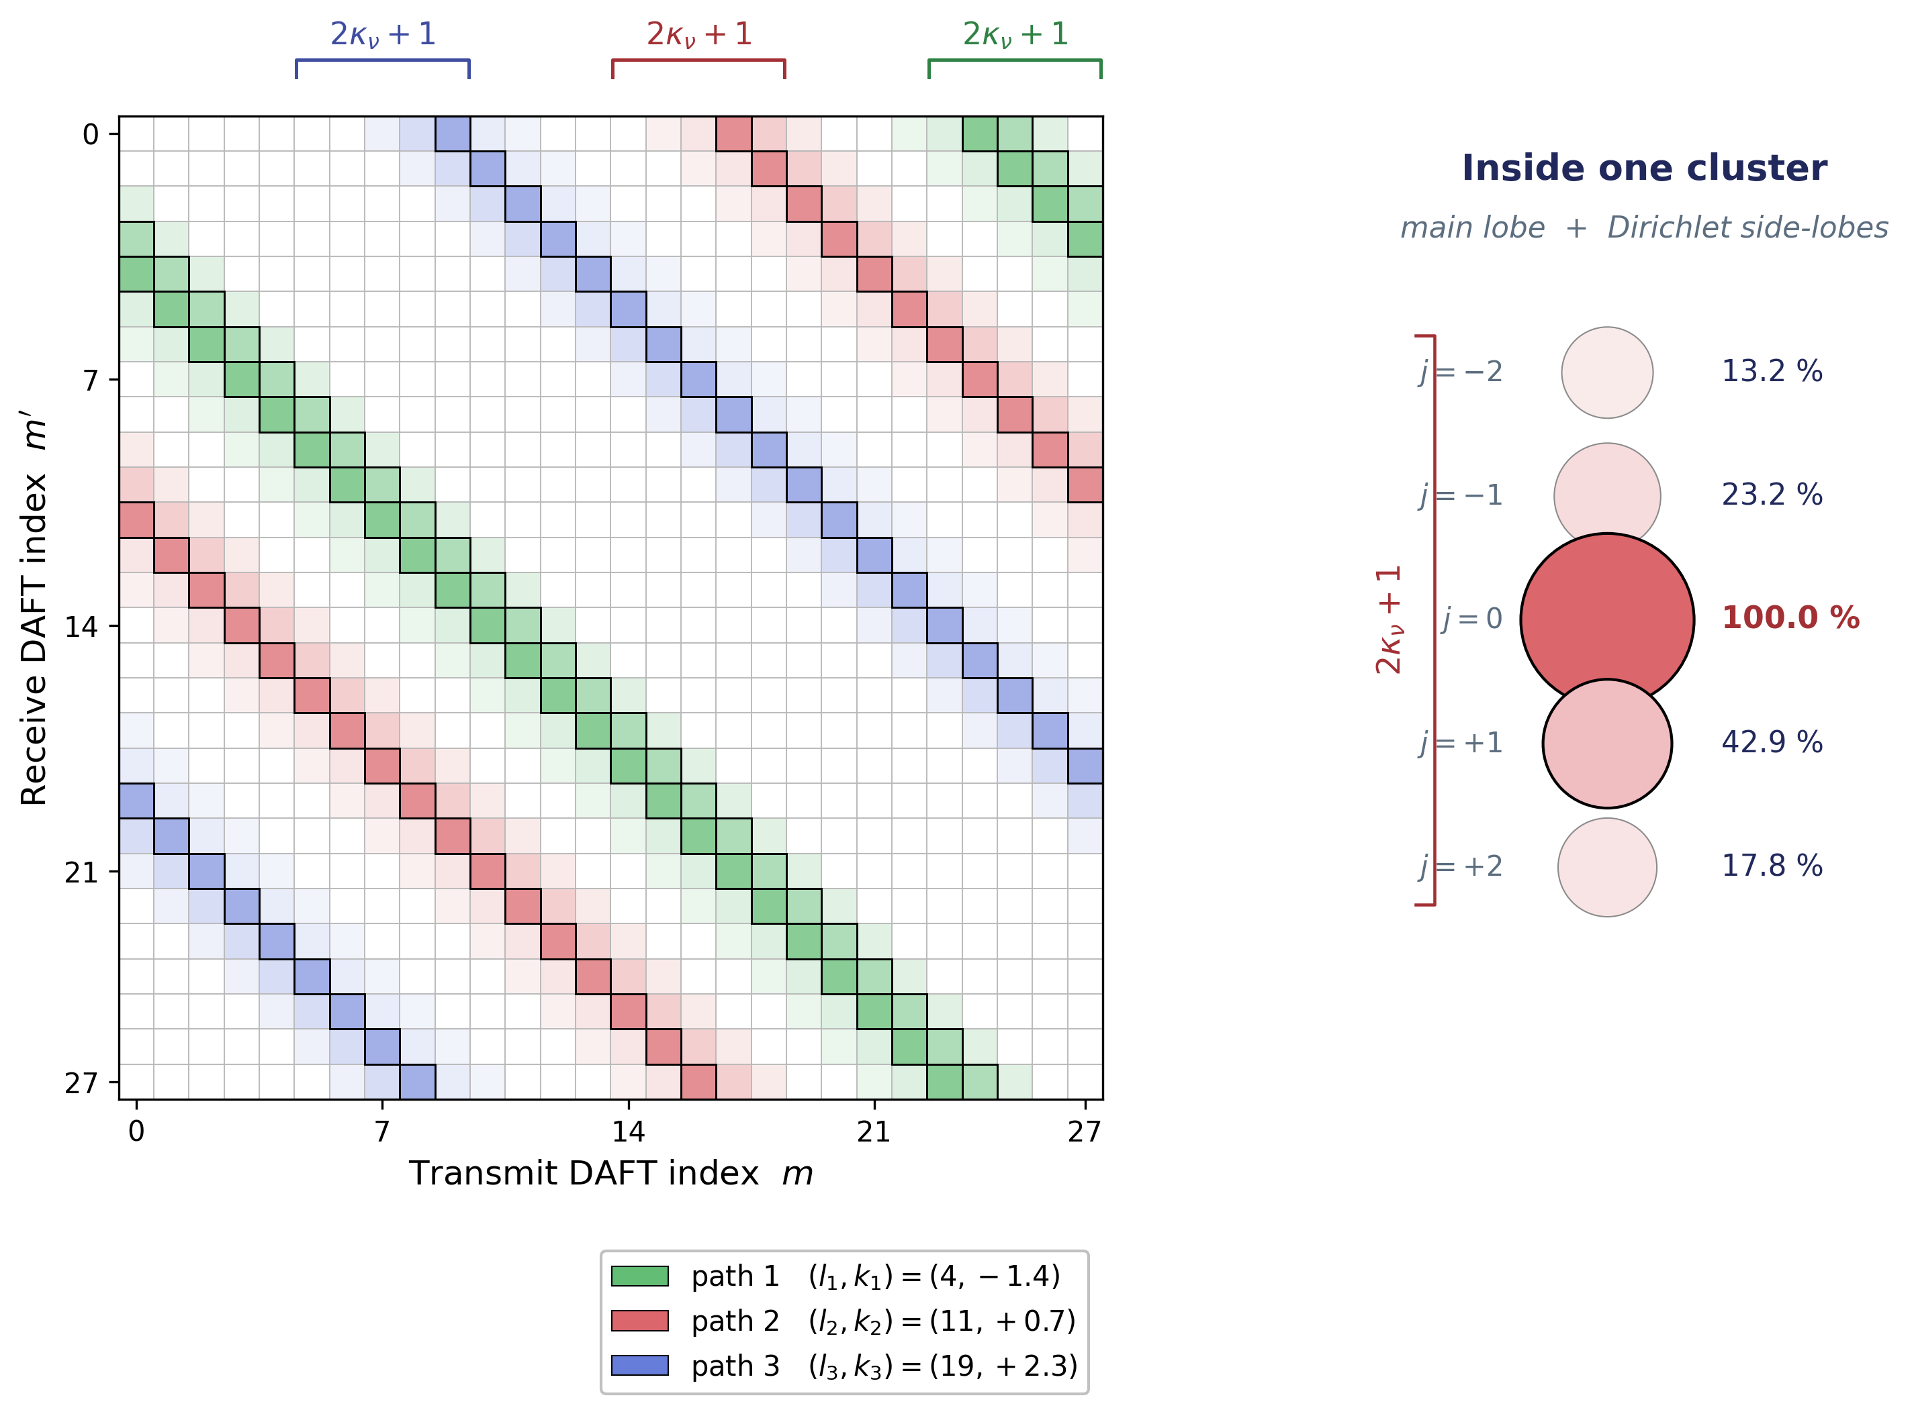
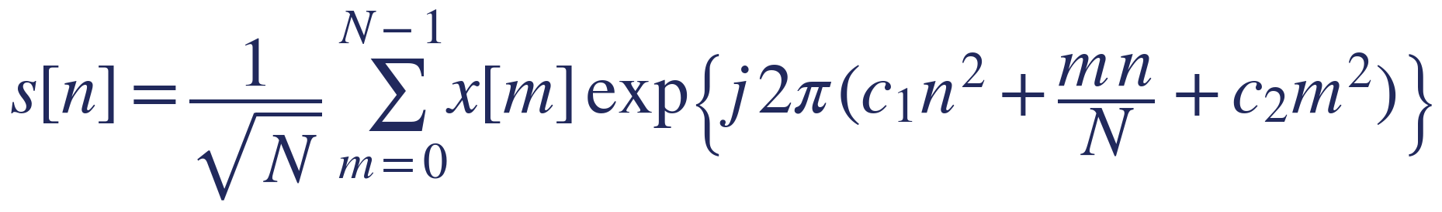
3
AFDM — One Sparse Chirp-Domain Effective Channel
Affine Fourier Transform aligned with the (delay, Doppler) geometry
From OFDM to a chirp basis (DAFT)
|H_eff| for a 3-path AFDM channel
Two tunable chirp coefficients c₁, c₂ align the basis with the channel's (l, k) lattice — every physical path collapses into a compact, sparse pattern in the chirp domain.
IDAFT (transmit waveform)
Chirp-domain received vector
Special case: c₁ = c₂ = 0 ⇒ IDAFT = IDFT, AFDM ≡ OFDM.
→ Each (l_p, k_p) → one localized atom in H_eff.
→ Sparse recovery (OMP) becomes the natural channel-estimation primitive.
→ Recovers OTFS-style time–frequency diversity on a 1-D transform.
Each physical path lights up one DAFT-domain super-diagonal; the cluster width 2κ_ν + 1 is the Dirichlet-leakage signature of fractional Doppler.
AFDM Transceiver for UWA • Yikun Guo • 2025–2026
4 / 16

Slide 5
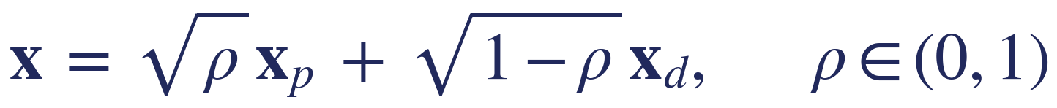
4
Superimposed Pilots — Saving Spectrum, Buying an Error Floor
Why one-shot OMP+MP saturates at BER ≈ 5×10⁻²
Every chirp sub-carrier carries data + pilot
Why ρ trades capacity ↔ estimation
SP frame
≈ 5×10⁻²
→ Doubles data capacity vs. embedded-pilot. x_p: Zadoff–Chu (r = 7). ρ = 0.5.
estimation-limited BER floor of one-shot OMP+MP from SNR ≥ 15 dB (ρ = 0.5, P_path = 8)
Pilot projection at the receiver
Capacity
Pilot fraction
Interference
→ Data interference (1−ρ)¹ᐟ² · xpᴴ H_eff x_d scales with channel norm and does NOT shrink with SNR.
doubled vs EP
ρ = 0.5
scales with ‖H_eff‖, σ²-indep.
⇒ Mid-to-high-SNR error floor: one-shot OMP + MP-BP saturates at BER ≈ 5×10⁻², NMSE frozen near −11.3 dB from SNR ≥ 15 dB.
⇒ The interference floor — not the noise — is the engineering enemy.
AFDM Transceiver for UWA • Yikun Guo • 2025–2026
5 / 16

Slide 6
5
An Iterative Receiver Is Unavoidable — Which Iteration?
Three options; only one keeps the sparse-recovery complexity class
SP-induced data interference does not decay with σ² → the receiver MUST iterate channel estimation and detection.
REJECTED
REJECTED
PROPOSED
Option A Re-OMP each iter
Option B Dense LMMSE CE
Option C OMP-once + cheap iters ✓
5 × OMP per frame
(ΦᴴΦ)⁻¹ each iter
1 × OMP, then iterate only LS / MP-BP
≈ 2.6× cost, same 𝒪(P·N²) class
≈ 145× baseline at N = 1024
Same 𝒪(P·N²) class as a single OMP
Re-runs the same support-selection problem 5×.
Empirically, support Jaccard already > 0.94 from t = 2 → atoms barely change.
Constant-factor waste, no asymptotic relief.
Cubic per-frame cost 𝒪(N³).
Throws away the chirp-domain sparsity prior we just paid for with AFDM.
Two orders of magnitude too expensive for embedded UWA modems.
Run OMP only once → lock the support.
Iterate only: (i) damped data-aided LS gain refit; (ii) sparse MP-BP detection.
Justified empirically by the support-recall probe on the next slide.
Decision: Option C — contingent on showing that one OMP pass already finds (almost) all the support.
AFDM Transceiver for UWA • Yikun Guo • 2025–2026
6 / 16

Slide 7
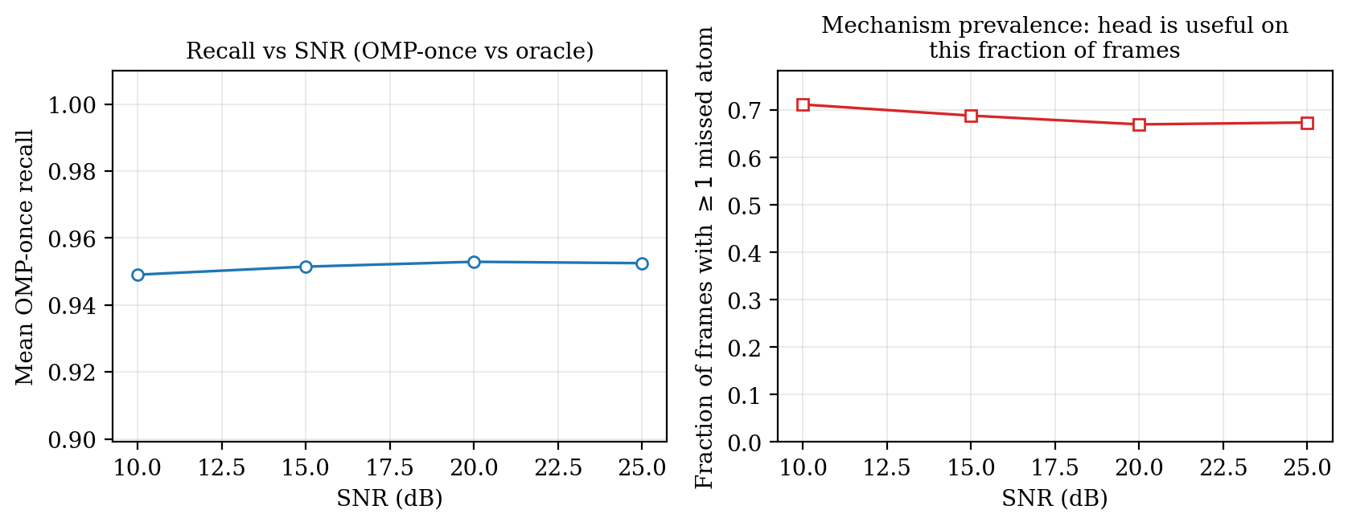
6
Why OMP-Once Is Enough — A Direct Support-Recall Probe
The first OMP pass already finds ~95% of the Dirichlet-expanded oracle support
OMP-once recall vs. Dirichlet-expanded virtual-tap oracle
Key reading
≈ 95 %
mean recall — flat across SNR ∈ {10, 15, 20, 25} dB
Stable in SNR ⇒ the residual ~5% is structurally Dirichlet-leaked, not noise-driven.
Re-running OMP cannot find what isn't in the dictionary's main-lobe pattern.
MP-BP graph degree bounded by P · (2κ_leak + 1) = 40 (effective ≈ 28).
→ Iterating LS / MP-BP on a locked support is sufficient — and cheap.
AFDM Transceiver for UWA • Yikun Guo • 2025–2026
7 / 16

Slide 8
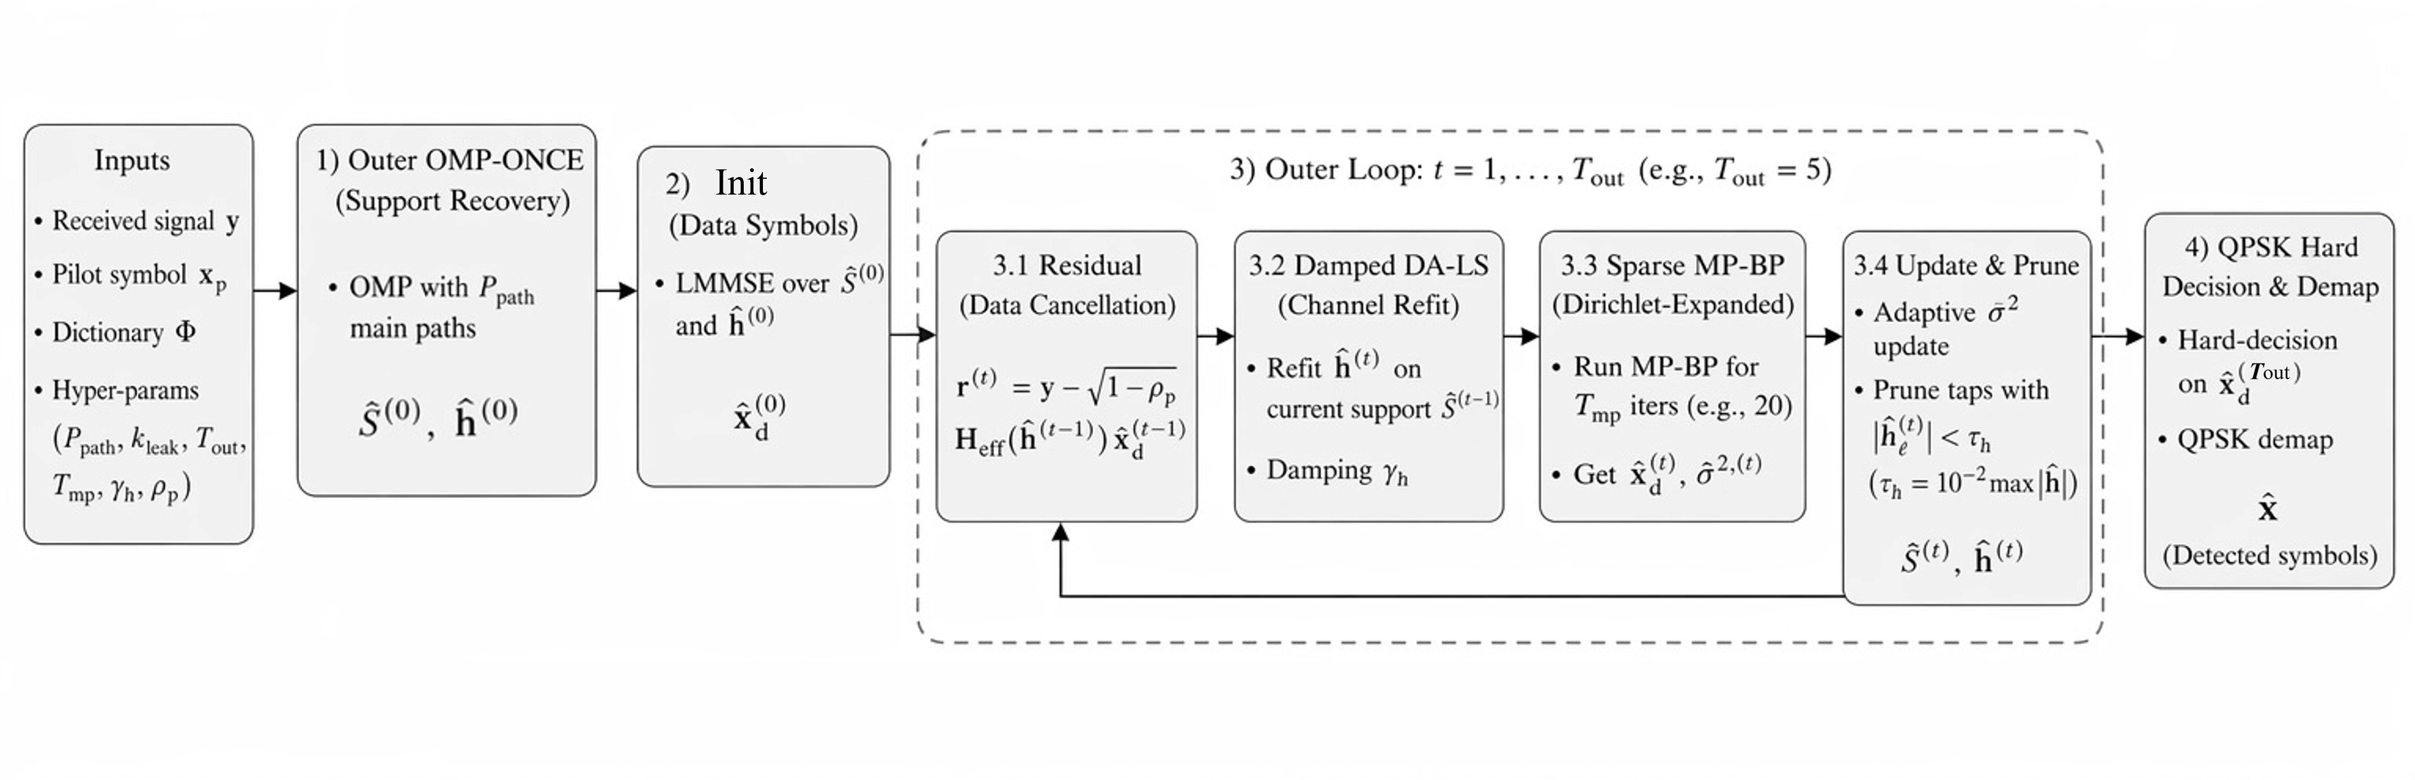
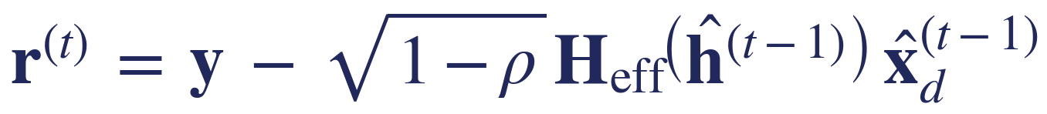
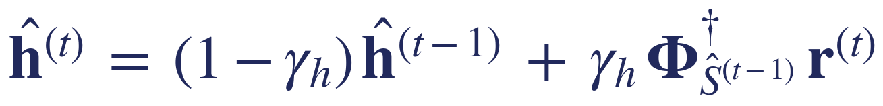
7
Method 1 — Classical Joint OMP-once + Iterative LS / MP-BP
Lock the support; iterate only the cheap downstream blocks (Algorithm 1)
System block diagram — classical joint receiver
Algorithm at a glance
Step 0: OMP on Φ → support Ŝ⁽⁰⁾, gains ĥ⁽⁰⁾; LMMSE init x̂_d⁽⁰⁾.
Loop t = 1 … 5 (T_out = 5)
① Data-cancel → see equation below
② Damped DA-LS gain refit on locked Ŝ
③ Sparse MP-BP (T_mp = 20, η = 0.5)
④ Adaptive σ², gain prune (keep top-P)
Decide: QPSK demap → x̂_d.
Per-frame complexity
BER gain over one-shot
MAC count at N = 1024
𝒪( P · N² )
2 – 3 orders
≈ 18.6 M
same class as one OMP
at SNR = 25 dB on a paired-frame test
vs. 48.6 M (re-OMP) and 2.7 G (LMMSE)
AFDM Transceiver for UWA • Yikun Guo • 2025–2026
8 / 16

Slide 9
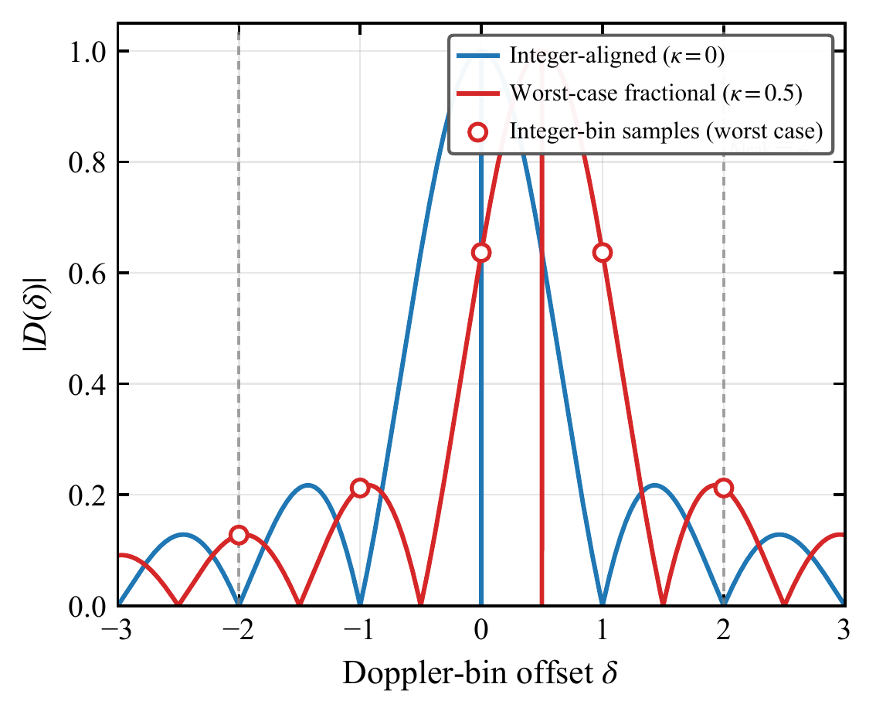
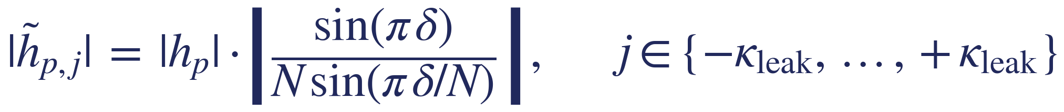
8
Why Add Learning? — The Structural 5% That OMP Misses
Fractional-Doppler leakage produces deterministic side-lobes, not noise
The residual is geometric, not random
Dirichlet kernel |D(δ)|
Each path's fractional Doppler residual κ = k_p − ⌊k_p⌉ spreads energy onto integer-bin neighbours via the Dirichlet (aliased-sinc) kernel.
Dirichlet expansion (per path)
Worst-case residual (κ = 0.5): two adjacent integer bins each carry ≈ 41% of per-path energy.
The next pair carries ≈ 4.4% — small but structurally predictable.
Why a neural network?
Selecting the missing leakage atom = a non-linear ranking on an integer (Δl, Δk) lattice, conditioned on neighbour gains.
Closed-form thresholds on |Φᴴr| can't separate weak side-lobes from noise — learning fuses self + relational features.
Deep unfolding keeps the task small (few features, few params) and the receiver explainable.
Blue: integer-aligned (κ = 0). Red: worst case (|κ| = 0.5). Dashed: κ_leak = 2 truncation.
AFDM Transceiver for UWA • Yikun Guo • 2025–2026
9 / 16

Slide 10
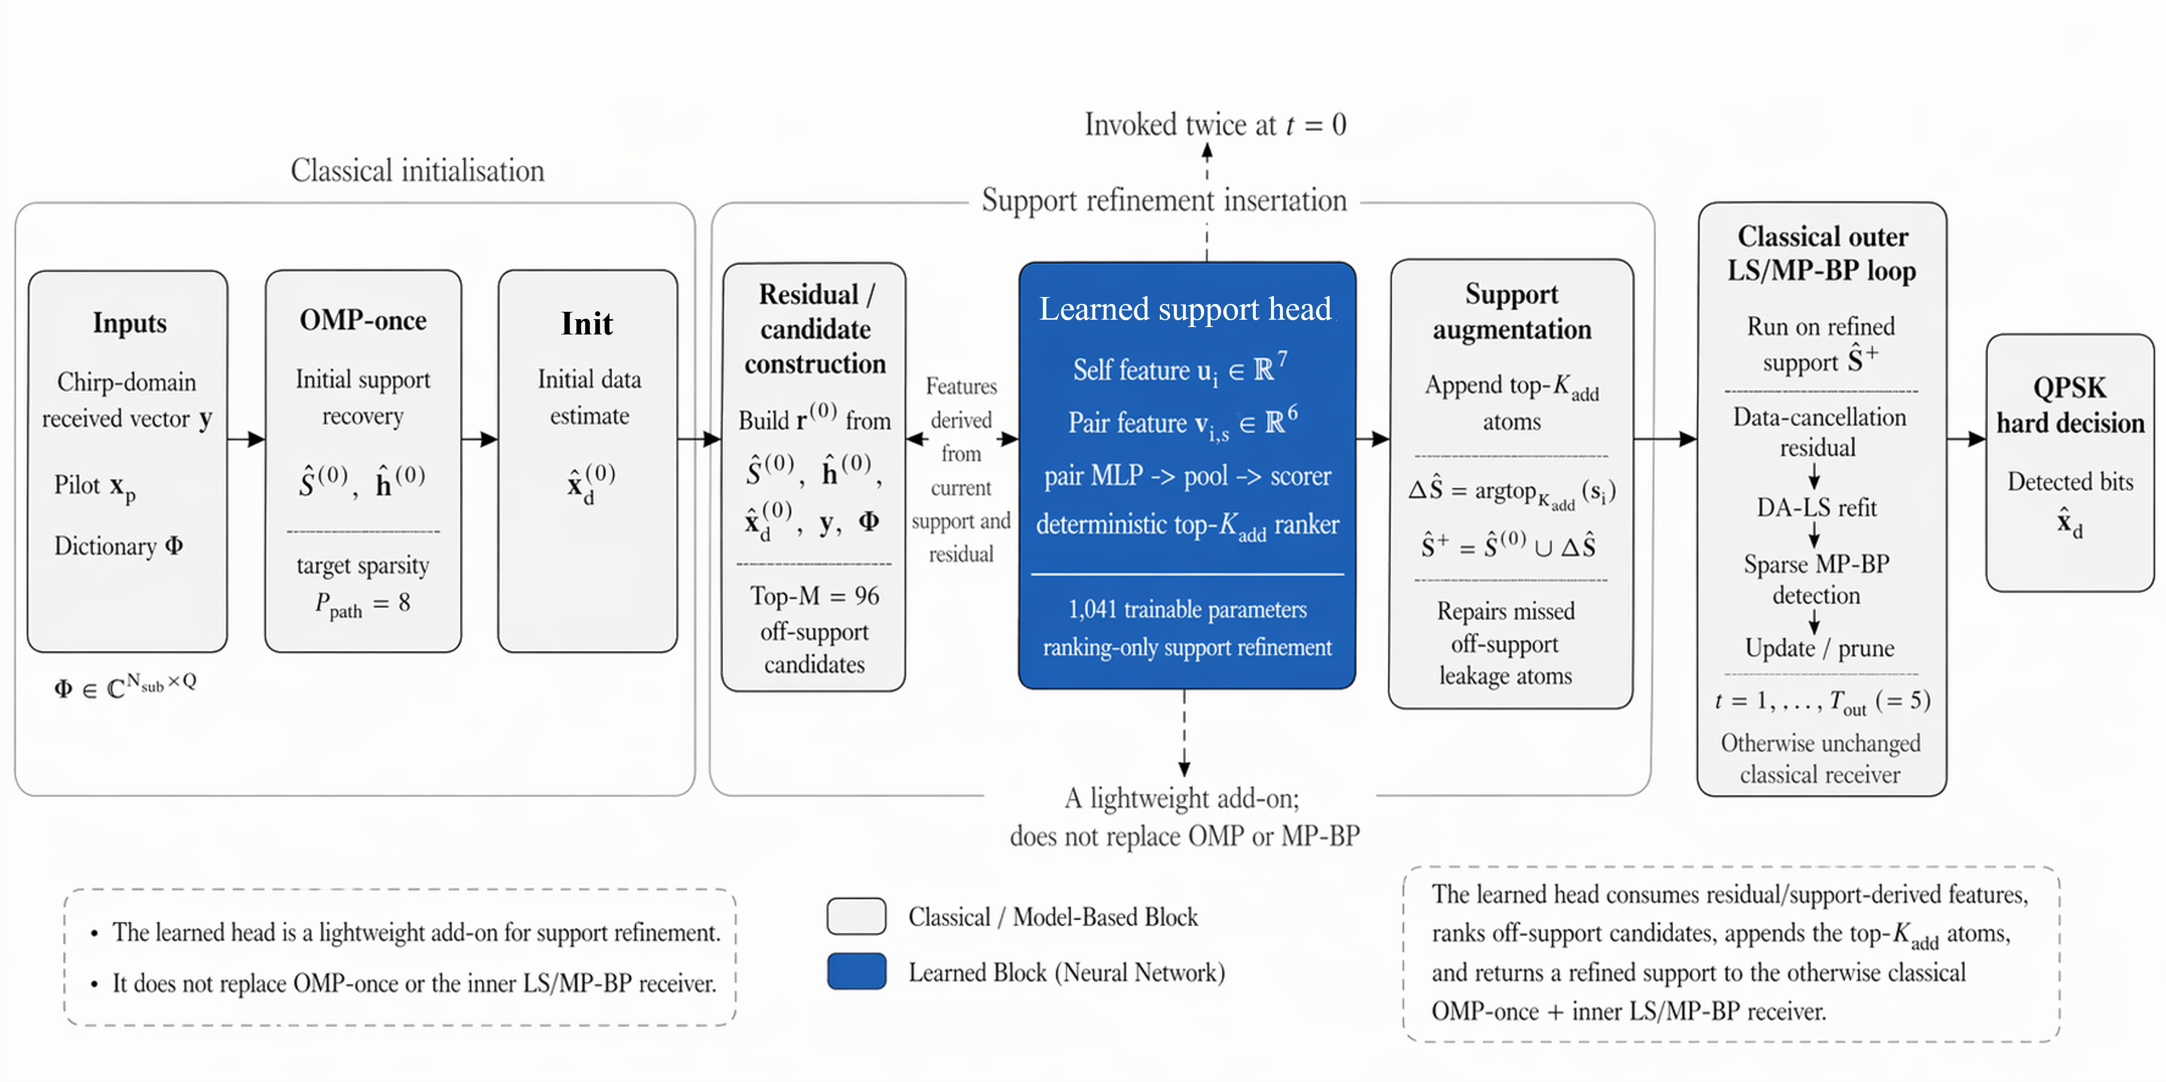
9
Method 2 — Learned Support-Refinement Head
Plugged in once at t = 0, between OMP-once and the iterative loop
Where · after OMP-once, before t = 1
What · top-K = 4 ranker over M = 96 atoms
Capacity · 1 041 trainable params
Cost · +1.5 M MAC (≈ 8 % overhead)
AFDM Transceiver for UWA • Yikun Guo • 2025–2026
10 / 16

Slide 11
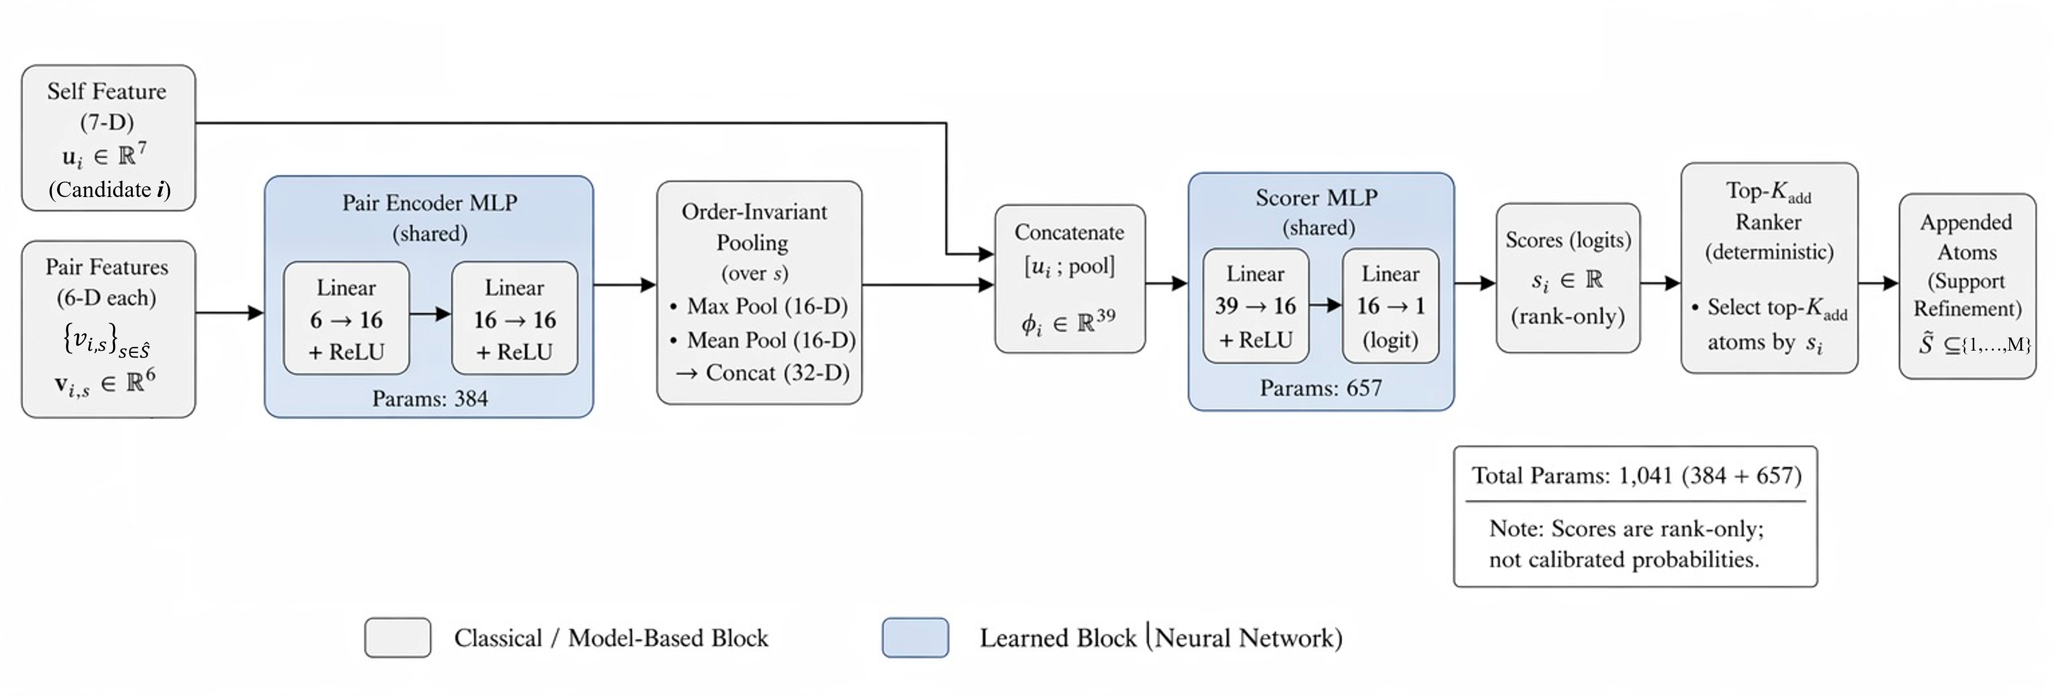
10
Inside the Head — Self & Pair Features → Shared Encoder → Ranker
Order-invariant pooling so the support set has no canonical ordering
7-D self feature u_i
6-D pair feature v_{i,s}
Architecture
log |Φ_iᴴ r| matched-filter strength
margin to weakest active atom
normalised (l_i, k_i) — physical lattice prior
residual-normalised projection
rank among M = 96 candidates
Dirichlet-neighbour binary flag
integer offsets (l_i − l_s, k_i − k_s)
log |ĥ_s| + gain prominence
dictionary coherence |Φ_iᴴ Φ_s|
normalised geometric distance
encodes the (Δl, Δk) = (0, ±1) Dirichlet signature
Pair encoder ℝ⁶ → ℝ¹⁶ → ℝ¹⁶ (384 params)
Pool channel-wise max + mean over Ŝ
Scorer ℝ³⁹ → ℝ¹⁶ → ℝ (657 params, SiLU)
Inference: top-K = 4 ranking, bias patch +10
Training: BCE + pairwise hinge (λ = 0.5)
AFDM Transceiver for UWA • Yikun Guo • 2025–2026
11 / 16

Slide 12
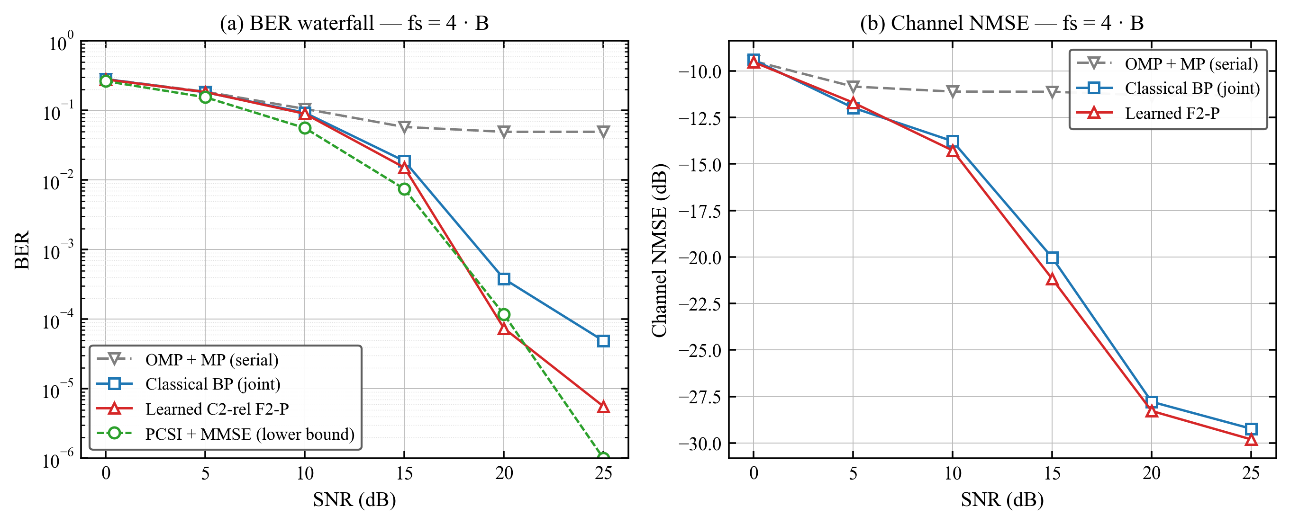
11
Results — BER Waterfall and Channel-Estimation NMSE
Paired-frame protocol, N = 1024, ρ = 0.5, P_path = 8, f_s = 4B
Combined BER + NMSE (4B operating point)
Pooled paired BER (3 seed blocks)
SNR
Classical
Learned
Δ paired
20 dB
5.0 × 10⁻⁴
3.1 × 10⁻⁴
−37.7 %
25 dB
1.0 × 10⁻⁴
6.0 × 10⁻⁵
−40.2 %
30 dB
1.8 × 10⁻⁵
1.1 × 10⁻⁵
−37.6 %
≈ 2 dB
paired BER separation, learned-head over classical, at SNR ∈ {20, 25, 30} dB
Serial OMP+MP saturates at ≈ 5×10⁻², NMSE frozen at −11.3 dB.
Classical joint gains 2–3 orders of magnitude over serial.
Learned head sits strictly below classical at every high-SNR cell.
All three Δ values pass paired McNemar at p < 10⁻⁶.
AFDM Transceiver for UWA • Yikun Guo • 2025–2026
12 / 16

Slide 13
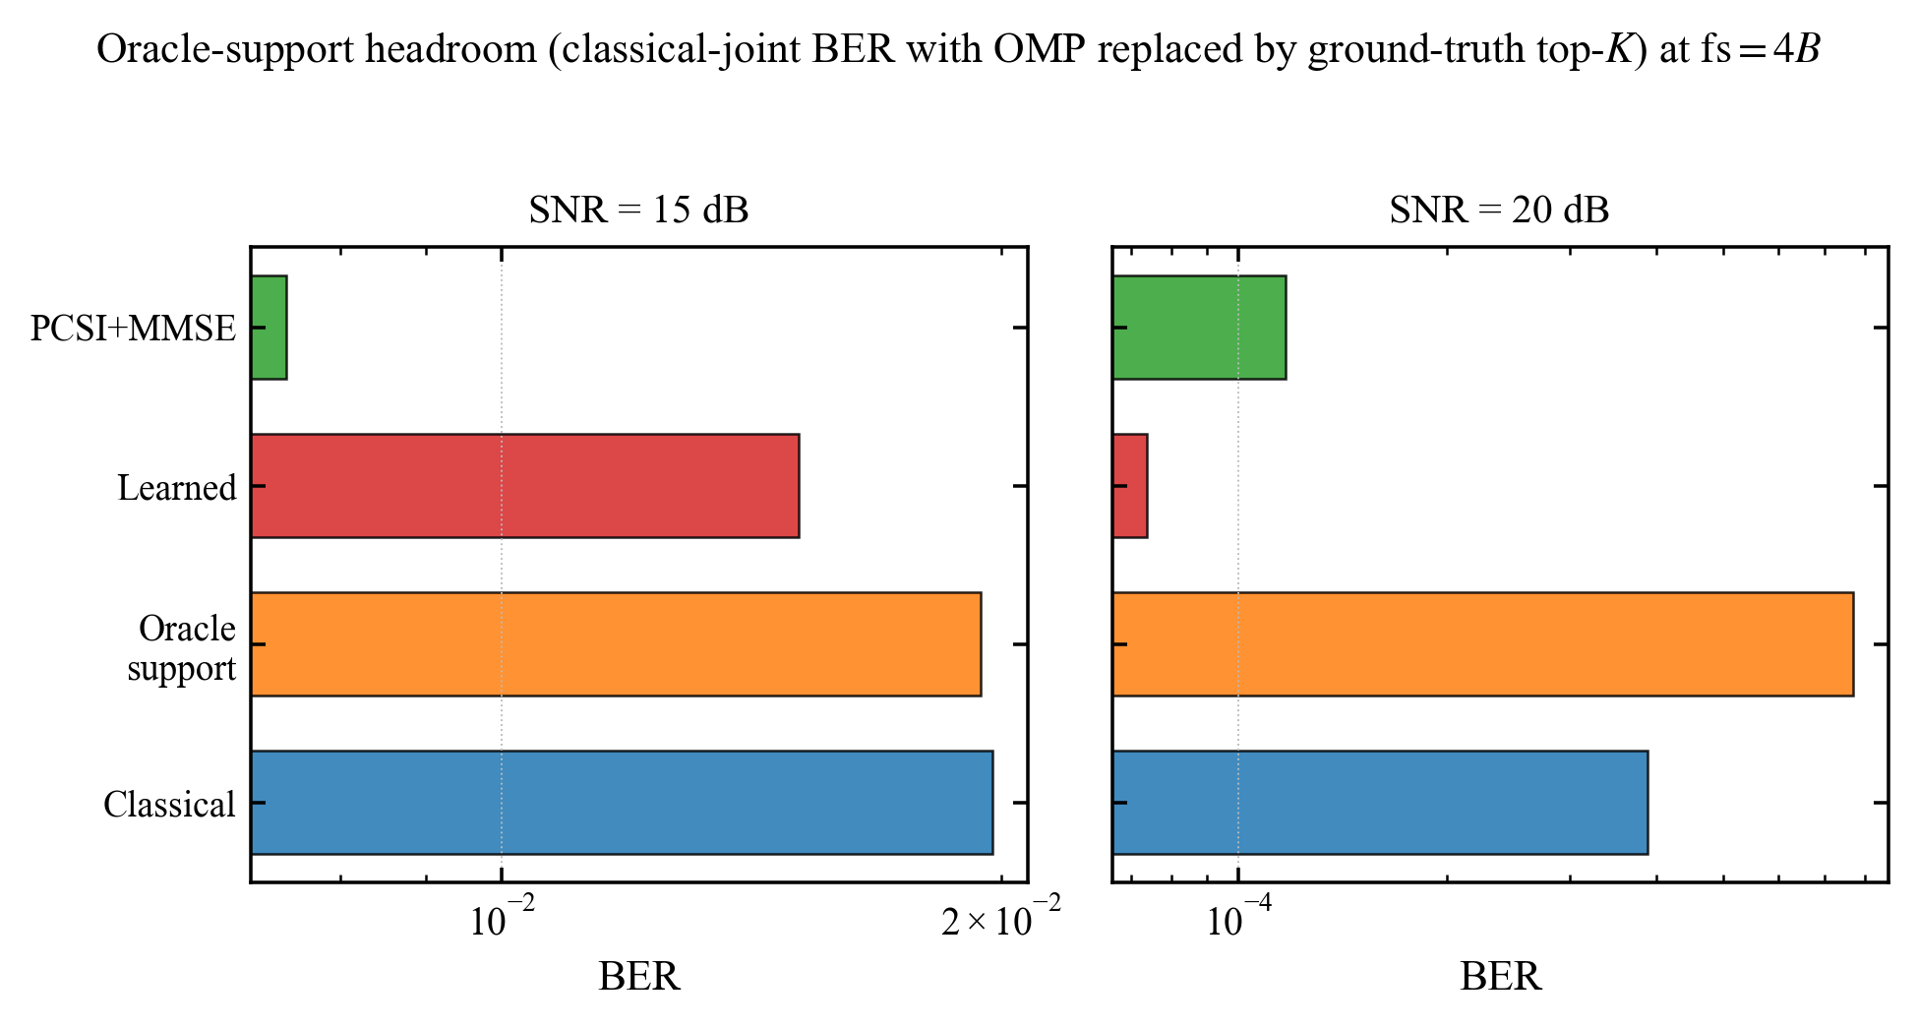
12
Mechanism — How Much of the Achievable Gap Does the Head Close?
Top-P physical-support oracle = a valid ceiling for any same-dictionary refiner
Oracle-headroom decomposition
Gap closed = (baseline − learned) / (baseline − oracle)
61 %
81 %
98 %
15 dB
20 dB
25 dB
Physical oracle reaches censored-zero BER at SNR ≥ 20 dB on 5×10⁵ paired bits per cell — a tight ceiling.
Learned head closes 61 / 81 / 98 % of the gap at SNR = 15 / 20 / 25 dB.
→ The BER gain is attributable to support refinement, NOT to a generic noise-averaging effect.
Outer-iteration probe confirms saturation by T_out = 4 – 5 at SNR = 20 dB.
AFDM Transceiver for UWA • Yikun Guo • 2025–2026
13 / 16

Slide 14
13
Complexity Stays in the Sparse-Recovery Class
+ 1.5 M MAC over the classical core — about 8 % overhead at N = 1024
Per-frame complexity at N = 1024
At a glance
Recipe
Asymptotic class
MAC / frame
Relative
+ 8 %
MAC overhead
learned vs classical
Serial OMP + 1× MP-BP
𝒪( P · N² )
≈ 14.0 M
0.75 ×
Classical joint (proposed)
𝒪( P · N² )
≈ 18.6 M
1.00 × baseline
1 041
head parameters
(384 + 657)
Learned-head joint (proposed)
𝒪( P · N² )
≈ 20.1 M
≈ 1.08 ×
Re-OMP-per-iter (rejected)
𝒪( P · N² ) · 5×
≈ 48.6 M
2.61 ×
Dense LMMSE channel est.
𝒪( N³ )
≈ 2.7 G
≈ 145 ×
÷ 145
cheaper than
dense LMMSE / MMSE
→ Both proposed receivers stay in the sparse 𝒪(P · N²) class — two orders of magnitude cheaper than any dense alternative.
÷ 2.6
cheaper than
re-OMP-per-iter
Relative MAC (log-ish, classical = 1×)
AFDM Transceiver for UWA • Yikun Guo • 2025–2026
14 / 16

Slide 15
14
Conclusions & Future Work
What was shown — and what naturally comes next
Three contributions
Future work
1
A low-complexity classical joint receiver.
Multi-scale multi-lag UWA
OMP-once + iterative damped DA-LS / sparse MP-BP. Recovers 2–3 orders of magnitude of BER over the one-shot baseline at SNR = 25 dB while staying in 𝒪(P · N²).
Per-path independent time-scaling beyond the first-order MSML approximation.
Differentiable top-K loss
2
A 1 041-parameter deep-unfolded support-refinement head.
Aligns training and inference rather than relying on a bias-shift patch.
Top-K = 4 ranking, deployed once at t = 0. Adds a consistent ≈ 2 dB paired separation at SNR ∈ {20, 25, 30} dB ( McNemar p < 10⁻⁶ ).
Embedded-deployment metrics
Latency, memory, and energy on real DSP / NPU targets — out of scope here.
3
A mechanism-grounded explanation.
The first OMP pass already captures ~95 % of the Dirichlet-expanded oracle support; the head closes 61 / 81 / 98 % of the baseline-to-oracle gap at SNR = 15 / 20 / 25 dB.
Field-data validation
Transfer to recorded UWA links beyond the simulator family.
AFDM Transceiver for UWA • Yikun Guo • 2025–2026
15 / 16

Slide 16
Thank you
Questions & Discussion
Yikun Guo • GUID 2840210g • 18736049201eric@gmail.com
Glasgow College, UESTC — Final Year Project Defense, 2025–2026

