Slide 1

Applied Computing Final Project Machine Learning Applied to a UFC dataset.
Professor : Laura Hervert Escobar
November 20th , 2020
Team 1.
Erick Axel Martinez Rios A01331212
Arturo Daniel Gonzalez Cañon A00513641
Alfredo Gallegos Pérez A01272429
Kevin Stalin Catzim Ríos A00818960
Christian Fernando López Orozco A01631685

Slide 2

Content
Introduction (Kevin)
Problem Statement and Methodology (Kevin)
Data analysis (Alfredo)
Feature Selection (Arturo)
Proposed solutions (Erick)
Results Analysis (Erick)
Conclusions (Christian)
References

Slide 3
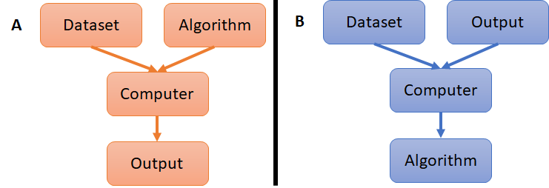
Introduction
Machine Learning is a subset of artificial intelligence that focuses on the development of techniques or algorithms that can best represent a set of data.
The characteristics and development of machine learning techniques have promoted their use in different fields generating a great variety of applications. (Speech recognition, image recognition, medical diagnosis) [2].
The present work aims to implement machine learning techniques to generate a model that can predict the winner in a UFC (Ultimate Fighting Championship) match based on the statistics of both fighters.
Figure 1. Machine Learning Paradigm [1].

Slide 4
What is UFC ?
The UFC is the largest mixed martial arts (MMA) promotion company in the world [3].
The goal of UFC is to find the ultimate fighter by hosting a one-night tournament by matching the top fighters in disciplines such as karate, jiu-jitsu, boxing, kickboxing, grappling, wrestling, and sumo [4].
The fights have an average duration of 5 minutes and the better-rank fighter is labeled as the red fighter while the challenger is labeled as the blue fighter [4].
There are several forms to win the fight like by knockout, submission, or by decision [4].

Slide 5
Problem Statements
Since the response variable is categorical, the challenge must be labeled as a classification problem.
Other aspects to consider are the high dimensionality of the database, its missing values, and the unbalanced proportion of the classes (Blue, Red, and Draw).

Slide 6
Methodology
Database selection and analysis
Dimensionality Reduction and Feature Selection.
Model Generation
Model Validation
Figure 2. Methodology workflow [5].

Slide 7
Database Description.
Table 1. Classes Distribution
Target Variable (Winner) | Number of Samples | Percentage
Blue | 1135 | 35.4466%
Draw | 51 | 1.5928%
Red | 2016 | 62.9606%
The raw data had 5144 samples and 144 variables.
Only 3202 samples remained.
After processing the categorical variables, the shape of the database was comprised of 158 columns and 3202 rows.
The dataset is a list of all the UFC fights until the year 2019 [3].
Table 2. Categorical Variables
Categorical Variable | Number of categories
R_fighter | 875
B_fighter | 1048
Referee | 166
Date | 445
Location | 146
Weight_class | 13
Title_bout | 2
B_Stance | 4
R_Stance | 4

Slide 8
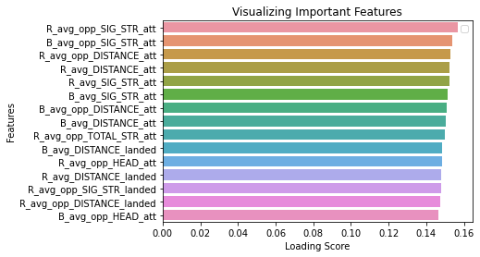
Feature Selection through PCA
Table 3. Variance percentage.
PCA Component | Variance Percentage
PC0 | 14.1075%
PC1 | 8.8113%
Total | 22.9189%
TO SELECT THE VARIABLES THE LOADING SCORES OF EACH VARIABLE IN THE FIRST PRINCIPAL COMPONENT WERE COMPUTED.
THE ONES WITH THE HIGHEST LOADING SCORE ABSOLUTE VALUE WERE SELECTED.
Figure 3. Loading scores of variables for the first principal component.

Slide 9
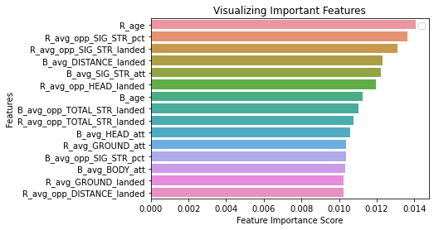
Feature Selection through GINI IMPORTANCE
The decision trees and random forest determine the importance of variables based on the its impurity [6,7].
In this case, Gini importance was used to determine the impurity of each variable and estimate their relative importance [6,7,12].
Figure 4. Relative importance scores based the Gini importance criteria.

Slide 10
Description of the models.
Model 1: It uses all the variables in the database to train the algorithms.
Model 2: It uses the 15 variables with the highest loading score based on the PCA analysis to train the algorithms.
Model 3: It uses the 15 variables with highest score based on the Gini importance criteria of impurity to train the model.
The data was split in two sets, 80% for training and 20% for testing.

Slide 11
Machine Learning Techniques Applied
Machine Learning Techniques
Decision Tree Classifier
Random Forest [11]
K-Nearest Neighbor [8]
Support Vector Machine [9,10]
Gini importance.
Model 1: Max depth 25
Model 2 and 3: Max depth 6 .
Z-score normalization
K= 7.
Z-score normalization.
Kernel: Radial Basis Function.
C = 1
120 trees were used to train the model.
Gini importance.
Model 1: Max depth 25.
Model 2 and 3: Max depth 6.

Slide 12
Results Comparison
Requires the standardization of the data and its testing phase is slow with high dimensional inputs.
Accuracy K- Nearest Neighbor | Complete Model (Model 1) | Reduced Model from PCA Loading scores (Model 2) | Reduced model from Gini importance scores (Model 3)
Training Set | 0.7107 | 0.6947 | 0.7224
Testing Set | 0.6209 | 0.5897 | 0.6490
Requires the standardization of the data.
Showed lower F1-Score values for Blue class (0.07)
Accuracy Support Vector Machine | Complete Model (Model 1) | Reduced Model from PCA Loading scores (Model 2) | Reduced model from Gini importance scores (Model 3)
Training Set | 0.7930 | 0.6474 | 0.6974
Testing Set | 0.6771 | 0.6271 | 0.6349
Accuracy Random Forest | Complete Model Model 1 | Reduced Model from PCA Loading scores Model 2 | Reduced model from Gini importance scores Model 3
Training Set | 1.0000 | 0.6818 | 0.7146
Testing Set | 0.6583 | 0.6537 | 0.6775
Requires 120 trees to make predictions.

Slide 13
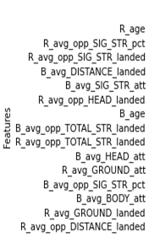
Selection of the best model
Decision Tree
Accuracy
F1-Score
Complexity
15 Features
Test Accuracy: 0.6365
Red Class: 0.75
Blue Class: 0.35
1 Decision Tree to perform the classification
Accuracy Decision Trees | Complete Model (Model 1) | Reduced Model from PCA Loading scores (Model 2) | Reduced model from Gini importance scores (Model 3)
Training Set | 1.0000 | 0.6790 | 0.6790
Test | 0.5663 | 0.6256 | 0.6365

Slide 14
Prediction Matches Results
Extract statistics from raw data based on color and name.
Compute the mean of the statistics.
Input the mean into the model.
Compute output Probability.
Average
RPS : 0.19356

Slide 15
Conclusions
It was concluded that the proposed reductions had similar performance results in terms of accuracy compared to the complete models.
The Gini importance provided a model by using a Decision Tree that is easily trainable, highly interpretable, and received a higher accuracy in the test phase. The selection is also supported by the low RPS.
None of the reduced models could predict when a Draw would occur during a match.

Slide 16
Conclusions
Nevertheless, the use of the Python computational tools and the use of the machine learning analysis tools allowed us to overcome these challenges and receive better results.
There were some challenges to treat the data such as its high dimensionality, the great quantity of missing values, and the pre-processing of the variables for training and testing.

Slide 17

Thanks for your attention.

Slide 18
References
● [1] Choi, R., Coyner, A., Kalpathy-Cramer, J., Chiang, M., &amp; Campbell, J. (2020, January 28). Introduction to Machine Learning, Neural Networks, and Deep Learning. Retrieved November 08, 2020, from https://tvst.arvojournals.org/article.aspx?articleid=2762344
● [2] Shinde, P. P., & Shah, S. (2018). A Review of Machine Learning and Deep Learning Applications. 2018 Fourth International Conference on Computing Communication Control and Automation (ICCUBEA). doi:10.1109/iccubea.2018.8697857
● [3] Warrier, R. (2019, July 05). UFC-Fight historical data from 1993 to 2019. Retrieved November 08, 2020, from https://www.kaggle.com/rajeevw/ufcdata
● [4] Hitkul, Aggarwal, K., Yadav, N., & Dwivedy, M. (2018). A Comparative Study of Machine Learning Algorithms for Prior Prediction of UFC Fights. Advances in Intelligent Systems and Computing, 67–76. doi:10.1007/978-981-13-0761-4_7
● [5] D.H. Wolpert, The Supervised Learning No-Free-Lunch Theorems, in: Soft Computing and Industry, Springer London, 2002: pp. 25–42. doi:10.1007/978-1-4471-0123-9_3.
● [6] A.C. Faul, A Concise Introduction to Machine Learning, Chapman and Hall/CRC, 2019. doi:10.1201/9781351204750.
● [7] G. Rebala, A. Ravi, S. Churiwala, An Introduction to Machine Learning, Springer International Publishing, 2019. doi:10.1007/978-3-030-15729-6.
● [8] Navlani, A. (2018, August 2). KNN Classification using Scikit-learn. Retrieved November 08, 2020, from https://www.datacamp.com/community/tutorials/k-nearest-neighbor-classification-scikit-learn.
● [9] Navlani, A. (2019, December). (Tutorial) Support Vector Machines (SVM) in Scikit-learn. Retrieved November 08, 2020, from https://www.datacamp.com/community/tutorials/svm-classification-scikit-learn-python
● [10] Sharma, S. (2019, December 18). How to Classify Non-linear Data to Linear Data? Retrieved November 08, 2020, from https://medium.com/analytics-vidhya/how-to-classify-non-linear-data-to-linear-data-bb2df1a6b781
● [11] Louppe, Gilles. (2014). Understanding Random Forests: From Theory to Practice. 10.13140/2.1.1570.5928.
● [12] Swamynathan, M. (2019). Mastering machine learning with Python in six steps: A practical implementation guide to predictive data analytics using Python. Berkeley: Apress. doi:10.1007/978-1-4842-2866-1
● [13] Ultimate Fighting Championship, U. (2020). UFC stats. Retrieved November 18, 2020, from http://ufcstats.com/statistics/events/completed

