Slide 1
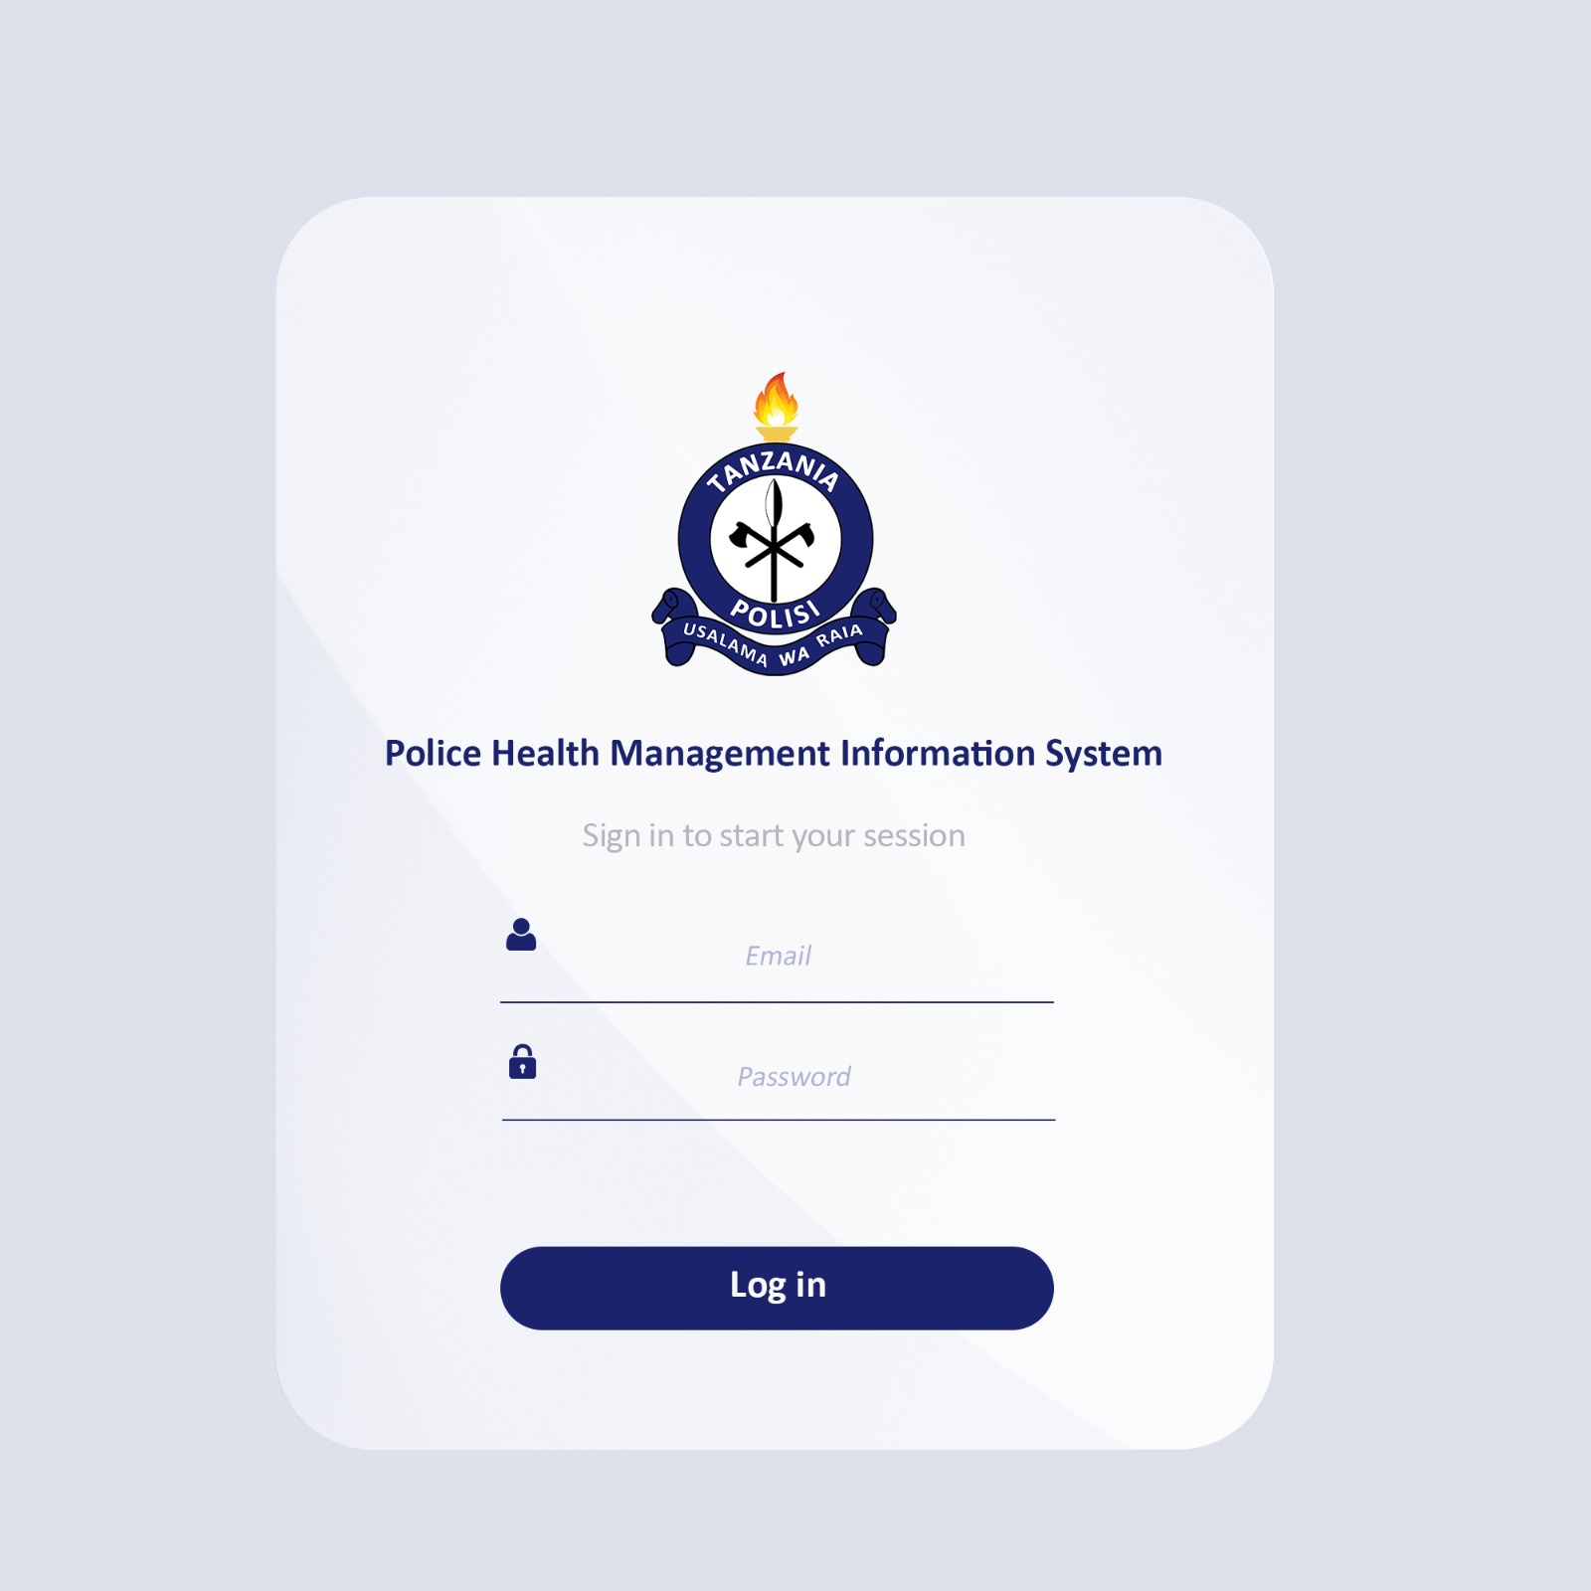


PHMIS
Police Health Management Information System
USER TRAINING GUIDE | May 2026
Prepared by TPF ICT Chiefdom

Slide 2
PHMIS Training Agenda
01
Introduction and Overview
06
Outpatient Services
What is PHMIS and how to get started
Consultation, diagnosis, treatment, disposition
02
Getting Started / Login
07
Inpatient Service
Access the system, login and password recovery
Admission, nursing care, labour & delivery, discharge
03
System Settings
08
Pharmacy Management
Facility, pharmacy, ward, billing & user management
Receiving, requisition, dispensing, stock-taking
04
Client Management
09
Investigation, RCH and Mortuary
Registration, card verification, advanced search
Lab/radiology, maternal & child health, mortuary
05
Bill Payments
10
Insurance and Reports
Pending bills, cashier processing, receipts
NHIF/CHF processing, facility & MTUHA reports

Slide 3
CHAPTER 01
Introduction to PHMIS
About the system, purpose, scope and user roles

Slide 4













PHMIS Training
What We Will Cover Today
13 modules across the full patient journey
1
2
3
4
5
System Settings
Client Management
Bill Payments
Triage
Outpatient Services
6
7
8
9
10
Inpatient Services
RCH
Pharmacy
Investigation
Prime Vendor
11
12
13
Mortuary
Insurance
Reports

Slide 5




PHMIS Training
Getting Started: Accessing PHMIS
How to log in and recover your password
System URL:
https://192.168.57.80:8001
STEP 1
STEP 2
STEP 3
STEP 4
Open Browser
Enter URL
Click Sign In
Enter Credentials
Use Google Chrome
(recommended)
or Mozilla Firefox
Type the URL in
the address bar
and press Enter
The login page
appears — click
Sign In button
Enter your username
and password then
click Sign In
Forgot Password? Click 'Forgot Password', enter your username → Answer Security Question Based on NIDA Information

Slide 6





PHMIS Training
User Types and Roles (RBAC)
Each user sees only the modules relevant to their role
System
Administrator
Medical
Personnel
Admin /
In-Charge
Accountant /
MTUHA Focal
Managerial
Full access to ALL modules. Setup, facility creation, user management. Only ONE super admin per organization.
Nurses, Clinicians, Pharmacists, Lab Technicians, Anesthetists. Access limited to their department.
Oversees facility operations. Extra access to Reports, Staff Performance and Patient Tracer.
Handles financial reporting and MTUHA (national health reporting) submissions.
Dashboard view only. Sees aggregated reports across multiple facilities. Read-only.
Key Principle: Role-Based Access Control (RBAC) — users can only access modules assigned to their role. All access is enforced server-side.

Slide 7
PHMIS Users and Roles
Receptionist
Lab/Radiology Tech
Registers patients, verifies cards, manages client visits
Posts investigation results, handles sample collection
Clinician/Doctor
Cashier
Consultation, diagnosis, investigation requests, treatment
Processes bill payments, generates receipts
Nurse
System Admin
Vital signs (Triage), nursing care, inpatient charting
User management, system settings, facility configuration
Pharmacist
Report Officer
Dispenses medicines, manages stock, handles requisitions
Generates facility, MTUHA and operational reports

Slide 8
What is PHMIS?
Police Health Management Information System
Centralizes patient data and digitalizes health operations across TPF facilities.
TPF Health Facilities
Targets more than 32 TPF facilities by July 2026 in collaboration with Health Command.
Key Benefits
Better patient records, resource management, disease tracking and staff capacity building.
💡 PHMIS is accessible at: 192.168.0........

Slide 9

PHMIS
Module 1
System Settings
and Configuration
Training Module
BEFORE clinical modules can be used, the facility must be fully configured.

Slide 10

PHMIS Training
Module 1: System Settings and Configuration
Foundational setup — must be done in order before going live
Facility Management
Facility Item Mapping
Item Pricing
Update facility name and address
Map all services, medications, investigations to the facility
Set prices (bulk CSV upload or manual entry). Zero price for insurance/exempt items.
Cost Sharing Groups
Pharmacy Stores
Ward Management
Create patient categories: user fee, insurance, exemption + sub-groups
Create stores, assign user access (full or partial), register vendors, set reorder levels
Create ward types, wards, add beds, assign nurses
Investigation Setup
Billing / GEPG
User Management
Map lab and radiology tests to departments; assign departmental user access
Configure payment modes. Facilities MUST use Government Electronic Payment Gateway (GEPG).
Register users using Check Number (C/N required). Assign roles and departments.

Slide 11









PHMIS Training
The Complete Patient Journey in PHMIS
Every step is connected — from arrival to discharge
1
2
3
4
5
Arrive at Facility
Registration
(MRN Generated)
Pay Bill
(GEPG / Cash)
Triage
(Vital Signs)
OPD
Consultation
6
7
8
9
10
Investigations
(Lab / X-ray)
Pharmacy
(Dispensing)
Disposition
(OPD Out / Admit)
Inpatient
(If Admitted)
Discharge
and Reports

Slide 12

PHMIS Training
Module 2: Client Management
Patient registration, search, visit management and referrals
Registration Workflow
Key Sub-Modules
1
Navigate to Client Management → Client Registration
Card Verification
Verify NHIF/CHF insurance cards
2
Click Full Registration to include Next-of-Kin details
Advanced Search
3
Fill all required fields and click Submit Form
Search by name, MRN, DOB, or date range
Patient Category
4
Select Category, Sub-Category, Service and Department
Change cost-sharing group (future bills only)
Payment Mode
5
Choose visit type: Normal or Referral Visit
Switch Prepaid / Postpaid
6
Click Start Visit → System generates unique MRN
End Client Visit
Close visit. NHIF: digital sign-off required
7
Print patient card with MRN for the patient
Incoming Referrals
MRN (Medical Record Number): Each patient receives a unique MRN upon first registration. Always use MRN to look up patients in any module.
View & process referrals from other facilities

Slide 13

PHMIS Training
Module 3: Bill Payments | Module 4: Triage
Billing must be settled before clinical consultation begins
Bill Payments
Triage – Vital Signs
Pending Bills
Captured BEFORE consultation to assess patient priority:
Search by MRN → view service lines → select → Collect Cash
GEPG Payment
Blood Pressure
Body Weight & Height
Click Generate Control Number → patient pays via bank/mobile
Cashier Bills
Oxygen Saturation (SpO₂)
Pulse Rate
View all bills processed by cashier within a date range
Reprint Receipt
Temperature
Respiratory Rate
Enter MRN → find bill → click Print to reprint receipt
Bill Cancellation
Nurse enters MRN → clicks Attend → adds vital signs → saves
Request cancellation → Approve Cancelled Bills workflow
Patient's bill must be SETTLED before the Attend button appears in the OPD consultation module.

Slide 14
PHMIS Training
Module 5: Outpatient Services (OPD)
Full clinical workflow from consultation to disposition
1
2
3
4
5
Consultation
(Bill Settled?)
Clerk Sheet
(Complaints)
Vitals
Entry
Diagnosis
(ICD-10)
Investigation
Orders
6
7
8
9
Results
Review
Confirm
Diagnosis
Treatment
(Prescribe)
Disposition
Disposition Options:
Ward Admission
Internal Referral
External Referral
Deceased Certification

Slide 15
PHMIS Training
Module 6: Inpatient Services (IPD)
Managing admitted patients from admission through discharge
Continuation Notes
Nursing Care
Manage Admitted Patients
Doctor records ward round notes. Click Continuation Notes → enter note → Submit.
Process admission requests. Click 'Admit Patient' or 'Transfer to another ward'. Create nursing care plans.
View all admitted patients. Add procedures and services. Click 'View History' to see full patient history.
Labour and Delivery
Discharge Patient
Charting
Record labour details. Add partograph measurements (type, hours, value, date/time). View Partograph History.
Click Discharge → Approve Client Discharge to complete the discharge process for the patient.
Add input/output charts, turning charts, treatment charts, vital signs recordings, and blood bank records.

Slide 16

PHMIS Training
Module 7: RCH | Module 8: Pharmacy Management
Maternal and child health services and pharmaceutical inventory
Reproductive & Child Health (RCH)
Pharmacy Management
Enter patient MRN → select patient → fill applicable forms:
Item Receiving:
Receive medicines into store; add batch and quantity
GBV/VAC (Gender-Based Violence / Violence Against Children)
Store Balance:
Check stock levels by store and date range
Children Attendance
Requisition and Issuing:
Antenatal Form
Request items from main store → issue to sub-store
Dispensing:
Postnatal Form
MRN → verify prescription dosage → dispense medication
Stock Taking:
Labour and Delivery
Physical count adjustment with adjustment type
Vaccination Records
Nearly Expired:
List items expiring within a set date range
Family Planning
Dispensing Book:
Download patient prescription history by MRN
Forms are gender-conditional. Male patients won't see Antenatal/Postnatal forms.

Slide 17

PHMIS Training
Module 9: Investigation (Lab and Radiology)
4-step quality-controlled results workflow
STEP 1
STEP 2
STEP 3
STEP 4
Sample Collection
Results Posting
Results Approval
Results Review
Lab Technician enters patient MRN → selects ordered test → clicks Collect → records Sample Type → saves.
Enter results text in textbox ('Enter Seen Results'). For radiology: upload PDF or image (max 5MB). Click Post Results.
Senior lab staff: click Result Approval → view results → Approve (sends to clinician) or Reject (returns for correction).
Clinician: click Result Review → view approved result → click Review to accept OR Reject to send back for reposting.
Amendment: If results need correction after posting, use Results Amendment → re-enter approval workflow. History viewable by MRN + date range.

Slide 18


PHMIS Training
Modules 10–12: Prime Vendor, Mortuary and Insurance
Procurement, mortuary operations, and insurance claims management
M10: Prime Vendor
M11: Mortuary Services
M12: Insurance (NHIF and CHF)
When MSD is out of stock (via ELMIS):
Corpse Registration (personal info + next-of-kin + service)
System generates Corpse Card — print for relatives
Services billed automatically via billing module
Cabinet Management: assign to cabinet slot
Post-Mortem documentation with attachments
Corpse Verification: record cause of death
Gate Pass → Print Burial Permit → Discharge
View claims (submitted and pending) by date range
NHIF: Item Mapping — facility items ↔ NHIF catalog (must match exactly!)
CHF: Item Mapping + Claim Admin Code + URL Config
User Mapping: link staff to practitioner numbers
Store NHIF/CHF credentials securely
Demo mode and Live mode configurable separately
Wrong item mapping = INCORRECT claim data
View OOS Notifications (by invoice #)
Click OOS items to see what's unavailable
Create Order: enter invoice # → select items → Prepare Order
Edit Order: adjust quantity / add comments
Submit to alternative supplier

Slide 19
PHMIS Training
Module 13: Reports
Facility operational reports and MTUHA national health reporting
Facility Reports
MTUHA Reports
Click Facility Reports → select report category → choose format → set date range → click Print.
Click MTUHA Reports → select Instance → Dataset → Year → Period(s) → click View Report.
Financial reports (billing, payments, collections)
MTUHA = National health information reporting system
Clinical reports (OPD, IPD, RCH attendance)
Required for government regulatory compliance
Pharmacy reports (stock, dispensing, near-expiry)
Data pulled from ALL clinical modules
Investigation reports (lab volumes, turnaround)
Supports monthly and quarterly submissions
Mortuary reports
Must be submitted by MTUHA Focal Person role

Slide 20
PHMIS Training
Facility Setup: Correct Configuration Order
MUST be completed in sequence before clinical modules are activated
PHASE 1
System Setup
Create / update facility profile • Register Facility Administrator (via Check Number)
PHASE 2
Facility Config
Item Mapping → Reception Items → Item Categories • Facility Item Pricing (zero for exempt items) • Cost Sharing → Sub Cost Sharing → Facility Cost Sharing
PHASE 3
Clinical Infra
Pharmacy Stores + Vendors + Reorder Levels + Tracer Meds • Ward Management: Types → Wards → Beds → Nurses • Investigation Setup: Dept Access + Item Mapping • Billing Setup / GEPG Payment Mode
PHASE 4
Insurance
NHIF: Credentials → Item Mapping → User Mapping • CHF: URL Config → Claim Admin Code → Item Mapping
PHASE 5
Go Live
Backlogs Import (historical patients if needed) • Departmental Access assignments for all users • Investigation Dept Access for lab/radiology staff

Slide 21

PHMIS Training
Data Security and Password Management
Protecting patient data — legal obligation under Tanzania Data Protection Act
Strong Passwords
No Credential Sharing
Role-Based Access
Use uppercase, lowercase, numbers and special characters. Minimum 8 characters. Change every 3–6 months.
NEVER share your username or password. Each action is attributed to your account. You are responsible.
Access only modules relevant to your role. Do not attempt to access systems outside your authorization.
Secure Devices
Phishing Awareness
OTP Recovery
Lock your computer when away. Do not leave patient data visible on unattended screens.
Verify all links and emails. PHMIS only sends OTPs — never sends links asking for passwords.
If you forget your password: click Forgot Password → enter username → OTP is sent to your email AND phone.

Slide 22
CHAPTER 02
Getting Started: System Walkthrough
Login, homepage navigation and password recovery

Slide 23
2.1 – Accessing PHMIS and Login
Open a web browser and navigate to:192.168.......
The PHMIS homepage displays available service modules as clickable tiles
Click the Sign In button (top-right corner, highlighted in red) to proceed
Enter your registered Username and Password on the login screen
Click Login — the system validates your credentials and loads your dashboard
Your name, facility, and role are displayed in the left sidebar
💡 Tip: Ensure you are using a stable internet connection before logging in.

Slide 24
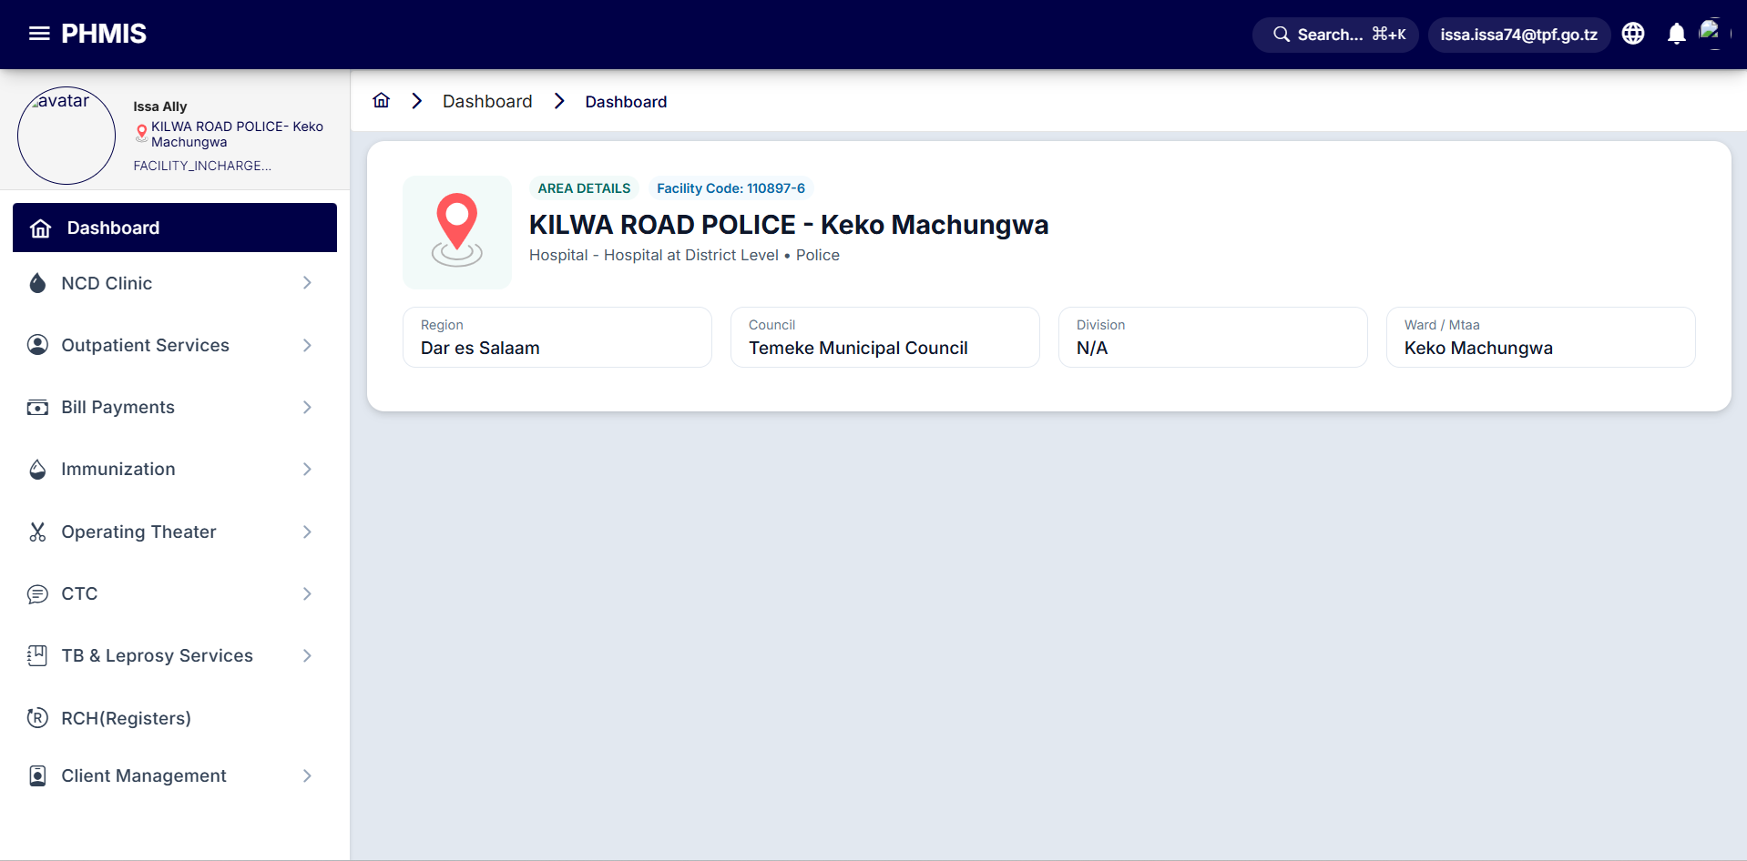
2.1 – System Dashboard Overview
After login, the main Dashboard displays your facility name and location
Left sidebar shows navigation menus based on your assigned role (RBAC)
Key menus include: System Settings, User Management, Reports, Triage, etc.
Your profile photo, name, and department appear at the top of the sidebar
Use the Home icon (top breadcrumb) to return to the main dashboard anytime
Notification bell icon alerts you to pending tasks and system messages
💡 Role-Based Access Control (RBAC) ensures each user only sees permitted menus.

Slide 25
2.2 – Password Recovery and Security
On the login page, click Forgot Password? link below the login button
Answer security Questions from NIDA Information
After successful Security Test you can continue with next step
Create a strong new password following the complexity requirements:
Minimum 8 characters with uppercase, lowercase, numbers and symbols
Best practice: Change your default password on first login
Never share your password with colleagues; each user has individual credentials
Use strong passwords
Keep credentials private
Min 8 chars, mixed case, numbers symbols
Never share your username or password
Log out after use
Report suspicious access
Always sign out when leaving the workstation
Notify admin of any unauthorized activity
💡 Contact your System Administrator if you do not receive the OTP email.

Slide 26
CHAPTER 03
System Settings
Facility management, pharmacy, ward, billing and user setup

Slide 27
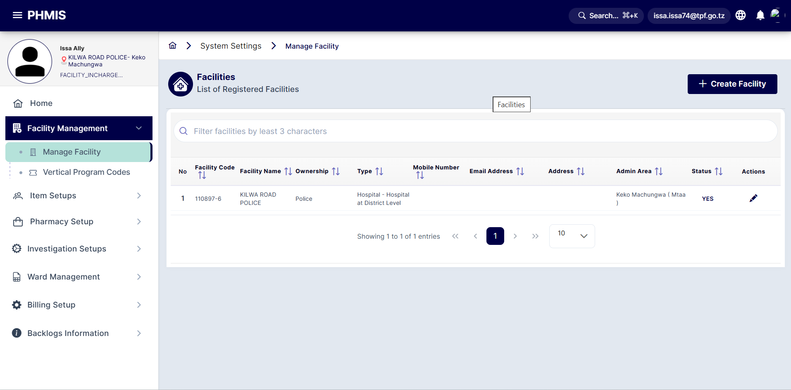
3.1.2 – Facility Item Mapping
Navigate to: System Settings → Facility Management → Facility Item Mapping
This screen lists all service items available for your facility (e.g., 39 items shown)
Each item shows: Name, Code, and Cost Sharing category (User Fee or Insurance)
Check/uncheck items to enable or disable them for your facility
Click the + Create button (top-right) to open the item mapping dialog
Select items from the list and assign appropriate Cost Sharing names
Click Save to confirm the mapping — unchecked items (e.g., NHIF) will not appear in billing
💡 Ensure facility items are correctly mapped before processing any patient bills.

Slide 28
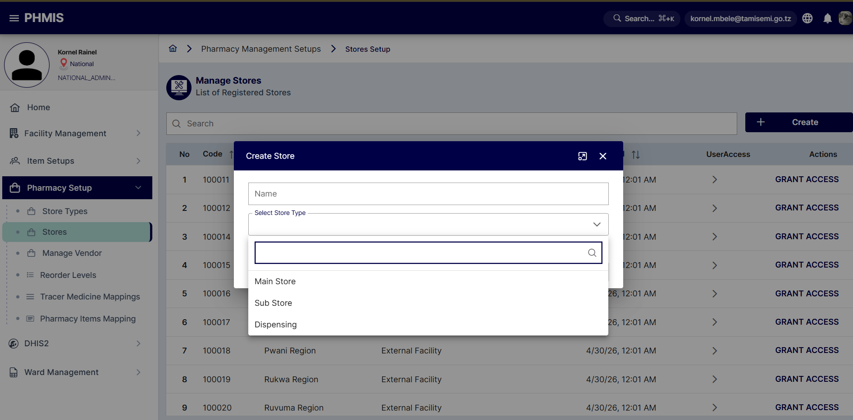
3.2.1 – Pharmacy Store Setup and Access
Navigate to: System Settings → Pharmacy Setup → Stores
The Manage Stores screen lists all configured stores (Main Store, Sub Store, Dispensing)
Click Grant Access to assign users access permissions to a specific store
The Permission Management panel allows selecting: Grant Access (Yes/No)
Select Access Type: Full Access (view & edit) or Partial Access (view only)
Search for users by at least 3 characters in the filter box
Select the user from the list and click Save to apply permissions
💡 Only users with Full Access can perform stock transactions in the assigned store.

Slide 29
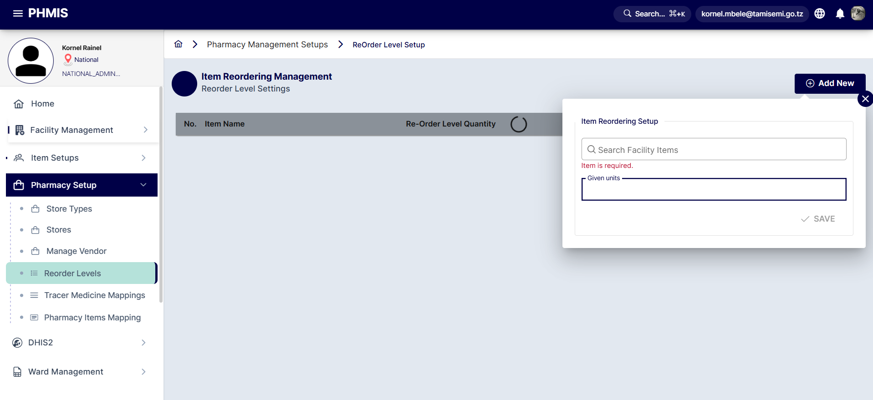
3.2.3 – Pharmacy Reorder Levels
Navigate to: System Settings → Pharmacy Setup → Reorder Levels
The Item Reordering Management screen lists medicines with low-stock alerts
Items highlighted in red have fallen below their defined reorder threshold
Click + Add New (top-right) to configure a reorder level for a new item
Search for the facility item (minimum 3 characters) in the search box
Enter the Given Units (reorder quantity threshold) and click SAVE
This triggers alerts when pharmacy stock falls below the configured minimum
💡 Regularly review reorder levels to prevent stock-outs of essential medicines.

Slide 30
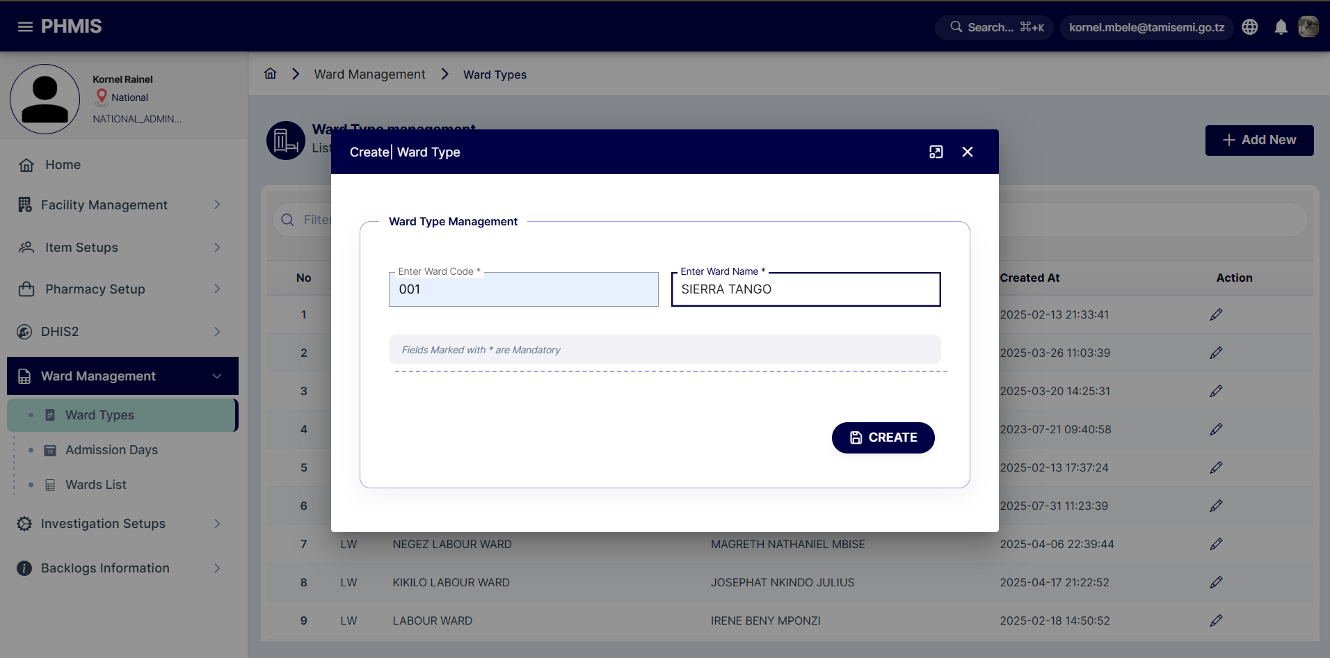
3.3.2 – Ward List Management
Navigate to: System Settings → Ward Management → Wards List
Displays all registered wards with: Ward Code, Name, Type, Creator and Date
Ward types include: OPD, Male/Female General, Surgical, Paediatric, etc.
Click + Create Ward (top-right) to register a new hospital ward
Use the Action menu (⋮) to Update, manage Beds, or Assign Nurse to a ward
Bed management allows setting total capacity per ward for admission tracking
Nurse assignment links nursing staff to specific wards for accountability
💡 Ward setup must be completed before any inpatient admissions can be processed.

Slide 31
CHAPTER 04
Client Management
Patient registration, verification and visit management

Slide 32
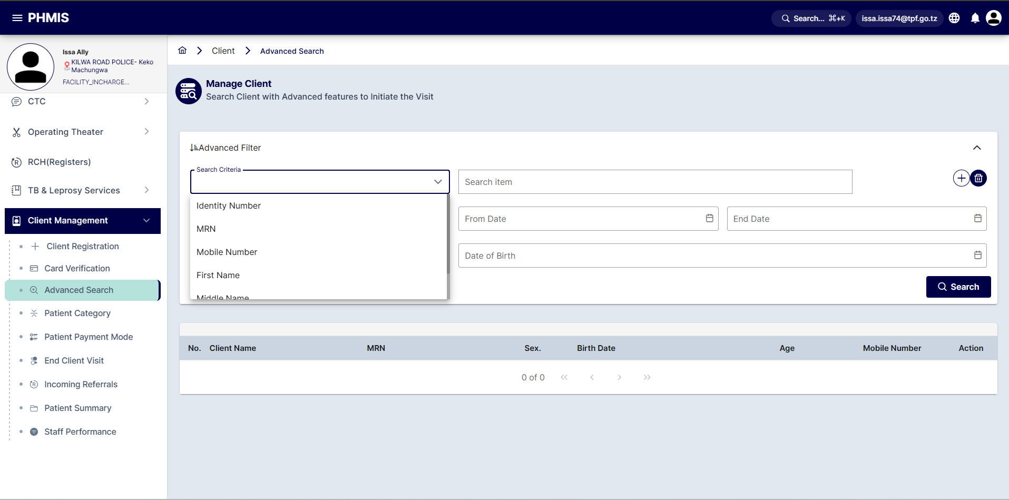
4.3 – Advanced Client Search
Navigate to: Client Management → Advanced Search
Use Advanced Filter to search across multiple criteria simultaneously
Search Criteria options: MRN, Mobile Number, First Name, Middle Name, Last Name
Enter date ranges (From Date / End Date) to narrow results by visit period
Date of Birth field allows age-based filtering for patient lookup
Click + to add multiple search criteria in a single query
Click the Search button to display matching patient records in the results table
Results show: Client Name, MRN, Gender, Birth Date, and Age
💡 Use MRN (Medical Record Number) for the fastest and most accurate patient lookup.

Slide 33
CHAPTER 06–07
Outpatient and Inpatient Services
Consultation, diagnosis, treatment, admission and discharge

Slide 34
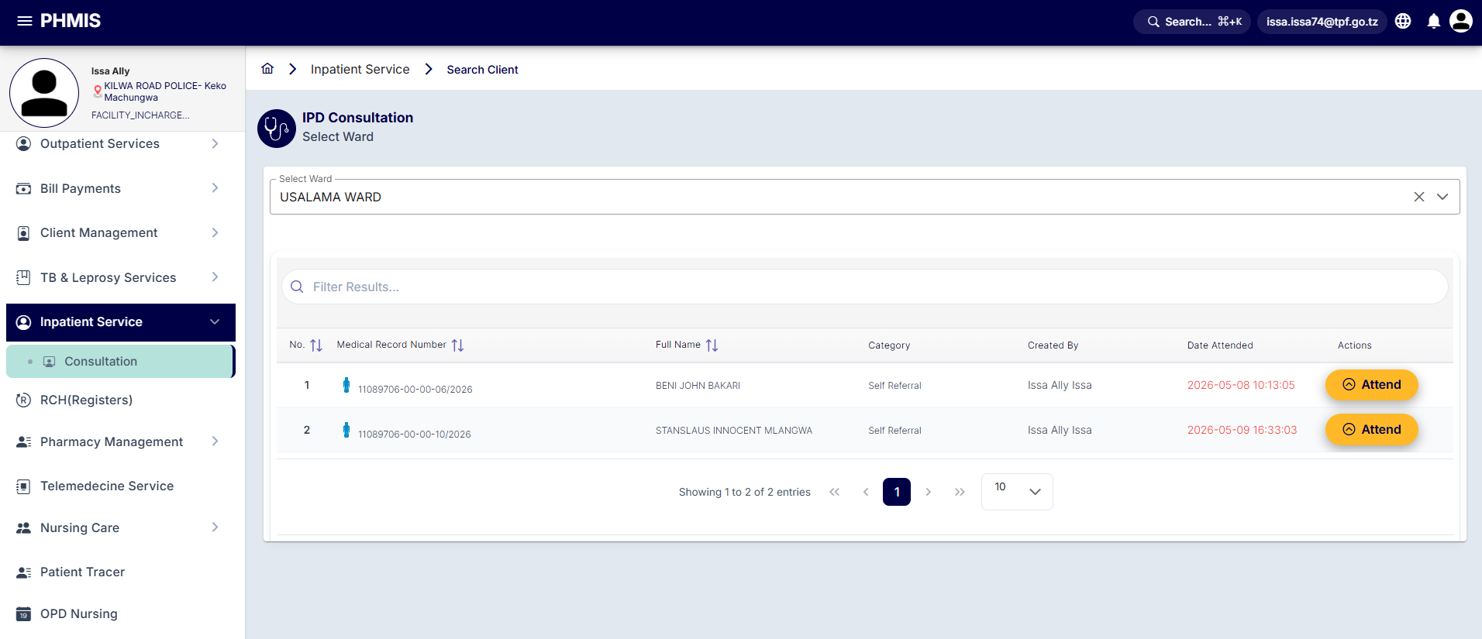
8.0 – Inpatient Service: Ward Selection
Navigate to: Inpatient Service → Consultation (IPD Consultation)
Click Select Ward to choose the appropriate inpatient ward for admission
A dialog lists available wards: OPD WARD, Male General, Female, Male, Wodi Ya Watoto, etc.
Select the ward that matches the patient's condition and bed availability
Paginated list (multiple pages) allows browsing all configured wards
After selecting a ward, search for the patient using MRN or name
Inpatient menus become active: Nursing Care, Continuation Notes, Manage Patients
💡 Ensure bed availability is checked before selecting a ward for admission.

Slide 35
CHAPTER 10
Pharmacy Management
Stock receiving, requisition, dispensing and inventory control

Slide 36
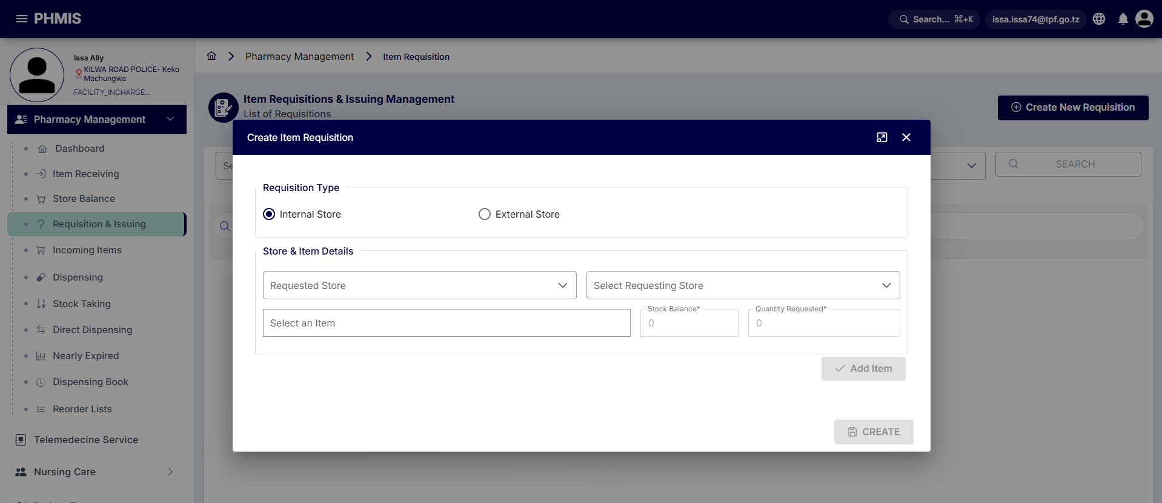
10.3 – Requisition and Issuing
Navigate to: Pharmacy Management → Requisition & Issuing
Click + Create New Requisition to initiate a stock request
Select Requisition Type: Internal Store (within facility) or External Store
For Internal: choose the Requested Store and the Requesting Store from dropdowns
Search for the item (medicine/supply) in the Select an Item field
Review Stock Balance (auto-filled) and enter Quantity Requested
Click Add Item to include it in the requisition, then add more items as needed
Click CREATE to submit the requisition for approval and issuing
💡 Internal requisitions are processed within the facility; external ones go to Prime Vendor.

Slide 37
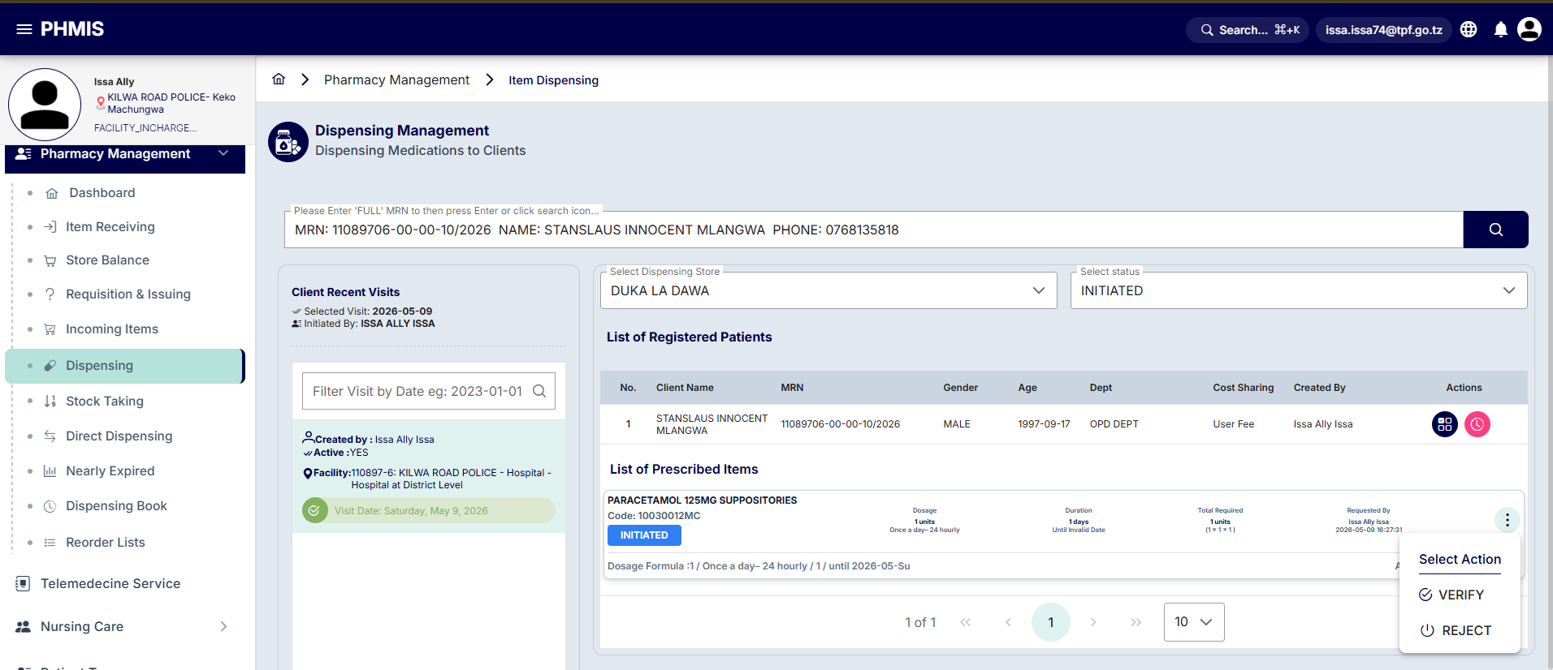
10.5 – Medicine Dispensing
Navigate to: Pharmacy Management → Dispensing
Select the Dispensing Store from the dropdown (e.g., ngamiani disp)
Filter by status: INITIATED, VERIFIED, DISPENSED, or REJECTED
Patient prescriptions appear in the List of Registered Patients table
Click the Prescribed button next to a patient to open their prescription
From the Select Action menu choose: VERIFY to confirm the prescription is correct
After verification, dispense the medicines and update quantities in the system
Use REJECT option if prescription has errors — document the reason
💡 Always verify the patient MRN matches the prescription before dispensing.

Slide 38
CHAPTER 09 · 11 · 13
Investigation, RCH and Mortuary
Lab/radiology results, maternal health records and mortuary services

Slide 39
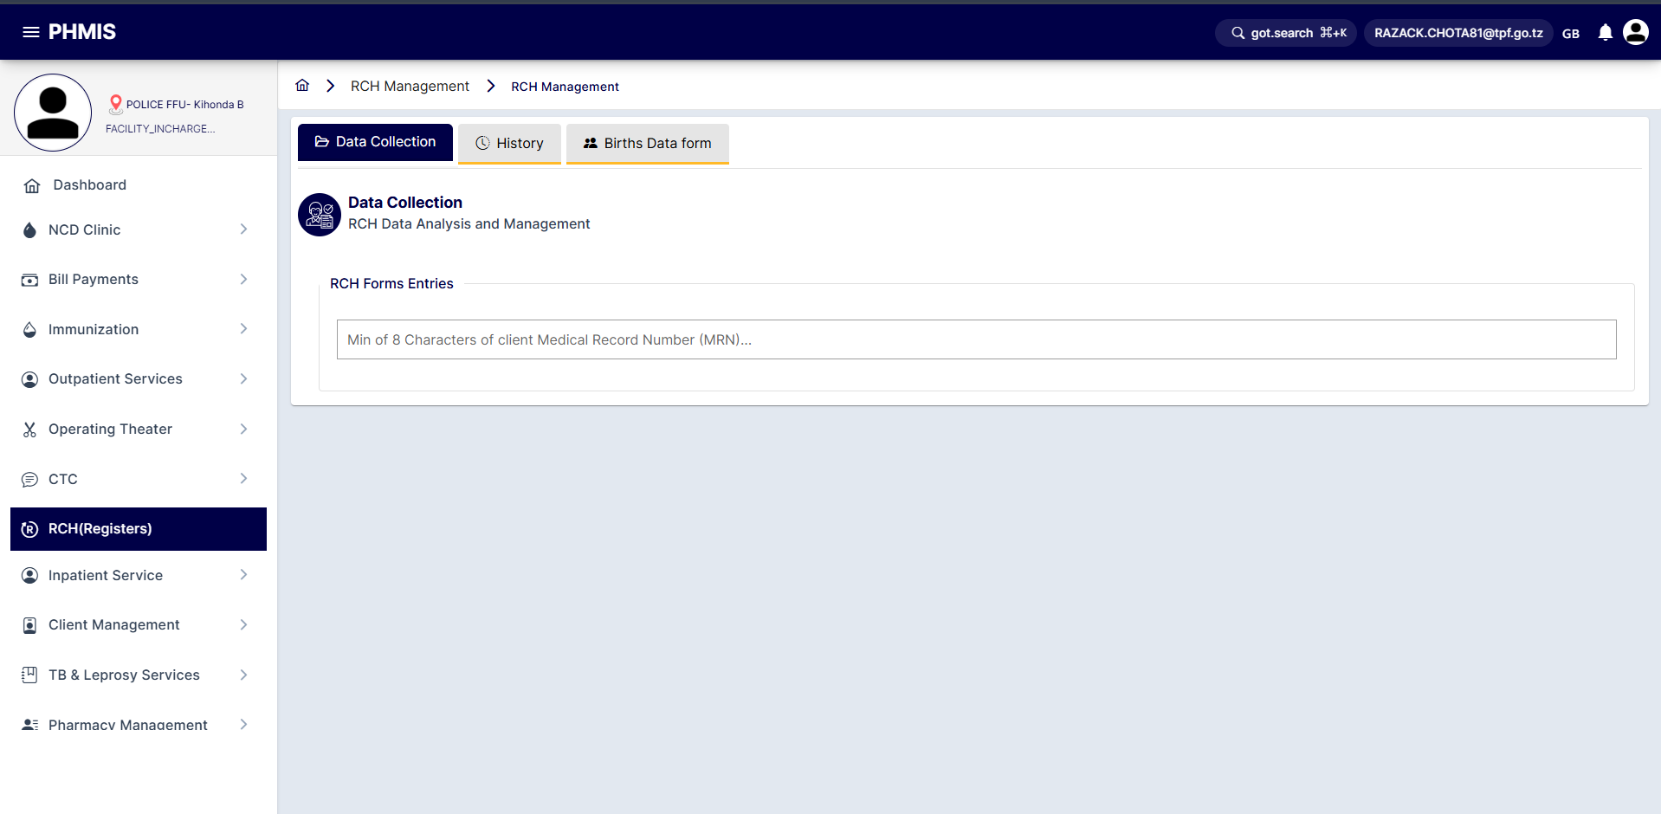
9.0 – RCH (Reproductive and Child Health)
Navigate to: RCH from the left sidebar
Select a form type from the left panel: Child Attendency, Postnatal, Antenatal, Labour and Delivery, Vaccination, or Family Planning
Currently selected form is highlighted in blue (e.g., Child Attendency shown)
For Child Attendency: enter Jina la Mama (Mother's Name) and vaccination status
Fields marked with * are mandatory — the form cannot be saved without them
HEID no field captures the child's health identifier for tracking purposes
Click Save to commit the record; use Reset to clear the form if needed
💡 RCH data feeds into MTUHA reports for national maternal and child health statistics.

Slide 40
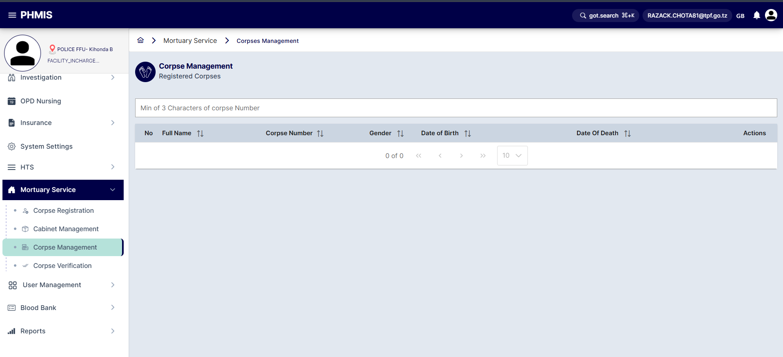
13.0 – Mortuary Services: Corpse Management
Navigate to: Mortuary Service → Corpse Registration → Corpse Management
The Corpse Taker form captures details of the person collecting the body
Required fields: Full Name, Gender, Client Phone Number, Residence Area
Additional fields: Transport, Country, Occupation, Relationship to deceased
Taker's Identity and Relative status must be documented for records
Use the Other Information rich-text box for supplementary notes
Enter Funeral Area to record destination for post-release tracking
Click Corpse Taker button to finalize the release and update cabinet status
💡 All corpse releases must be fully documented before the cabinet is marked as vacant.

Slide 41
CHAPTER 14–15
Insurance and Reports
NHIF/CHF claims processing and facility reporting

Slide 42
15.0 – Reports Available in GOTHOMIS
Facility Reports
MTUHA Reports
• Daily Patient Census
• Outpatient Statistics
• Inpatient Occupancy
• Revenue Summary
• Drug Consumption
• Staff Performance
• OPD Register (Form 053)
• IPD Register (Form 041)
• MCH Register
• Pharmacy Consumption
• Laboratory Results
• Disease Surveillance
Insurance Reports
Management Reports
• NHIF Claims Summary
• CHF Enrollment
• Insurance Revenue
• Pending Claims
• Approved Claims
• Claims Rejection Analysis
• User Activity Log
• Stock Movement Report
• Mortuary Register
• Prime Vendor Orders
• Investigation Turnaround
• Facility Comparison
💡 Reports can be filtered by date range, facility, department and user.

Slide 43
Quick Reference: Key Workflows
Patient Registration
Post Lab Results
Client Mgmt → Client Registration → Fill Form → Save → MRN Assigned
Investigation → Lab Results Posting → Enter Results → Approve → Available to Clinician
Outpatient Flow
Generate Report
Triage (Vitals) → Consultation → Diagnosis → Investigation → Treatment → Disposition
Reports → Select Report Type → Set Date Filter → Generate → Export/Print
Bill Payment
Admit Patient (IPD)
Bill Payments → Pending Bills → Select Patient → Verify → Process Payment → Print Receipt
Inpatient Service → Select Ward → Search Patient → Consultation → Nursing Care
Dispense Medicine
Corpse Release
Pharmacy → Dispensing → Select Store → Find Prescription → Verify → Dispense
Mortuary → Corpse Registration → Select Corpse → Corpse Management → Corpse Taker → Save

Slide 44
KEY REMINDERS
You are now equipped to use PHMIS effectively for your role
Always use MRN to look up patients
Bills must be settled before clinical consultation
Never share your login credentials
Contact your facility administrator for access issues

Slide 45
Thank You!
PHMIS – User Training Guide
System URL: 192.168.0.......
Prepared by: ICT Chiefdom-PHQ
For support: Health Command

