Slide 1





A
B
C
D
E
Introduction
Aims & Objectives
Research
Future Works
Conclusion
WeCare
Introduction about our project’s concept that connects everyday objects and devices to the internet enabling automated data collection.
The phases about a developed IoT-Based Smart Agricultural System using various gadgets to create a system for farmers works less.
The main aims and objectives of developing an IoT-based smart agricultural system to help farmers automate agricultural tasks in a very easy way.
The future of IoT-Based agricultural system that improves day by day on integrating wireless connectivity like Wi-Fi or GSM allowing to monitor it.
Adoption of IoT in agriculture explains a significant step towards modernizing traditional farming practices by utilizing real time data from sensors.
Presentation

Slide 2
A
B
C
D
E
Introduction
Aims & Objectives
Research
Future Works
Conclusion
WeCare
Introduction about our project’s concept that connects everyday objects and devices to the internet enabling automated data collection.
The main aims and objectives of developing an IoT-based smart agricultural system to help farmers automate agricultural tasks in a very easy way.
The phases about a developed IoT-Based Smart Agricultural System using various gadgets to create a system for farmers works less.
The future of IoT-Based agricultural system that improves day by day on integrating wireless connectivity like Wi-Fi or GSM allowing to monitor it.
Adoption of IoT in agriculture explains a significant step towards modernizing traditional farming practices by utilizing real time data from sensors.
Presentation

Slide 3
Group Members
WeCare
Niraj Shrestha
Erick Pradhan
Bikash Raj Chaurasiya
MD Rashid Fazeel
Surya Narayan Yadav

Slide 4
Introduction
WeCare is a two sided digital marketplace that connects customers with trusted local service providers, making it easy to search, compare, and book services. It empowers providers to showcase their skills, manage availability, and receive secure payments, creating value for both sides. With verified profiles, reviews, and a seamless booking process. WeCare aims to simplify everyday life and build a reliable community based service platform.

Slide 5
Aims & Objectives
To develop a two sided digital marketplace that connects customers with trusted local service providers in a convenient, transparent and efficient way.
Build a reliable, user-friendly platform with trust and transparency.
Enable customers to easily search, compare, and book services.
Help service providers showcase skills, manage availability, and get paid securely.

Slide 6
Reason – Why our group chose this idea?
Solve the problem of finding reliable and trusted service providers easily.
Provide professionals a platform to showcase services and reach more customers.
Develop a practical, innovative project with real-world value and growth potential.

Slide 7
What we learnt!?
Learning how to use ClickUp.
Understanding what makes a good website and how we can make one.
Teamwork and communication.

Slide 8
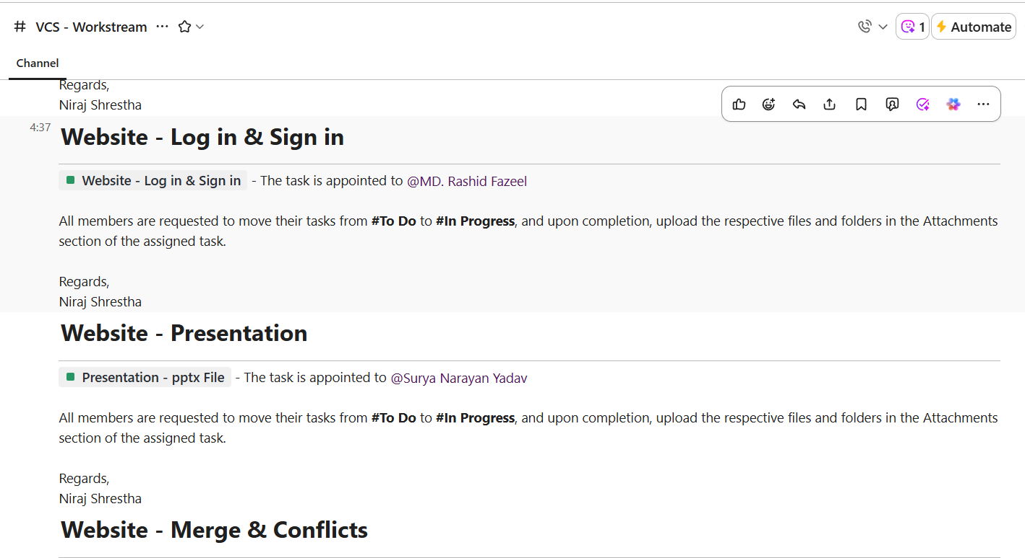
What we learnt!?

Slide 9
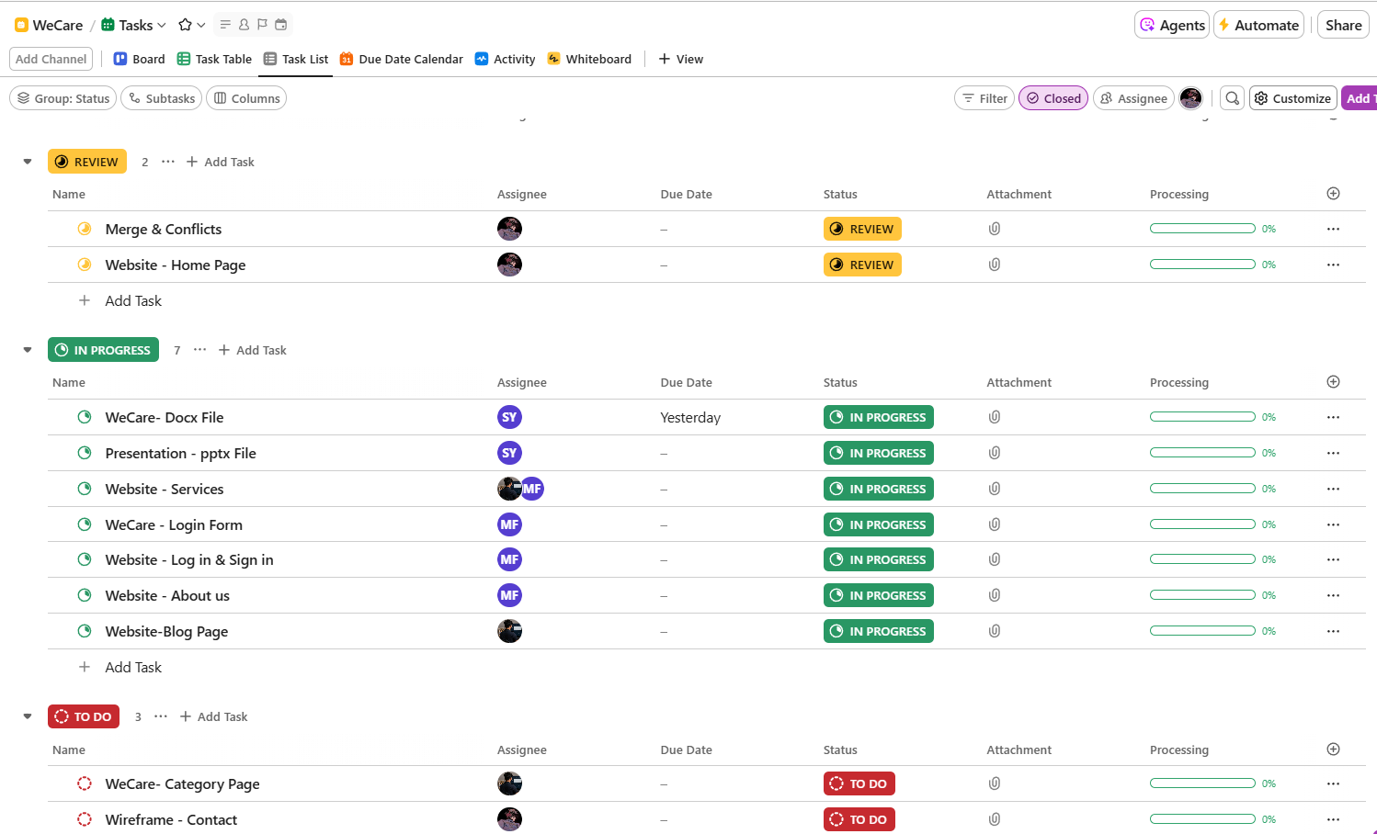
What we learnt!?

Slide 10
For Users Who Can’t Use The System
User friendly Design
Support and Assistance
Alternative Access
Awareness and Training

Slide 11
Future Works
Implementation of AI
Loyalty & Reward program
Real-time service tracking

Slide 12
Any feedbacks…?

Slide 13
Moving on…….

Slide 14
Thank you!

