Slide 1





A
B
C
D
E
Introduction
Aims & Objectives
Research
Future Works
Conclusion
WeCare
………………………………………………………………………………………………………………………………………………………………………………………………………………………………………………………………………………………………………………………………………………………………
The phases about a developed IoT-Based Smart Agricultural System using various gadgets to create a system for farmers works less.
The main aims and objectives of developing an IoT-based smart agricultural system to help farmers automate agricultural tasks in a very easy way.
The future of IoT-Based agricultural system that improves day by day on integrating wireless connectivity like Wi-Fi or GSM allowing to monitor it.
Adoption of IoT in agriculture explains a significant step towards modernizing traditional farming practices by utilizing real time data from sensors.
Documentation

Slide 2
A
B
C
D
E
Introduction
Aims & Objectives
Reason – Why our group chose this idea?
What we learnt
Future Works
IoT Based Smart Irrigation System
Presentation

Slide 3
Group Members
WeCare
Erick Pradhan (Leader)
Niraj Shrestha
Bikash Raj Chaurasiya
MD Rashid Fazeel
Surya Narayan Yadav

Slide 4
Introduction
WeCare is a digital marketplace that connects customers with trusted local service providers.
It makes everyday life easier by letting people search, compare, and book services with ease.
Service providers have a chance to showcase their skills, and grow their own businesses or services.

Slide 5
Unique Project Name – WeCare
The reason as to why this name was picked is to show a sense of what our website stands for.

Slide 6
Aims & Objectives
Aim:
To develop a two sided digital marketplace that connects customers with trusted local service providers in a convenient, transparent and efficient way.
Objectives:
To build a trusted, user-friendly platform that makes it easy for customers to book services and helps providers grow their business.
To enable customers to easily search, compare, and book services.
To help service providers showcase skills, manage availability, and get paid securely.
To build a reliable, user-friendly platform with trust and transparency.

Slide 7
Reason – Why our group chose this idea?
To solve the problem of finding reliable and trusted service providers easily.
To provide professionals a platform to showcase services and reach more customers.
To develop a practical, innovative project with real-world value and growth potential.
To empower skilled professionals to grow their business and income through a digital platform.

Slide 8
Unique – How is our idea different?
Two-sided marketplace
Personalized matching and recommendations
Booking of multiple services at once.

Slide 9
What we learned
GitHub.
ClickUp
Understanding what makes a good website and how we can make one.
Gained insights and knowledge of various topics.
Teamwork and communication.

Slide 10
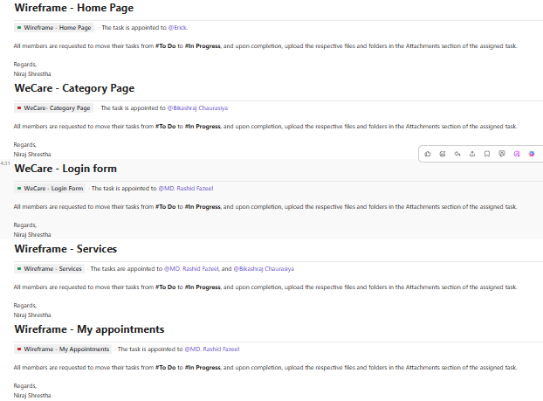
What we learned
Learned to effectively utilize ClickUp to plan, track, and manage project tasks.

Slide 11
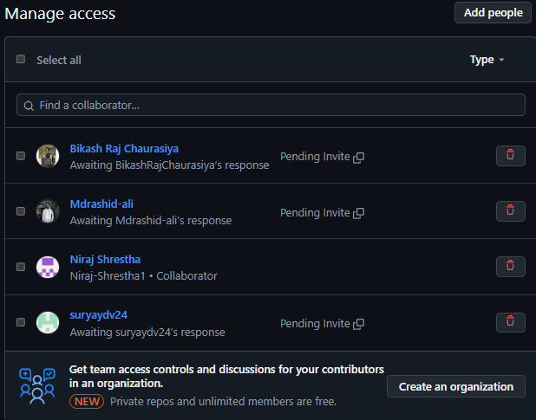
What we learned
Merging and managing the project through github

Slide 12
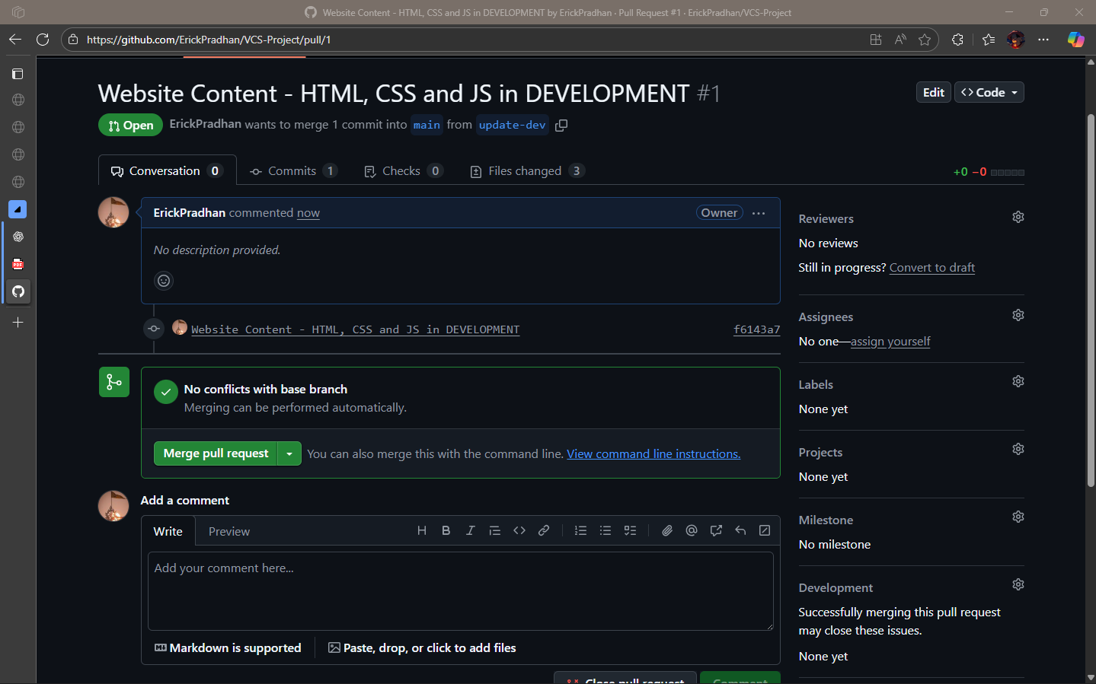
What we learned
Merging and managing the project through github

Slide 13
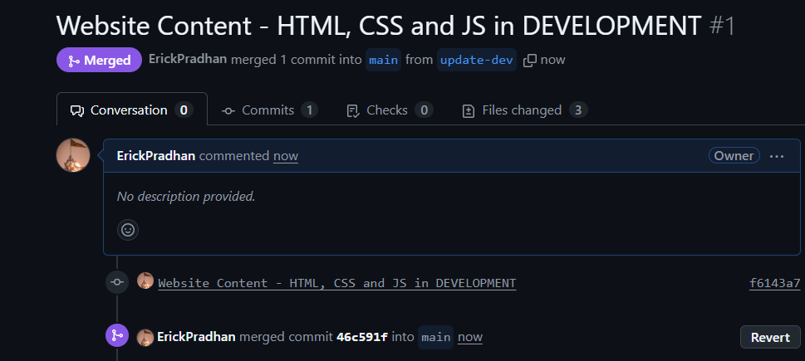
What we learned
Merging and managing the project through github

Slide 14
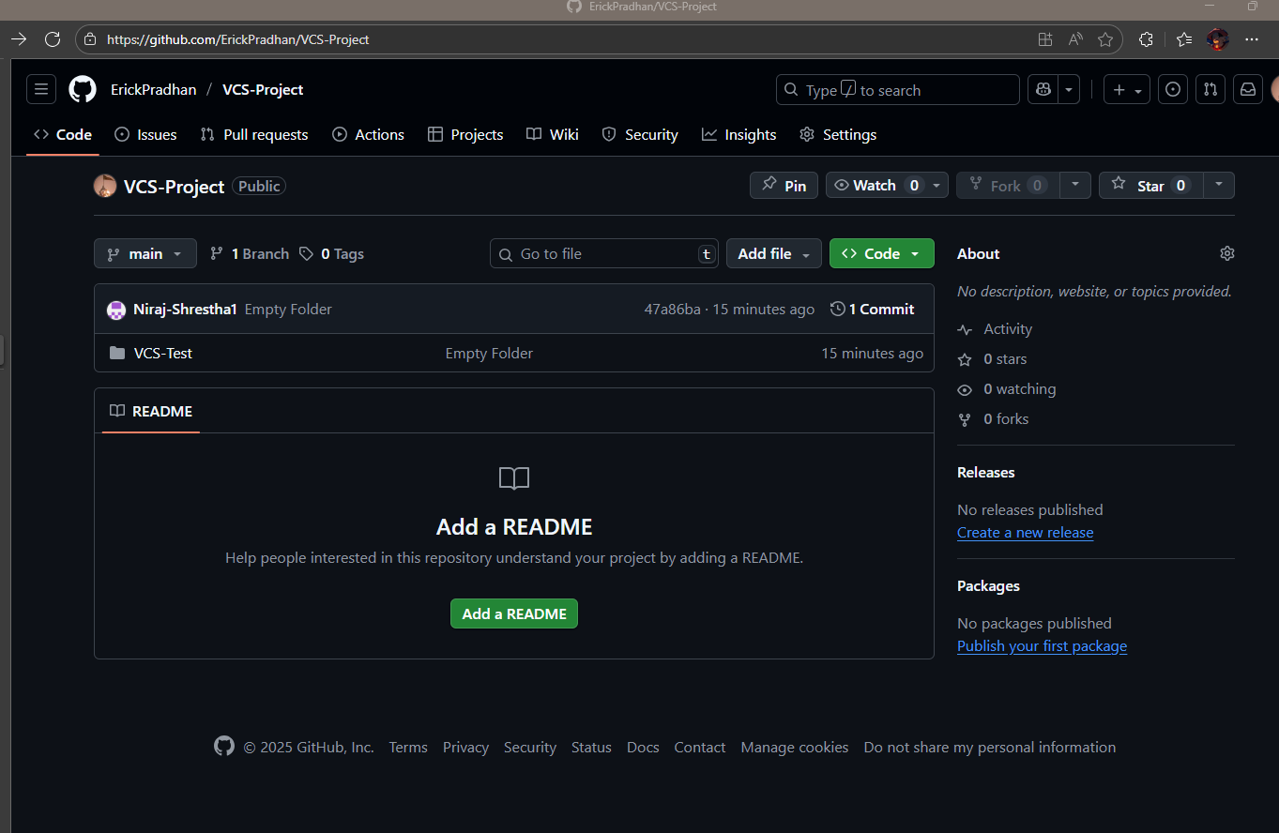
What we learned
Merging and managing the project through github

Slide 15
For Users Who Can’t Use The System
User friendly Design
Support and Assistance
Alternative Access
Awareness and Training

Slide 16
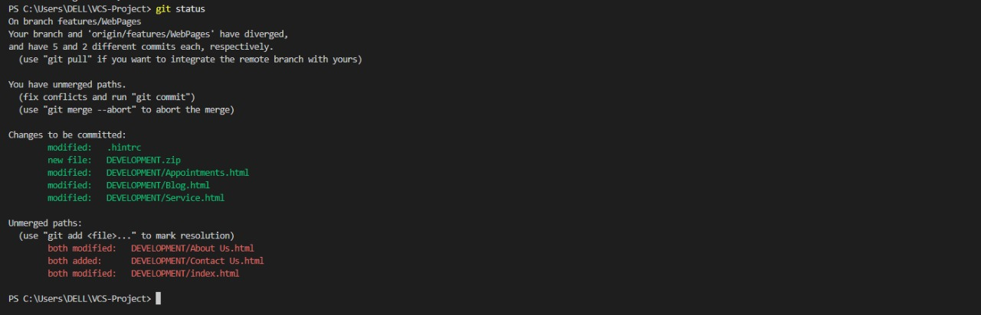
Challenges faced
Merge conflict.

Slide 17
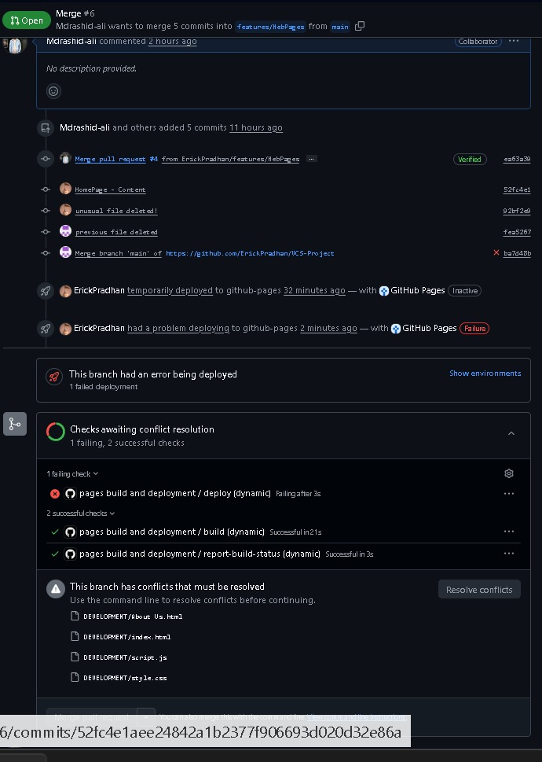
Challenges faced
Git conflict.

Slide 18
Future Works
Implementation of AI
Loyalty & Reward program
Real-time service tracking

Slide 19
Any feedbacks…?

Slide 20
Moving on…

Slide 21
Thank You!

