Slide 1
FINAL REPORT AGENT-BASED MODELING
ERICKA BERMUDEZ, 202230093
1

Slide 2
01
INTRODUCTION
2

Slide 3
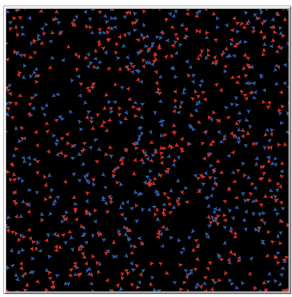
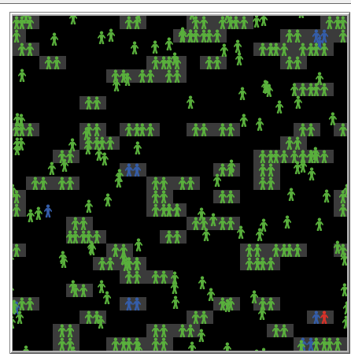
Base model
Using some modules from:
HIV model
3
Simple birth rates

Slide 4
Purpose and goal
Research by sociologist Kristin Park revealed that childfree people tended to be better educated, to be professionals, to live in urban areas, to be less religious, and to have less conventional life choices.
Maybe, these reasons are just correlated but are not the cause.
Some factors considered that may be contributing to the declining birth rates are increased unemployment, financial losses and economic uncertainty.
The goal is address financial insecurity as a reason people decide not to have children. I hope to observe how financial measures can determine the amount of births in one community.
4

Slide 5
02
MODEL
7

Slide 6
EXPLANATION OF THE MODEL
Annual income per household
In the environment we will have cost of living
Turtles will not have reproduction as a goal, but it will an option during their lifetimes
10

Slide 7
EXPLANATION OF THE MODEL: TURTLES
ANNUAL EARNINGS
SEX
CHILDREN
AGE
COUPLED?
12

Slide 8
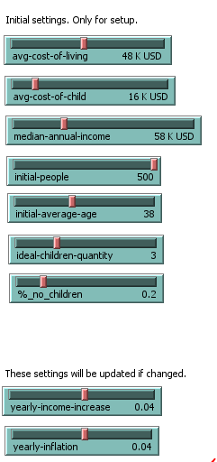
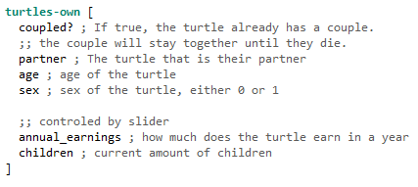
EXPLANATION OF THE MODEL

Slide 9
EXPLANATION OF THE MODEL: EVENTS BY STEP
If not in couple, turtle will move in random direction
Each tick will mean ageing. If age > lifespan, it will die
If there are turtles on the spot it moved to, check if opposite sex && reproductive age
Each tick, decide whether to reproduce.
Contrast combined annual income vs cost of living and cost of having a child
Even if they can afford it, they might decide not to, and the opposite
Conceiving rate is based on the age of the turtle and research
Annual income and costs will be increased each tick
13

Slide 10
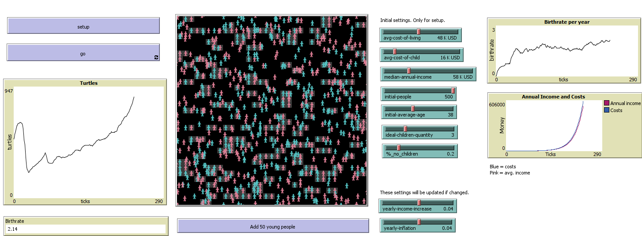
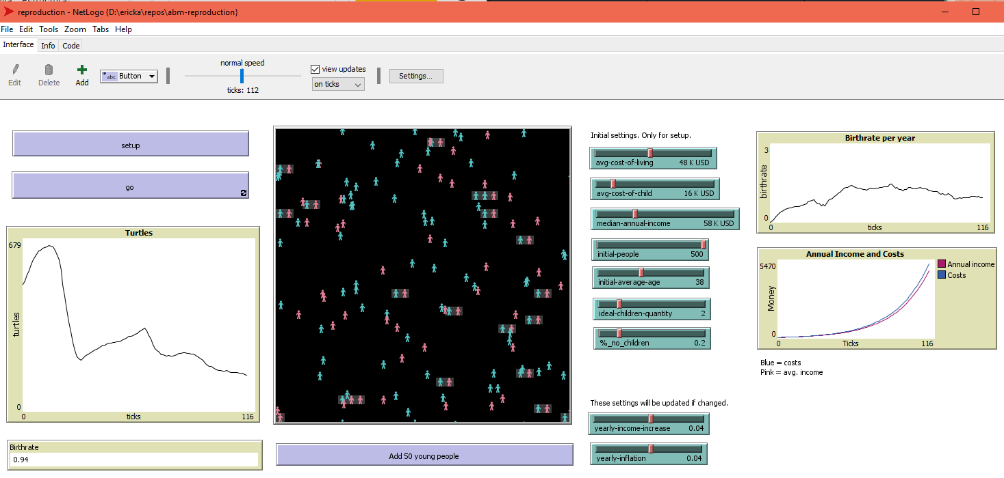
Verifications
14

Slide 11
03
Simulation Analysis
2

Slide 12
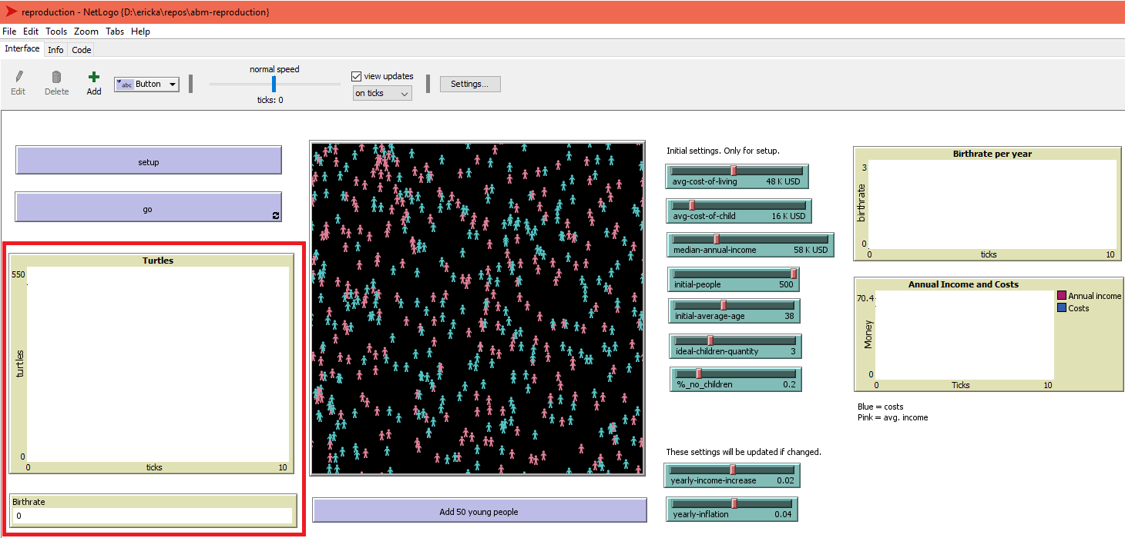
Measures
13

Slide 13
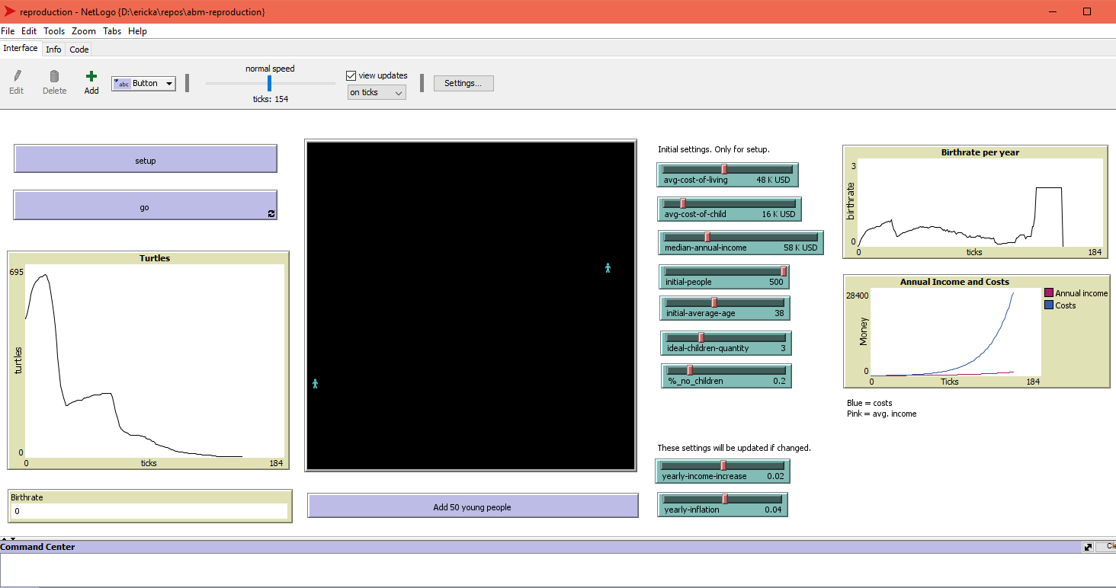
Observations

Slide 14


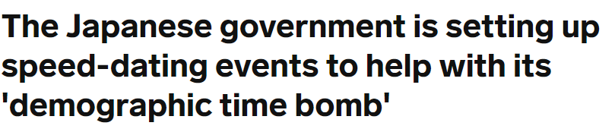
Analysis
Was the result expected?
Findings?
Some intuitive findings that I was not looking for.
The time turtles find
each other is very
important!

Slide 15
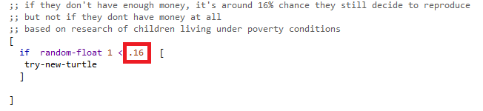
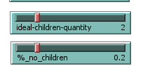
Analysis
The community needs people that reproduce even if they cannot afford it.
This data is needed for the model and
cannot be addressed financially

Slide 16
Conclusions
Establishing a model for human reproduction taking into account social issues is not easy and cannot be replicated using financial security/insecurity alone. However, it is possible to replicate quite a similar behavior to real life based on costs/earnings, so financial factors are involved in the decision.
Based on financial measures, urban areas cannot survive without injection of population provided by non-urban areas.
Moreover I think it was interesting to learn how many actions taken by different governments regarding immigration acted on the model, and the emergence related to the age of coupled turtles.

Slide 17
References
The Annie E. Casey Foundation. (2021, September 20). New Child Poverty Data Illustrate the Powerful Impact of America’s Safety Net Programs. The Annie E. Casey Foundation. https://www.aecf.org/blog/new-child-poverty-data-illustrates-the-powerful-impact-of-americas-safety-net-programs
De Rose, A. F., Ambrosini, F., Mantica, G., & Terrone, C. (2021). Impact of covid-19 on birth rate trends in the Italian metropolitan cities of Milan, Genoa and Turin. Public Health, 198, 35–36. https://doi.org/10.1016/j.puhe.2021.06.026
María Sosa Troya, N. M. (2019, December 26). Why women in Spain are waiting longer to have a baby. EL PAÍS English Edition. Retrieved April 21, 2022, from https://english.elpais.com/elpais/2019/12/20/inenglish/1576832586_836639.html#:~:text=Ter esa%20Castro%2C%20a%20demographer%20from,certain%20amount%20of%20job%20sec urity.

Slide 18
References
Muth, L. C. (2018, January 11). What the difference between mean and median tells us about income inequality. Datawrapper Blog. https://blog.datawrapper.de/weekly-chart-income/
Age and fertility. (n.d.). Gov.Au. Retrieved June 9, 2022, from https://www.betterhealth.vic.gov.au/health/conditionsandtreatments/age-and-fertility

Slide 19
Questions?
15
Thank you for your attention!

