Slide 1
Chicago’s Crime and Social Economic Data Analysis using Hadoop, Apache Pig, and Tableau
By: Luis Cardenas, Jocelyn Gallo, Raymond Ko, Diana Hoang, and Eric Kha

Slide 2
Introduction
The city of Chicago has some of the strictest gun control laws.
The occurrences of crimes in the City of Chicago placed amongst the top five
We wanted to take a different approach and instead of correlating guns with crime rates, we wanted to dig a little deeper.

Slide 3
We want to analyze the relationship between the crime rate and socioeconomic status.

Slide 4
Experimental Specs
Management Node’s VCPU: 12
Data Node’s VCPU: 4
Management Node’s RAM: 42 GB
Data Node’ s RAM: 24GB
IBM Bluemix BigInsights
Cluster Version: 4.2
# of Management Nodes: 1
# of Data Nodes: 1

Slide 5
Required Data
crime.csv - 1.4 GB
Social-econ.csv - 3.8 kB
communityCoordinates.txt - 2kB

Slide 6



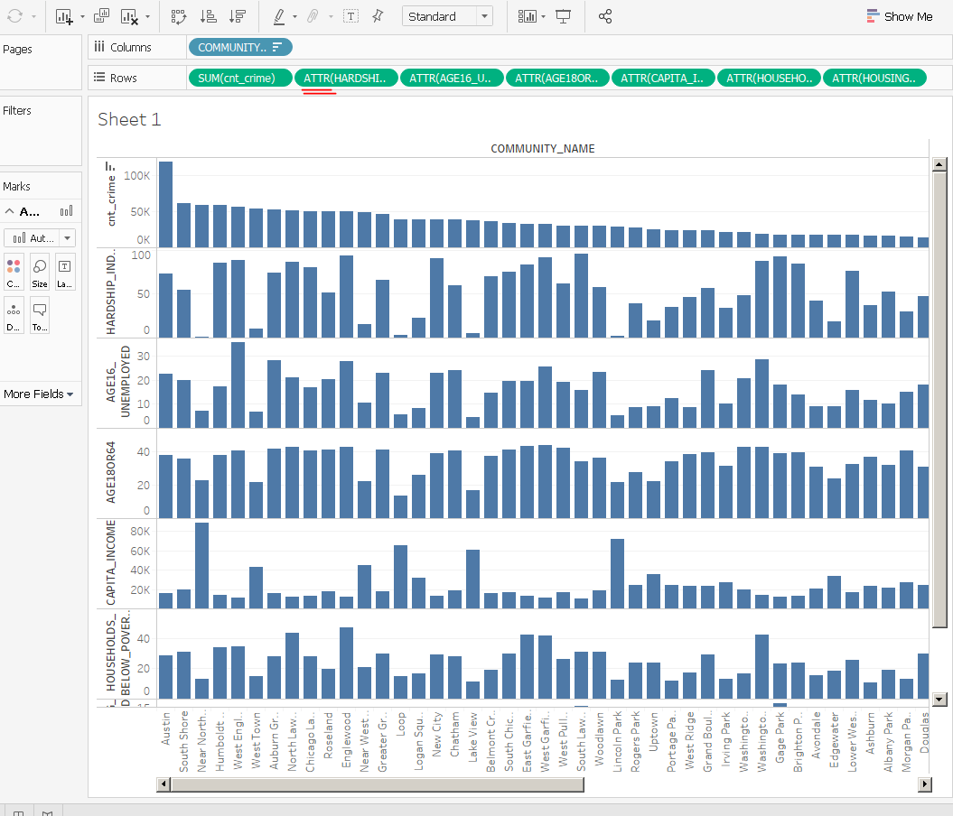

Data.gov
ETL
Apache Pig
Tableau/Visualization
Ambari File Browser

Slide 7
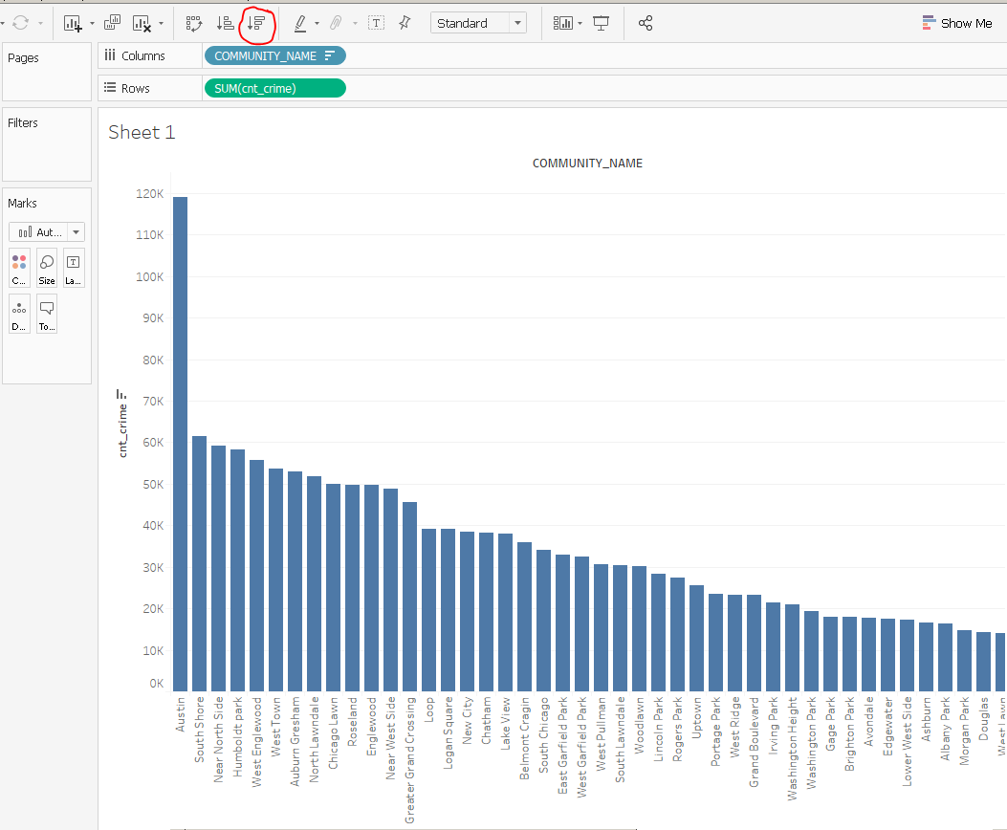
Data Output: View of community areas with highest to lowest crime rate

Slide 8
Data Output: Comparing crime rate with socioeconomic attributes

Slide 9
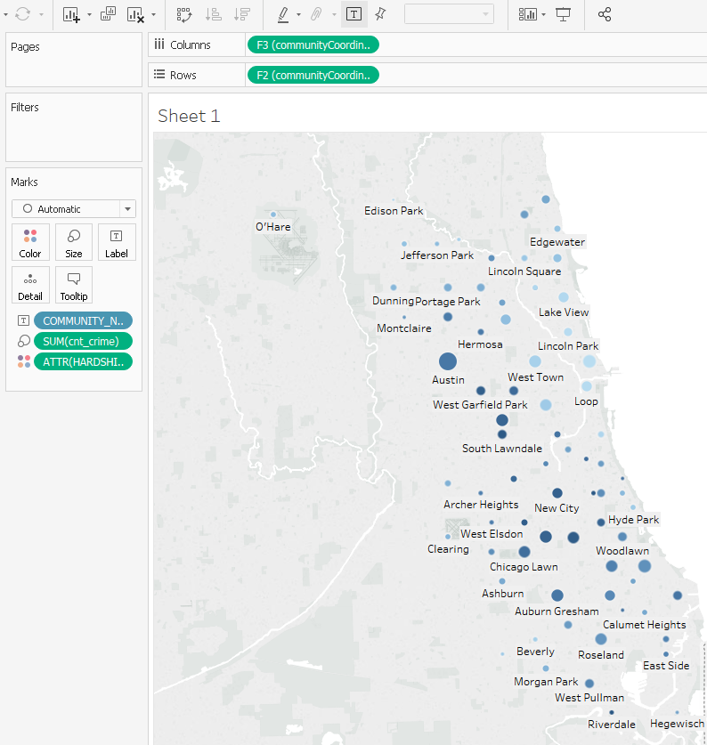
Data Output:Crime rate and hardship index
Notes:
HARDSHIP INDEX - Score that incorporates each of the six selected socioeconomic indicators (see dataset description)

Slide 10
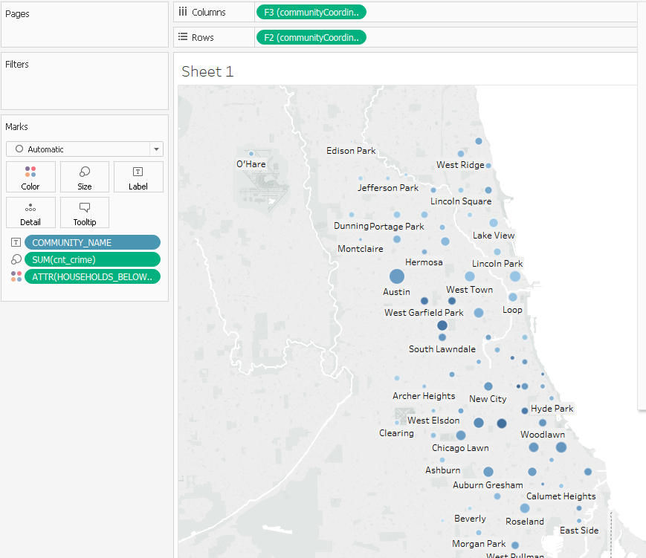
Data Output: Crime rate and percent households below poverty
Notes:
PERCENT HOUSEHOLDS BELOW POVERTY - Percent of households living below the federal poverty level

Slide 11
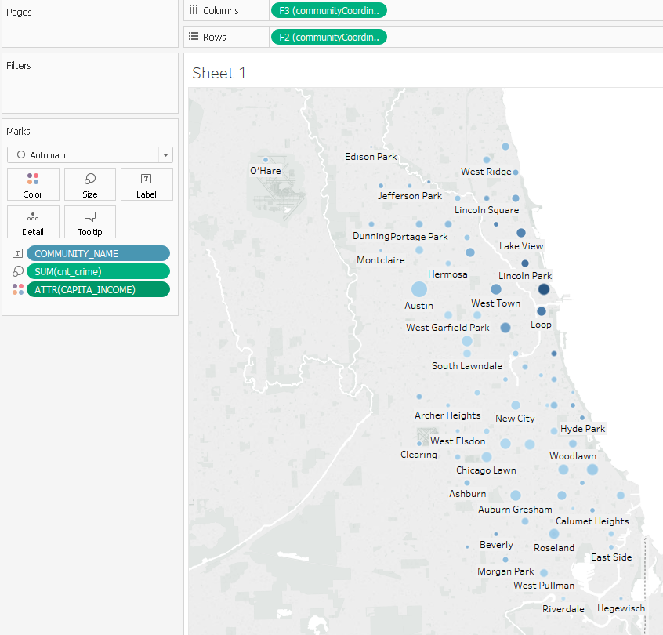
Data Output: Crime rate and per capita income
Notes:
PER CAPITA INCOME - Community Area Per capita income is estimated as the sum of tract-level aggregate incomes divided by the total population

Slide 12
Conclusion
There is a strong correlation exists between socioeconomic level and crime occurrences.
Instead of manipulating stricter gun laws and the mode of violence, perhaps a solution to fix crime rate lies in manipulating poverty levels.

Slide 13
References
https://catalog.data.gov/dataset/crimes-2001-to-present-398a4
https://catalog.data.gov/dataset/census-data-selected-socioeconomic-indicators-in-chicago-2008-2012-36e55
https://en.wikipedia.org/wiki/Community_areas_in_Chicago
Github: https://github.com/thuh1030/BigDataTeam3

