Slide 1
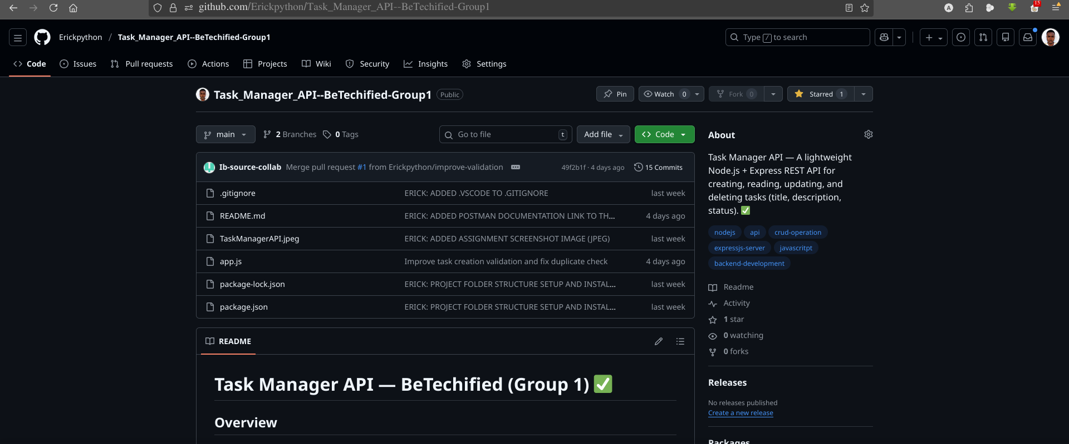
TASK MANAGER API
BeTechified
‘RESTful Backend Application’
GitHub Repo: https://github.com/Erickpython/Task_Manager_API--BeTechified-Group1

Slide 2
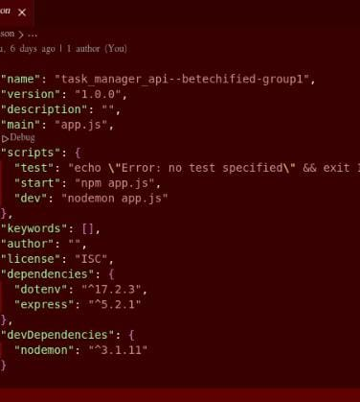
PROBLEM STATEMENT
Build an API that lets users perform (CRUD) tasks:
Create
Read
Update
Delete.
Each task should have a title, description, and status (pending/completed).

Slide 3
TABLE OF CONTENTS
2
Problem Statement
4
CRUD Operation - Create
5
CRUD Operation - Read
6
CRUD Operation - Update
7
CRUD Operation - Delete

Slide 4
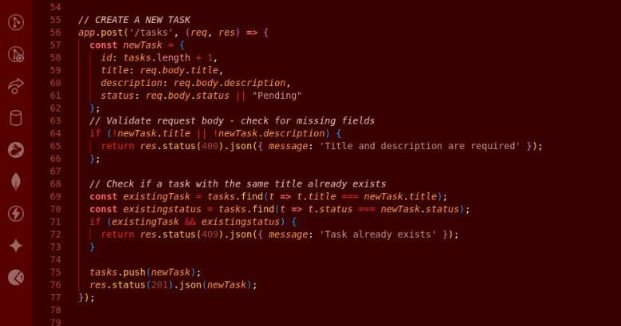
CRUD Operation { Create }
Section 1
TASK MANAGER API
ENDPOINTS

Slide 5
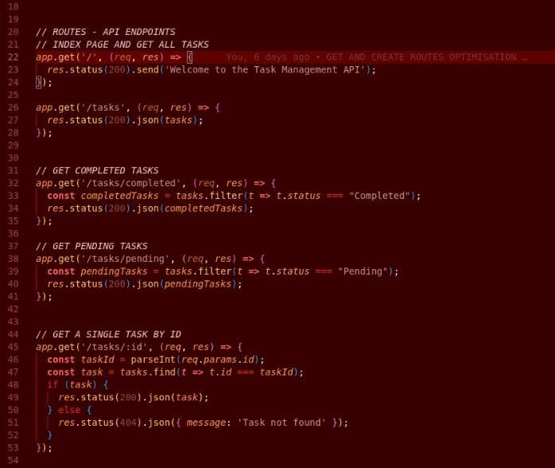
CRUD Operation { Read }
Section 2
TASK MANAGER API
ENDPOINTS

Slide 6
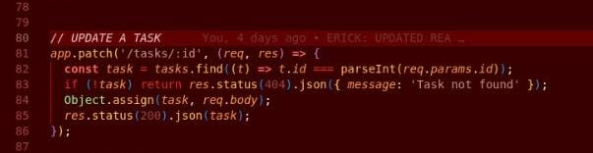
CRUD Operation { Update }
Section 3
TASK MANAGER API
ENDPOINTS

Slide 7
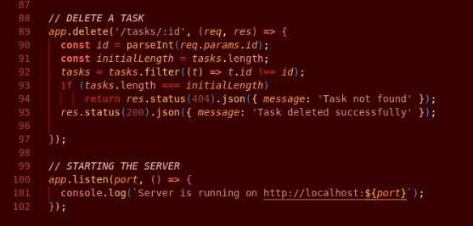
CRUD Operation { Delete }
Section 4
TASK MANAGER API
ENDPOINTS

Slide 8
SUMMARY
Section 5
TASK MANAGER API
ENDPOINTS
POST /tasks — Creates a new task {status: 201}
Requires title and description {error: 400}
Defaults status to Pending if not provided
Prevents creation of tasks with empty fields {error: 400}
Prevents duplicate tasks (same title & status) {error: 409}
GET /tasks — Retrieves all tasks {status: 200}
GET /tasks/completed — Retrieves completed tasks {status: 200}
GET /tasks/pending — Retrieves pending tasks {status: 200}
GET /tasks/:id — Retrieves a task by ID {status: 200}
PATCH /tasks/:id — Updates a task {status: 200}
DELETE /tasks/:id — Deletes a task by ID {status: 200}

