Slide 1

Joint Radar and Communication signal processing at the receiver
Reporter: Honghao Li
Mentor: Tianyao Huang
Notes:
My name is Li Honghao。Today I will present some preliminary results on Joint Radar and Communication signal processing at the receiver.

Slide 2


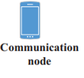
System model
Uplink
Scattering link
Notes:
Let’s consider a system with one Base Station ,one communication user and one target. The Base Station is equipped with one transmit antenna and one receive antenna. The communication user keeps sending communication signal to the Base Staion and the Base Station will receive both communication signal and radar signal at the same time and the same frequency.

Slide 3
System model
Preliminary method:
2.remove
Communication signal
1.decode
Com.power>Radar.power
Received signal
3.Pulse compression
Target distance
1.Pulse compression
Target distance
Com.power<Radar.power
2.remove
Received signal
3.decode
Communication signal
Notes:
Let’s consider a system with one Base Station ,one communication user and one target. The Base Station is equipped with one transmit antenna and one receive antenna. The communication user keeps sending communication signal to the Base Staion and the Base Station will receive both communication signal and radar signal at the same time and the same frequency. After receiving the signal, When the communication power is higher than radar power, we firstly decode the communication signal using the received signal and secondly we remove this communication part. The we Pulse compress the residual part of the signal. When the radar power is higher than the communication power, we first do the pulse compression, then remove this radar part, and finally decode the communication part.
强调一下收到信号在comm_radar这一块
写一个接收信号的仿真，这样更好懂一些
拆成两页

Slide 4
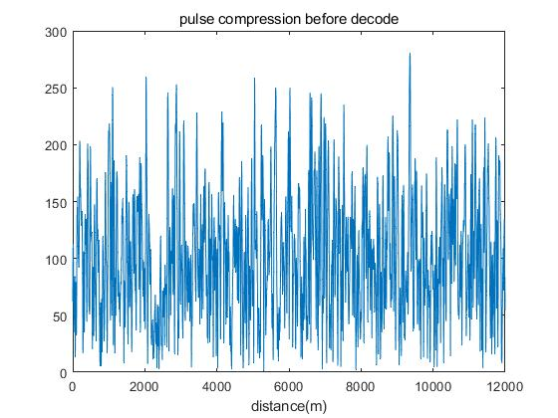
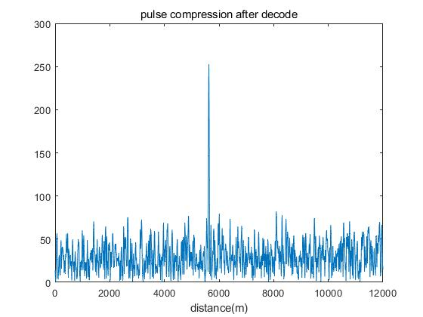
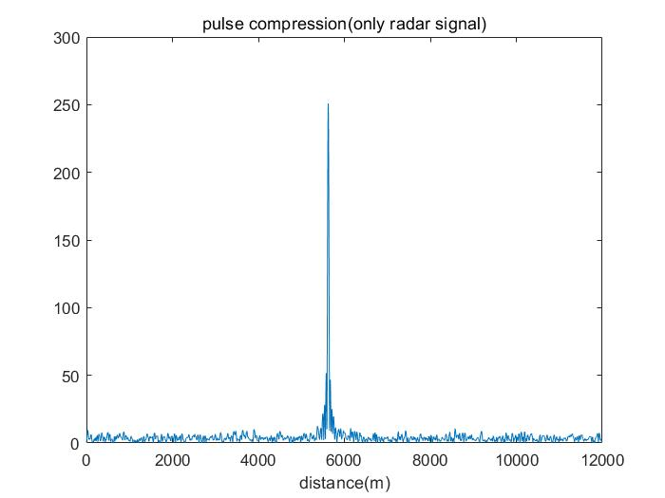
Simulation results
Simulation condition:
Com.power=5 Radar.power=1
SNR=7db SINR=3.98db
Com.power>Radar.power
ber=4%
ber_therotical=1.2%
Notes:
In the first two pictures, We set the communication signal power is fives times the radar signal power, the signal to noise ratio is 7db and the Signal to Interference plus Noise Ratio =3.98db. We use our first preliminary method. We could see that before decoding, the pulse compression result can’t show us the target distance because of the high communication signal power. The low noise power and radar power relative to the communication signal means that the communication bit will be decoded with low bit error rate 0.004.So the communication signal will be removed well and the peak in the pulse compression result is clear.
加上理论的解码误码率
加上完全去掉通信信号后雷达信号的脉压结果

Slide 5
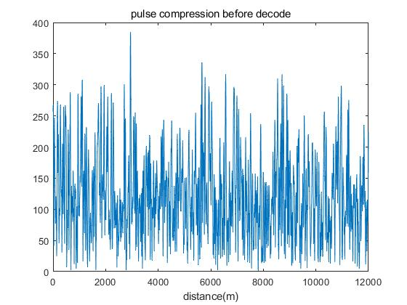
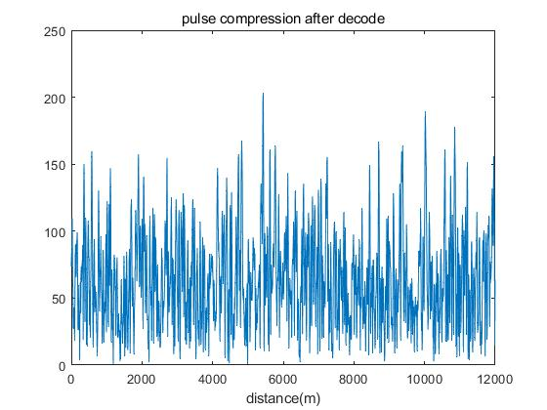
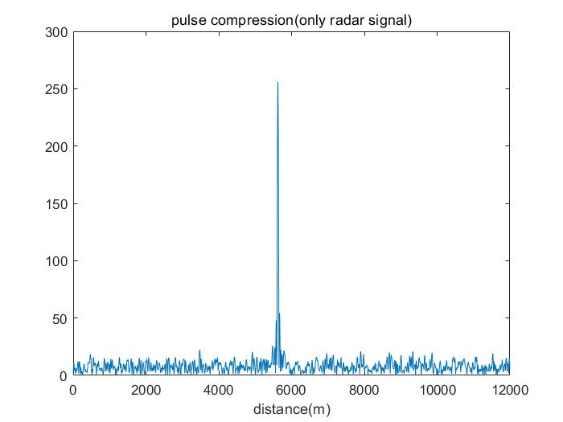
Simulation results
Simulation condition:
Com.power=5 Radar.power=1
SNR=0db SINR=-0.792db
ber=8.4%
ber_therotical=7.9%
The communication ber has approached the theoretical limit
Notes:
In the second two pictures, the communication signal power is still fives times the radar signal power, the signal to noise ratio is 0 db and the Signal to Interference plus Noise Ratio =-0.792db. We still use the first method.In this picture we could see that the communication signal isn’t decoded well with the bit error rate is 0.084, so the residual part still consists of the communication part. As the result, the peak in the pulse compression isn’t clear in the second picture.

Slide 6
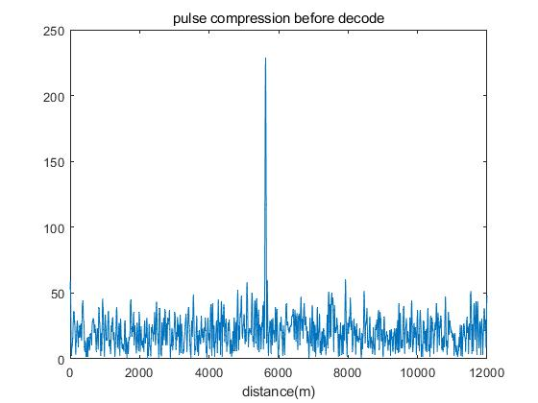
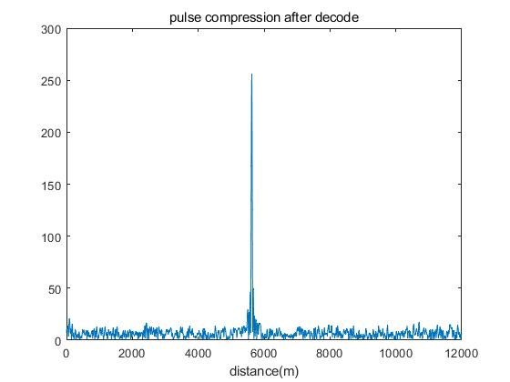
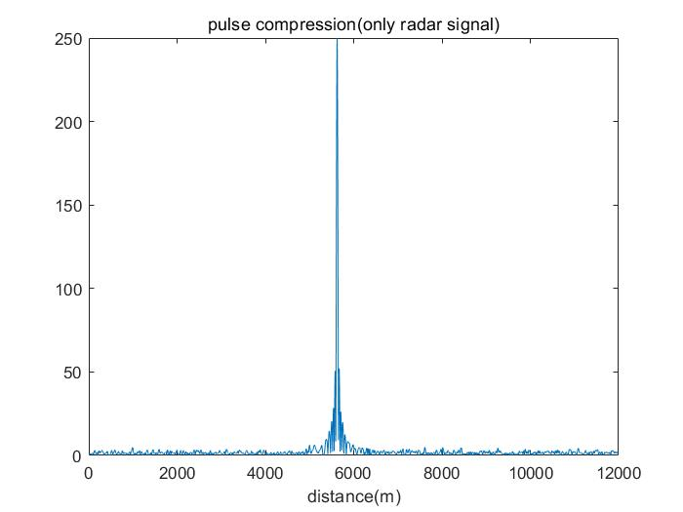
Simulation results
Simulation condition:
Com.power=1 Radar.power=1
SNR=7db SINR=-0.790db
ber=0.4%
ber_therotical=0.07%
Notes:
n the last two pictures, we set the communication signal power is same as the radar signal power. So we use the second method. In this condition, the interference of the radar to the communication can’t be ignore. if we firstly use the pulse compression to get the target distance and the radar reflection waveform, then remove it and decode the residual part. The bit error rate will be 0%, and the peak in the pulse compression will be more clear.
From these three pictures, we will see that using the preliminary method, the radar waveform and the communication signal can be separated from the received signal.
Thank for your attention.

