Slide 1










Pineland Music School
Team Members:
Jesse Day
Stanislav “Stas” Berezin Ka Long “Eric” Lee Zijun “Emma” Lu
Group22- Fantastic Tech

Slide 2
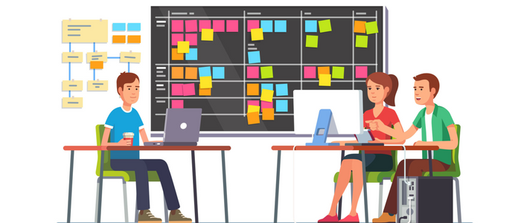

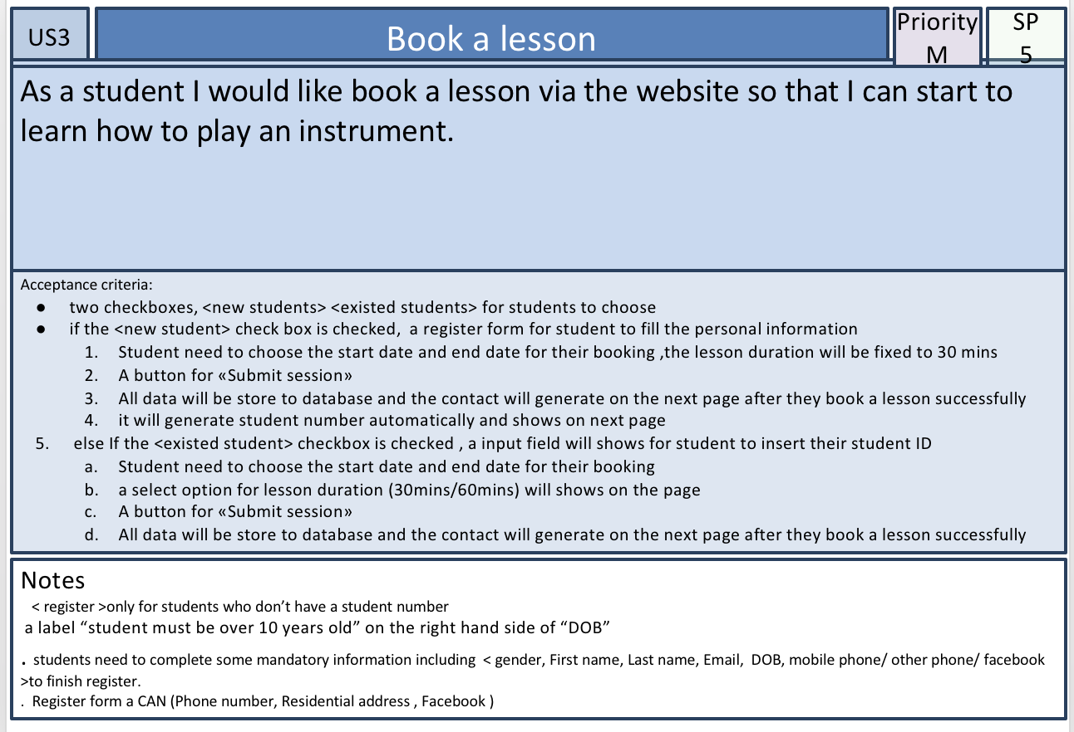
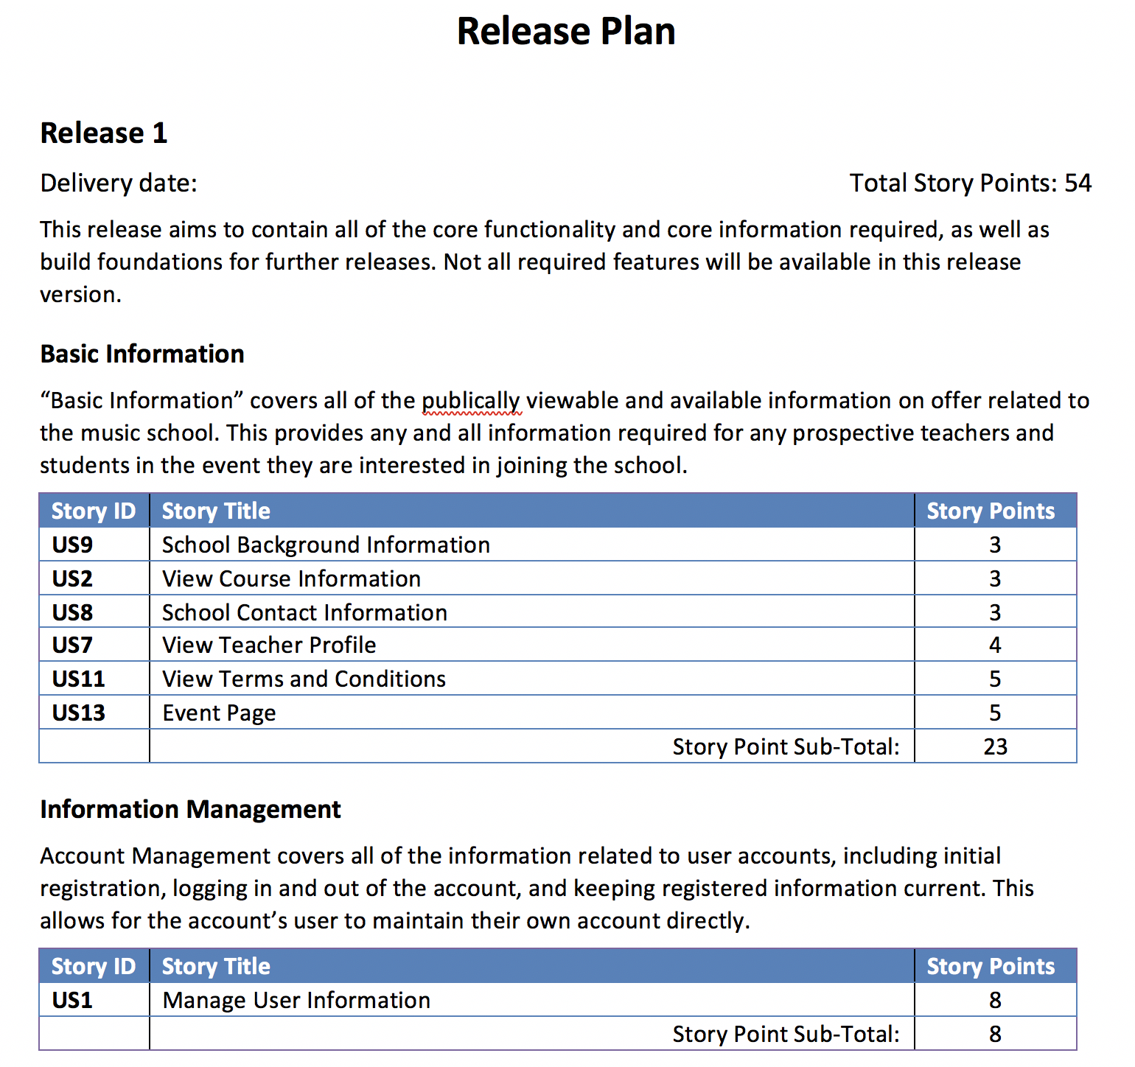



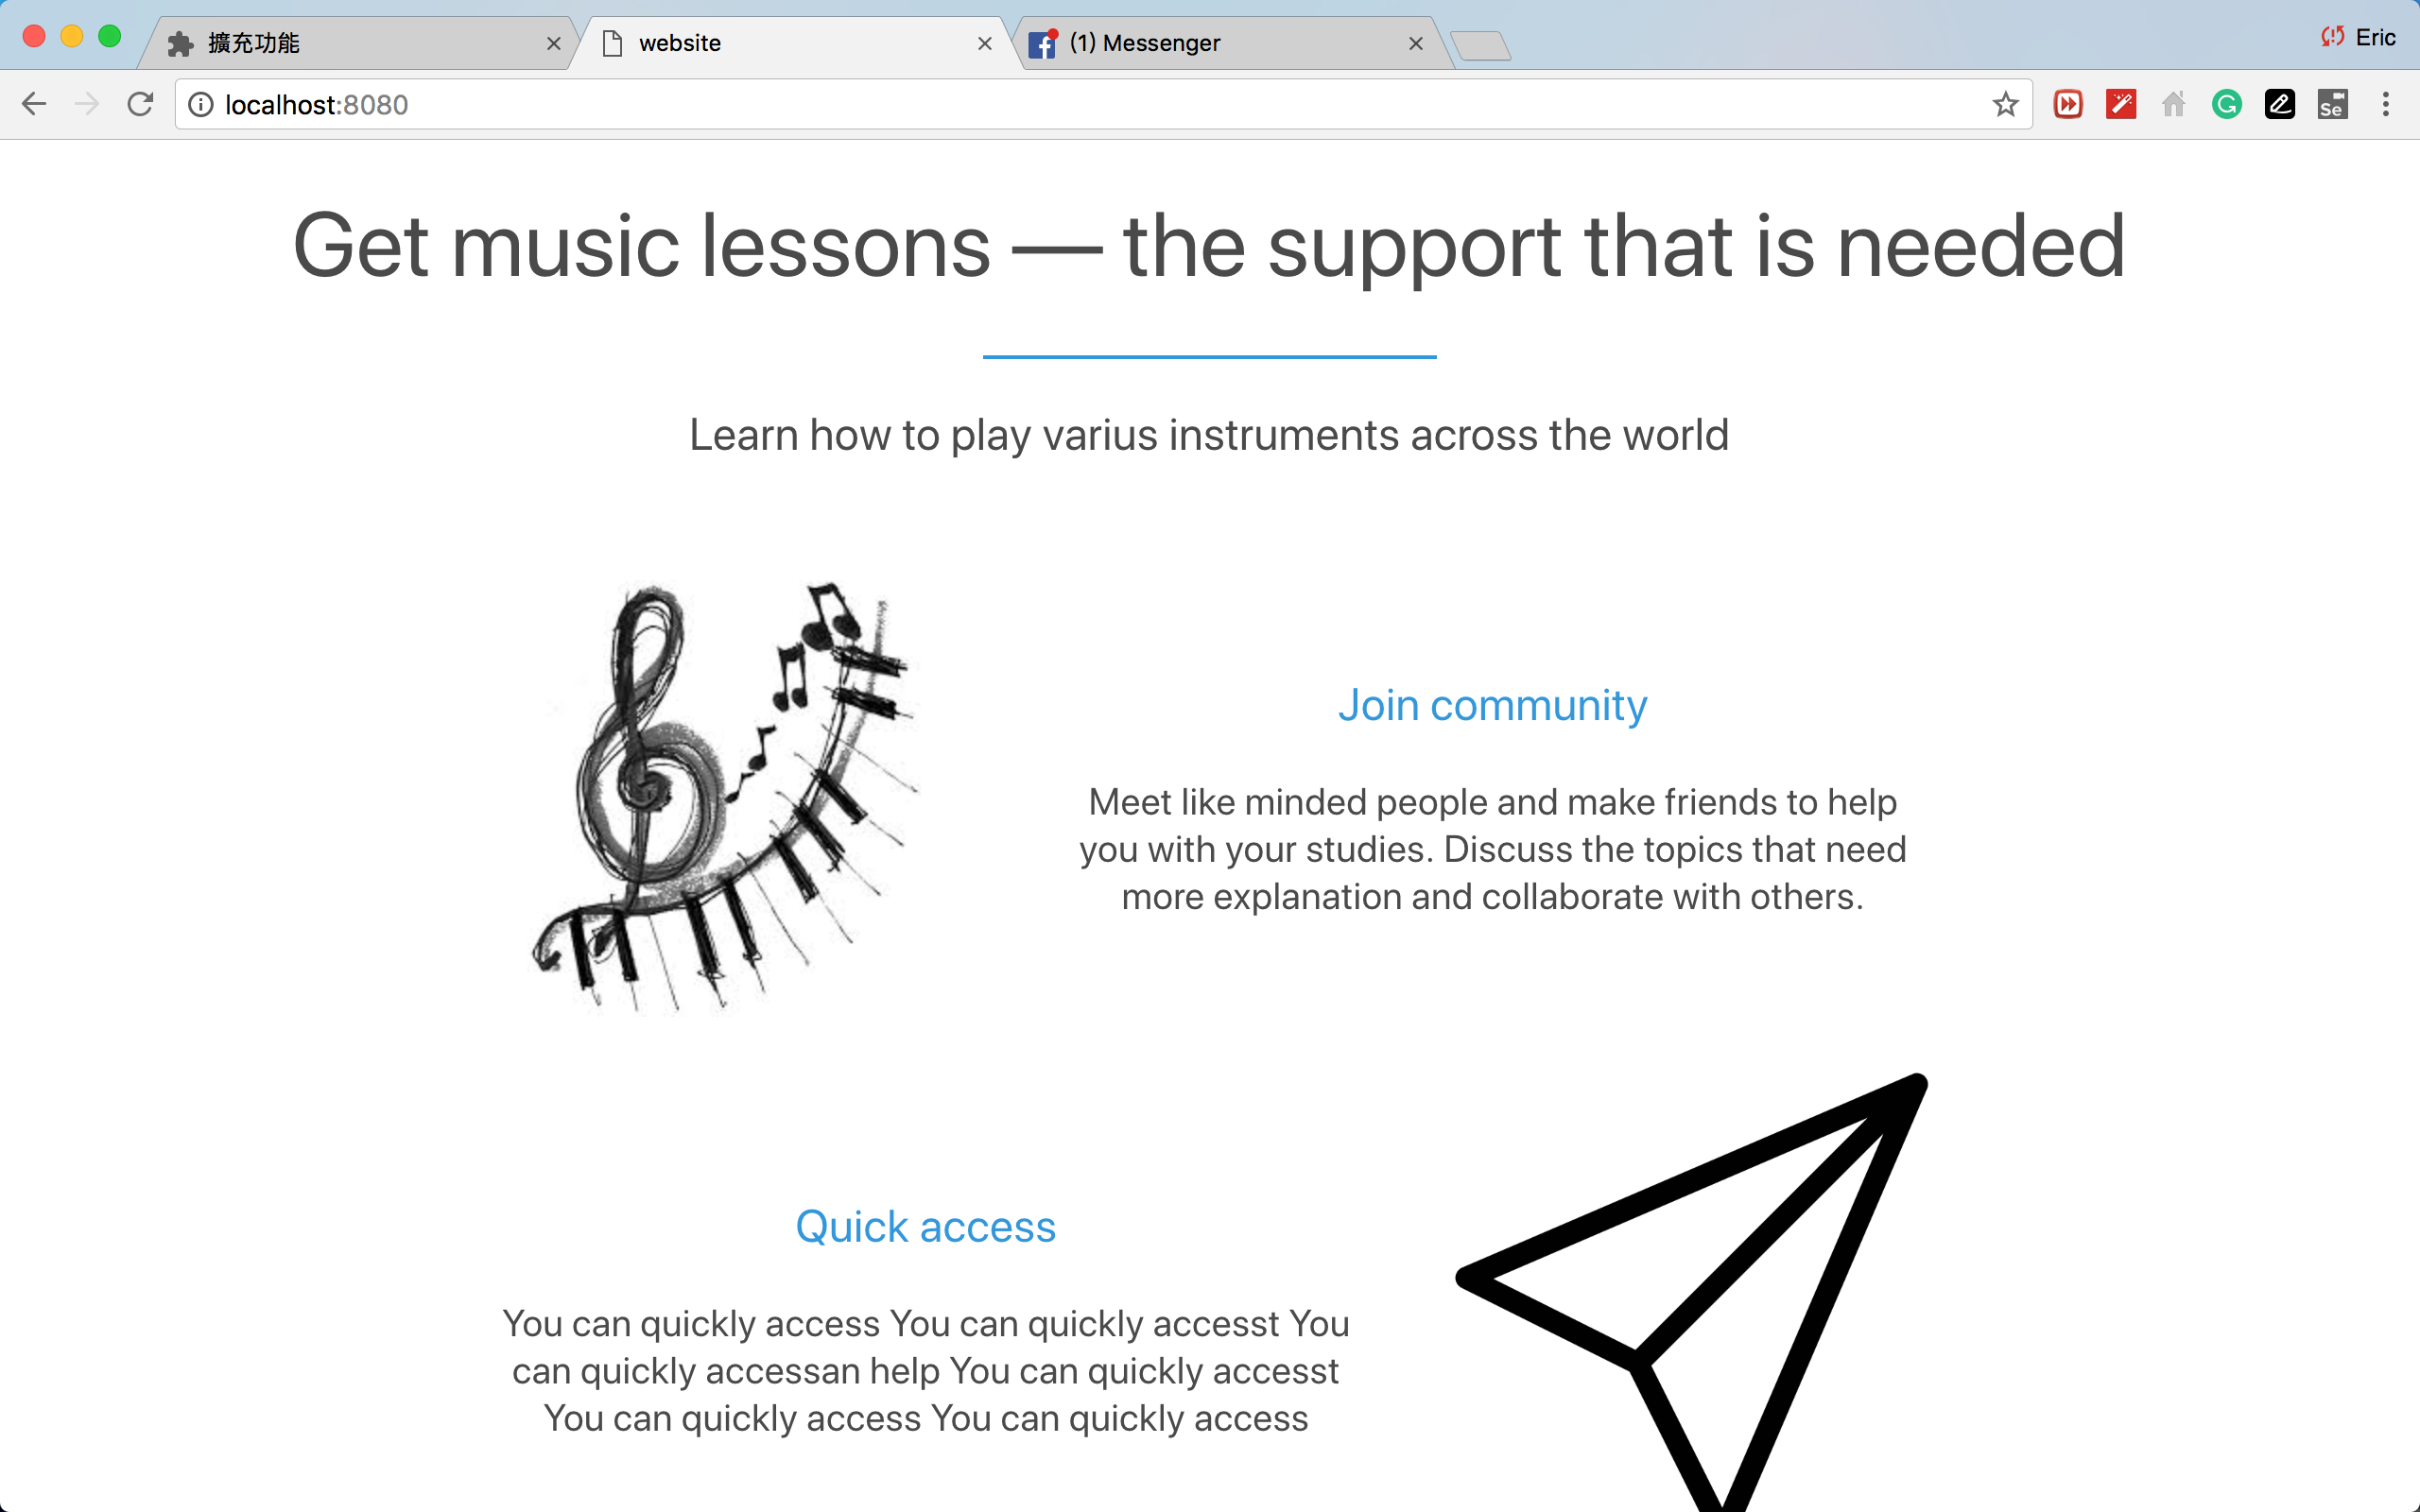
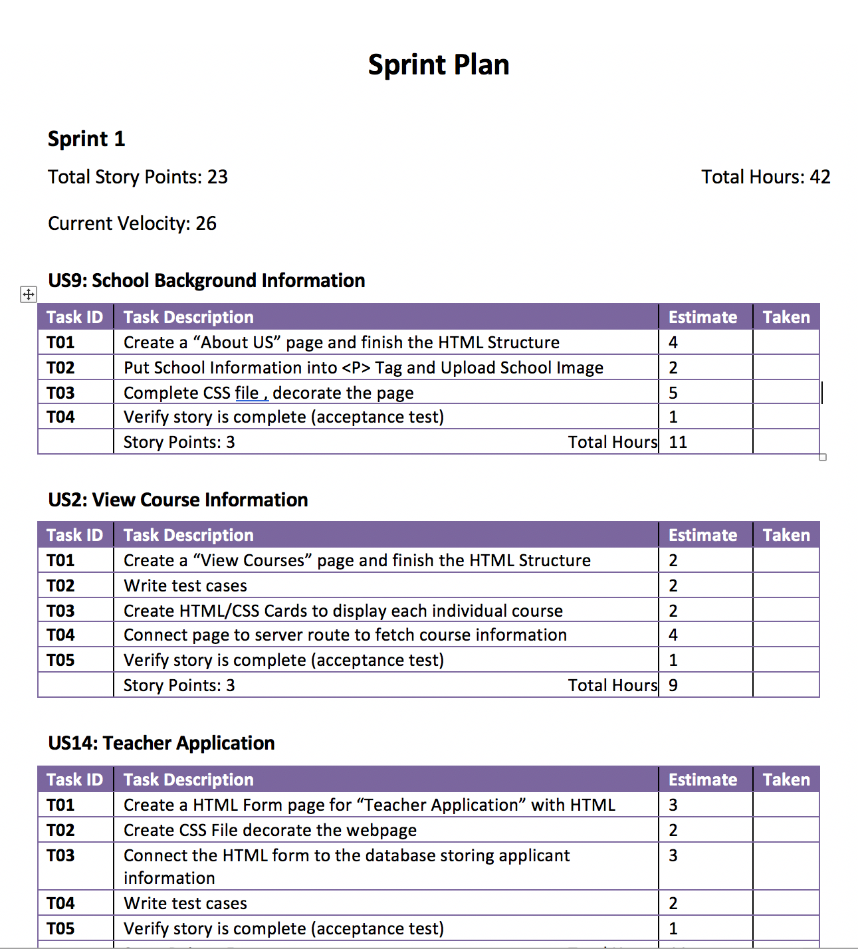
Our Scrum Process
Cc
Collaborative Effort
Product backlog
16User story
Release Planning
Pineland Music School
Business CASE
Create Deliverables
Final Product
Sprint backlog

Slide 3

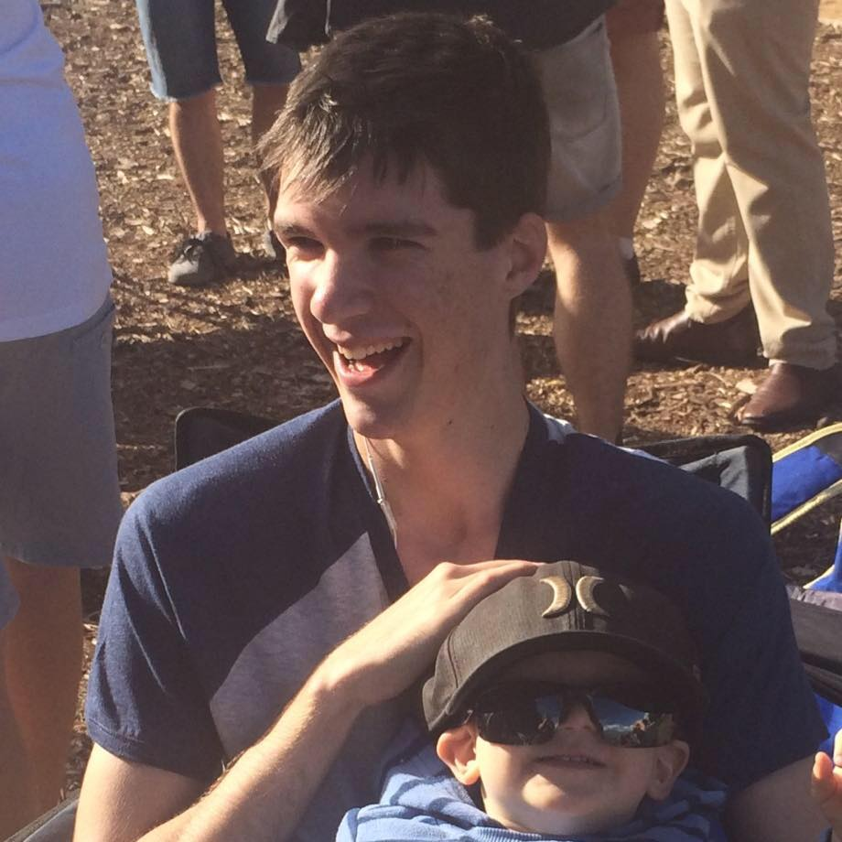
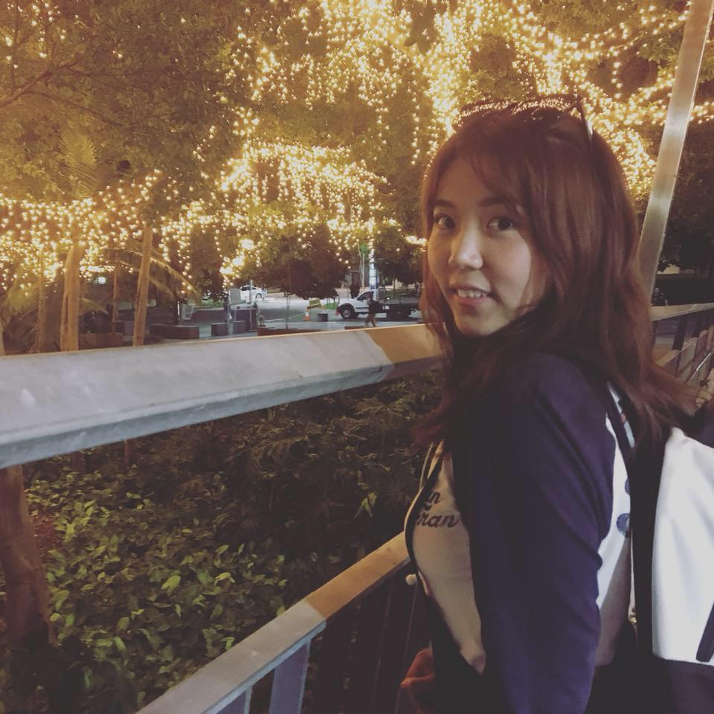

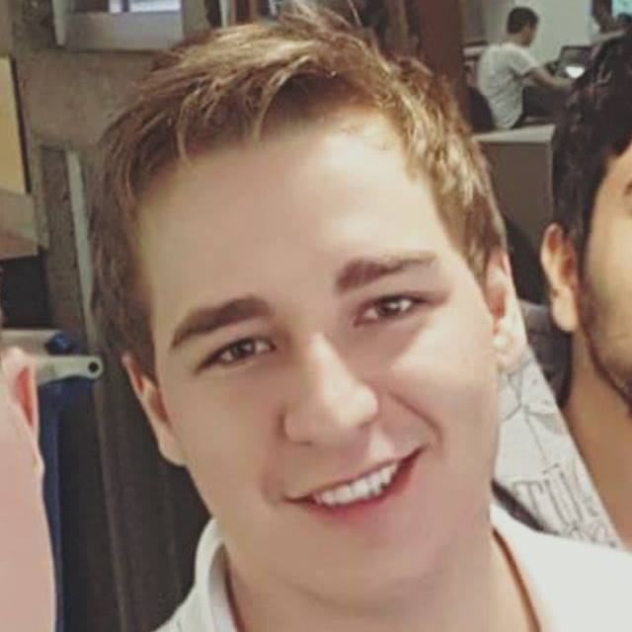

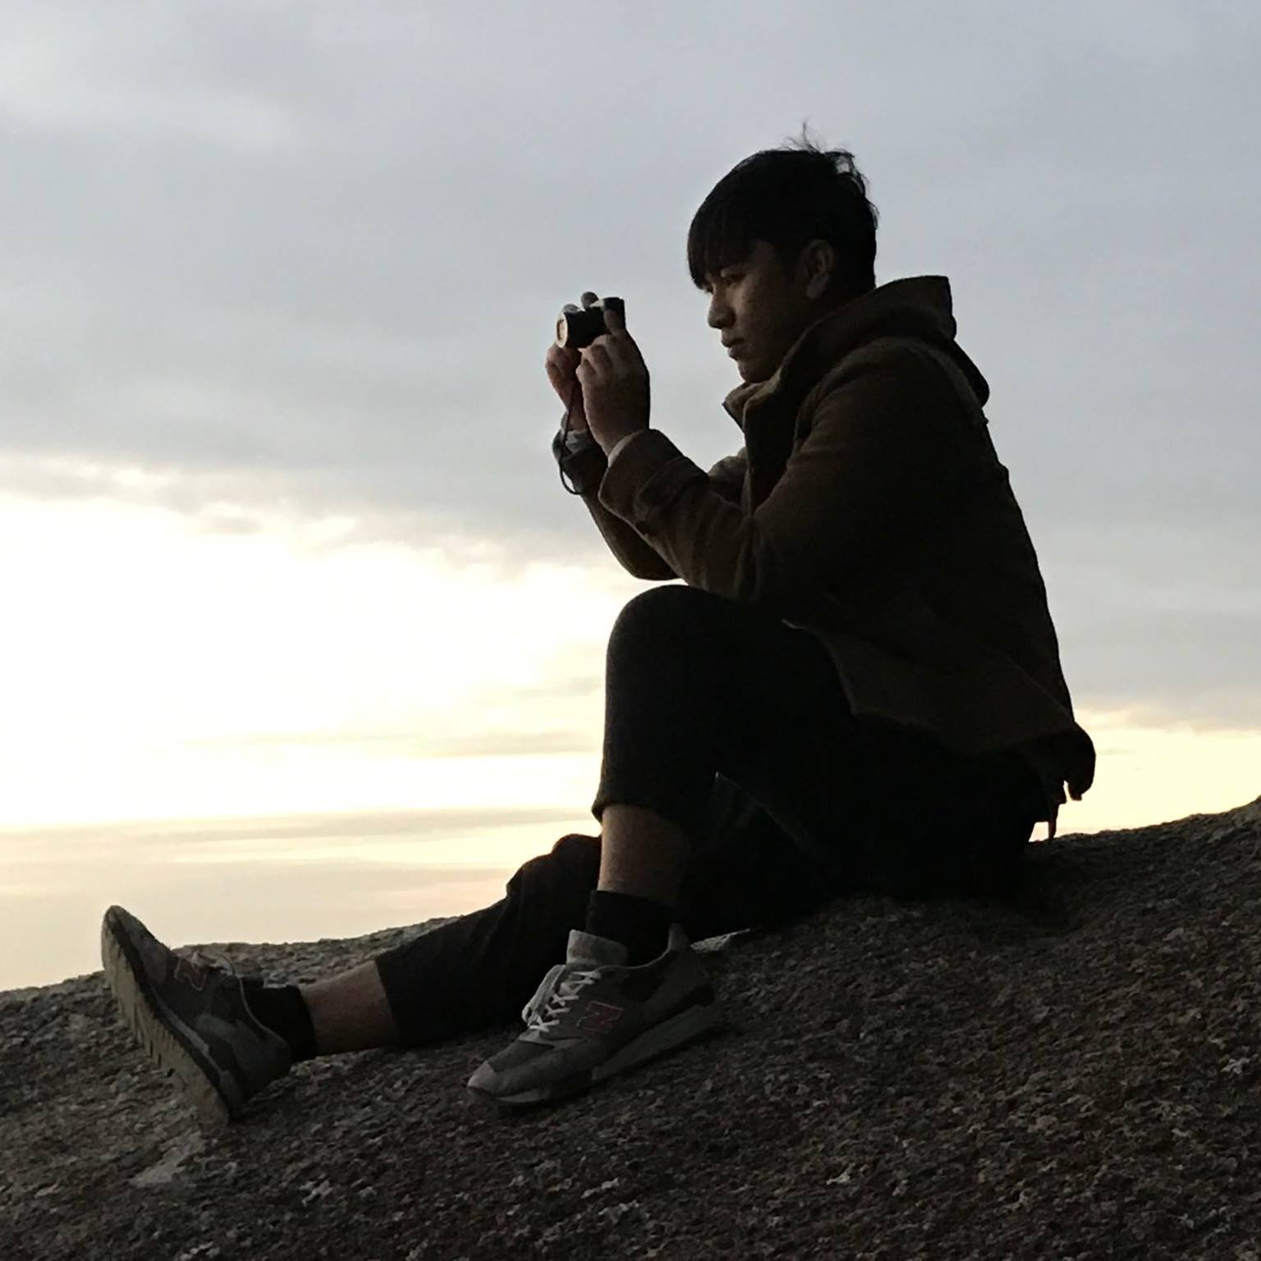
Jesse Day
Zijun LU
Product Owner
Stas
Scrum master
+
Developer
Eric
Developer

Slide 4

Team work
Zijun LU
Jesse Day
Select user story From customers’ perspective
Decide the release plan
Give feedback through process
Process modelling
Client
Eric
Stas
Review user story From developer’ perspective
Produce sprint plan
Develop web site
Deploy web site
Build up database
Unit testing
Developer

Slide 5

Individual work
Select user story
Make Process plan
UI design using
MarverApp
Process Modelling using
BMPN
Organize work backlog
Class diagram
Softer ware Component diagram
monitoring the product backlog.
Clients keep asking questions all the time
Zijun LU
Writing web site content
Web set mapping
Record the progress of
Project
Write team reflection
UI design
Music school logo design
monitoring the product backlog
Jesse Day

Slide 6

Individual work
created mysql itself
design tweaks,
making final web pages, routing for back-end
modelling object for mysql
unit tests for front-end
low fidelity mock-ups (the bootstrap ones),
connectivity between front and back and deployment
Eric
architecture layout for front-end file system and back-end layout
initial html/CSS design,
routing, MySQL NodeJS integration,
unit tests for back-end,
Debugging
minute meetings reports
scrum master plan
Stas
IT Developer is the best occupation in the world

Slide 7
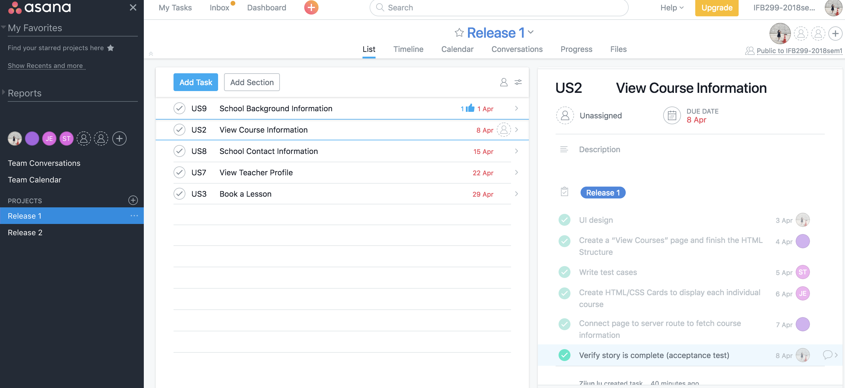
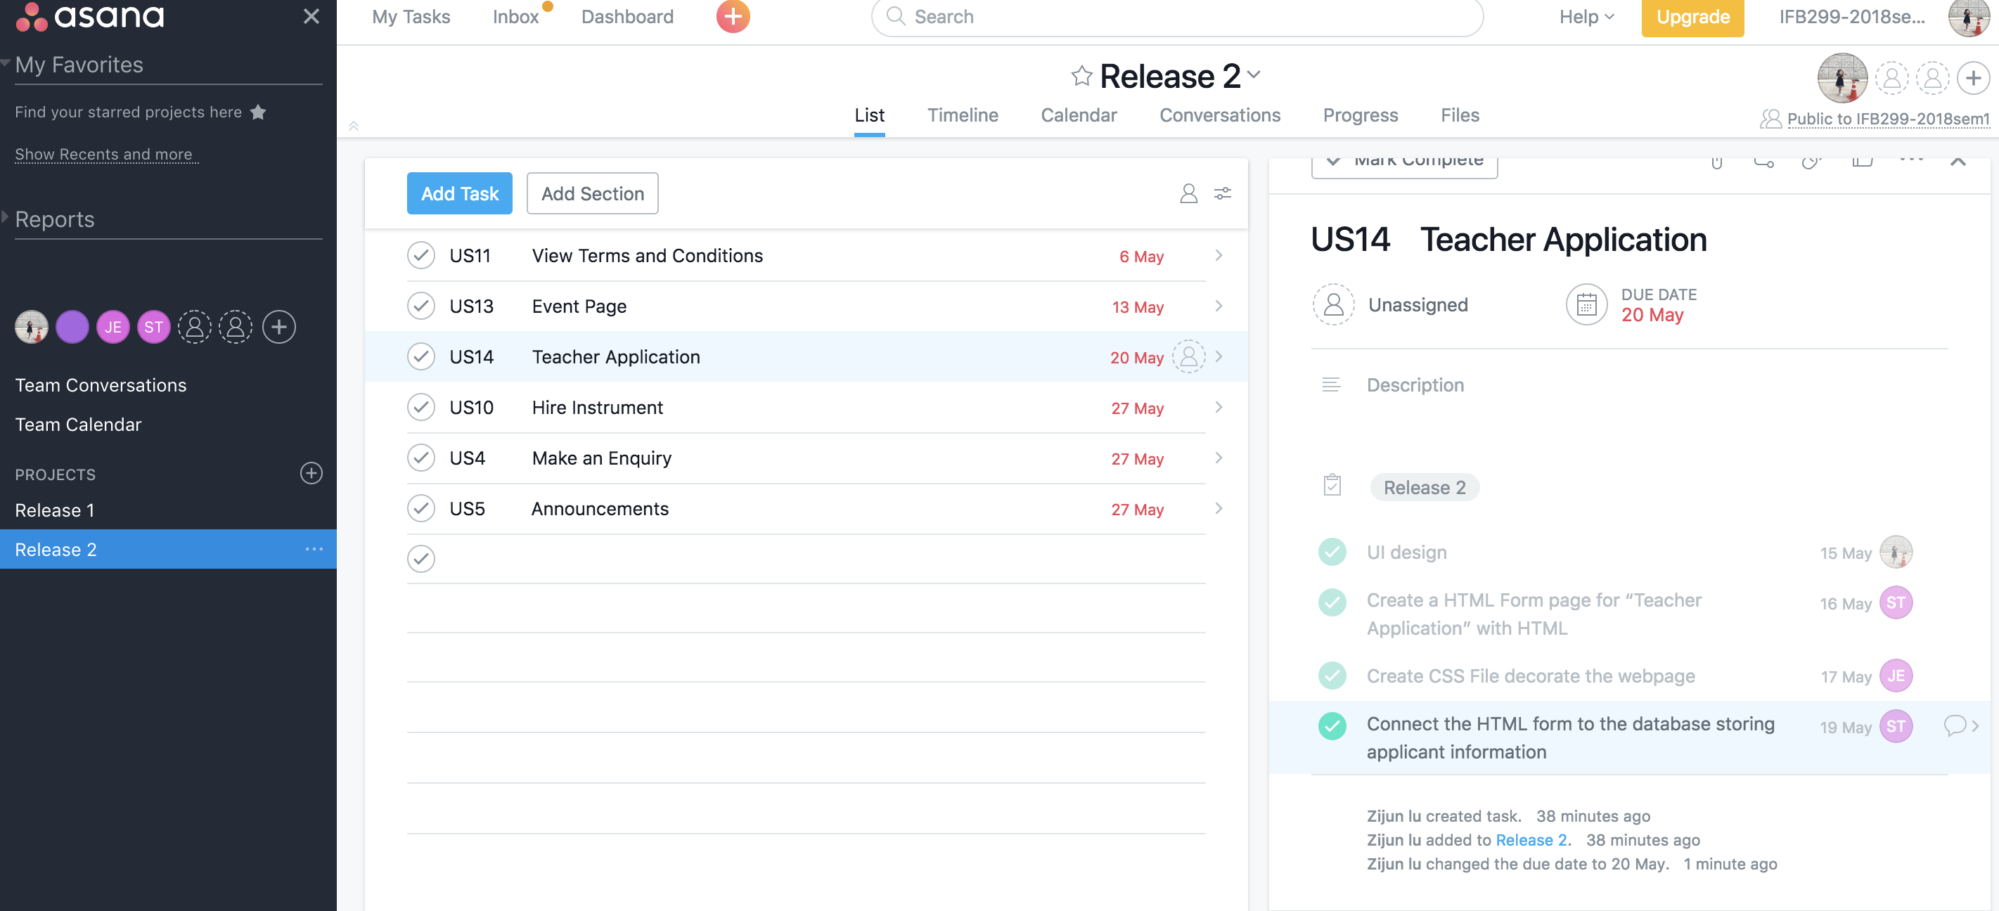

Management Technology
+
+
Setting task for every release plan
Communicate with team easily
Assign sub task to team member
Easy to use
Setting up due date for every task
Progress is transparency for team

Slide 8


Show Time for our Final Product
Enjoy

