Slide 1
SwiftLog Logistics
Supply Chain Analytics & Business Intelligence
Executive Presentation | Power BI Analysis | January–September 2026
Prepared for SwiftLog Logistics Limited leadership. Analysis is based on the provided Week 5 logistics datasets and the completed Power BI model.
AnalystLab Africa Week 5 | Data Analytics Track

Slide 2
1. Business Overview & Project Objectives
Business Context
Project Objectives
• SwiftLog operates across customers, orders, products, inventory, warehouses, shipments, deliveries and returns.
• Rapid expansion has created delivery delays, inventory challenges and limited executive visibility.
• The BI solution integrates operational datasets into a management-ready Power BI model.
• Monitor overall business performance and revenue trends.
• Improve delivery efficiency and identify delay bottlenecks.
• Strengthen inventory and warehouse decision-making.
• Evaluate customers, products, returns and supplier data quality.
• Support faster, evidence-based executive decisions.
SwiftLog Logistics Analytics | Reporting period: 1 Jan – 8 Sep 2026

Slide 3
2. Data Foundation & Preparation
11 operational datasets integrated in Power BI
Data Sources
Cleaning & Transformation
Modeling Principles
• Customers, Orders and Order Items
• Products and Returns
• Inventory and Warehouses
• Shipments and Delivery Performance
• Employees and Suppliers
• Dedicated Date table for time intelligence
• Verified column names, types and keys
• Checked missing values and duplicate records
• Trimmed / cleaned text fields
• Removed 3 exact duplicate inventory rows
• Grouped employees by warehouse and merged EmployeeCount
• Merged Delivery Performance into Shipments
• Created Month, Month Number and Quarter fields
• Single-direction relationships used where possible
• Date table related to Orders[OrderDate]
• Supplier table intentionally remains disconnected because no shared SupplierID key exists
• Model limitations were documented rather than hidden
SwiftLog Logistics Analytics | Reporting period: 1 Jan – 8 Sep 2026

Slide 4
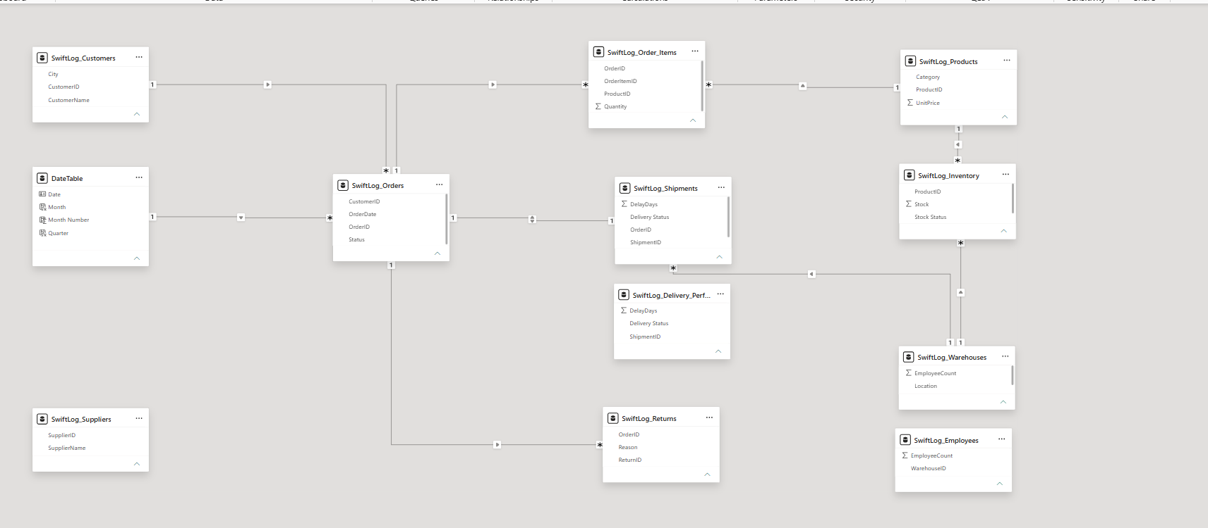
3. Data Model & Relationships
Relational model designed to support cross-functional analysis
Core Relationships
• Customers → Orders
• Orders → Order Items
• Products → Order Items
• Products → Inventory
• Warehouses → Inventory and Shipments
• Orders → Shipments and Returns
• DateTable → Orders
Supplier analysis is constrained because SupplierID is not present in Products, Shipments or Inventory.
SwiftLog Logistics Analytics | Reporting period: 1 Jan – 8 Sep 2026

Slide 5
4. Executive KPI Summary
7.11M
5,000
5,000
1,000
250
Total Revenue
Total Orders
Total Shipments
Total Customers
Total Products
37.21%
3.52 days
3,186
186
15
On-Time Delivery Rate
Avg. Delivery Delay
Delayed Shipments
Low-Stock Products
Warehouses
Management priority: delivery performance. Nearly two-thirds of shipment-status records are delayed, while the dashboard reports an on-time delivery rate of 37.21%.
SwiftLog Logistics Analytics | Reporting period: 1 Jan – 8 Sep 2026

Slide 6
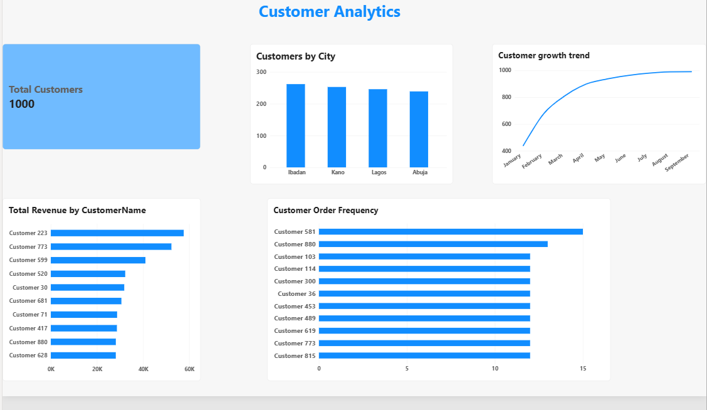
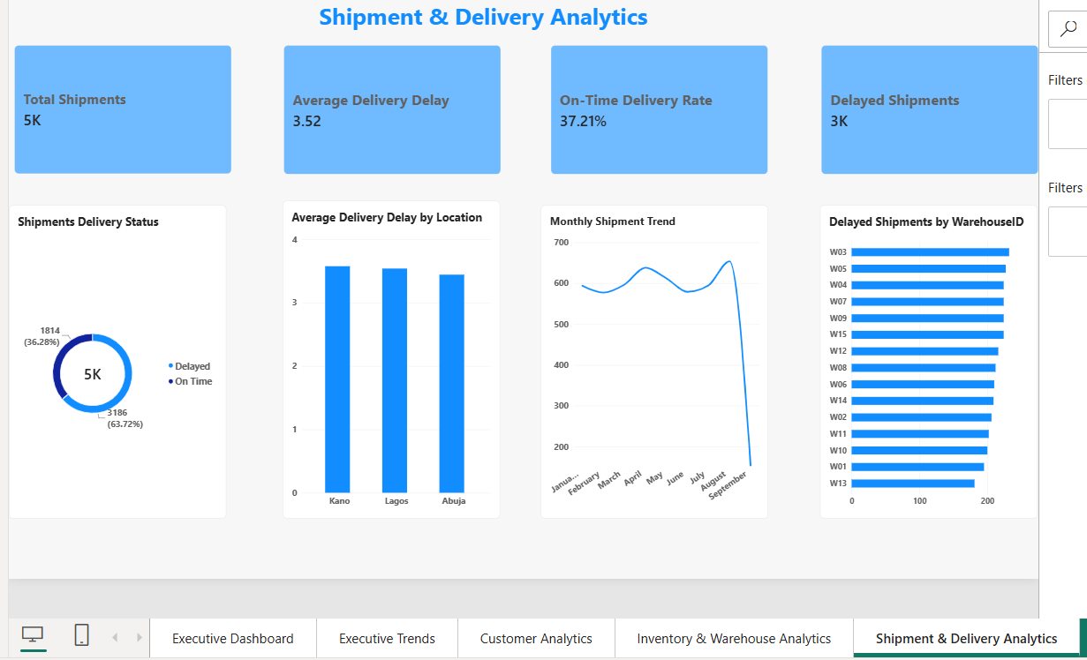
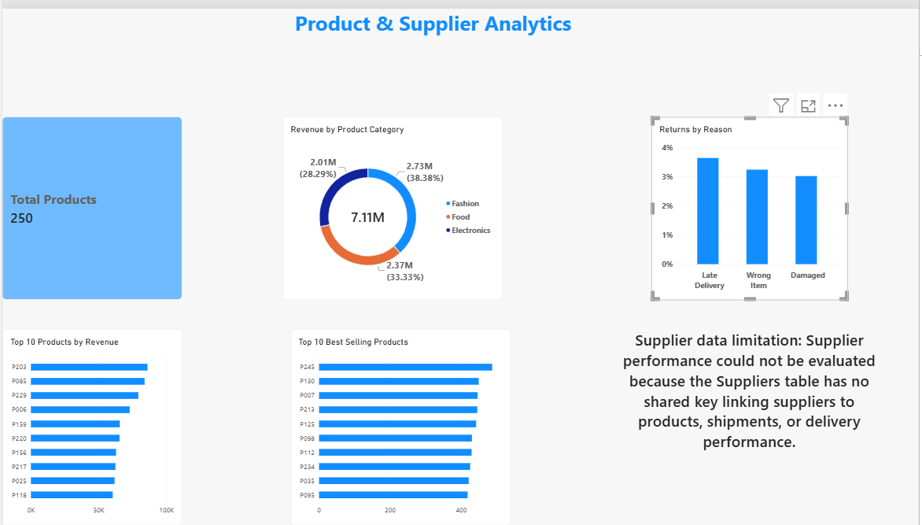
5. Dashboard Solution
Six main analytical pages plus drill-through and tooltip pages
Customer Analytics
Shipment & Delivery
Product & Supplier
• Interactive navigation, bookmarks, synchronized Month slicer, cross-filtering and conditional formatting.
• Product Details drill-through and Product Tooltip support deeper product analysis.
• Dynamic report titles and mobile layouts improve usability across viewing contexts.
SwiftLog Logistics Analytics | Reporting period: 1 Jan – 8 Sep 2026

Slide 7
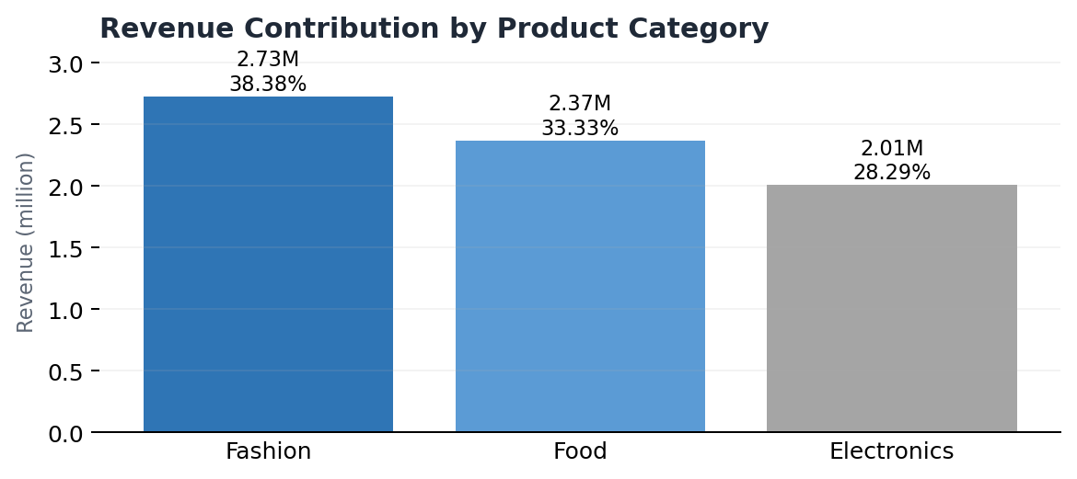
6. Commercial & Customer Insights
What the dashboard shows
• Fashion contributes the largest revenue share: 2.73M (38.38%).
• Food contributes 2.37M (33.33%); Electronics contributes 2.01M (28.29%).
• Top revenue products: P203, P085 and P229.
• Top revenue customers: Customer 223, Customer 773 and Customer 599.
• August was the strongest month with 654 orders and approximately 2.85M in revenue.
• April was also strong with 638 orders and approximately 2.74M in revenue.
Business implication: protect high-value products from stockouts, prioritize high-value customer retention, and build capacity ahead of peak demand periods.
SwiftLog Logistics Analytics | Reporting period: 1 Jan – 8 Sep 2026

Slide 8
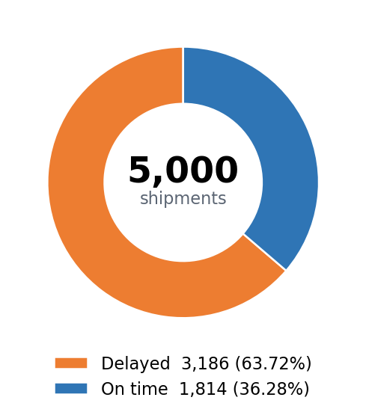
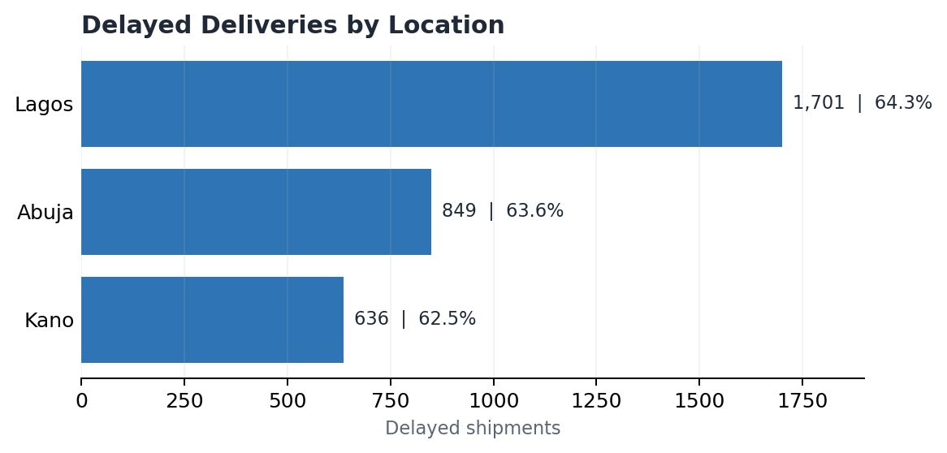
7. Delivery Performance & Operational Risk
Key Findings
• 3,186 of 5,000 shipment-status records are delayed (63.72%).
• Average delivery delay: 3.52 days.
• Lagos: 1,701 delayed shipments; 64.3% delay rate.
• Abuja: 849 delayed; 63.6%.
• Kano: 636 delayed; 62.5%.
• Similar delay rates across regions suggest a system-wide delivery issue.
Priority action: investigate dispatch processes, route planning, handoffs and workload bottlenecks—starting with Lagos because it carries the largest absolute delay burden.
SwiftLog Logistics Analytics | Reporting period: 1 Jan – 8 Sep 2026

Slide 9
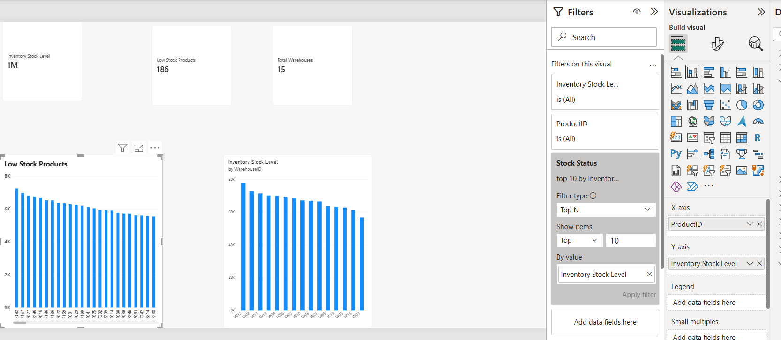
8. Inventory & Warehouse Insights
Operational Interpretation
• 15 warehouses are monitored across the network.
• 186 products are flagged as low stock.
• Inventory should be prioritized using revenue, units ordered and low-stock exposure.
• W13 shows comparatively lower delayed-shipment volume; W01 and W11 also perform relatively better on the available delay indicator.
• A formal warehouse-utilization KPI cannot be calculated because warehouse capacity is absent.
• Inventory turnover is presented as a proxy because COGS and average inventory value are unavailable.
SwiftLog Logistics Analytics | Reporting period: 1 Jan – 8 Sep 2026

Slide 10
9. Data Quality & Analytical Limitations
Structural Data Gaps
How the BI Solution Handles Them
• Supplier performance cannot be measured reliably because SupplierID is not linked to Products, Shipments or Inventory.
• Product-level return rates cannot be attributed reliably because Returns contains OrderID but not ProductID or OrderItemID.
• Many returned orders contain multiple products, making indirect attribution ambiguous.
• Average delivery time cannot be calculated because shipment/delivery timestamps are unavailable.
• Warehouse utilization cannot be calculated without warehouse capacity.
• The report avoids fabricating unsupported measures.
• Proxy measures are clearly labeled where formal definitions cannot be met.
• September is incomplete through 8 September and should not be compared directly with full months.
• Future data capture should add SupplierID, ProductID/OrderItemID on returns, delivery timestamps, capacity and cost fields.
SwiftLog Logistics Analytics | Reporting period: 1 Jan – 8 Sep 2026

Slide 11
10. Strategic Recommendations
1
Improve on-time delivery
6
Plan for peak demand
Review dispatch, routing and delay root causes.
Build stock, staffing and delivery capacity before peak months.
2
Prioritize Lagos
7
Rebalance inventory
Investigate workload, scheduling and transport bottlenecks.
Use low-stock and revenue views to guide transfers and replenishment.
3
Benchmark stronger warehouses
8
Reduce avoidable returns
Transfer effective practices from lower-delay warehouses.
Address damage, wrong-item and late-delivery causes.
4
Protect top products
9
Strengthen source data
Prioritize P203, P085 and P229 availability.
Add missing supplier, return, delivery-time and capacity keys.
5
Retain high-value customers
10
Institutionalize KPI monitoring
Target Customers 223, 773 and 599 with proactive service.
Track revenue, delays, returns and inventory through Power BI.
SwiftLog Logistics Analytics | Reporting period: 1 Jan – 8 Sep 2026

Slide 12
11. Expected Business Impact & Conclusion
Expected Business Impact
Executive Conclusion
Next Steps
• Faster visibility into revenue, orders, delivery delays and inventory risk.
• Better prioritization of high-value products, customers and regions.
• More disciplined warehouse and replenishment decisions.
• Stronger management focus on delivery reliability and service quality.
• Delivery performance is the most urgent operational priority.
• Commercial performance is diversified across product categories.
• The highest-value products and customers create clear growth opportunities.
• Several analytical gaps originate in source-data design rather than Power BI.
• Use the dashboard as a recurring management tool.
• Improve source-data relationships and timestamps.
• Track corrective actions against the delivery KPIs.
• Expand BI once supplier, return and capacity data are strengthened.
SwiftLog Logistics Analytics | Reporting period: 1 Jan – 8 Sep 2026

