Slide 1
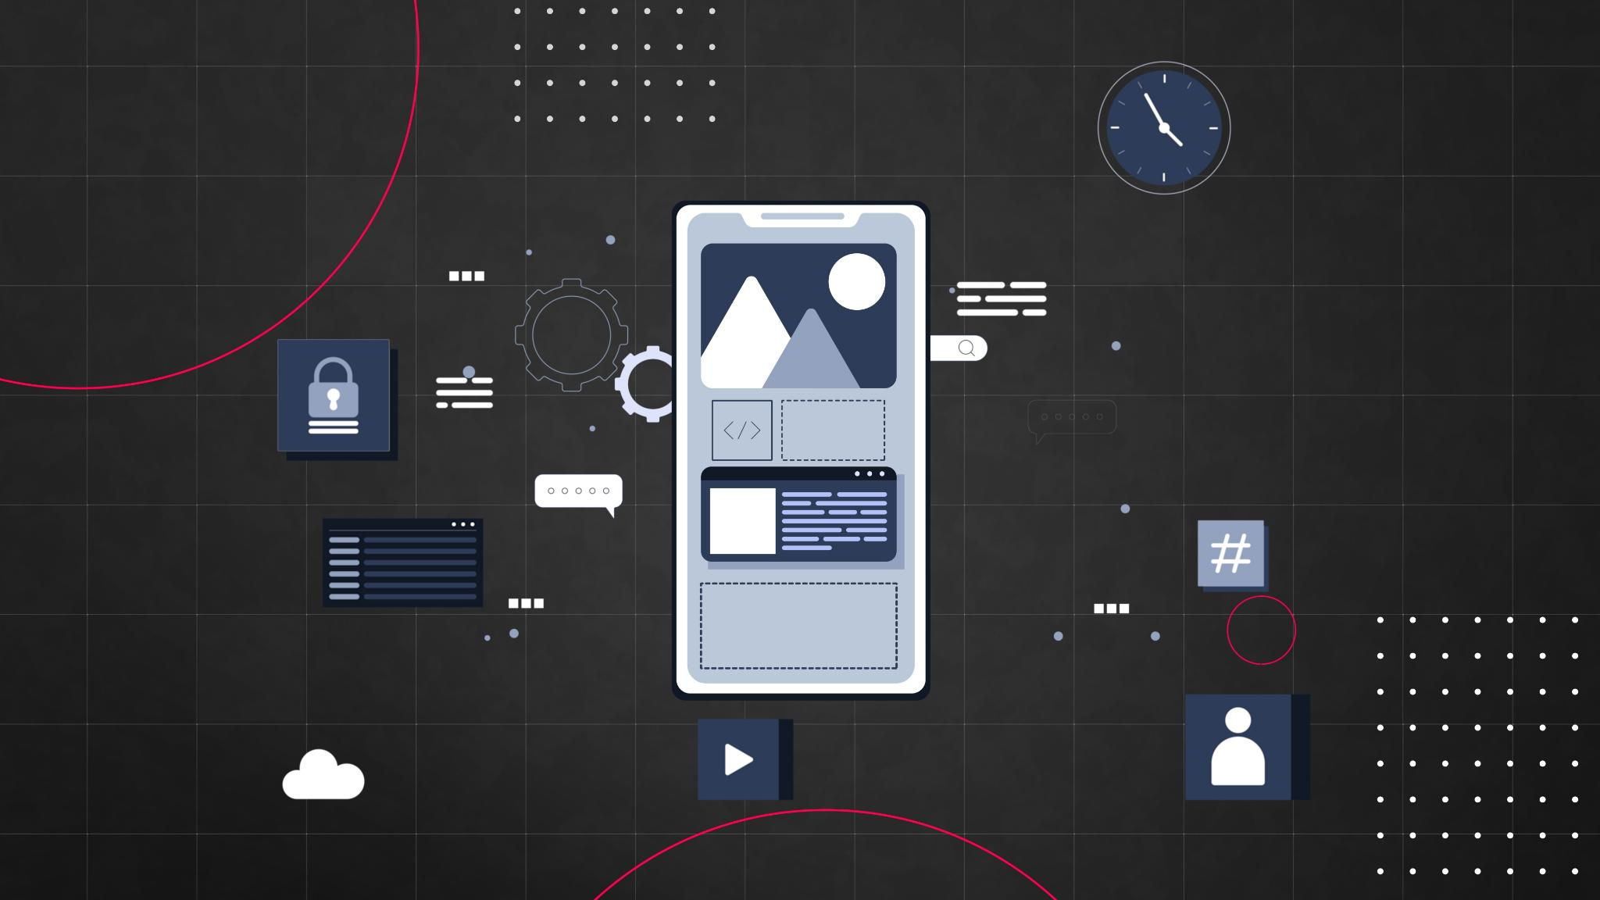
Online Store Website Design and Development
Eric Arnaud Ekra
Mamadou Siradiou Barry
Mohammad Hani Yaghmaeian
Notes:
--- This presentation provides detailed instructions and best practices for planning, designing, and developing a successful website project. We will cover all critical phases from defining scope to collaborative development. Image source: Microsoft 365 content library

Slide 2
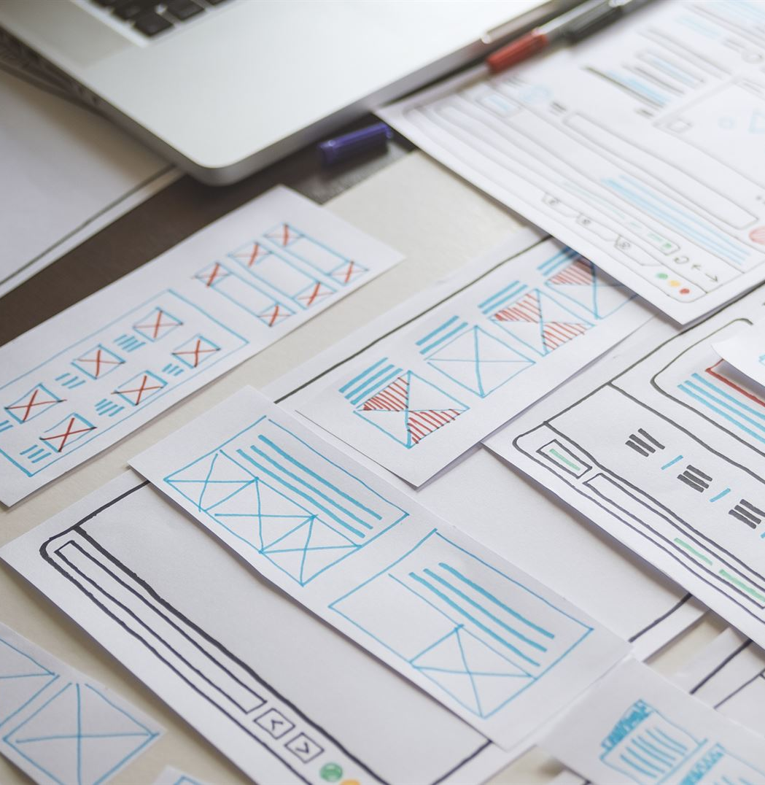
Agenda Items
Defining Project Scope and Vision
Effective Content Planning and Research
Developing a Unified Brand Identity
Wireframing and Creating Content Mockups
Selecting Tools for Website Design and Development
Collaborative Site Development Process
Notes:
--- We will explore key aspects of website design and development including project scope definition, content planning, brand identity, wireframing, tool selection, and collaborative development workflows to ensure a cohesive and efficient project. Image source: Microsoft 365 content library

Slide 3
Defining Project Scope and Vision
Notes:
A clear project scope and vision are essential to guide the website design process. This section focuses on understanding the website’s purpose, setting measurable goals, and identifying the target audience to align all efforts.

Slide 4

Clarifying the Website’s Purpose and Core Message
Define Website Purpose
The purpose of the website is to create a modern online shop that specializes in selling all types of products.
Core Message Consistency
The core message of the website is to make the products that we are selling visible and available to order.
Design and Content Alignment
The website was designed for accessibility and multiplatform display by providing an optimal viewing experience across a range of devices. The website includes 8 pages (Home, Products, Cart, Contact, About Us, Order History, Account, Login).
Notes:
--- Establish precisely what the website aims to communicate. Defining the core message ensures consistency and relevance in design and content decisions throughout the project. Image source: Microsoft 365 content library

Slide 5

Establishing Primary Goals and Desired Outcomes
Set Clear Objectives
The objective of the SystemStore Website is to present different products to the customers and to have each visit converted to a Sales.
Guide Design Decisions
Accessibility and multiplatform display are the guiding design principles followed.
Measure Project Success
The website success will be measured by the conversion rate. How many visitors of the website purchased at least one product and how often they order a product from our website.
Notes:
--- Set clear objectives such as increasing conversions, improving user engagement, or enhancing brand awareness. These goals help shape design choices and measure project success. Image source: Microsoft 365 content library

Slide 6

Identifying and Understanding the Target Audience
Conduct Audience Research
The target audience is customers age 18 to 54 looking for one stop shop place.
Tailor Website to Users
The website was designed to attract users by making it simple to search for products, to place order and to pay. Accessibility and multiplatform display design principles help achieve those objectives.
Notes:
--- Conduct audience research to understand demographics, preferences, and behaviors. Tailoring the website to user needs improves usability and effectiveness. Image source: Microsoft 365 content library

Slide 7
Effective Content Planning and Research
Notes:
Organizing and gathering quality content is critical for an impactful website. This section covers collecting media assets and structuring content logically for clear navigation.

Slide 8

Collecting Required Text, Images, Graphics, and Media
Gathering Written Copy
Products descriptions and prices were displayed And all the web pages incorporated to the project are self explanatory.
Collecting Visual Media
high-quality photos of each product were incorporated and that help support and enhance the message visually.
Incorporating animated images
In order to provide a wonderful user experience animated images were incorporated to the website for the purpose of providing dynamic content for better experience.
Ensuring Content Quality
The design team in selecting the photos and animated images was guided by the quality and relevance to enhance overall user engagement and experience.
Notes:
--- Gather all necessary content elements including written copy, photos, icons, and videos. Ensuring content quality and relevance enhances the user experience. Image source: Microsoft 365 content library

Slide 9
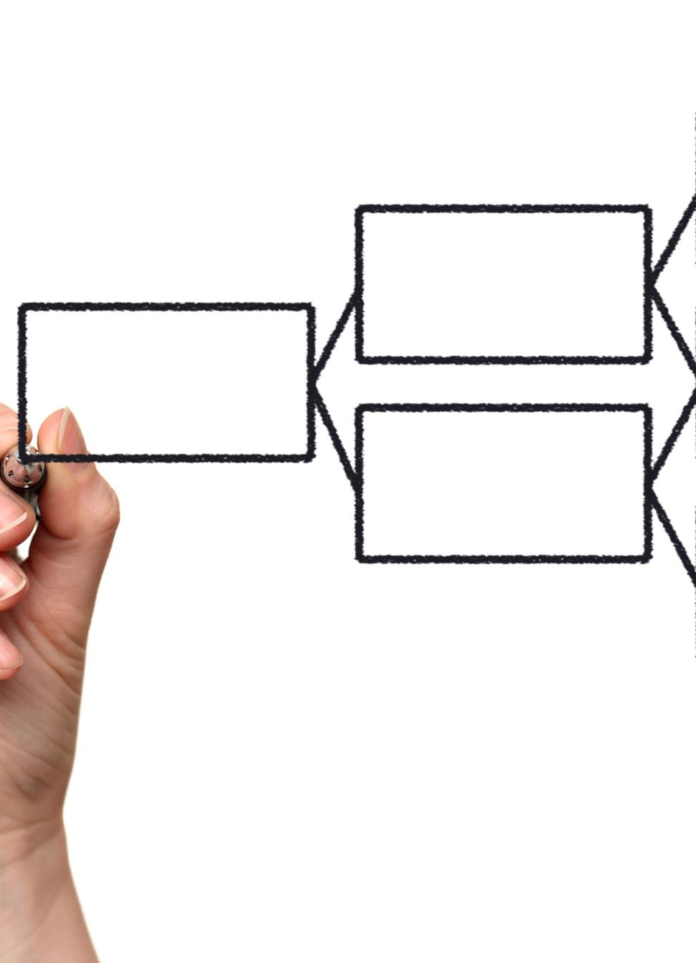
Organizing and Structuring Content by Pages and Sections
Website Architecture Planning
The content of the website is organized in specific pages which are :
AboutUs , Account, Cart , Contact, Product, Login and OrderHistory.
Coherent Content Grouping
The content of each page is group into coherent sections to enhance user understanding and content discoverability.
Intuitive Navigation Support
The website design supports intuitive navigation and improves accessibility for users.
Notes:
--- Map out the website architecture and group content into coherent sections and pages. A clear structure supports intuitive navigation and accessibility. Image source: Microsoft 365 content library

Slide 10
Developing a Unified Brand Identity
Notes:
Consistency in visual elements strengthens brand recognition. This section emphasizes designing a cohesive visual language and aligning UI components with the brand.

Slide 11

Designing a Consistent Visual Language: Logo, Fonts, and Color Palette
Logo Development
The website logo was designed around simplicity and readability. The logos clearly represents the brand’s identity and values to ensure effective recognition.
Font Selection
The fonts selected reflect the brand personality and maintain readability across different media and platforms.
Color Palette Choice
The harmonious color schemes enhances the brand’s visual appeal and motivate customers to buy the listed products.
Notes:
--- Develop or refine logos, select fonts, and choose color schemes that reflect the brand’s personality, ensuring a harmonious and professional look. Image source: Microsoft 365 content library

Slide 12

Ensuring Brand Alignment for UI Elements Such as Buttons, Icons, and Links
Consistent Styling
Uniform styling for buttons, icons, and links were used to ensure easy navigation and brand recognition.
Brand Identity Integration
Colors and typography were used to reinforce the brand messaging.
Unified User Interface
User interface was designed around simplicity and easy navigation in order to improve the user experience.
Notes:
--- Style interactive elements consistently with the brand identity to create a unified user interface and reinforce brand messaging. Image source: Microsoft 365 content library

Slide 13
Wireframing and Creating Content Mockups
Notes:
Early visualizations help align stakeholders and guide development. This section focuses on creating wireframes and mockups for different devices.

Slide 14

Building Initial Wireframes and User Interface Sketches
Basic Layout Development
Initial wireframes focus on basic page structure without graphic elements to clarify functionality.
Functionality Representation
Wireframes convey interface functionality and user flow for design and development teams.
Blueprint for Teams
Wireframes serve as blueprints guiding designers and developers through project requirements.
Notes:
--- Develop basic layouts representing page structure and functionality without graphic detail. Wireframes act as blueprints for the design and development teams. Image source: Microsoft 365 content library

Slide 15

Designing Layouts for Both Desktop and Mobile Experiences
Responsive Design Principles
Designs fit different screen sizes and orientations for optimal usability.
Consistent User Experience
Ensure visual consistency to provide seamless navigation and accessibility.
Accessibility Across Devices
The website is designed to support all users regardless of the device they use.
Notes:
--- Create responsive designs that adapt seamlessly to various screen sizes, ensuring a consistent and accessible user experience across devices. Image source: Microsoft 365 content library

Slide 16
Selecting Tools for Website Design and Development
Notes:
Choosing the right tools and frameworks can streamline the project. This section explores popular CSS frameworks and development tools for efficiency and quality.

Slide 17

Choosing a CSS Framework (Bootstrap 5, Tailwind CSS, Etc.)
Responsive Design Support
Bootstrap was used to simplify building layouts adaptable to different screen sizes and devices.
Rapid Prototyping Capability
Bootstrap was used to create buttons, navbars, alerts, forms. Those set ready to use UI elements helps make the navigation easy and the site accessible.
Consistent Styling Patterns
CSS was used to enforce uniform styles to maintain visual coherence across projects.
Notes:
--- Evaluate frameworks based on project needs to facilitate responsive design, rapid prototyping, and consistent styling patterns. Image source: Microsoft 365 content library

Slide 18

Utilizing the Appropriate IDE and Version Control Tools
Integrated Development Environment (IDE)
Visual Studio Code was use as an Integrated Development Environment for the project. The IDE helps the coding and facilitate the debugging process and finding solutions for some technical challenges we faced.
Version Control Systems
GitHub was used to host code repositories, store the different version of the code.
Improved Collaboration
Github was used to collaborate between the Team Members to facilitate communication and to track the changes to the code.
Notes:
--- Select development environments and version control systems like Git to improve collaboration, code quality, and project management. Image source: Microsoft 365 content library

Slide 19
Collaborative Site Development Process
Notes:
Effective teamwork and structured workflows are vital for successful development. This section covers coding structure, styling, interactivity, and collaboration practices.

Slide 20
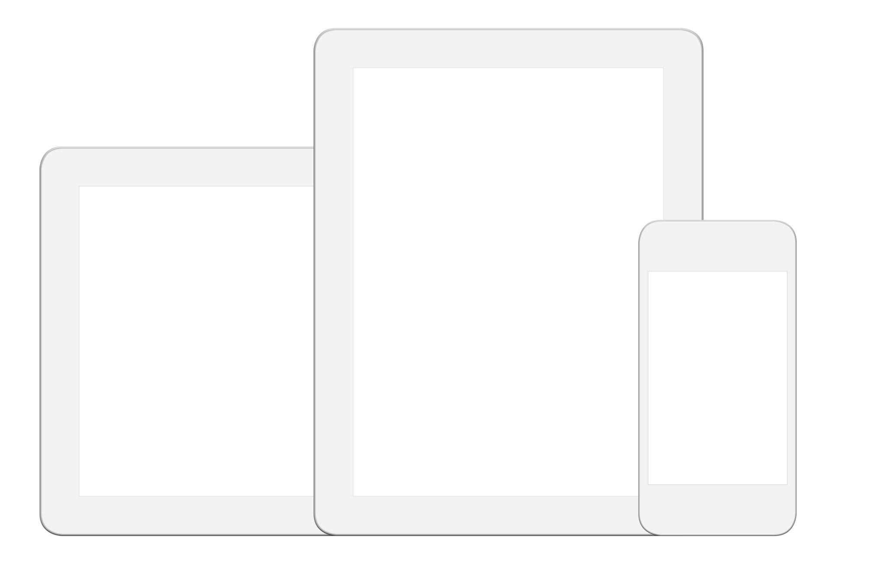
Structuring the Site with HTML5, CSS3, JavaScript
Use of HTML5
HTML5 was used to provide semantic structure to webpages improving accessibility and SEO.
Styling with CSS3
CSS3 was used enhances visual appearance and responsiveness across devices with advanced design features.
JavaScript Functionality
JavaScript was used to add interactivity and dynamic content for improved user experience.
Notes:
--- Organize code using modern standards and frameworks to build a maintainable, scalable, and performant website. Image source: Microsoft 365 content library

Slide 21

Styling and Adding Interactive Features
Visual Styling
Attractive and consistent styles were used to improve user engagement and overall experience.
Animations
Interactivity while creatin an account or ordering the products helps the user navigates easily.
Interactive Forms
Forms enable user input, making the experience more engaging and personalized.
Dynamic Content
Dynamic content updates in real-time to keep users informed and engaged.
Notes:
--- Enhance the user experience by applying visually appealing styles and incorporating interactive elements such as animations, forms, and dynamic content. Image source: Microsoft 365 content library

Slide 22

Fostering Teamwork Using Modern Development Practices
Agile Methodologies
Github helps the team to be Agile and enables clear communication on the changes made and facilitate the approval of all the team members.
Code Reviews
Code reviews and debugging improve the quality of the website and knowledge sharing among team members.
Notes:
--- Adopt agile methodologies, code reviews, continuous integration, and clear communication to ensure smooth collaboration and project success. Image source: Microsoft 365 content library

Slide 23
CONCLUSIONS
THANK- YOU ! FEEL FREE TO ASK QUESTIONS
Notes:
By clearly defining scope, planning content, establishing brand identity, designing thoughtfully, selecting the right tools, and collaborating effectively, teams can deliver successful and impactful websites.

