Slide 2
Presentation Outline
Abstract
Introduction
Background, Problem Statement, Objectives, Justification
Literature Review
Existing Technologies
Related Works
Gaps
Proposed Methodology
Expected outcomes
Proposed Budget and Time plan
Notes:
10/13/2020
2

Slide 3
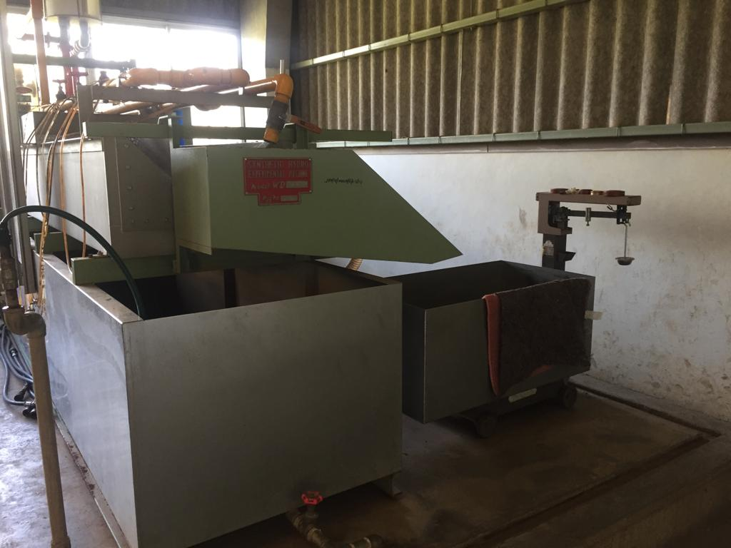
Synthetic Hydro-Experimental Machine

Slide 4
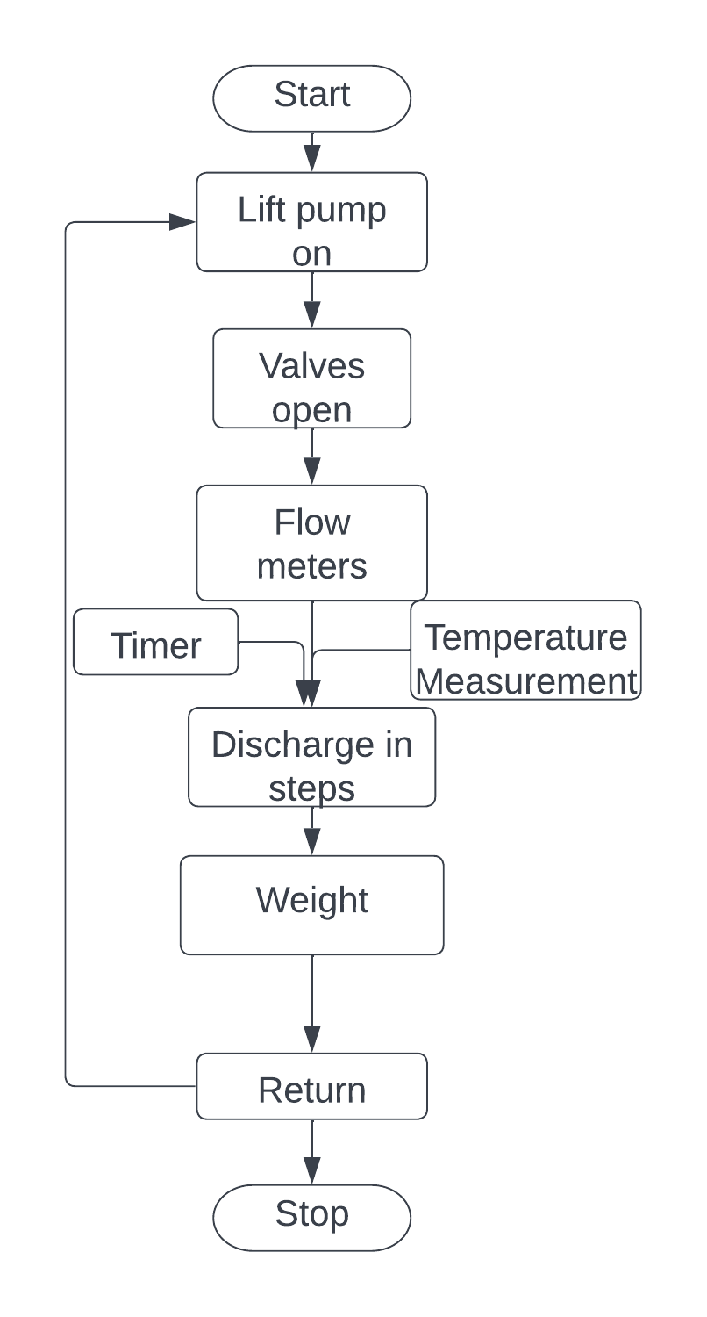
Introduction: Background
Fluid flow measurement
Quantifying a property of an uninterrupted flow.
Flow meters
Turbine flow meter, rotameter, venturi, and orifice.
Bernoulli’s Theorem.
Synthetic Hydro-Experimental Machine
Consists of venturi, and orifice
Establishing a relationship between discharge, differential pressure, and the coefficient of discharge.
Experiment procedure
Notes:
Fluid flow property measured and related to the flow. (relating pressure to the flow)
Each flow meter alter a physical property and the measures the change.
Bernoulli’s theorem – an increase in the velocity of a fluid occurs simultanously with a decrease in static pressure.
Procedure

Slide 5
Introduction: Problem Statement
Fluid flow experiments required one to synchronize discharge collection with time and temperature measurement.
Current state of the Synthetic Hydro-Experimental Machine.
Determination of steps based on human intuition
Discharge collection synchronization by a minimum of two operators
Incremental weight measurement.
Results in Cd outside the tolerable range.
Automated Synthetic Hydro-Experimental Machine
Precise discharge flow control.
Automated discharge collection.
Automate discharge weight and temperature measurement.

Slide 6
Introduction: Objectives
Main Objective
To automate the discharge collection process of the Synthetic Hydro-Experimental Machine.
Specific Objectives
To design an automated discharge flow control unit that can precisely discharge in steps.
To design and fabricate a discharge collection unit with automated weight, time and temperature measurements.
To design a user interface and the control algorithm.

Slide 7

Literature Review: Existing technologies
Computational Fluid Dynamics
Powerful modeling and analysis technique of non-linear differential equation of fluid flow properties.
Tukimin et al developed a CFD model to determine the coefficient of discharge of the Venturi. They compared the results to those obtained from a physical experimental setup.
The results showed a 1% difference.
Analytical Predictions
Utilizes Bernoulli’s equation.
Assumptions - Flow is linear.
- Flow is incompressible.
- The flow is steady
- No losses.

Slide 8
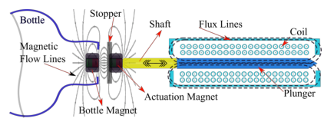
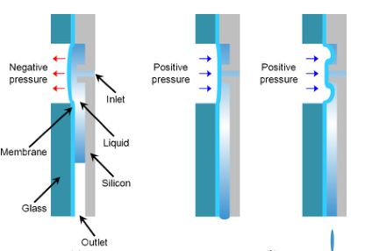
Literature Review: Related Works
Electromagnetic Activation
Automated Water Sampler
Angelo et al
Water sample collection
- Actuation mechanism >
Pneumatics
Power of compressed air for actuation
Sangmin and Joonwon
- Dispensing doses

Slide 9
Literature Review: Gap Analysis
CFD
- undermines credibility of the experiment.
- Computational resource intensive (ANSYS).
Analytical
- Tedious computations
- Assumptions
Synthetic Hydro-Experimental Machine.
- Mechanical and manual.

Slide 10
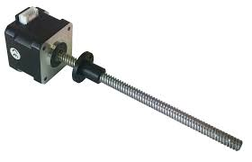
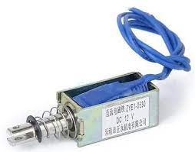
Methodology: Discharge Flow Control
Requirement: Discharge in precise steps
Utilizes the existing ball valve.
Actuation Mechanisms
Stepper Linear Actuator
Piezoelectric Actuator
Considerations
Torque requirements
Step size

Slide 11
Methodology: Discharge Flow Control

Slide 12
Methodology: Dischare collection unit
Outlet valve.
Requirement: faster discharge
Considerations: Position and size.
Weight Measurement
Approaches: Ultrasonic, Load cells
Considerations: Reliability
Temperature measurement
Approaches: Contact and non contact
Considerations: - Sensitivity.
- Reliability.
Flow Diversion Sub-unit
Requirements: - Fast response
- Minimal Splashes
Consist of a flap and an actuation mechanism.
Considerations: Size, shape, material
Actuation mechanisms: Motor, electromagnets.
Discharge collection tank
Requirements: - elevation utilizes gravity
- Minimal environmental effect.
Considerations: - Position
- Insulation
- Shape

Slide 13
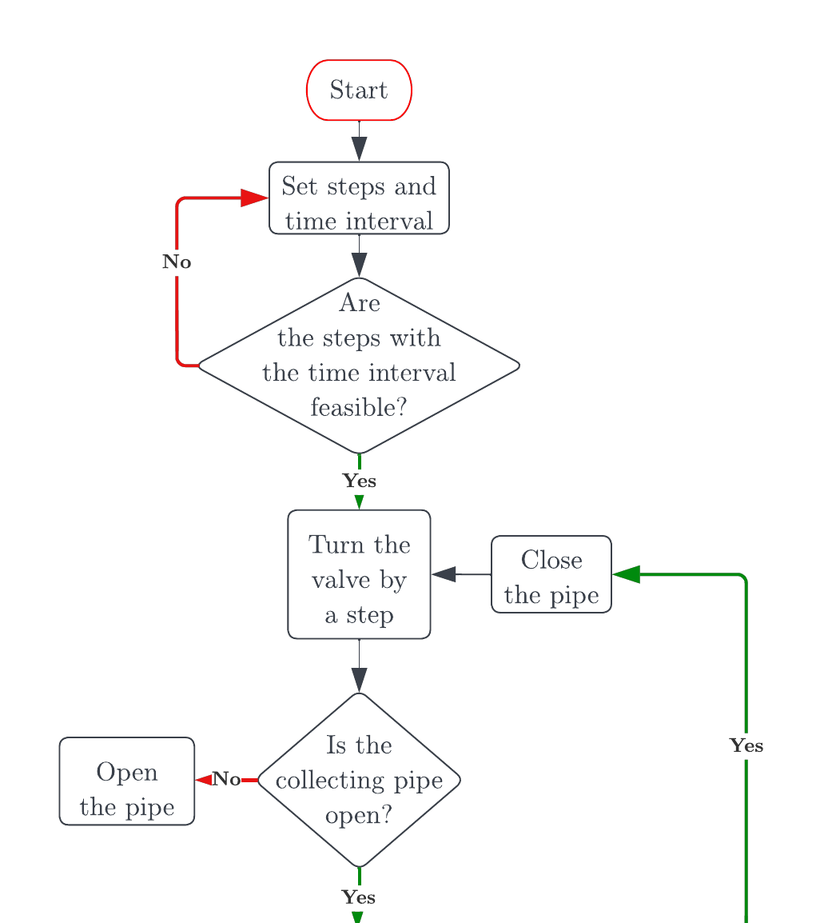
Methodology: Interface and Control
Processing Unit.
GPIOs
Processing power
Interface.
Ergonomics.
Size.
Aesthetics.

Slide 14
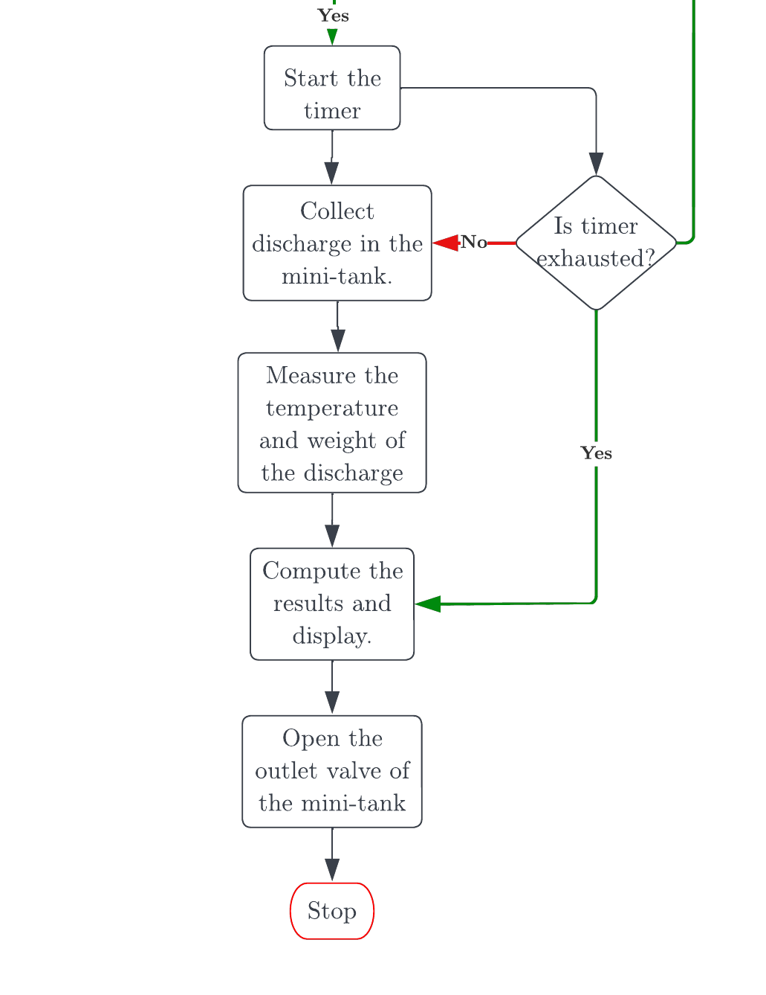
Methodology: Control Cont…

Slide 15
Expected Outcomes
Discharge flow control
- Can turn the ball valve in precise steps.
- Accuracy of the steps is to the nearest whole number.
Discharge collection unit
- Synchronized discharge collection with temperature and weight measurements.
Flow diversion unit
- Accurate collection of the stream within the time interval.
Discharge collection tank.
- Correctly shaped for accurate weight measurement.
- Utilize gravity to eliminate the need for an extra pump.
Control and display
- Ergonomic Display
- Capable board

Slide 16
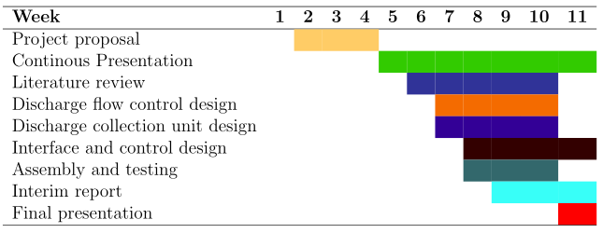
Time plan

Slide 17
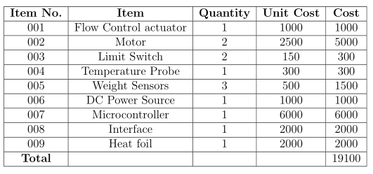
Budget

Slide 18


