Slide 1
The Technology Value Stream
Eric Williams-Phillips
Bellevue University | CSD 380
Sue Sampson

Slide 2
What is a value stream?
Anything that delivers a product or service
“An end-to-end collection of activities that creates a result for a ‘customer’” –James Martin, (Martin, 1995)
Every value stream starts with an idea and ends with that idea being in the hands of the customer as its intended form

Slide 3
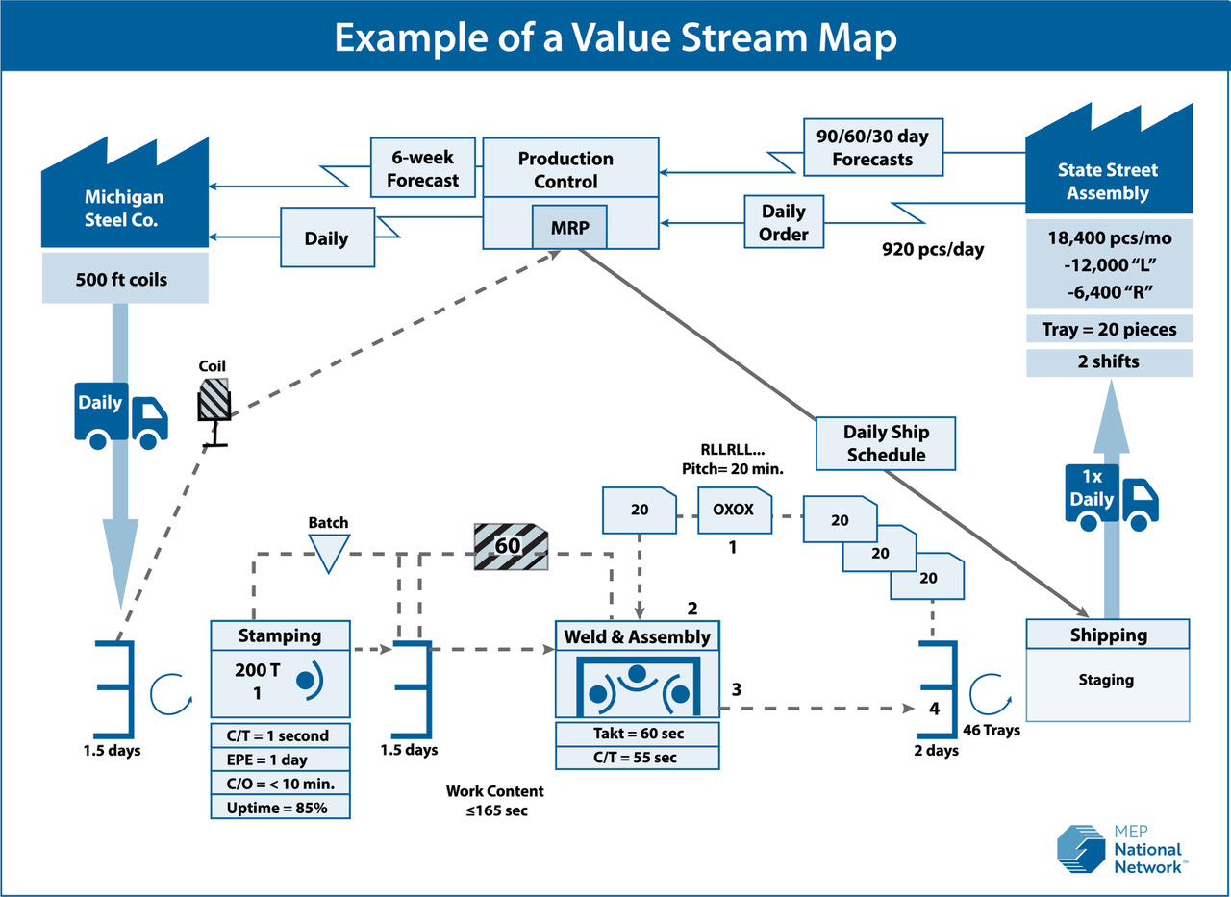
Example of value stream map in manufacturing
Figure 1. Example of a manufacturing value stream map by the NIST
(Value Stream Mapping | NIST, 2024)

Slide 4
What makes a digital value stream different?
A digital value stream is different as each stream varies
The product requirements are constantly changing which can make it difficult to produce quality results
There are phases within phases (coding, building, QA, testing, etc.)
Much of a digital value stream is automated
Digital value streams are customer-centric, relying heavily on feedback before the final product

Slide 5
Lead Time vs. processing time
Lead time is a measurement of value stream performance
Lead time measurement begins when the request is initially made and ends when the request is completely fulfilled (Kim et al., 2016)
Customer-facing measurement means this typically is focused on more
Processing time is another measurement used to track value stream performance
Processing time measurement starts when the work starts, omitting the time that the work is waiting in a queue (Kim et al., 2016)

Slide 6
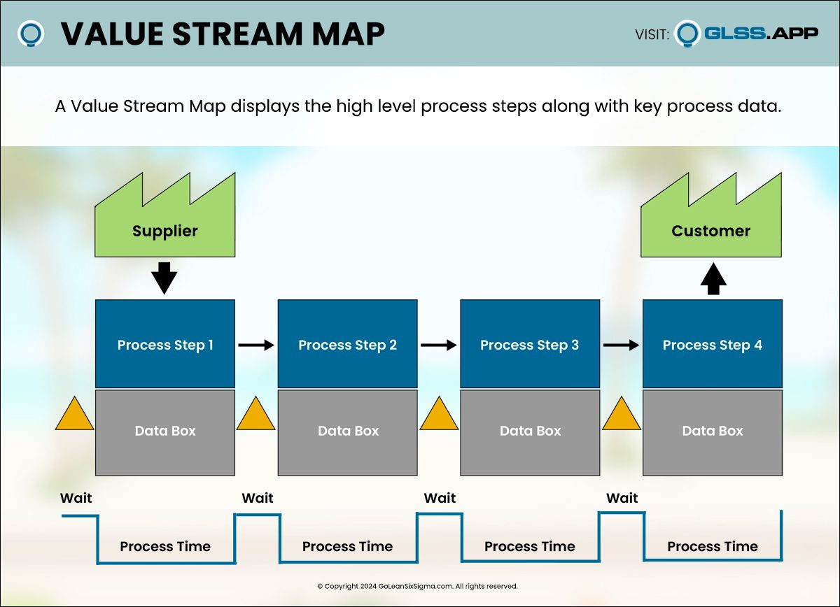
Value Stream map Template with Process and queue slots
Figure 2. Simple value stream map template with slots for projected process times, wait periods considered “queues” that are not counted toward process time
(Value Stream Map Template. 2024, GoLeanSixSigma)

Slide 7
Deployment lead times requiring months
Sometimes deployment lead times can require months to fulfill
More common in larger organizations with more complex organizations that utilize a more “monolithic” architecture (unified, or closely integrated system)
High reliance on manual testing
Requires multiple approval processes
Fixing issues in a project that requires a high lead time can take days or weeks
(Kim et al., 2016)

Slide 8
Deployment lead times requiring Minutes
Ideally developers receive fast and constant feedback to allow for faster and more independent implementations
Achieved by continuous code review of small changes into VC repository
Small changes are tested and deployed into production to provide confidence in functionality
Modular coding practices make these miniature pushes easier
Because the changes are smaller, the impacts of failure are smaller and more contained
(Kim et al., 2016)

Slide 9
Resources:
Beal, H. (n.d.). What is a Value Stream? https://www.vsmconsortium.org/blog/what-is-a-value-stream
Kim, G., Debois, P., Willis, J., & Humble, J. (2016). The DevOps Handbook: How to Create World-Class Agility, Reliability, and Security in Technology Orga
nizations. https://dl.acm.org/citation.cfm?id=3044729
Martin, J. (1995). The great transition: Using the Seven Disciplines of Enterprise Engineering to Align People, Technology, and Strategy. AMACOM/American Management Association.
Value Stream Map Template. (2024). GoLeanSixSigma. https://goleansixsigma.com/value-stream-mapping/
Value Stream Mapping | NIST. (2024, May 22). NIST. https://www.nist.gov/mep/value-stream-mapping

