Slide 1

Final Presentation
Visually simulating high-quality planning domain models
Group #2
Notes:
interesting but challenging project

Slide 2

Client
(Represented by Swarup Kumar Mohalik)
Lately focused especially on Artificial Intelligence & innovative communication
Local learning (distributed sites)
Global decision making (consolidation of data)
AI Planning and its languages
Notes:
If anyone here sometimes reads tech news, they might have heard about how Ericsson, 4 days ago, was for the first time able to run 5g on a 4g network of 2.6Hz, with the speed of 40GB/s.
This latest test was part of a project named SCOTT, the same project our tool is going to be included in after a few months.

Slide 3

Ericsson, Project SCOTT & Our Work
Our work is now a cell of the SCOTT project
Will be used in automated warehouses
Main usage is in Artificial Intelligence planning to plan tasks for robots.
Will allow:
Overview of deadlocks stages
Selecting actions and updating planning tree
Returning to a previous state, and resume the visualization from there
Notes:
The was a really tiny cell in a large frame of innovative solutions being developed by Ericsson

Slide 4
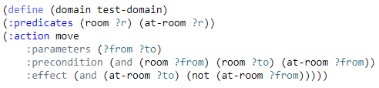
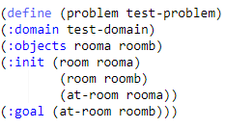
Recap of PDDL (Planning Domain Definition Language)
AI planning – An important branch of Artificial intelligence
Realization of strategies or actions executed in a sequential order
Used by AI planners
The output of AI planners can be executed by AI agents to carry out plans (Autonomous vehicles, Robots)
PDDL consists of two files
Problem file + Domain file

Slide 5
THE VISUAL SIMULATOR

Slide 6
Purpose
Will aid developers of PDDL
Easily spot bugs and errors through the visualization of the states
Seeing how the code corresponds to the different states
Simulate the actions that can be executed within the PDDL code
Easily see the execution of actions, step by step

Slide 7
Features
Implemented
Visualizing and simulating the domain model & state tree
Returning to the previous states
Storing the state history
Not implemented/Optional
Checking syntax
PDDL text editor
Integration with VAL-tool

Slide 8
Feedback & improvements
Steering group feedback
Implemented:
a scroll bar
a reset button
storing state history
number for each action
Other groups’ feedback
Used Graphviz instead of drawing tool

Slide 9
TOOL DEMONSTRATION

Slide 10
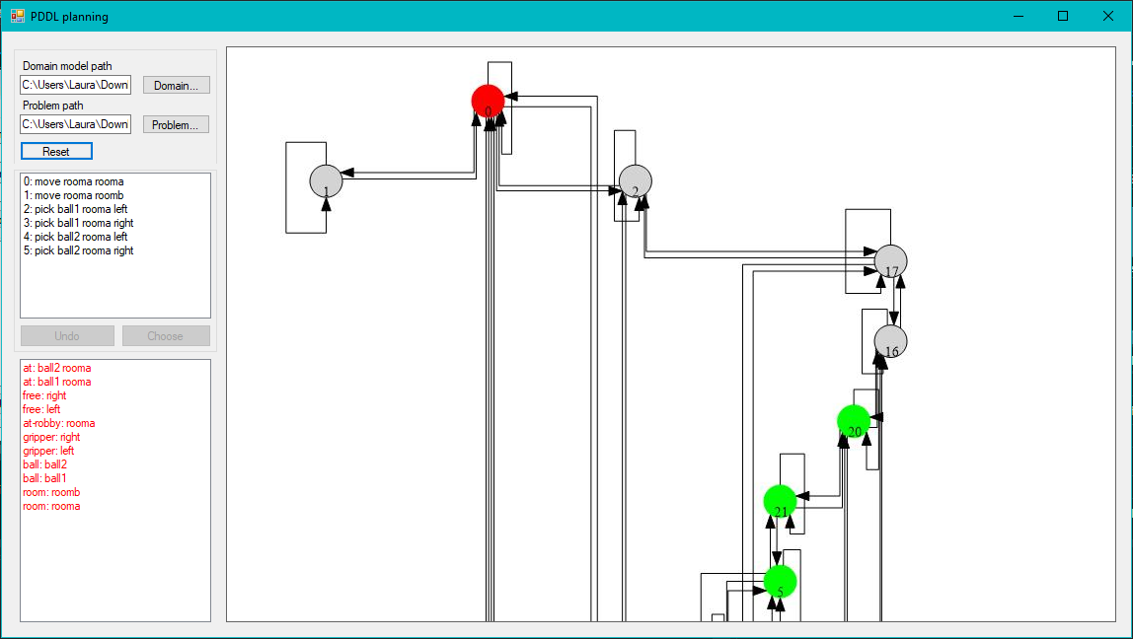
Figure 1. Initial state

Slide 11
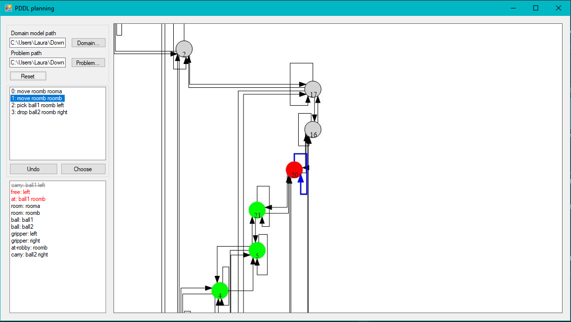
Figure 2. Highlighting an activity l

Slide 12
Acceptance testing
Satisfied client.
Suggested future improvements:
Adding new features of PDDL 2.1 (fluents)
Removing actions that take us to the previous state
Negative preconditions
Integrating with the VAL-tool
Syntax checker and PDDL editor

Slide 13
Work Pattern
& Experiences

Slide 14
Task prioritization & distribution
Estimated importance of functional and non-functional requirements
Created sub-tasks according to requirements’ priority decided
Used a color code system to indicate importance on Trello for easiness
Estimated required effort and time of implementation
All members had different & diverse tasks
Individual assessment of the implementation progress & ETA
Notes:
we had non functional like PDDL text editor and syntax checker - LOW priority, left for end
PARSE PDDL - Smaller pieces of work to implement
Colour code helped in emphasizing which task to pick up first
LINES of code take more time
A member had to implementate as well as write in documentation
lack of assessment from a supervisor allowed for individual asessment

Slide 15
Work pattern change
Initial time plan partly followed
Longer implementation than expected
Cause: Lack of documentation of VAL-tool
Work could have been easier and shorter
Parsed via Regex instead
Required effort distributed efficiently between members
Good accordance with the tasks assigned by group manager and then reported by Trello responsible
Task | Actual Effort (person days)
Project meetings | 68
Project presentations | 8
Research | 21
Documentation | 51
Testings | 4
GUI development | 47
Back-end dev. | 73
Total | 272

Slide 16
Change management & results
A lot of research helped in coping with the dismiss of VAL Tool
Adoption of new tools
Updated group structure
New sub-teams with new tasks but with same primary role
Adapting work to other feedback
In the meantime learned Trello, GitHub and Visual Studio
Developed co-operation and leadership skills
Autonomous planning skills

Slide 17
Positive Experiences
Gained experience regarding planning of an actual software project
Industry requirements with academic consequences
All group members learned about PDDL from scratch
Increased interpersonal skills
Independent work from lack of dynamic client communication
Got to know wonderful people with different backgrounds and experiences

Slide 18
Unfavorable Experiences & Improvements
Abstractism of AI Planning and PDDL
Lack of support in the initial phases of the project that lead to delay and a lot of research
Less progress during vacations due to members’ personal tasks
Steering meetings not used by all members for practicing presenting and verbal skills

Slide 19
Thank you for your attention.

