Slide 1
Visual Simulator for High Quality Planning Domain Models
swarup.kumar.mohalik@ericsson.com
aneta.vulgarakis@ericsson.com

Slide 2
AI, Planning and Domain Models
Planning is a major research and application area in AI
Input to planning
Domain models describe actions that the AI agents can execute to change the state of the world
Initial and the goal state
Output of planning
Sequence or partial order of actions the agents should execute to achieve the goal starting at the initial state

Slide 3
Good Domain Models
AI Planning is hinged upon good domain models
Models must be correct, consistent and complete
Need a GUI-based tool to help build high-quality planning models
The tool should support
representation of domain, problem, plans
syntax check
simulation
debug
runtime checks for violation
Property verification

Slide 4
They will build a tool where the user can edit (or maybe as a first step just import) a textual PDDL domain model, and simulate it for debugging purposes. The simulation GUI should present the current state (i.e. what predicates are true/false and which actions are possible). Selecting one of the possible actions should result in an updated state. In addition to showing the current state, maybe a possibility to return to a previous state and try a separate action from there (possibly some visualization of the whole tree of reached states, allowing the user to just click on one of them and make that the current state.
Jan’s Summary

Slide 5
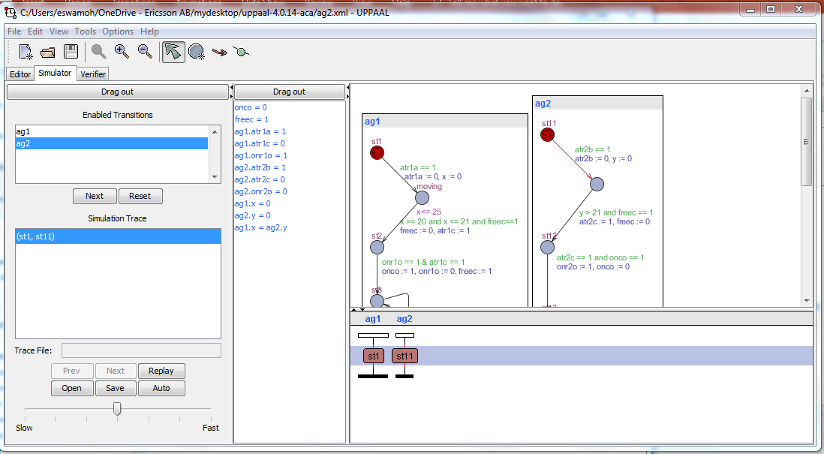
Example – UPPAAL tool
Need a similar tool for planning domain model development

Slide 6
Basic Functionality
GUI is brought up
Load a domain and problem instance
Synthesize a PDDL domain and problem //A service with REST-based service is available
Check syntax and point out bugs [assume no bug to start with]
Bug is in the ontology instance => change instance and reload
Bug is in PDDL synthesis => debug synthesizer and restart
Show current state, explored state tree and enabled actions
User can choose an action
System will update the current state and state tree
User can select any of the explored states (also with a “go back” function)
System will update the current state
Simulate (upto K steps)
System selects arbitrary actions and simulates

Slide 7
Technology Needed for a Minimal Tool
User interface
Ontology
PDDL
http://www.cs.toronto.edu/~sheila/2542/w09/A1/introtopddl2.pdf
https://arxiv.org/pdf/1106.4561.pdf
Metric-FF (planner) // not directly related, but is good to play around with
https://fai.cs.uni-saarland.de/hoffmann/metric-ff.html
Version 2.0 or 2.1
VAL tool (plan validator)
https://nms.kcl.ac.uk/planning/software/val.html
communication mechanisms (REST, other?)
Docker (put generic components as service)
Stretch
Runtime verification tool (to be selected/written)
version control for domain/plan
Databases
Integrate with UPPAAL for domain verification

Slide 8
Technology Needed for Stretch
Stretch
Runtime verification tool (to be selected/written)
version control for domain/plan
Databases
Integrate with UPPAAL for domain verification

