Slide 1
Project plan presentation
Group #2
A visual simulator for high-quality planning domain models

Slide 2
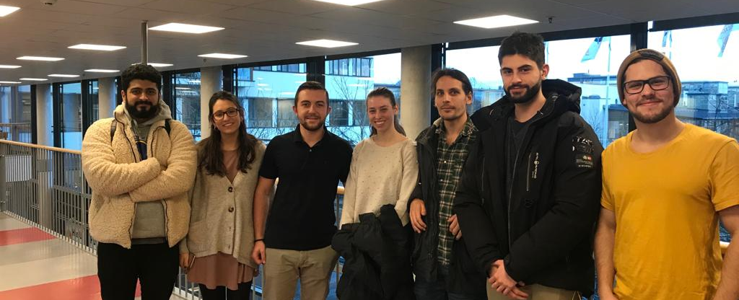
The team
Erik P
Allan
Erik E
Johannes
Marta
Ermal
Laura

Slide 3
Overview
Our client
AI planning
PDDL (Planning Domain Definition Language (PDDL))
A visual simulator for high-quality planning domain models
Meeting the client
Requirement elicitation
Priority of features (?)
Initial backlog
Non-functional requirements(?)
Roles and responsibilities

Slide 4

Our Client
Contact person: Swarup Kumar Mohalik

Slide 5
AI planning
AI planning
Automated planning and scheduling
Automate sequences of actions to be executed by an AI agent (Robot, autonomous vehicle)

Slide 6
Planning Domain Definition Language (PDDL)
Planning Domain Definition Language (PDDL)
An attempt to standardize Artificial Intelligence planning languages
Domain-definition, Problem-definition

Slide 7
What the client wants from us: A visual simulator for high-quality planning domain models
Visually simulate files for AI planning
Debugging

Slide 8
Meeting the client
Client located in India
Skype, Google Hangouts
Preparation of meetings
Limitation of client interaction

Slide 9
Requirement elicitation
Detailed project description from Jan
PowerPoint project proposal from out client, Swarup

Slide 10
Priority of features
Create simple mockup version of tool
Add functionality iteratively
Import PDDL files, and debug if we have time

Slide 11
Initial backlog

Slide 12
Non-functional requirements (???)

Slide 13
Roles and responsibilities
Allan - Conﬁguration Manager (Trello)
Laura – Configuration Manager (GIT)
Johannes - Client Contact
Marta: Management of documentation & reports
Erik P - Presentation Overseer
Ermal: Group Manager
Erik E - Conﬁguration Manager (Developer Studio)

Slide 14
Roles and responsibilities
Marta – Management of documentation & reports
Erik P - Presentation Overseer
Erik E - Conﬁguration Manager (Developer Studio)
Allan - Conﬁguration Manager (Trello)
Laura - Conﬁguration Manager (GIT)
Johannes - Client Contact
Ermal - Group Manager

Slide 15
Thanks for listening

