Slide 1
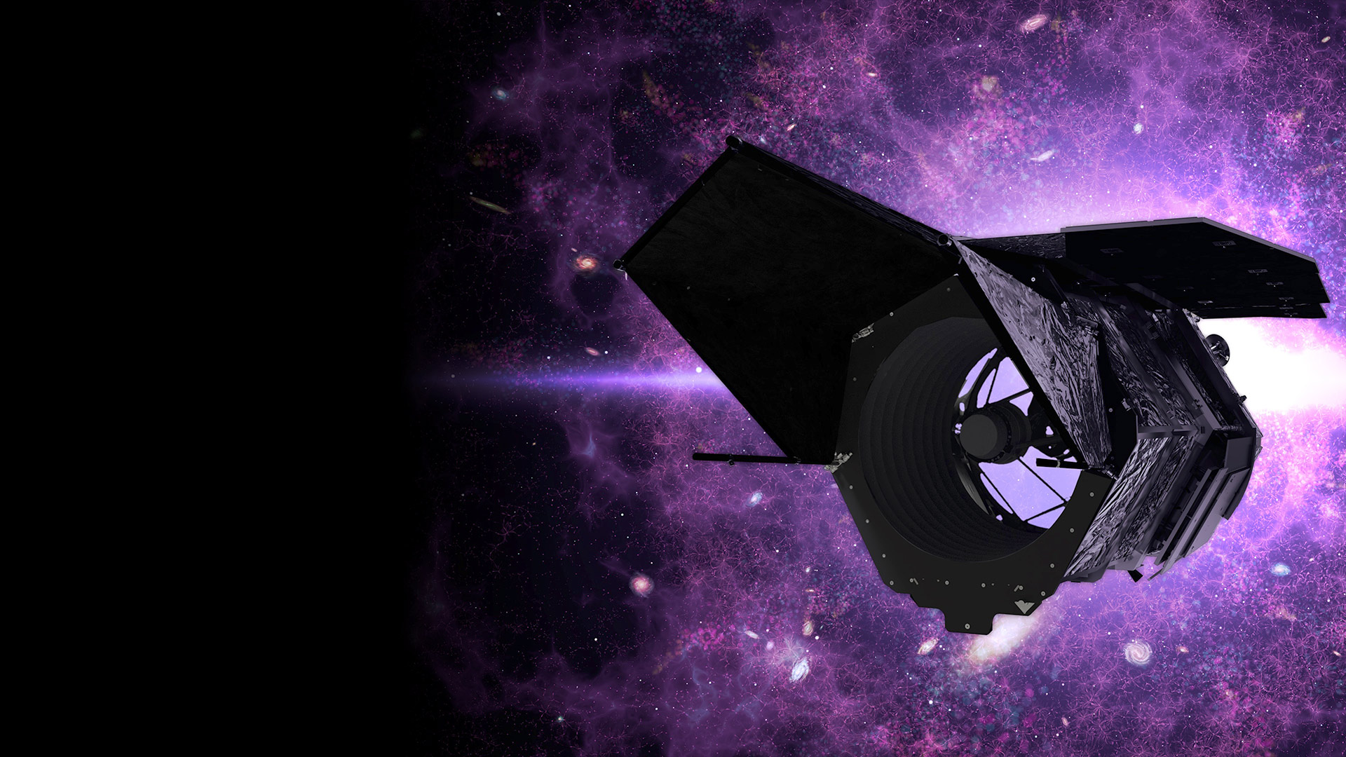
Integrated Modeling for the RST
STOP Pipeline and Jitter Analysis
Eric Chen – Astrophysics Junior, UC Berkeley

Slide 2
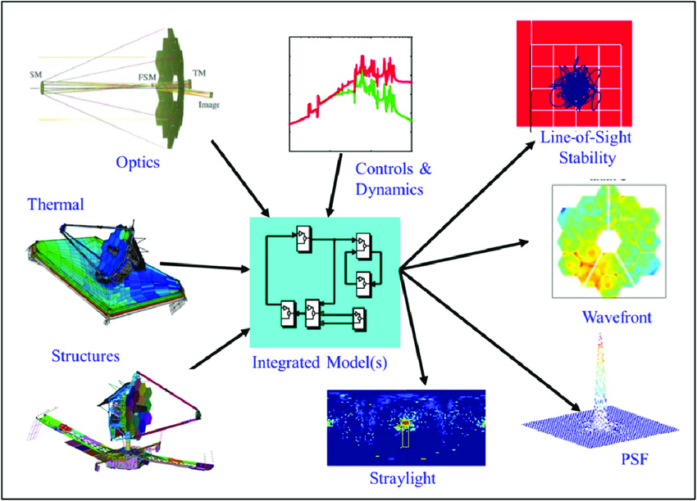
What Is IM?
Figure Caption Goes here (move around as needed)

Slide 3
STOP Pipeline and Jitter Analysis
STOP: Structural, Thermal, and Optical Pipeline
  Challenge: Jobs span multiple computers, hard to track progress
  Solution: Log streaming function
Jitter Analysis: Reaction wheel causes vibrations and affects image quality
  Challenge: Analysis script is one giant MATLAB file, requires manual handoff and calculations are slow
  Solution: Standalone MATLAB function and improved efficiency in calculation
Figure Caption Goes here (move around as needed)

Slide 4
STOP Before
Original Workflow
  Friction: Each engineer has their own scripts and only they can run it
  Downtime: Speed of analysis rested on availability of each individual team
Automated Workflow
  GUI launches on local computer
  Connects to IM Computer and Discover through GUI script
  However, logs are generated on Discover, and it has a 2FA process.
  Hard to track progress of remote run unless logging in to Discover constantly
Figure Caption Goes here (move around as needed)

Slide 5
STOP After
Log Streaming
  Daemon collects new logs generated on Discover
  Bundles together and send it over to IM Computer and then relayed to local computer
Blue arrow: Task Definition
Green arrow: Logs
Local Computer
IM Computer
Discover
Figure Caption Goes here (move around as needed)
2FA

Slide 6
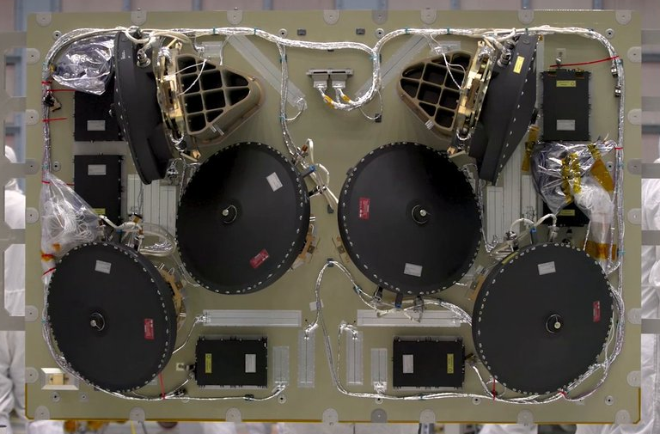
What is Jitter?
  Wheels cannot be manufactured perfectly
  Spinning with imperfections causes disturbance at the spinning frequency
  Tiny vibration at the same frequency as a structural mode would be amplified
  Vibrations propagate throughout the telescope causing the optics assembly to vibrate as well
Figure Caption Goes here (move around as needed)

Slide 7
Jitter After Pt. 1
Old script shortfalls
  New analysis requires copying the MATLAB file which is not a safe way to distribute
  Different initial condition needed to be manually changed inside the script
  MATLAB error messages were not helpful, they were not specific to our analysis
Improvements
  Standalone MATLAB function that doesn’t require copying and editing
  Inputs are defined when calling the function, no more editing the body of the script
  Custom helper function and error message for easier debugging
Figure Caption Goes here (move around as needed)

Slide 8
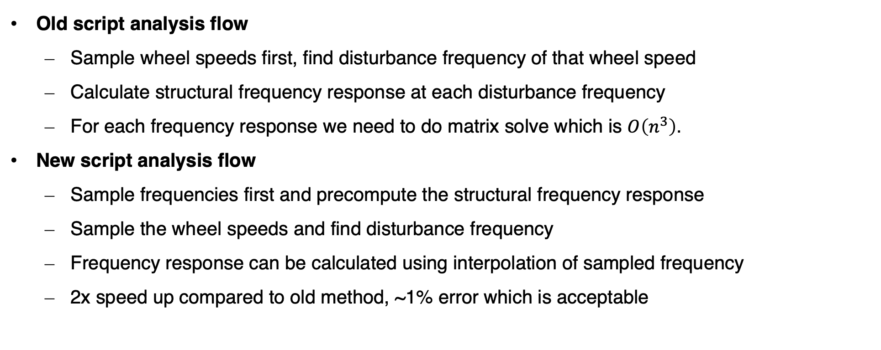
Jitter After Pt. 2
Old script analysis flow
  Sample wheel speeds first, find disturbance frequency of that wheel speed
  Calculate structural frequency response at each disturbance frequency
  For each frequency response we need to do matrix solve which is $O\left(n^{3}\right)$.
New script analysis flow
  Sample frequencies first and precompute the structural frequency response
  Sample the wheel speeds and find disturbance frequency
  Frequency response can be calculated using interpolation of sampled frequency
  2x speed up compared to old method, ~1% error which is acceptable
Figure Caption Goes here (move around as needed)

Slide 9
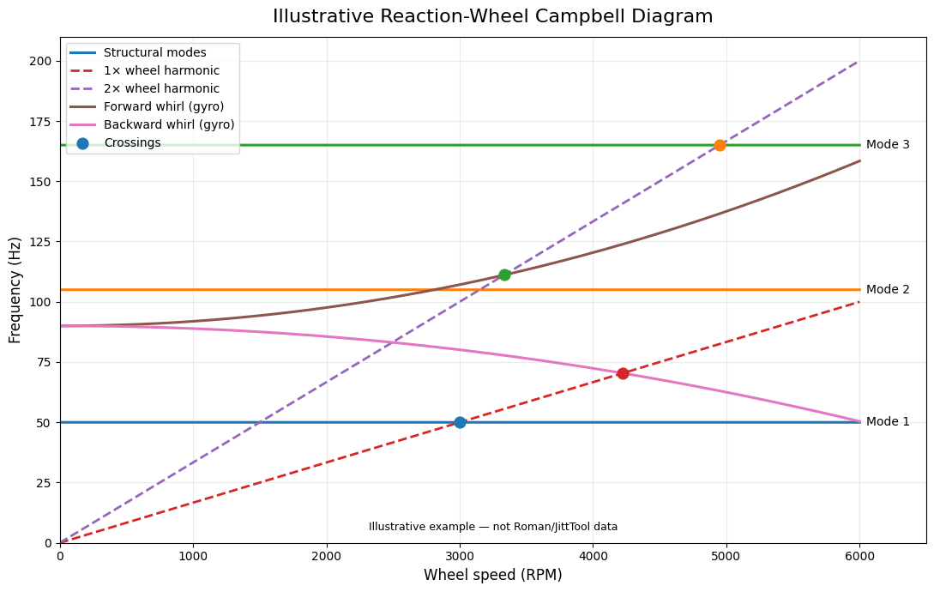

Slide 10
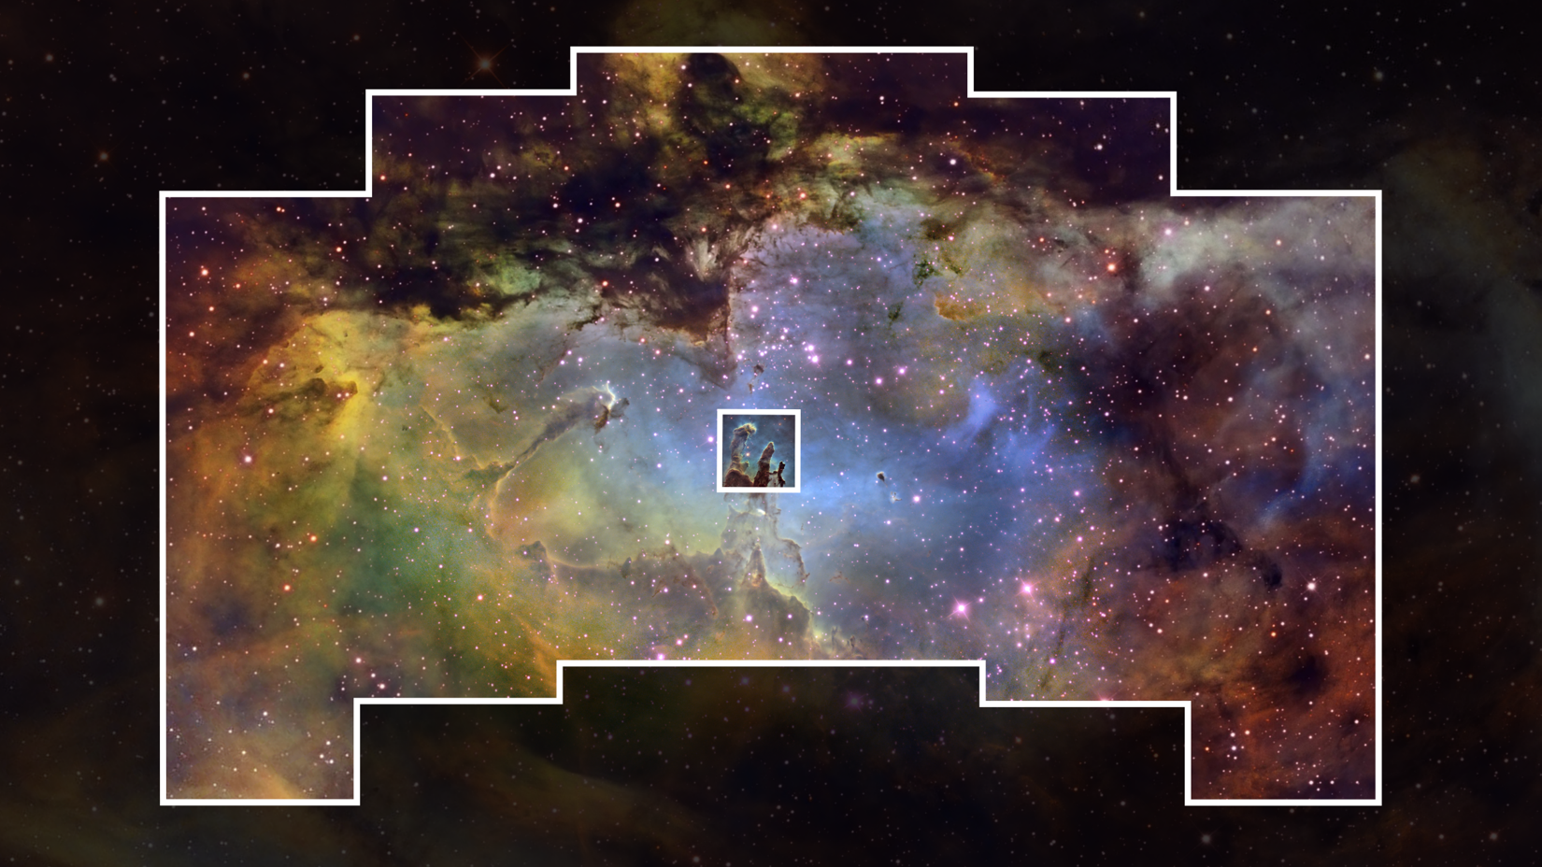
THANK YOU FOR LISTENING!

