Slide 1

Full CMOS Implementation of Bidirectional Associative Memory Neural Network with Analog Memristive Synapse
B.Tech Thesis Presentation
Sachin Mohanty
Roll No: 2301180
Under the Supervision of:
Dr. Mourina Ghosh
Department of Electronics & Communication Engineering Indian Institute of Information Technology Guwahati
25th April, 2022
CMOS BAM Neural Network

Slide 2





Contents
Introduction
Motivation
Objective
4
Work Done
5
Conclusion and Future Work
CMOS BAM Neural Network

Slide 3




Outline
Introduction
Motivation
Objective
4
Work Done
5
Conclusion and Future Work
CMOS BAM Neural Network

Slide 4
What is Neuromorphic Computing & Why Use It?
The Neuromorphic Solution
The Von Neumann Bottleneck
Conventional computing separates CPU and Memory.
Constant data movement causes high latency and massive energy consumption.
Modern AI requires Kilowatts of power.
Brain-Inspired: Brain processes and stores data in synapses using only
∼20W.
Neuromorphic Computing: Hardware mimics biological neural networks.
Highly parallel, event-driven, integrates memory with computation.
CMOS BAM Neural Network

Slide 5
What is a Memristor?
The Fourth Fundamental Element
Postulated by L.O. Chua (1971).
Relates magnetic flux (φ) and charge (q).
Resistance depends on history of current — non-volatile memory.
I
V
Pinched loop
Key Property
The 4 elements:
R (V-I) L (Flux-I)
(Flux-Charge)
_{M =} dφ
⇒ Memristance
C (Charge-V) M
dq
Pinched hysteresis loop in I-V characteristic
CMOS BAM Neural Network

Slide 6
Memristors as Artificial Synapses
Why Memristors?
Analog tunable resistance → synaptic weight
Non-volatile → memory without power
High density crossbar arrays In-memory computation
O₁ O₂ O₃
V₃
M
M
M
V₂ M
M
M
Hardware Challenge
Physical memristors are not available in standard CMOS PDKs due to fabrication complexities → Need a CMOS emulator!
V₁
M M M
Memristive Crossbar
CMOS BAM Neural Network

Slide 7

Outline
Introduction
Motivation
Objective
4
Work Done
5
Conclusion and Future Work
CMOS BAM Neural Network

Slide 8
Literature Review & Motivation
Work |  | Approach |  | Limitation
Zhao et al. 2017) | (ISPACS | Memristor model | SPICE | Hardware not fabricat-able
Shi & 2020)
Saxena 2019)
Zeng (IEEE
In-situ learning BAM
SPICE model only
(MWSCAS
Compact CMOS emu-lator
Applied to memcomput-ing
This Work
Full CMOS BAM,
180nm
First full CMOS imple-mentation
Research Gap & Motivation
No prior work implemented a complete CMOS circuit of BAM using a CMOS memristor emulator in standard technology.
Physical stochastic device characteristics limit reliable weight storage.
CMOS BAM Neural Network

Slide 9
Outline
Introduction
Motivation
Objective
4
Work Done
5
Conclusion and Future Work
CMOS BAM Neural Network

Slide 10
Problem Statement & Objectives
Problem Statement
To design and simulate a 6×6 Bidirectional Associative Memory neural network using a CMOS-based tunable memristor emulator as the synaptic element in SCL 180nm CMOS technology.
Specific Objectives
1
Objective 1: Implement a CMOS memristor emulator with tunable resistance to act as an artificial synapse.
Objective 2: Build a fully analog 6×6 BAM crossbar synapse circuit.
Objective 3: Resolve analog TIA loading issues for stable logic outputs.
Objective 4: Demonstrate successful pattern learning and bidirectional recall of spatial patterns via Virtuoso simulations.
2
3
4
CMOS BAM Neural Network

Slide 11
Outline
Introduction
Motivation
Objective
4
Work Done
5
Conclusion and Future Work
CMOS BAM Neural Network

Slide 12
Proposed Technique: BAM Algorithm & Weight Calculation
Two-Layer Neural Network
X-layer (n neurons) ↔ Y-layer (p neurons) Fully connected via weight matrix W
W
Bidirectional: input from either layer
X-Layer
Y-Layer
y_{next} = f (xW , x ), x_{next} = f (yW ^{T} , y )
Hebbian Learning Rule
_{W} T
M
Tetris pattern pairs used:
Black box = +1, White box = −1
Σ
T
W = X Y
k k
k=1
Logical weights: W_{jk} ∈ {−3, −1, +1, +3}
CMOS BAM Neural Network

Slide 13
Implementation: CMOS Memristor Emulator
Tunable Resistance Mechanism
Transistor M1 in deep triode region:
W
G = K_{n L} (V_{GS} − V_{CM} − V_{Tn})
Memristor Emulator
W/L = 0.42 µm / 10 µm
VGS controls resistance continuously
Comparator (Vg vs Vtarget )
Switch (Q3,Q4) + Cm
Vtarget
Level shifter (+V_{CM} )
Programming Circuit
M1 (triode) A → B
Gm block senses V_{AB} , charges C_{m}
Comparator monitors V_{g} vs V_{target}
1
2
3
Switch opens when V_{g}
S^{L}ac^{e}hi^{v}n ^{e}M^{l}oh^{s}a^{h}nt^{i}y^{ft}(^{e}III^{r}T ªGu^{d}w^{d}ah^{s}ati^{V})
= Vtarget
4
CM
offset
CMOS BAM Neural Network

Slide 14
Implementation: Crossbar Architecture & Mapping
1M Crossbar Synapse
Output at Y-layer column k:
6×6 Weight Matrix Generated
p
Σ
V = R (G − G )V
ok 0 s jk ij
−1
−1 −1
+1 −3
+1 +1 −3
−1 −1 +3
−1 +3 −1
+3 −1 −1
+1 +1 +3
+3 +3
+3 +3 +1
−3 −3 −1
+1 +1 −1
+1 +1 −1
j=1
+1

+1

W = 





Weight to Resistance Mapping
Two-Stage OTA
Used for: (a) virtual ground Vm, (b) 6 column TIAs
PM2 width = 4 µm for balanced 2nd stage
Weight | Resistance | Vtarget
+1 | 95.2 kΩ | 700 mV
−1 | 84 kΩ | 830 mV
+3 | 110 kΩ | 584 mV
−3 | 75 kΩ | 970 mV
CMOS BAM Neural Network

Slide 15
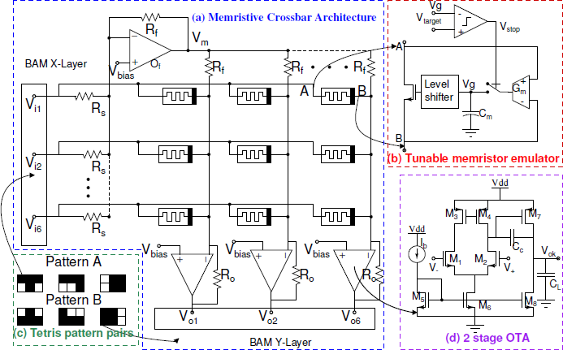
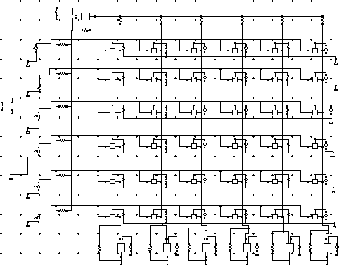
Circuit Implementation: Reference vs. Our Design
Reference Architecture
Our 180nm CMOS Implementation
Proposed theoretical BAM
Full Analog Virtuoso Schematic
Transition to Silicon: We realized the theoretical 1M Crossbar by modeling physical PWL sources, two-stage OTAs, and tuning transimpedance parameters.
CMOS BAM Neural Network

Slide 16
Results: Learning Phase (Memristor Programming)
Programming Time
Training Protocol (0 – 5 µs)
Target resistance reached rapidly.
5 µs training window provides ample time to securely lock weights. ✓
V_{target} PWL sources pulse each cell Comparator charges C_{m} toward V_{target} Switch opens when V_{g} = V_{target} Weight locked non-volatilely on C_{m}
Circuit Design Challenges Solved
1
OTA imbalance: 2nd stage PMOS width increased to 4µm.
Virtual ground: Separate Vm summing node implements crossbar properly.
Switch topology: Complementary pass-gates ensure full weight swing.
Capacitor Voltage Behavior
2
0–5 µs: C_{m} charges to V_{target}
5.001 µs: V_{target} drops to 0 V (locked)
3
CMOS BAM Neural Network

Slide 17


Results: Simulation Waveforms (Pattern Recall)
Transient Response (10 µs – 40 µs Inference Window)
Input Pattern A: [+1, +1, +1, −1, +1, −1] → Expected B: [−1, +1, −1, +1, +1, +1]
Trannient Renpenne
BRM Erennhar_BamP nchematic
łł"EE"⟡P 4at Rpr ł8 P⟡Ph
Trannient Renpenne
BRM Erennhar_BamP nchematic
łł"E5"ł5 4at Rpr ł8 P⟡Ph
Name Vis V1
/net6 900.0mV ^{1.05}
1.0
.95
.9
.85
.8
/net5 900.0mV ^{1.05}
1.0
.95
.9
.85
.8
/net4 900.0mV ^{1.025}
.975
V1
V2
Name Vis V2
V1
V2
-1
/vo1
1.70402V ^{2.0}
1.75
-1
1
1
V (V)
1.5
1
1
V (V)
1.25
/vo2
1.0
.75
1.68684V ^{2.0}
-1
1.75
1 -1 1
V (V)
1.5
1
1
1
V (V)
1.25
/vo3
1.0
.75
344.111mV ^{2.0}
1.5
1.0
.5
0.0
-.5
1.73183V ^{2.0}
-1 -1
V (V)
1
1
V (V)
.9
.85
/net3 820.0mV ^{1.05}
1.0
.95
.9
.85
.8
/net2 900.0mV ^{1.05}
1.0
.95
.9
.85
.8
/net1 820.0mV ^{1.05}
1.0
.95
.9
.85
.8
/vo4
1
-1
1.75
1
1
V (V)
-1
-1
1.5
V (V)
1.25
/vo5
1.0
.75
1.73183V ^{2.0}
1
1 1
1
1.75
V (V)
-1
1.5
1
V (V)
1.25
/vo6
1.0
.75
835.845mV ^{2.0}
-1
-1 ₁ ₁
1.75
1 1
V (V)
1.5
V (V)
19.57192us
1.25
1.0
.75
.5
30.58886us
10.0 15.0 20.0 25.0 30.0 35.0 40.0
time (us)
10.0 15.0 20.0 25.0 30.0 35.0 40.0
time (us)
Markern
!ł !P
Markern
!ł !P
x Jneth Jnet5 Jnet4 JnetE JnetP Jnetł
łR+57łRkn E⟡+E5E4kn
x Jveł JveP JveE Jve4 Jve5 Jveh
łR+h55Rkn 84R+łm!
ł+7P⟡h! P+PER8m! ł+75⟡4! ł+75⟡4!
ł+E5hł!
E⟡+588Rkn ł+7⟡4! ł+h8h8! E44+łłm! ł+7Eł8! ł+7Eł8! 8E5+85m!
R⟡⟡+⟡m! R⟡⟡+⟡m! R⟡⟡+⟡m! 8P⟡+⟡m! R⟡⟡+⟡m!
8P⟡+⟡m!
8P⟡+⟡m! R⟡⟡+⟡m! 8P⟡+⟡m! R⟡⟡+⟡m!
Printe4 en h; hket
8P⟡+⟡m! R⟡⟡+⟡m!
Page ł eF ł
Printe4 en h; hket
Page ł eF ł
Input Pattern Pulses Output Recalled Pattern
Activation: Outputs > 1 V evaluate to logic +1, outputs < 1 V to logic −1. The graph successfully demonstrates the expected logic exact pattern matches.
CMOS BAM Neural Network

Slide 18
Outline
Introduction
Motivation
Objective
4
Work Done
5
Conclusion and Future Work
CMOS BAM Neural Network

Slide 19
Conclusion & Future Work
Conclusions
Successfully implemented 6×6 BAM in standard 180 nm CMOS.
CMOS memristor provides tunable non-volatile weight storage.
Full simulation demonstrates correct pattern association.
First full CMOS implementation of BAM with a CMOS synapse.
Future Work
Layout design and post-layout simulation.
Extend to larger BAM networks
(12×12, 24×24) for image recognition.
Implement on-chip STDP learning for autonomous updates.
Power analysis and energy optimization.
CMOS BAM Neural Network

Slide 20
References
L. Chua, “Memristor-the missing circuit element,” IEEE Trans. Circuit Theory, vol. 18, no. 5, pp. 507–519, 1971.
R. S. Williams, “How We Found The Missing Memristor,” IEEE Spectrum, vol. 45, no. 12, pp. 28–35, 2008.
S. K. Vohra, S. Thomas, M. Sakare, D. M. Das, “Full CMOS Implementation of Bidirectional Associative Memory Neural Network with Analog Memristive Synapse,” IEEE MWSCAS, pp. 445–448, 2021.
S. N. Truong, K. Min, “New memristor-based crossbar array architecture with 50% area reduction,” J. Semiconductor Technol. Sci., vol. 14, no. 3, pp. 356–363, 2014.
V. Saxena, “A compact CMOS memristor emulator circuit and its applications,” IEEE MWSCAS, pp. 190–193, 2019.
CMOS BAM Neural Network

Slide 21
Thank You
Questions & Discussion
Contact
Your Name — Roll No: 2003019 Department of ECE, IIIT Guwahati
CMOS BAM Neural Network

