Slide 1
Memristor-Based Spatio-Temporal Associative Memory (Concept Explanation and Replication)
Sachin Mohanty
IIIT Guwahati
February 16, 2026
Memristor-Based Spatio-Temporal Associativ
February 16, 2026
10 / 18
e Memory (Concept Explanation and Replicati

Slide 2
Why Neuromorphic Computing?
Motivation
Limitation of Conventional Computing
Von Neumann architecture separates memory and processor Constant data movement → high energy consumption Memory bottleneck limits performance
Scaling CMOS reaching physical limits
Energy Comparison
Human brain: 20 Watts
Modern AI systems: Kilowatts to Megawatts
Need computing systems that are: Energy efficient
Parallel Event-driven
Memory and computation integrated
Memristor-Based Spatio-Temporal Associativ
February 16, 2026
10 / 18
e Memory (Concept Explanation and Replicati

Slide 3
Why Brain-Inspired Systems?
Motivation
The human brain performs: Pattern recognition Associative memory Learning and adaptation Fault tolerance
using:
Massive parallelism Spiking communication Synaptic plasticity
Neuromorphic computing attempts to replicate:
Neurons + Synapses + Spikes
in hardware.
Memristor-Based Spatio-Temporal Associativ
February 16, 2026
10 / 18
e Memory (Concept Explanation and Replicati

Slide 4
Why Memristors for Neuromorphic Systems?
Motivation
Memristors naturally resemble biological synapses: Resistance depends on history (plasticity) Non-volatile memory
Analog weight storage
High density crossbar integration Energy efficient switching
Memristor = Electronic analogue of synapse
This makes them ideal for: Neuromorphic circuits Associative memory Spiking neural networks
Memristor-Based Spatio-Temporal Associativ
February 16, 2026
10 / 18
e Memory (Concept Explanation and Replicati

Slide 5
Flux–Charge Relation (Chua’s Missing Element)
Fundamental Theory
Four fundamental circuit variables:
∫
∫
v (t), i (t),
Three classical elements: Resistor: v = Ri Capacitor: q = Cv Inductor: ϕ = Li
Missing relation:
q(t) =
i (t) dt,
ϕ(t) =
v (t) dt
dϕ dq
M(q) =
v (t) = M(q(t)) · i (t) Resistance depends on charge history → memory.
Memristor-Based Spatio-Temporal Associativ
February 16, 2026
10 / 18
e Memory (Concept Explanation and Replicati

Slide 6
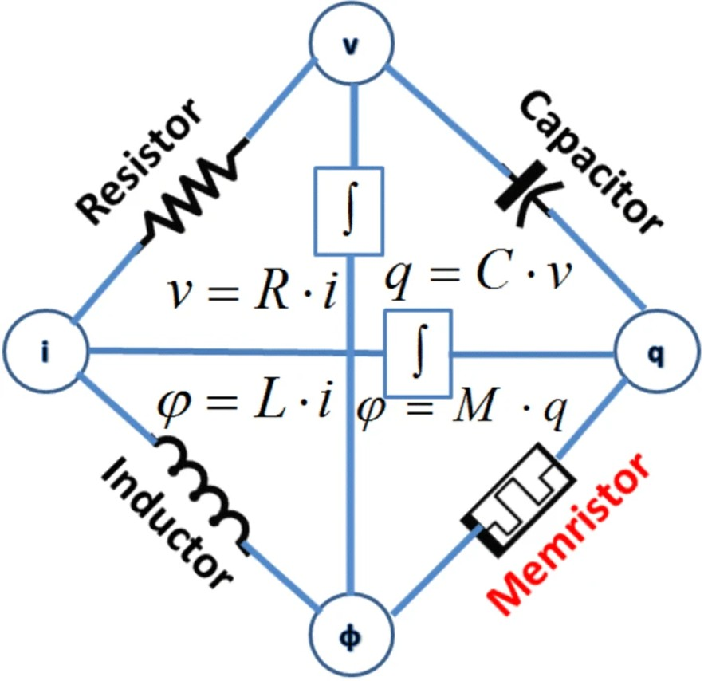
Fundamental Theory
Flux–Charge Graphical Representation
Memristor-Based Spatio-Temporal Associativ
February 16, 2026
10 / 18
e Memory (Concept Explanation and Replicati

Slide 7
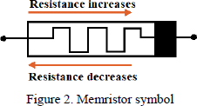
Fundamental Theory
Memristor Symbol
Memristor-Based Spatio-Temporal Associativ
February 16, 2026
10 / 18
e Memory (Concept Explanation and Replicati

Slide 8
Formation of Hysteresis Loop
Fundamental Theory
Applied voltage:
v (t) = V₀ sin(ωt)
Low frequency:
State variable tracks voltage Large pinched hysteresis
High frequency:
State lags behind Loop shrinks
Pinched at origin because:
v = 0 ⇒ i = 0
Memristor-Based Spatio-Temporal Associativ
February 16, 2026
10 / 18
e Memory (Concept Explanation and Replicati

Slide 9
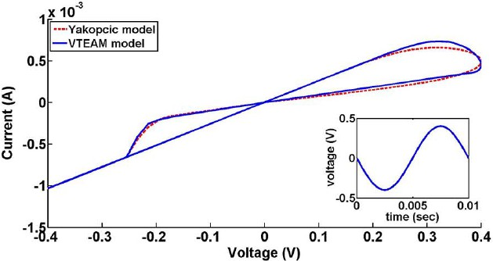
Fundamental Theory
Pinched I–V Hysteresis Loop
Memristor-Based Spatio-Temporal Associativ
February 16, 2026
10 / 18
e Memory (Concept Explanation and Replicati

Slide 10
VTEAM Model
VTEAM Model

— v )
k (v
α
f (w ), v > v_{off}
v_{on} < v < v_{off}

off off
off
off
dw
= 0,
dt _{k}
₎αon _{f}
(v − v (w ), v < v
on on on
on
Switching only beyond threshold voltage. Prevents unwanted state change.
Memristor-Based Spatio-Temporal Associativ
February 16, 2026
10 / 18
e Memory (Concept Explanation and Replicati

Slide 11
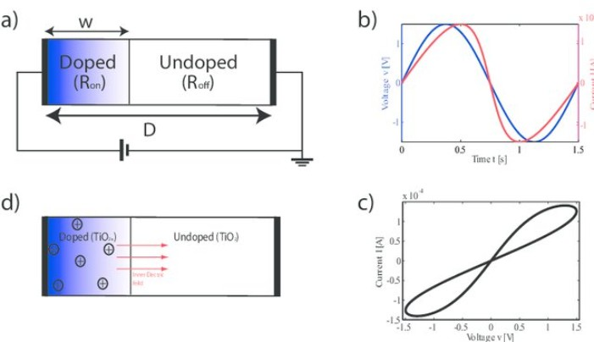
VTEAM Model
VTEAM Model Characteristics
Memristor-Based Spatio-Temporal Associativ
February 16, 2026
10 / 18
e Memory (Concept Explanation and Replicati

Slide 12
Human Associative Memory Mechanism
Associative Memory Concept
Brain retrieves information by pattern similarity (content-addressable memory).
Working Principle:
Information stored as distributed synaptic weights Neurons communicate via spikes (temporal coding) Incoming spikes are weighted by synaptic strength Neurons integrate inputs over time
If membrane potential crosses threshold → neuron fires Recurrent connections reconstruct full stored pattern
Partial Input Pattern → Neural Dynamics → Complete Memory Recall
Memristor-Based Spatio-Temporal Associativ
February 16, 2026
10 / 18
e Memory (Concept Explanation and Replicati

Slide 13
Associative Memory in Hardware
Associative Memory Concept
Mapping:
SIPO → Cortex
MMC → Stored pattern XNOR + AND → Comparator MBO → Neuron firing
Memristor-Based Spatio-Temporal Associativ
February 16, 2026
10 / 18
e Memory (Concept Explanation and Replicati

Slide 14
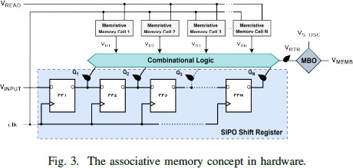
Associative Memory Concept
Hardware Block Diagram
Memristor-Based Spatio-Temporal Associativ
February 16, 2026
10 / 18
e Memory (Concept Explanation and Replicati

Slide 15
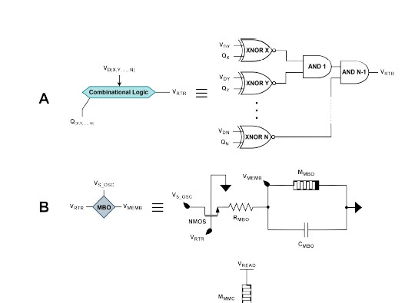
Associative Memory Concept
Hardware Block Diagram
Memristor-Based Spatio-Temporal Associativ
February 16, 2026
10 / 18
e Memory (Concept Explanation and Replicati

Slide 16
Pattern Recognition Principle
Associative Memory Concept
N
^
V = (Q XNOR MMC )
RTR i i
i =1
If TRUE → MBO enabled → Spike output.
Memristor-Based Spatio-Temporal Associativ
February 16, 2026
10 / 18
e Memory (Concept Explanation and Replicati

Slide 17
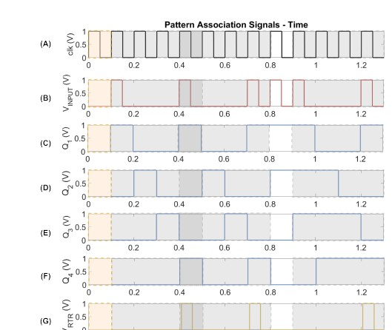
Associative Memory Concept
Output Spike
Memristor-Based Spatio-Temporal Associativ
February 16, 2026
10 / 18
e Memory (Concept Explanation and Replicati

Slide 18
Conclusion
Conclusion
Conventional computing faces energy and scaling limits Brain provides efficient model
Memristor mimics synaptic behavior VTEAM models threshold switching
Spatio-temporal associative memory replicated Pattern match produces neuromorphic spike
Memristor-Based Spatio-Temporal Associativ
February 16, 2026
10 / 18
e Memory (Concept Explanation and Replicati

