Slide 1
Prototype Chart

Slide 2

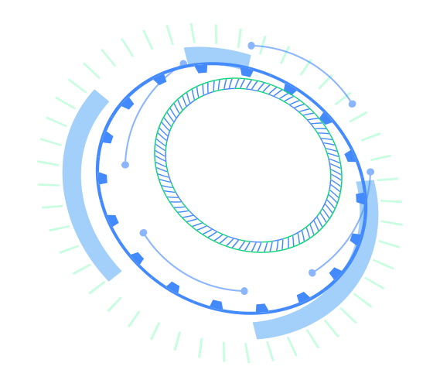


Data Factory
Streaming Data Bus
Big Data Infrastructure Services
Data Computing Service
Stream Computing
JD MapReduce

Slide 3
Elastic Compute, creating clusters quickly;
Computing as required, cost saving;
Data synchronization among different data sources;
Periodic task scheduling;
Task monitoring and early warning;
Real-time data cleaning statistics & analysis;
Automatic integration of relevant products;
Custom operation, computing cluster flexibility;
Enterprise-class data warehouse;
Complete hosting rapid analysis;
Agile development of custom scheduling;
Flexible authority management;
Corresponding service of flexible management;
Quick access and integrated stream computing;
Auto filing;

Slide 4
Data Factory
1. Data access
2. Add connection
5. Create task
6. Operation
scheduling
7. Submit/start
8. Job operation and maintenance
Data Computing Service
3. Create library list
4. Task development (SQL/Python//Scala)
BI Report
9. Add data
10. BI Report

Slide 5
Streaming Data Bus
Data Visualization Screen
1. Data access
2. Create subject
3. Filing setting
4. Create screen
5. Connect data
Stream Computing
7. Create input
6. Create application
8. Create output
9. Create search

Slide 6
JD MapReduce
1. Create clusters
2. Parameter configuration
3. Create operation
4. Regular task scheduling

