Slide 1
U.S. Flight Delay Prediction
and Airport Risk Segmentation
Modern Data Mining · Spring 2026
Prediction: Can pre-departure features forecast arrival delay ≥ 15 min?
Segmentation: Do airports cluster into meaningful delay-risk groups?
Yiting Li · Sihan Yan · Junyang Wang

Slide 2
Research Questions
Section A
Predictive Task
Segmentation Task
Can we predict whether a 2019 U.S. domestic flight will arrive ≥ 15 minutes late using only information available before departure?
▸ Target: ArrDel15 (binary — delayed / not delayed)
▸ Methods: LASSO Logistic Regression, Random Forest, Extra Trees
▸ Evaluation: ROC AUC, PR AUC, top-decile lift
Do U.S. airports fall into meaningful delay-risk segments when summarized by their operating profiles?
▸ Unit of analysis: airport-level aggregates
▸ Method: K-means clustering (k = 3)
▸ Goal: interpretable operational groups
Key insight: Two linked questions: individual-flight risk and broader system structure.

Slide 3
Data Source and Preprocessing
Section A
▸ 2019 U.S. domestic flights — BTS Marketing Carrier On-Time Performance database (Kaggle).
▸ Only variables known before departure are retained as predictors.
▸ Carrier · Origin · Destination · Month · Day-of-month · Departure block · Elapsed time · Distance
▸ A reproducible pipeline builds cleaned samples and airport profiles for both analysis tasks.
Raw source
Combined_Flights_2019.parquet
↓
Prediction sample
flights_2019_sample.parquet
↓
Clustering input
airport_profiles_2019.csv
Key insight: Data restricted to pre-takeoff information — well matched to the research question.

Slide 4
Sample and Variables
Section A
10 % stratified sample — stratified by Month × ArrDel15 to preserve seasonality and class balance.
791,724
19.29 %
373
flights in prediction sample
sample delay rate (ArrDel15)
origin airports in sample
Core predictors (all available before departure)
Carrier
Origin / Destination
Airline identifier
Airport IATA codes
Month / DayOfMonth
Departure Block
Temporal features
Scheduled departure window
Scheduled Elapsed Time
Distance
Planned flight duration
Route distance in miles
Key insight: Large, structured sample built for fair model comparison across methods.

Slide 5
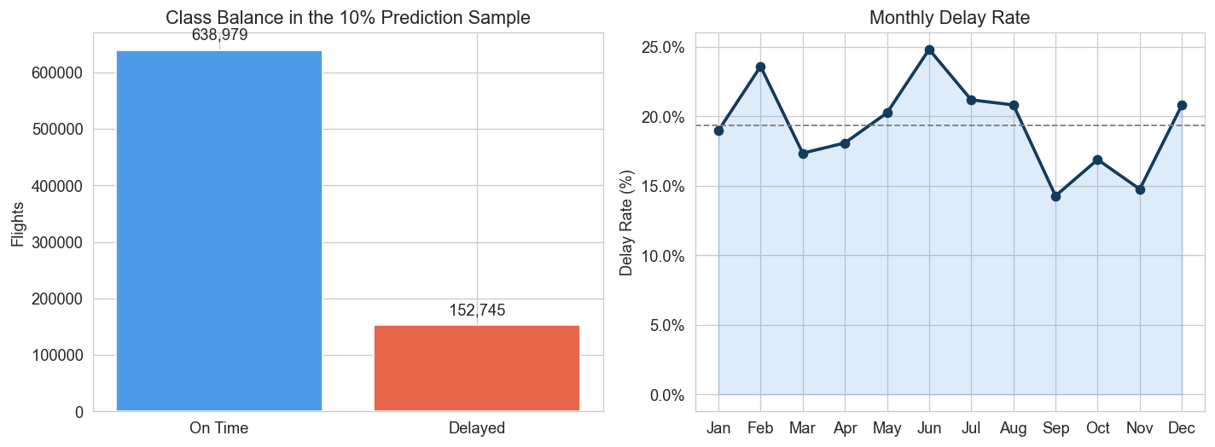
Exploratory Analysis Strategy
Section B
▸ EDA covered: class balance, monthly seasonality, airline differences, departure-time risk, and airport heterogeneity.
▸ Visible timing effects → departure block included as a predictor.
▸ Airport heterogeneity → motivates the separate clustering analysis.
▸ EDA was not decorative — each pattern directly influenced modeling decisions.
▸ Key figures: monthly delay trend, airline delay rates, departure-block risk, and top-airport heat map.
Key insight: EDA established that delay risk is structured — seasonal, timing-driven, and airport-dependent.

Slide 6
Predictive Modeling Setup
Section B
Always On-Time Baseline
LASSO Logistic Regression
▸ Predicts no delay for every flight.
▸ Sets ceiling for naive accuracy.
▸ ROC AUC = 0.500 by construction.
▸ Sparse, interpretable linear classifier.
▸ L1 penalty → automatic variable selection.
▸ Coefficients flag risky airports & windows.
Random Forest
Extra Trees (robustness)
▸ Ensemble of decision trees.
▸ Captures nonlinearities & interactions.
▸ Tuned via random search + cross-validation.
▸ Randomized splitting variant of RF.
▸ Additional nonlinear robustness check.
▸ Same evaluation protocol as RF.
Key insight: All models evaluated on the same train / validation / test split and the same metrics.

Slide 7
Why LASSO and Random Forest?
Section B
LASSO Logistic Regression
Random Forest
▸ Interpretable: non-zero coefficients directly name risky airports and departure windows.
▸ Sparse: L1 regularization reduces noise from the long airport tail.
▸ Honest baseline: if simple features work, LASSO shows it clearly.
▸ Output: 5 highest-risk destinations and origins identified.
▸ Nonlinear: captures threshold effects and interactions LASSO cannot.
▸ Robust: ensemble averaging reduces variance from individual trees.
▸ Group importance: highlights which feature categories matter most.
▸ Output: departure hour, day-of-month, distance lead feature groups.
Key insight: Method choice is driven by the question — not by a desire to stack unnecessary algorithms.

Slide 8
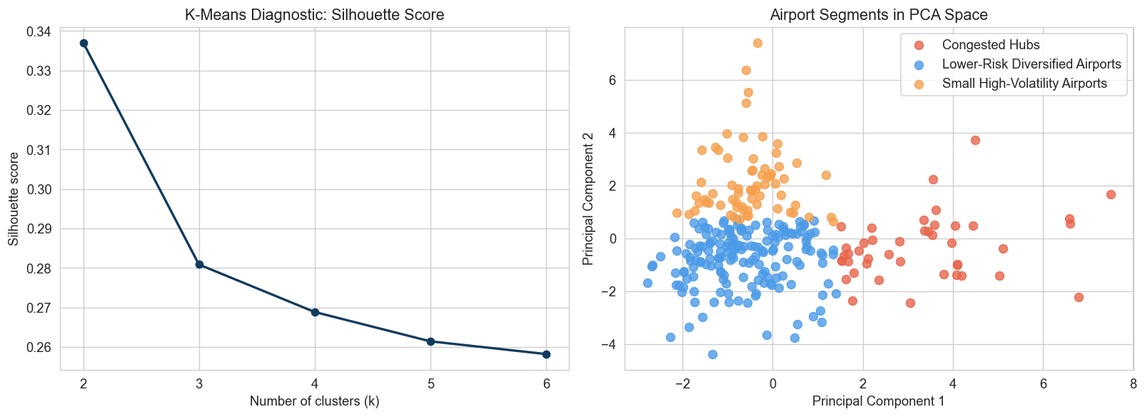
Airport Segmentation Strategy
Section B
▸ Airport profiles aggregate: delay rate, mean & upper-tail delay, carrier diversity, destination diversity, evening traffic share, and flights per day.
▸ K-means tested for k = 2 through k = 6.
▸ Airports with < 1,000 annual flights excluded to avoid micro-cluster instability.
▸ k = 3 chosen over silhouette-optimal k = 2 for interpretability.
▸ Final clusters: Congested Hubs · Small High-Volatility · Lower-Risk Diversified.
Key insight: Clustering used as an interpretive tool — not a purely mechanical optimization exercise.

Slide 9
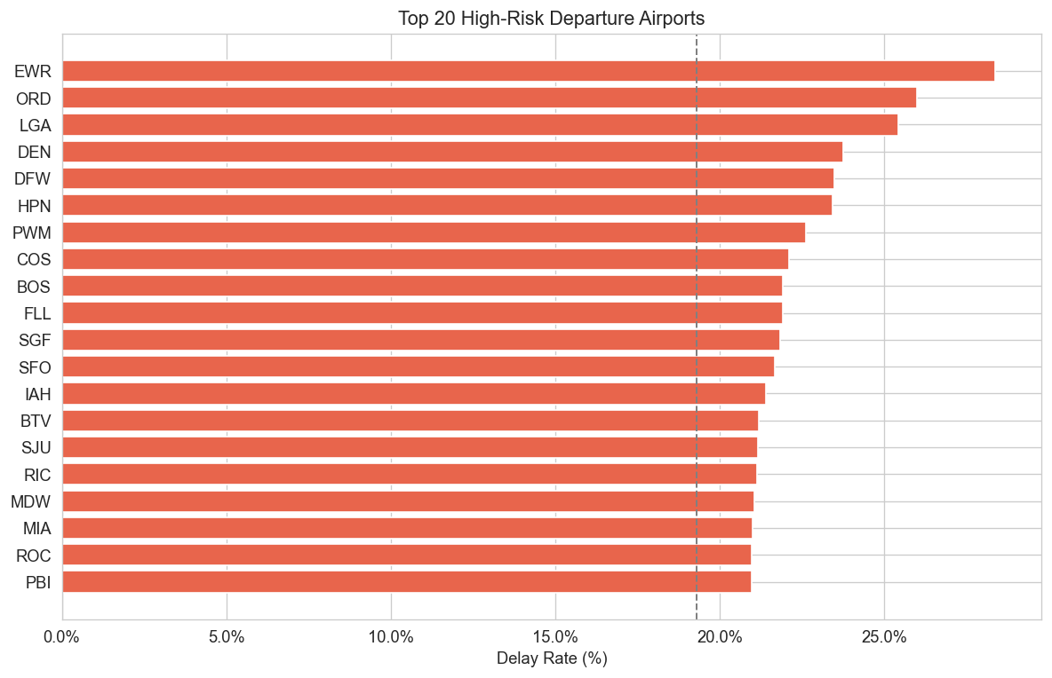
Key Exploratory Findings
Section C
▸ June → highest-delay month; September → lowest.
▸ Departure block 19:00–19:59 is the riskiest window; overnight departures are safest.
▸ Congested hubs — EWR, ORD, LGA — dominate the high-risk airport list.
▸ Both timing and airport context carry signal into the predictive models.
Key insight: Timing and airport context are the dominant themes — structured, not arbitrary.

Slide 10
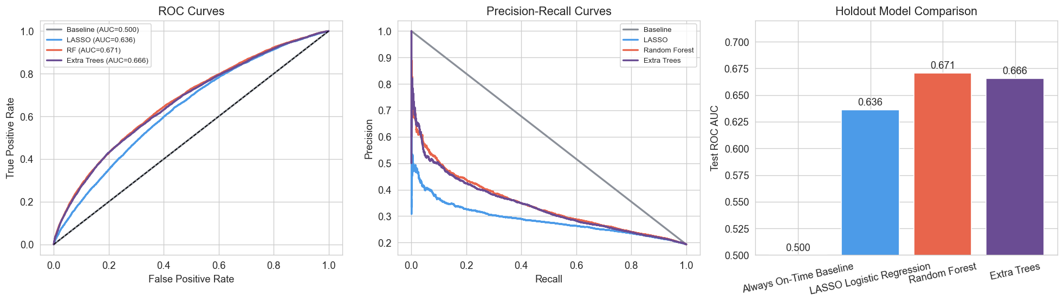
Predictive Model Comparison
Section C
Model
ROC AUC
PR AUC
Top-10 % Lift
Always On-Time
0.500
0.193
1.00×
LASSO
0.636
0.286
1.74×
Random Forest
0.671
0.343
2.21×
BEST
Extra Trees
0.666
0.338
2.17×
Key insight: Random Forest best overall; both trained models materially outperform the naive baseline.

Slide 11
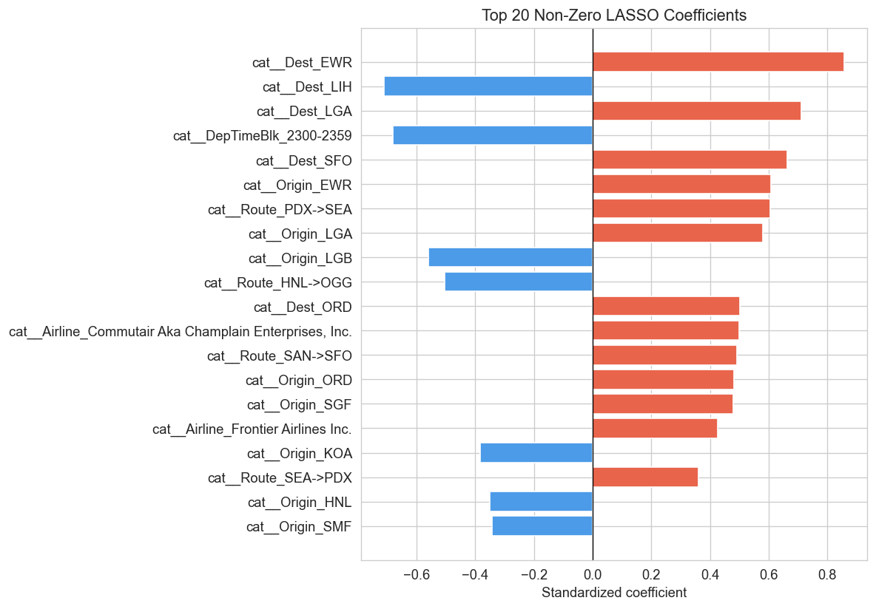
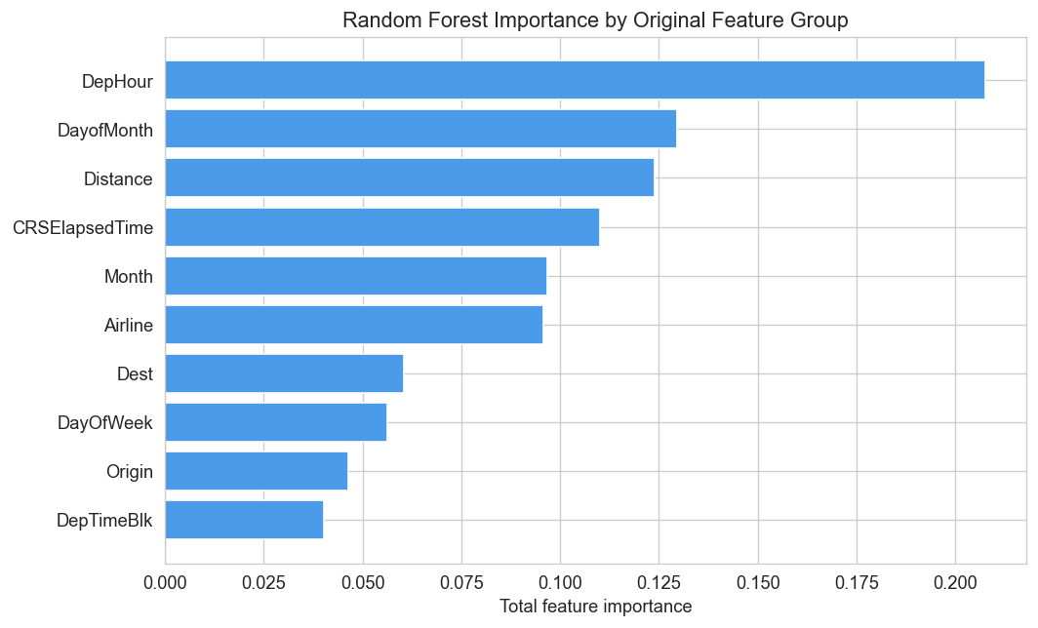
Interpretable Feature Signals
Section C
LASSO Coefficients
Random Forest Group Importance
▸ + Risk: destinations / origins EWR, LGA, SFO
▸ − Risk: low-traffic airports, overnight departure blocks
▸ Top groups: departure hour, day-of-month, distance, scheduled elapsed time, month.
▸ Time-based features dominate; airport IDs add incremental signal.
Key insight: Delay risk reflects specific airport effects and broader timing-related scheduling structure.

Slide 12
Airport Segments (k = 3)
Section C
Congested Hubs
Small High-Volatility
Lower-Risk Diversified
43 airports
67 airports
168 airports
Avg delay rate: 19.4 %
Avg delay rate: 21.9 %
Avg delay rate: 16.2 %
~367 flights / day
~16 flights / day
~28 flights / day
EWR · ORD · LGA · DFW · DEN
ACK · ASE · EGE · HDN · COU
Broad mix of mid-size regional airports
Key insight: Delay risk is embedded in operating environment — not only in individual flights.

Slide 13
Limitations and Conclusion
Section C
Limitations
What We Delivered
▸ No weather data, maintenance shocks, or ATC constraints observed.
▸ Upstream network spillovers (rotational delays) not captured.
▸ Single-year analysis — temporal generalization should be cautious.
▸ AUC is moderate by design: the hardest delay drivers are unobserved.
▸ Pre-departure delay risk is real and rankable — Random Forest ROC AUC 0.671, top-decile lift 2.21×.
▸ Airport operating environment shapes delay risk — 3 interpretable segments identified.
▸ Reproducible, documented pipeline with all figures and tables ready for submission.
▸ Honest result: moderate performance reflects structural data limits, not a modeling failure.
Key insight: Pre-departure data contain real signal — moderate performance is the honest result given structural data limits.

