Slide 1
PART1: ASUN-A Clustering Method for Arbitrary Shaped Clusters Using Maximum Nearest Neighbor Ratio
PART2: ClusterGAN-Latent Space Clustering in Generative Adversarial Networks

Slide 2
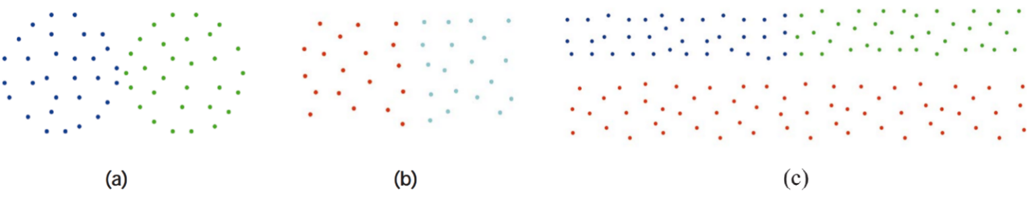
ASUN-Motivation
closeness & interconnectivity
Density/Ratio & KNN

Slide 3
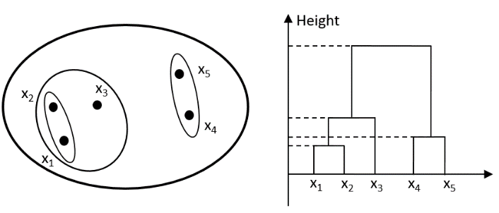
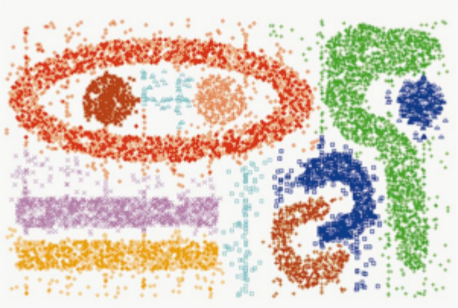
ASUN-Dendrogram&Arbitrary-Shped Clusters
Table 1 Characteristic Comparison of Clustering Algorithms
Algorithm | Method Simplicity | Dendrogram Integrality | Monotonic Characteristic | Support for arbitrary shapes | Number of Parameters
Linkage Metric[5][28] | Yes | Yes | Strong | No | 0
BIRCH[25] | Yes | Yes | Strong | No | 3
CURE[9] | No | -- | -- | Yes | 4
CHAMELEON[17] | No | -- | -- | Yes | ≥6
l-SL, al-SL[20] | Yes | -- | -- | Yes | 1
FKMCE[1] | No | -- | -- | Yes | 3
CLASP[11] | No | -- | -- | Yes | 2
ASUN | Yes | Yes | weak | Yes | 1

Slide 4
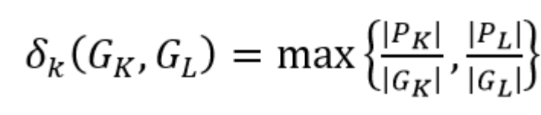
ASUN-Similarity Measurement
Definition 1 (kNNP Relation):
Definition 2 (Similarity Measurement):
Why max？

Slide 5
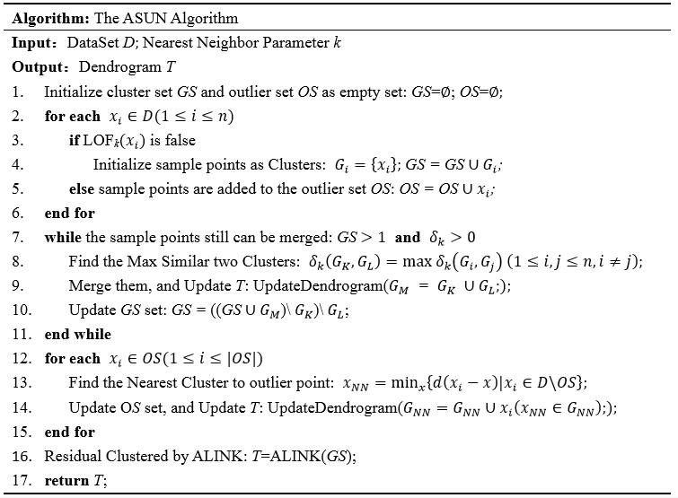
ASUN-Algorithm

Slide 6
ASUN- f-ASUN
In Step2：
(1)a list structure is used to save all cluster pairs from being merged, and each element of this list represents a cluster pair.
(2) if the new similarity result of this loop equal to the max similarity previously saved, and only when the cluster pair corresponding to the new similarity does not exist in the merge list, the new cluster pair is added to the merge list.
(3)merge all cluster pairs in the merge list at once.

Slide 7
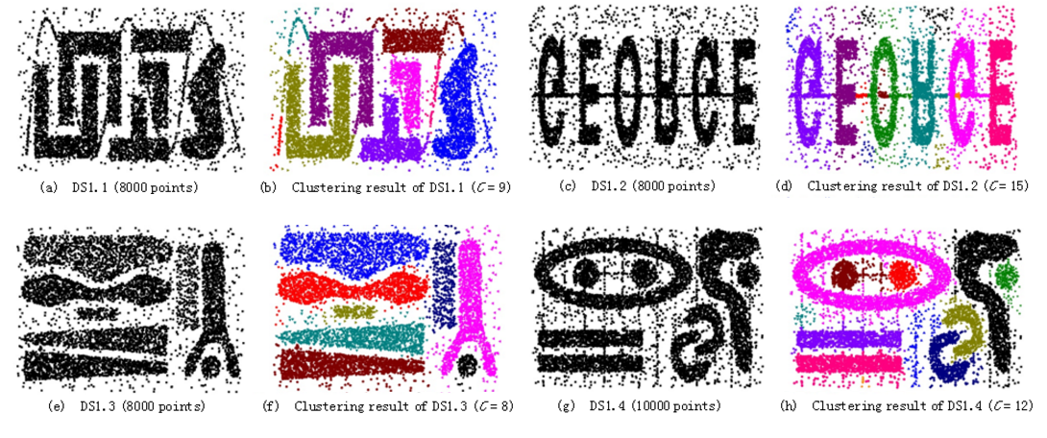
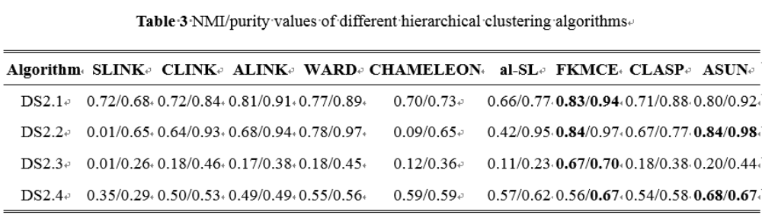
ASUN- Evaluation

Slide 8
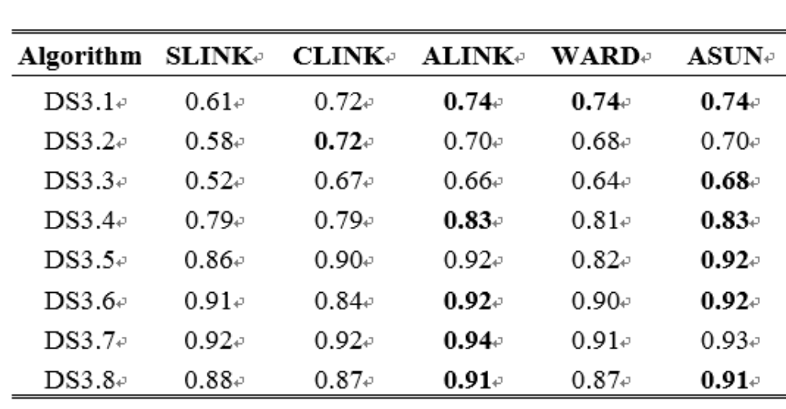
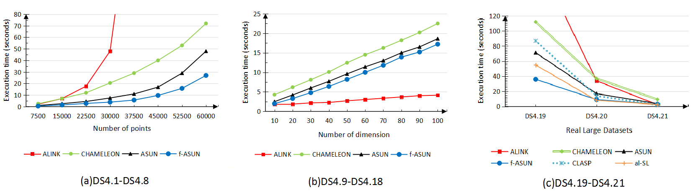
ASUN- Evaluation
Tests CPCC Values of Dendrogram under Different Hierarchical Clustering Algorithms

Slide 9
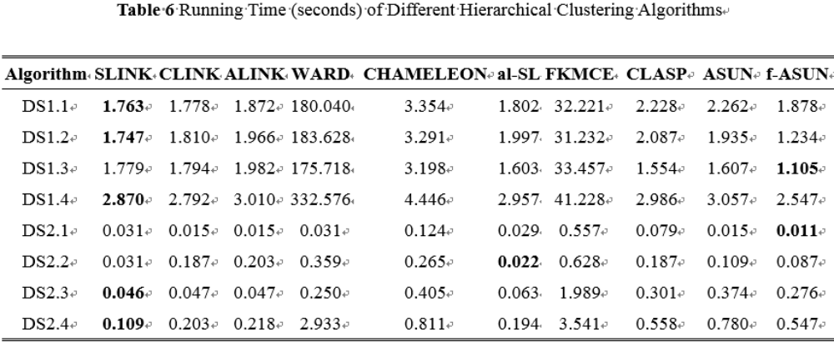
ASUN- Evaluation

Slide 10
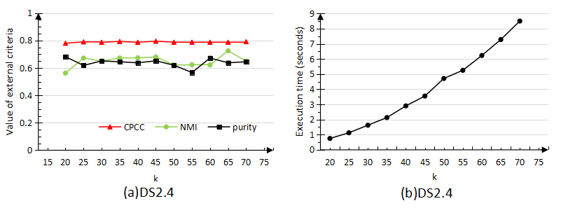
ASUN- Evaluation

Slide 11
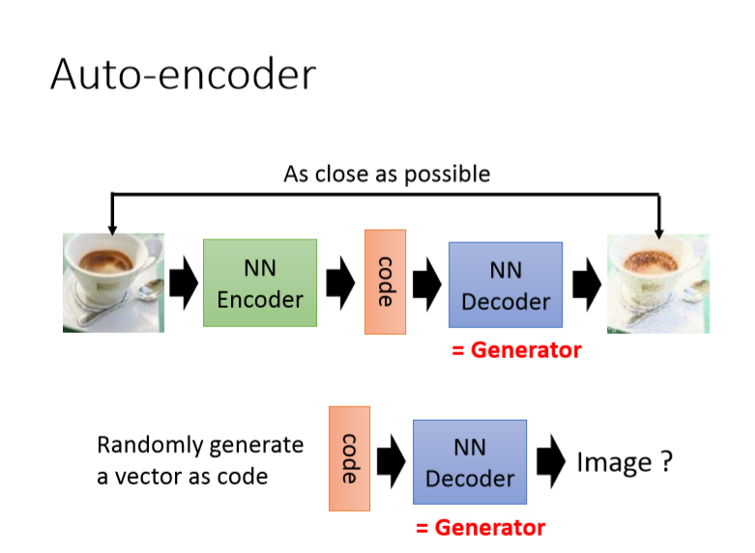
ClusterGAN

Slide 12
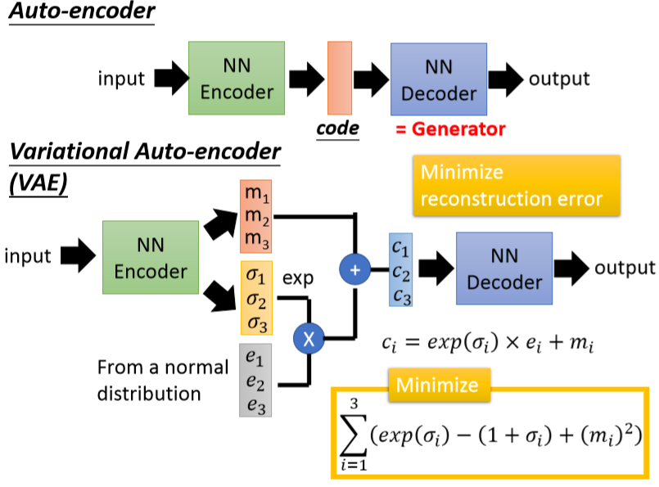
ClusterGAN

Slide 13
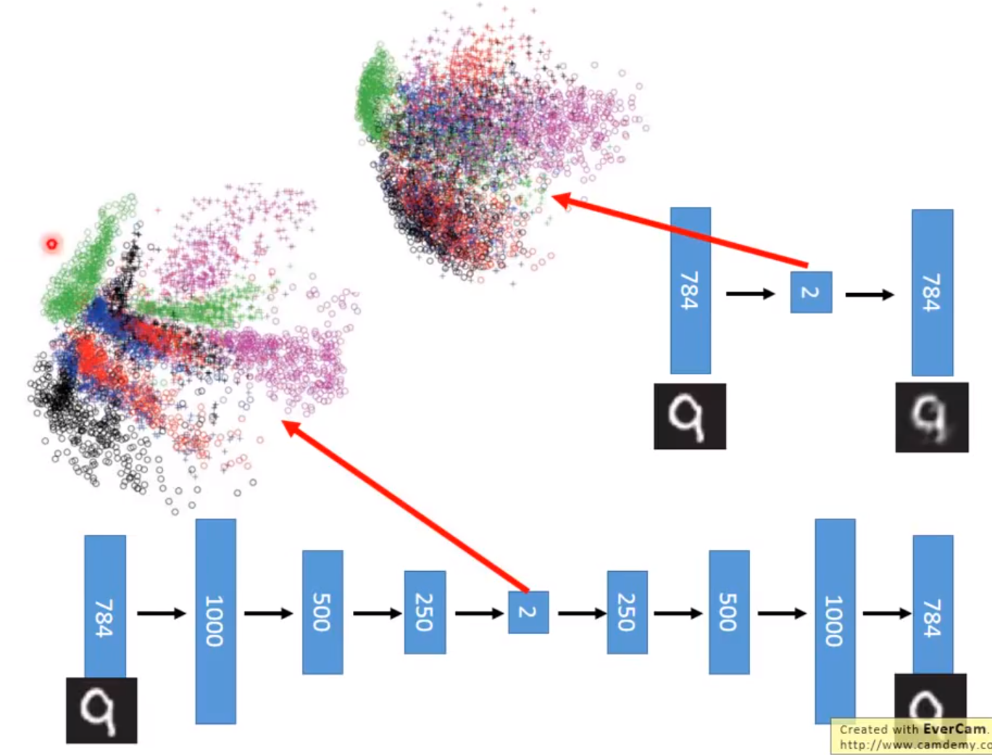
ClusterGAN

Slide 14
ClusterGAN
GAN
G
Z
X'
Cluster?
X'
D
score
X
公式略。
对D：fix住G，希望D给真实数据X给出高分，给伪数据X‘打低分
对G：fix住D，希望生成的X'可以在当前D中得到高分

Slide 15
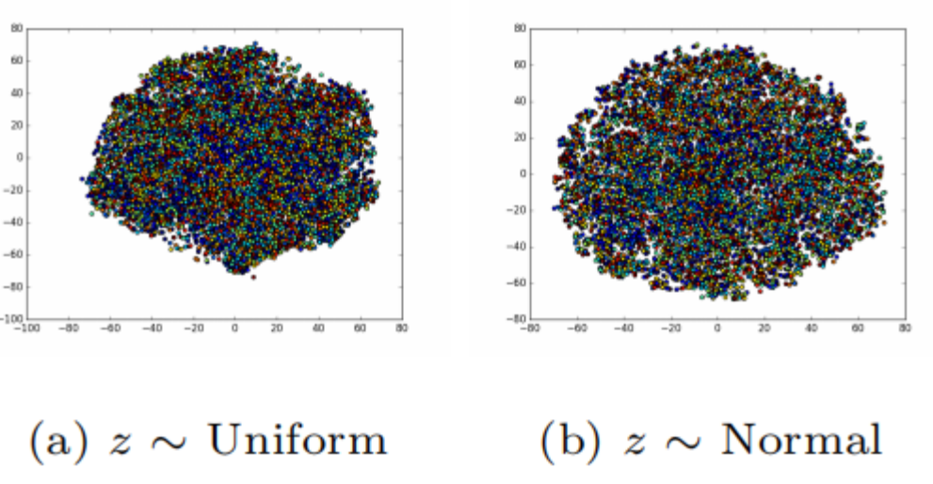
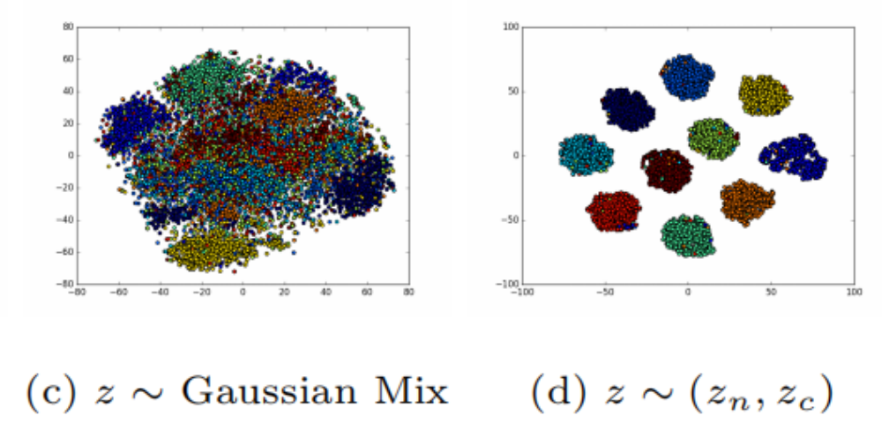
ClusterGAN
Problems need to be solved:
1.preserve latent space interpolation
2.clear cluster structure

Slide 16
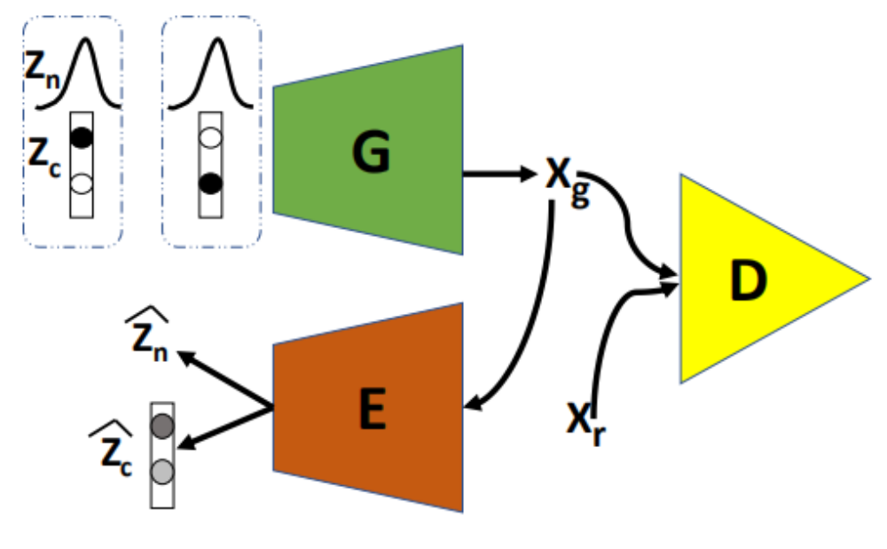
ClusterGAN
discrete & continuous =>latent variables

Slide 17

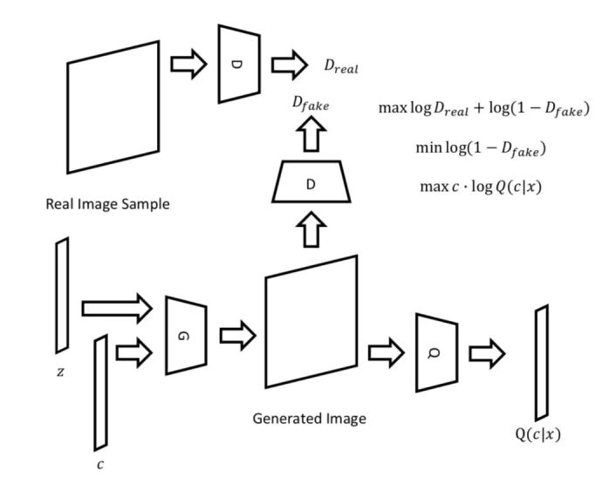
InfoGAN

Slide 18
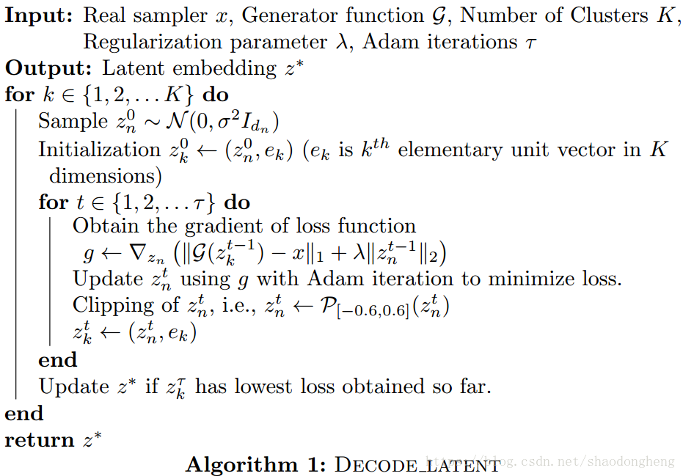
ClusterGAN
Loss Func & Optimization

Slide 19
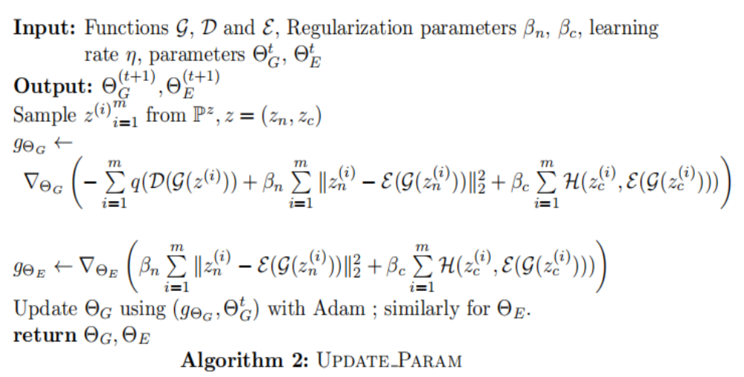

Slide 20
Implementation
DCGAN
1.define NN structure(params, active func)
2.define loss func(cross_entropy)
3.define train iteration, epoch, batch
4.define optim method( Adam)
5.tf.session.run()

Slide 21


Problem

Slide 22
THANKS
Ref：
[1].Mukherjee, Sudipto , et al. "ClusterGAN : Latent Space Clustering in Generative Adversarial Networks." (2018).

