Slide 1


Running tests within the API
Erik Nel

Slide 2
What are tests and why do we need it?
Unit testing is a software testing method by which individual units of source code are put under various tests to determine whether they are fit for use or not.
Unit tests make your code future proof since you anticipate the cases where your code could potentially fail or produce a bug.

Slide 3


Advantages of tests.
Reduces costs of testing as defects are captured in a very early phase.
Improves design and allows better refactoring of code.
Reduces defects in the newly developed features or reduces bugs when changing the existing functionality.

Slide 4
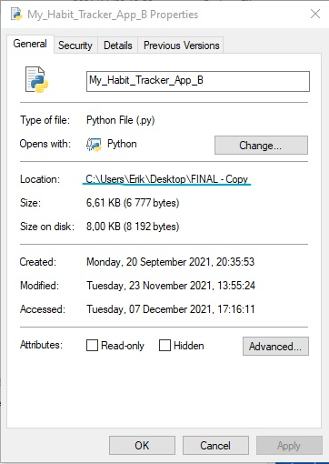
Running the tests for the application.
To run the tests we first need to copy the directory of the file. Open up the properties and copy the ‘path’.
In command line type in ‘cd ’, followed by the path and press enter.
Then type in the following ‘pytest <program name> - -capture=tee-sys’.

Slide 5
Continued…
Next the program will start to run as normal. Note that the system can only test for ‘Longest streak of certain habit’, which is under the option of ‘Habit Analysis’.
You will then be asked to select a habit. After the longest streak have been displayed you can simply type ‘ok’ and hit enter. The program will then ask you once again to select the habit and display it’s longest streak again. Once again type ‘ok’ and hit enter.
The program will then display whether the test has failed or passed.

Slide 6
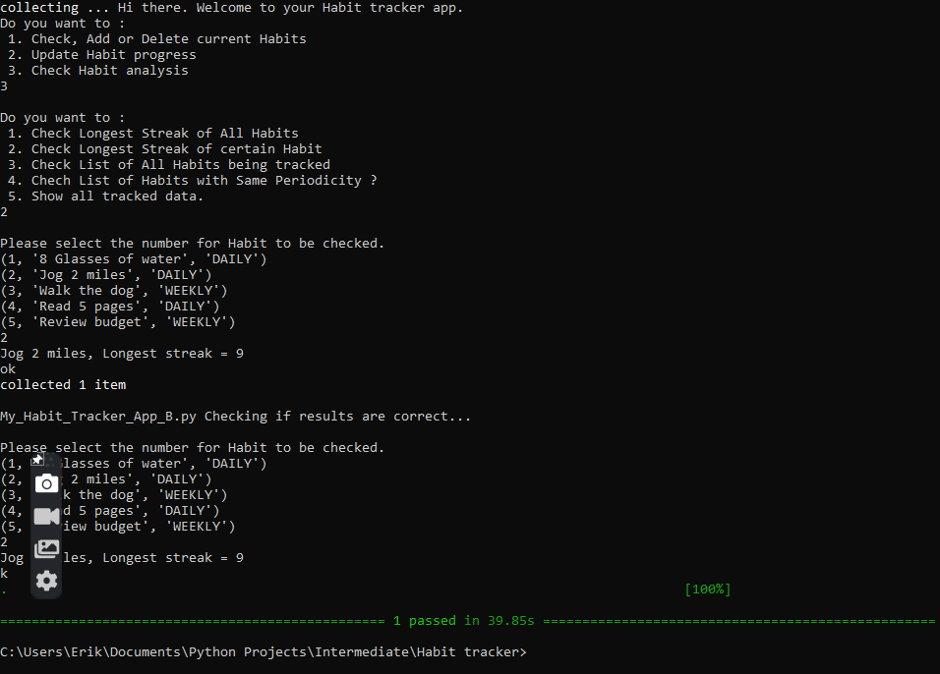
Test example:

