Slide 1


Development/ Reflection phase
ERIK NEL

Slide 2


PRESENTATION CONTENTS:
1. Tools used to create application.
2. How to run the program.
3. Interface and basic operating procedures.
4. More operations and using the program.

Slide 3
Tools used within application:
The tools that were used to create this application was straight forward.
We used a basic programmer interface called ‘Sublime Text’ in which the app was created.
The user will run the application by simply opening it on their computer. After all processes are finished the application will stop running and the user can exit the program.
All data and information will be saved within a database, attached to the program file. SQLite3 was used to create a small database within the application.

Slide 4
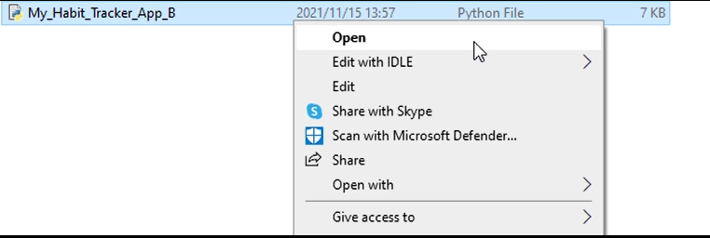
Starting the application.
To start the application, double-left-click on application name. OR…
To start the application, left-click once on the application name, followed by a right-click. A list of options will appear, select the option “open”.

Slide 5
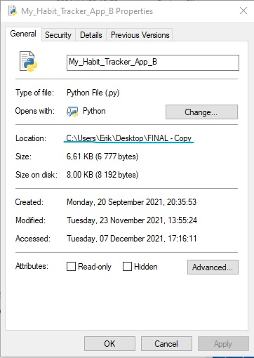
Running Program from Command Line
First you need to copy the directory for the application. Do this by viewing the properties of the file on computer.
Next, go to command line, type ‘cd ’, and then paste the directory you have just copied and hit enter. In the next line, type ‘python’ followed by the program name and ‘.py’, then hit enter.

Slide 6
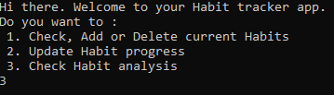
INTERFACE AND BASIC USAGE
Once open, you will see the following screen open where the application will run.
Use your keyboard’s numbers to interact with the program where options are presented.

Slide 7
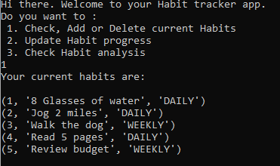
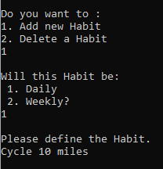
Checking, Adding and Deleting Habits
When the first option is selected, a list of all Habits will be printed out.
Adding and Deleting Habits is very easy. Just follow the instructions given. Like so:

Slide 8
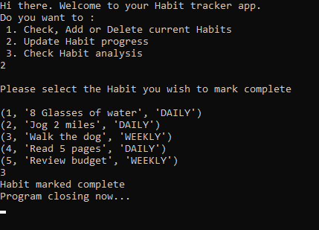
Marking a Habit complete.
To mark a habit complete, all the user has to do is select the number, and the program does the rest.

Slide 9
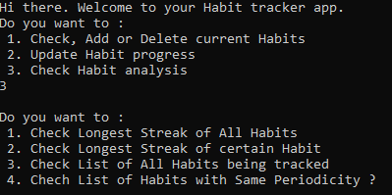
Checking Habit Analysis.
Checking Habit analysis is just as easy. Here you will be able to see all of the possible information on your habits. Just select which one you want to see.

Slide 10
CONCLUSION
As demonstrated it is quite easy to use the application.
Some of the benefits for this application was how easy it is to create.
The application is small and easy to run.
It is not complicated to use and is very quick to add or delete or do what you want to.
Please not that this is still the first version and is very basic, updates and upgrades can be made later on and published for a better user experience.

