Slide 1
MCP Dev Summit Toronto 2026
Multi-Agent Systems in Practice:
What Our Experiments
Taught Us
OCTOBER 6, 2026

Slide 2
AI AGENT ORCHESTRATION PATTERNS
AI Engineering Is Balancing
Cost, Speed and Capability
Capability
Cost
Use fewer tokens and lighter-weight models.
Speed
Run work in parallel, and cache what repeats.
Capability
YOUR SYSTEM
A stronger model or more reasoning helps,
but mostly: give each call the right context.
Cost
Speed
2

Slide 3
AI AGENT ORCHESTRATION PATTERNS
Investigating: Capability Is a Context Problem
What goes in shapes what comes out.
ANSWER QUALITY
SWEET SPOT
LESS CONTEXT
MORE CONTEXT
TOO LITTLE
JUST ENOUGH
TOO MUCH
It guesses.
It nails it.
It gets lost.
Missing facts get filled in
The model sees what the task needs,
Key details get buried and
with confident guesses.
and little else.
instructions get ignored.
3
Notes:
Too little context: the model guesses. Missing facts get filled in with confident guesses. Too much: it gets lost. Key details get buried and instructions get ignored. Just enough: it nails it. The model sees what the task needs, and little else. That is the sweet spot.

Slide 4
AI AGENT ORCHESTRATION PATTERNS
Agentic Patterns For:
Context rot
4

Slide 5
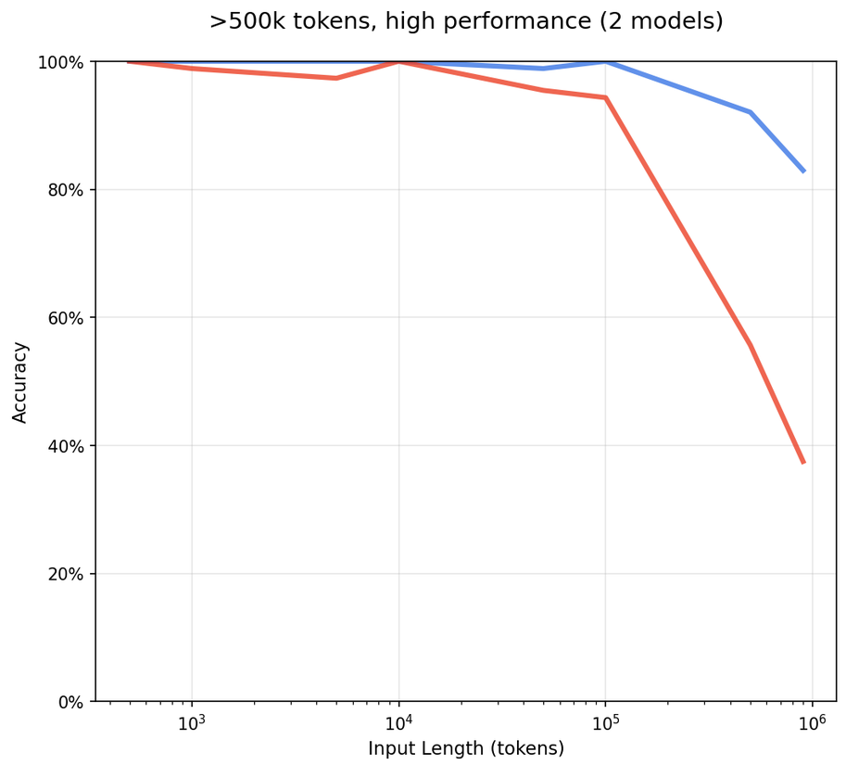
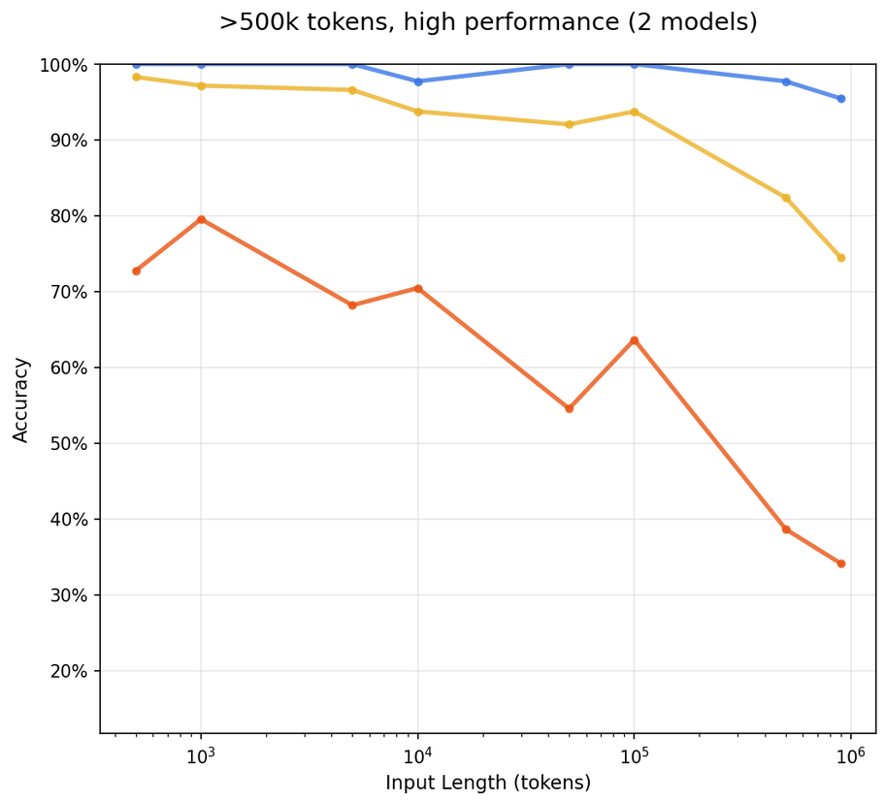
AI AGENT ORCHESTRATION PATTERNS
Context Rot, Measured
Chroma popularized the term in July 2025: models get worse as the input grows, even on simple tasks.
NEEDLE THAT DOESN’T ECHO THE QUESTION
LOOK-ALIKE DISTRACTORS
High similarity
Low similarity
No distractors
One
Four
Models tested: 18, including Claude Opus 4, o3, GPT-4.1, Gemini 2.5 Pro and Qwen3-235B. Both panels show the two best models with windows over 500K tokens; Chroma doesn’t name which two.
Source: Chroma Research, “Context Rot: How Increasing Input Tokens Impacts LLM Performance” (Hong, Troynikov, Huber), July 14, 2025.
5
Notes:
In July 2025, Chroma published Context Rot: How Increasing Input Tokens Impacts LLM Performance, and the name stuck. They tested 18 models from Anthropic, OpenAI, Google and Alibaba, including Claude Opus 4, o3, GPT-4.1, Gemini 2.5 Pro and Qwen3-235B. Even on simple retrieval, accuracy falls as the input grows. These panels show the two best models with windows over 500K tokens. Left: when the needle does not share the question's wording, accuracy falls off past 100K tokens. Right: put look-alike distractors next to the needle; with four, even these models fall to about a third near a million tokens.

Slide 6
AI AGENT ORCHESTRATION PATTERNS
Targeting the Limiting Factor
Long context used to be the limiting factor. The people testing models say it is being solved.
“
“
For text, Gemini 1.5 Pro achieves 100% recall up to 530k tokens, 99.7% up to 1M tokens, and 99.2% accuracy up to 10M tokens.
Long context improvements are a HUGE deal. This unlocks 1mil context windows to actually work. Now GPT doesn’t randomly forget 9-30% of your context.
JD
Jeff Dean @JeffDean
Gemini 1.5 Pro · Feb 2024
ND
Nick Dobos @NickADobos
GPT-6 Astra · Sep 2026
Then Chief Scientist, Google
Prompt engineer, The Browser Company
If the window holds, the limiting factor moves to cost and speed.
6
Notes:
Context used to be the limiting factor. That is changing. Back in February 2024, Jeff Dean, then Google's Chief Scientist, reported that Gemini 1.5 Pro had 100 percent recall up to 530K tokens, 99.7 percent up to a million, and 99.2 percent at 10 million. And when GPT-6 Astra launched in September, Nick Dobos called its long-context gains a huge deal: they unlock million-token windows to actually work, and GPT no longer randomly forgets 9 to 30 percent of your context. So if the window holds, the limiting factor moves: to cost and speed.

Slide 7
AI AGENT ORCHESTRATION PATTERNS
Context Evals
Our own eval set, built to test agentic patterns and context strategies, not just models.
01 · HOW WE TEST
02 · FIRST RUN
03 · HARDER SET: RESULTS
Patterns and Context,
Not Just Models
100%
Astra
Perfect to 768K on the two hardest types
Sol
Perfect to 128K; from 256K misses long counting
Luna
Misses even at 32K; 20% right at 768K
PATTERNS
LUNA
SOL
ASTRA
Sol and Astra on needle-in-a-haystack questions
100%
100%
87%
50%
20%
task with a hidden trap
0%
32K–128K
256K–512K
768K
The test: one decision at the end of a replayed support shift. The rule is
stated once at the top; the facts it needs hide among hundreds of
look-alike cases. One shot, no search tool.
7
Notes:
We have been iterating on our own eval set to experiment with these agentic patterns and context strategies. Models are not the primary focus of these evals; the patterns are. We run each pattern on each model with a set of tasks that have traps and false positives, so we can trigger the benefits these patterns give: organized decision making and less context bloat. Our initial experiments saturated for Sol and Astra: they had a 100 percent success rate on needle-in-a-haystack questions. We had to make the tasks dramatically harder to get these results. On the harder set, Luna misses even at 32K and gets only 20 percent right at 768K. Sol is perfect through 128K; from 256K it starts missing, almost always on counting: finding both earlier approvals for one customer among hundreds of look-alike cases. Astra got every decision right up to 768K, including the exact counting task Sol failed. The best predictor of a right answer was whether the model chose to reason: Sol was 34 for 34 when it reasoned. These are small samples, three tasks per question type, so read them as failure modes, not rates.

Slide 8
AI AGENT ORCHESTRATION PATTERNS
Context Windows Are Becoming Fully Searchable
In 2026, frontier models keep their accuracy across the whole window.
OPENAI MRCR V2 · 8 NEEDLES
96.3%
GPT-6 Astra between 512K and 1M tokens
256K–512K
Sol
91.5%
Astra
100%
512K–1M
Sol
73.8%
Astra
96.3%
OpenAI, GPT-6 Astra launch, September 2026 · Sol is GPT-5.6 Sol
For frontier models, finding what is in the window is no longer the hard part.
8
Notes:
In 2026 that changed. On OpenAI's 8-needle MRCR test, GPT-6 Astra scores 96.3 percent between 512K and a million tokens, up from 73.8 for GPT-5.6 Sol, and 100 percent from 256K to 512K, up from 91.5. So for frontier models, finding what is in the window is no longer the hard part.

Slide 9
AI AGENT ORCHESTRATION PATTERNS
Three Ways To Manage Context
Context strategies keep one agent and manage what it sees. Agentic patterns split the work across agents.
CONTEXT STRATEGY
CONTEXT STRATEGY
AGENTIC PATTERNS
Compress it
Fetch it
Split it
Keep one agent; shrink its history to fit the window.
Keep one agent; pull in only what the step needs.
Spread work across agents, each with its own slice.
summary
agent
orchestrator
notes · todo
9
Notes:
There are three ways to manage context. Two are context strategies that keep a single agent. Compress it: shrink the history so it fits the window. The risk is that a summary drops the detail you needed later. Fetch it: pull in only what the step needs; the risk is that retrieval misses an exception. The third is the agentic patterns from the first half: split the work across agents, each with its own slice. Handoffs can drop context, and it costs two to five times the tokens.

Slide 10
AI AGENT ORCHESTRATION PATTERNS
Five Multi-Agent Orchestration Patterns
Same agents, five different ways to coordinate them.
Sequential
Concurrent
Group Chat
Handoff
Magentic
10

Slide 11
AI AGENT ORCHESTRATION PATTERNS
Sequential Orchestration
Agents are chained in a predefined order. Each one processes the previous agent’s output.
Agent 1
Agent 2
Agent 3
Agent n
Input
···
Result
task
Model
Model
Model
Model
final output
Knowledge
Knowledge
Knowledge
Knowledge
Tools
Tools
Tools
Tools
MCP LAYER
each agent has its own
MCP
MCP
MCP
MCP
MCP connections
Common state
— Shared context across every agent in the pipeline
1
Input enters Agent 1
2
Output becomes the next input
3
The last output is the result
It reasons with its own model,
Each agent builds on the previous
Order is fixed up front: routing
knowledge and tools.
one, down to Agent n.
is deterministic.
BEST FOR
WATCH OUT FOR
Clear linear dependencies and step-by-step refinement.
Early errors flow downstream, and there is no parallelism.
11
Notes:
A task comes in. Agent 1 takes the input and works on it with its own model, knowledge and tools. It has its own MCP connections. Each agent's output becomes the next agent's input, all the way down to Agent n. Each brings its own MCP connections. The last agent's output is the result. The order is fixed up front, so routing is deterministic. A common state carries shared context across every agent in the pipeline. Best for clear linear dependencies and step-by-step refinement. Watch out: early errors flow downstream, and there is no parallelism.

Slide 12
AI AGENT ORCHESTRATION PATTERNS
Bug Triage to Pull Request
WORKED EXAMPLE
Trigger: an e-commerce store's checkout fails with HTTP 500 errors after release 2.14.1, and Sentry raises an alert.
STEP
AGENT
MCP SERVER
OUTPUT PASSED ON
1
Triage agent
→
Root cause: cart total is null in applyDiscount()
Reads the alert and analyzes stack trace
Sentry MCP
2
Diagnose agent
→
Regression in src/cart/discount.ts, commit a1b2c3d
Finds the code and the commit
GitHub MCP
3
Fix agent
→
Patch plus regression test, as a diff
Writes the patch and a test
4
Report agent
→
PR #482 opened, ticket ENG-1043 linked
Opens the PR, files the ticket
GitHub + Jira MCP
RESULT
Fix ready: PR #482 with a passing regression test, linked to Jira ticket ENG-1043.
WHY SEQUENTIAL FITS
MCP IN THIS FLOW
Each step needs the previous step's output, so the order is fixed.
Only agents that need outside data connect to MCP servers.
12
Notes:
The checkout fails with HTTP 500 errors and Sentry raises an alert. The triage agent reads the alert and the stack trace through Sentry MCP: the cart total is null in applyDiscount(). The diagnose agent takes that root cause and finds the code and the commit through GitHub MCP: a regression in src/cart/discount.ts. The fix agent writes the patch and a regression test. It needs no outside data, so it has no MCP server. The report agent opens the PR and files the ticket through GitHub and Jira MCP. The result: PR #482 with a passing regression test, linked to Jira ticket ENG-1043. Sequential fits because each step needs the previous step's output. Only agents that need outside data connect to MCP servers.

Slide 13
AI AGENT ORCHESTRATION PATTERNS
Concurrent Orchestration
Agents work on the same input at the same time. A collector combines their results.
1
BROADCAST
2
RUN INDEPENDENTLY, IN PARALLEL
3
AGGREGATE
Agent 1
+ sub-agents
Model · Knowledge · Tools
Agent 2
Model · Knowledge · Tools
Input
Result
task
Initiator
Agent 3
Collector
final output
same input to all
Model · Knowledge · Tools
gathers all results
slowest
AGGREGATES BY
Agent n
Voting
Model · Knowledge · Tools
Weighted merge
Each agent calls MCP tools in parallel
LLM synthesis
MCP LAYER
Total time = the slowest
Use same servers at once: watch rate limits
agent, not the sum
and write conflicts. Prefer read-only tools.
BEST FOR
WATCH OUT FOR
Independent perspectives and time-sensitive work.
Conflicting results, cost multiplied by N, and shared-state races.
13
Notes:
A task comes in: for example, a pull request to review. Broadcast: the initiator sends the same input to every agent. Each agent works independently, with its own model, knowledge, tools and context window. They finish at different times. MCP layer: every agent calls MCP tools at once, on the same servers. Watch rate limits and write conflicts; prefer read-only tools. Aggregate: a collector gathers every result and combines them, by voting, a weighted merge or an LLM synthesis. One final output. Total time is the slowest agent, not the sum of them. Best for independent perspectives and time-sensitive work. Watch out for conflicting results, cost multiplied by N, and shared-state races.

Slide 14
AI AGENT ORCHESTRATION PATTERNS
Parallel Pull Request Review
WORKED EXAMPLE
Trigger: a pull request is opened and needs a review from several angles.
ALL FOUR START AT ONCE
Security reviewer
Semgrep MCP
Scans the diff for vulnerabilities
INPUT
Performance reviewer
COLLECTOR
Pull request #482
Looks for hot paths and N+1 queries
Collector agent
diff + description
Merges four reviews into one,
Test coverage reviewer
ranked by severity
Finds changed lines with no tests
GitHub MCP
GitHub MCP · posts the review
Docs and style reviewer
Checks API docs and naming
RESULT
One review comment posted on PR #482, with findings ranked by severity.
WHY CONCURRENT FITS
MCP IN THIS FLOW
The four reviews are independent, so total time is the slowest one.
Only reviewers that need outside data connect; the others read the diff.
14
Notes:
A pull request comes in: PR #482, with its diff and description. All four reviewers start at once on the same diff. Security scans it for vulnerabilities, with Semgrep MCP. Performance looks for hot paths and N+1 queries. Test coverage finds changed lines with no tests, with GitHub MCP. Docs and style checks the API docs and naming. A collector agent merges the four reviews into one, ranked by severity, and posts it through GitHub MCP. The result: one review comment on PR #482, with the findings ranked by severity. Concurrent fits because the four reviews are independent, so total time is the slowest one. Only reviewers that need outside data connect; the others read the diff.

Slide 15
AI AGENT ORCHESTRATION PATTERNS
Group Chat Orchestration
Agents discuss in one shared thread. A chat manager decides who speaks and when to stop.
Group chat
next turn
Shared chat thread
context grows
Human participant
manager
Optional · observes, adds input
Agent 1
Chooses who speaks next
Adds its perspective
Agent 1
Judges when to stop
Agent 2
Model · Knowledge · Tools
done yet?
Builds on, or challenges, Agent 1
HOW IT RUNS
Agent 2
1
Seeds the thread with the input
Agent n
Model · Knowledge · Tools
Contributes expertise, and tool results
2
Invokes the next agent
Human
Agent n
Observes and steers (optional)
Model · Knowledge · Tools
3
The agent reads the whole thread
every agent reads the whole thread, then appends
and adds its turn
Checks: done? If not, repeat
consensus or quality gate met
Agents call MCP tools on their turn
4
from step 2
MCP LAYER
Result
Every agent sees tool results in the thread,
so results are trimmed before posting.
BEST FOR
WATCH OUT FOR
Consensus building, brainstorming, and maker-checker review.
Endless loops, growing context, and control past three agents.
15
Notes:
A group chat manager runs the conversation: it chooses who speaks next and judges when to stop. It seeds a shared chat thread with the input. It invokes the next agent. The participants are specialist agents, and optionally a human. Agents call MCP tools on their turn; every agent sees the tool results in the thread, so results are trimmed before posting. Each agent reads the whole thread and adds its turn, so the context grows with every turn. A human can observe and steer. After each turn the manager checks: done? If not, it repeats from step 2. When consensus or a quality gate is met, the thread produces the result. Best for consensus building, brainstorming and maker-checker review. Watch out for endless loops, growing context, and control past three agents.

Slide 16
AI AGENT ORCHESTRATION PATTERNS
Database Migration Review
WORKED EXAMPLE
Trigger: a schema migration needs agreement before it goes to production.
Chat manager
Shared thread: review of migration 0042_add_status.sql
orchestrates only
Author agent
1
Proposes: add status column with constraint NOT NULL, and add an index
Picks who speaks next
Stops once the reviewer
Schema reviewer
approves the plan
2
Adding the NOT NULL constraint scans the whole table under a lock that blocks queries
Postgres MCP
HOW IT RUNS
3
Author agent
Every agent reads the whole thread,
Revises: add a nullable status column, backfill in batches then add the constraint
then adds its turn. Tool results
Performance agent
are trimmed before they are posted.
4
EXPLAIN confirms the status query uses the new index
Postgres MCP
5
Chat manager
Reviewer approves the revised plan. Consensus reached, stop.
RESULT
Approved migration plan: nullable column, batched backfill, then the constraint.
WHY GROUP CHAT FITS
MCP IN THIS FLOW
A maker and checkers need to challenge each other until they agree.
Only the database reviewers connect to a Postgres MCP server.
16
Notes:
A chat manager runs the review. It only orchestrates: it picks who speaks next, and stops once the reviewer approves the plan. Everyone works in one shared thread, reviewing migration 0042_add_status.sql. Every agent reads the whole thread, then adds its turn. Turn 1: the author agent proposes a status column with a NOT NULL constraint, and an index. Turn 2: the schema reviewer checks Postgres through MCP. Adding NOT NULL scans the whole table under a lock that blocks queries. Turn 3: the author revises: a nullable column, a batched backfill, then the constraint. Turn 4: the performance agent runs EXPLAIN through Postgres MCP and confirms the status query uses the new index. Turn 5: the reviewer approves the revised plan, so the chat manager stops: consensus reached. The result is an approved migration plan. Group chat fits because a maker and checkers need to challenge each other until they agree. Only the database reviewers connect to a Postgres MCP server.

Slide 17
AI AGENT ORCHESTRATION PATTERNS
Handoff Orchestration
Agents pass full control to one another until the right one resolves the task.
RESOLVED
Result returned: one final answer from whichever agent resolves the task
2
1
Agent 1
3
Agent 2
Agent 3
Agent n
Input
hand off
hand off
hand off
task
Triage / generalist
+ context
Specialist
+ context
Specialist
+ context
Specialist
Handle it, or hand it off
+ identity
Handle it, or hand it off
+ identity
Handle it, or hand it off
+ identity
Handle it, or hand it off
MCP LAYER
only the active agent's
MCP
MCP
MCP
MCP
tools are in use
5
ESCALATED
Human support: optional escalation, with the full context passed along
1
Agent 1 receives and
2
It can handle it:
3
Or it hands off: full
4
The next agent repeats
5
Any agent may escalate
analyses the task
return the result
control moves on
the same check
to a human
BEST FOR
WATCH OUT FOR
The right specialist only becomes clear during processing.
Infinite handoff loops and unpredictable routing paths.
17
Notes:
A task comes in. Agent 1, a triage generalist, receives and analyses the task. MCP layer: only the active agent's tools are in use. If it can handle the task, it returns the result: one final answer from whichever agent resolves it. Or it hands off: full control moves to a specialist, along with the context and identity, and the specialist's own MCP tools. The next agent repeats the same check: resolve it, or hand it off again. Any agent may escalate to human support, with the full context passed along. Best when the right specialist only becomes clear during processing. Watch out for infinite handoff loops and unpredictable routing paths.

Slide 18
AI AGENT ORCHESTRATION PATTERNS
Deployment Failure Support
WORKED EXAMPLE
Trigger: a developer reports that orders-service pods are stuck in ImagePullBackOff.
Resolved: the last agent returns one answer, with the pipeline re-run and the image published
1
Triage agent
2
Kubernetes specialist
3
CI and registry specialist
Classifies the request
hand off
Reads pod status and events
hand off
Inspects builds and the image registry
+ context
Kubernetes MCP
+ context
GitHub MCP
DECISION
DECISION
DECISION
App bug or platform issue? Platform:
Pods are healthy, the image is missing:
Root cause found: resolve.
hand off.
hand off.
Human on-call: optional escalation from any agent, with the full context passed along
WHY HANDOFF FITS
MCP IN THIS FLOW
The right specialist only becomes clear as the problem is investigated.
Only the active agent's tools are in use; the triage agent needs none.
18
Notes:
A developer reports that orders-service pods are stuck in ImagePullBackOff. The triage agent classifies the request: app bug or platform issue? It is the platform. At any point, an agent can escalate to the human on-call, with the full context passed along. Triage hands off, with the context, to the Kubernetes specialist. It reads pod status and events through Kubernetes MCP: the pods are healthy, but the image is missing. It hands off again, to the CI and registry specialist, which inspects the builds and the image registry through GitHub MCP and finds the root cause. It resolves the issue: one answer, with the pipeline re-run and the image published. Handoff fits because the right specialist only becomes clear as the problem is investigated. Only the active agent's tools are in use; the triage agent needs none.

Slide 19
AI AGENT ORCHESTRATION PATTERNS
Magentic Orchestration
A manager builds and revises a task ledger with specialist agents, then executes the plan.
Task ledger
LIVE
Open-ended problem
Human
Optional · reviews the plan, takes over
Goal and approach
1
receives problem
2
Agent 1
Task 1
edits
Manager
3
Model · Knowledge · Tools
Task 2
IN PROGRESS
agent
delegates
Agent 2
Task 3 (discovered)
NEW
Plans, consults, re-plans
Model · Knowledge · Tools
Task 4 (discovered)
NEW
4
re-plan
Agent n
Task 5
REMOVED
Goal met, or stalled?
Model · Knowledge · Tools
Task 6
5
on track: execute
Specialists call MCP tools as assigned
Manager adds, removes and reorders tasks
Result
MCP LAYER
+ documented plan
Manager reads each server's tool list to plan.
Risky tool calls wait for human approval.
BEST FOR
WATCH OUT FOR
Open-ended problems with no predetermined solution path.
Slow convergence, stalls on vague goals, and high token cost.
19
Notes:
An open-ended problem comes in, and the manager agent receives it. The manager writes a task ledger: the goal, the approach, and the tasks it knows about so far. It edits the ledger as it goes. It delegates tasks to specialist agents, which call MCP tools as assigned. The manager reads each server's tool list to plan, and risky tool calls wait for human approval. A human can review the plan or take over. After each round it checks: is the goal met, or has progress stalled? If it stalls, the manager re-plans: it discovers new tasks, removes others, and reorders the ledger. Once it is on track, it executes the plan and returns the result, with the plan documented. Best for open-ended problems with no predetermined solution path. Watch out for slow convergence, stalls on vague goals, and high token cost.

Slide 20
AI AGENT ORCHESTRATION PATTERNS
Latency Regression Investigation
WORKED EXAMPLE
Trigger: p99 latency doubled after release 2.14.2 and nobody knows why.
Task ledger
LIVE
Goal: find why p99 latency doubled after release 2.14.2
Metrics agent
Reads latency by endpoint
Grafana MCP
Chart p99 latency per endpoint
Manager agent
List the changes shipped in 2.14.2
edits
Code agent
Plans, assigns, re-plans.
Reads release diffs and commits
GitHub MCP
Check CDN cache hit rate
REMOVED
Updates the ledger after
every result.
Inspect slow queries on /checkout
NEW
Database agent
Reads query plans and stats
Postgres MCP
Propose a fix or a rollback
NEW
Specialists are added by the manager as the plan changes.
RESULT
Cause found: a new ORM query on /checkout does a full table scan. Fix: add an index.
WHY MAGENTIC FITS
MCP IN THIS FLOW
The steps are unknown upfront: each finding changes the plan.
Each specialist connects to the MCP server for its own domain.
20
Notes:
A manager agent takes the problem: p99 latency doubled after release 2.14.2, and nobody knows why. It writes a task ledger with the goal and its first tasks: chart p99 latency per endpoint, list the changes shipped in 2.14.2, and check the CDN cache hit rate. It delegates: the metrics agent reads latency by endpoint through Grafana MCP, and the code agent reads the release diffs and commits through GitHub MCP. Each finished task gets checked off. The findings change the plan: the manager drops the CDN check, adds a task to inspect slow queries on /checkout, and brings in a database agent with Postgres MCP. The database agent finds it: a new ORM query on /checkout does a full table scan. The last task proposes the fix: add an index. Magentic fits because the steps are unknown upfront: each finding changes the plan. Each specialist connects to the MCP server for its own domain.

Slide 21
AI AGENT ORCHESTRATION PATTERNS
Agentic Systems into 2027
The model brings the capability. The agentic pattern helps you manage speed, cost and data organization.
Cost
Data management
Speed
tokens and model size
organization, governance, access
parallel work and caching
Agentic
pattern
Frontier model: the capability
Built in, as long as each call gets the essential data
21
Notes:
Agentic systems going into 2027 have the capability: the frontier model brings it, as long as each call gets the essential data. The agentic pattern is the fulcrum. It is how you balance speed, cost and data management: how your data is organized and governed, and who can access what.

Slide 22
AI AGENT ORCHESTRATION PATTERNS
Choosing a Pattern
Two questions: does everything fit in the context window, and does each step depend on the last?
Split the work
Speed
Keep the state compact
Cost
Concurrent
Parallel workers, each with a clean window
Summary or notes
Compress the history; one agent keeps going
Subagents
A lead agent delegates; each subagent returns a short summary
Knowledge graph
Fetch only the facts each step needs
Magentic
A manager keeps a compact task ledger
Sequential
Fixed stages, each passing on a compact result
DATA
SCALE
One agent, or parallel for speed
Cost
Speed
One agent
Cost
Single agent
The default: same accuracy, lowest cost
Single agent
Splitting adds handoff loss, not accuracy
Concurrent
Only to cut wait time, or to vote over runs
Handoff
When steps need different tools or permissions
Group Chat
When you want a debate; expect no gain over voting
TASK DEPENDENCE
Agentic pattern
Context strategy
Data governance
Any pattern that splits the work can also scope each agent’s data and access.
22
Notes:
To choose, start from context with two questions: does everything fit in the context window, and does each step depend on the last one? If it overflows and the subtasks are independent, split the work: concurrent workers each get a clean window, or a lead agent hands subtasks to subagents, each in a fresh window, and gets back only a short summary, so its own context stays small. If it overflows and each step needs the last, keep the state compact: one agent with summaries or notes, a knowledge graph to fetch only the facts each step needs, Magentic, where a manager keeps a compact task ledger and re-plans as it goes; or a sequential pipeline where each stage passes on a compact result. If it fits, one agent is the default. Go concurrent only to cut wait time or to vote. And if each step depends on the last, splitting adds handoff loss, not accuracy: use handoff only when steps need different tools or permissions, and a group chat only if you want a debate, since we expect it to do no better than voting. This is a working guide built from our expected results; the runs will confirm or move these lines. And data governance cuts across all of this: any pattern that splits the work can also scope each agent's data and access. The badges show what each choice buys: splitting the work buys speed; keeping the state compact and staying with one agent keep the cost down; and when it fits, go parallel only when you need the speed.

Slide 23



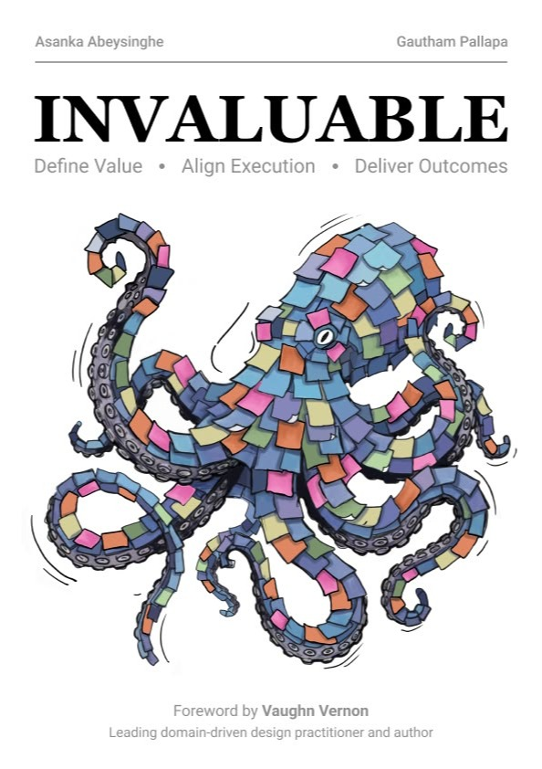
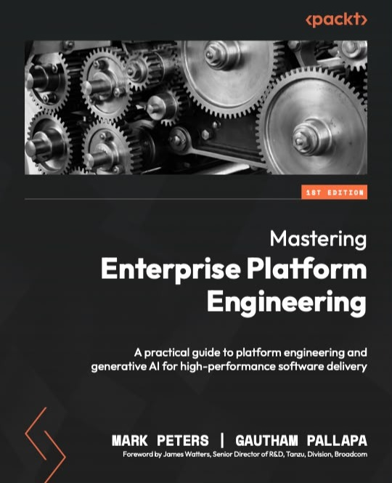
AI AGENT ORCHESTRATION PATTERNS
MCP DEV SUMMIT · TORONTO 2026
TEAM
Thank
you.
Erik Koning
Senior AI/ML Engineer · Scotiabank
in
erikkoningcanada
Alex Bajenaru
Full Stack Engineer · Scotiabank
in
alex-bajenaru
Questions? Come find us after the session, or pick up the code.
Gautham Pallapa
Principal Director, AI & Innovation · Scotiabank
in
gpallapa
Get the code
github.com/Erik-Koning/
agentic-patterns-eval
The five patterns, the context strategies and the full eval set.
Invaluable and Mastering Enterprise Platform Engineering, co-authored by Gautham Pallapa
23
Notes:
Thank you. Questions? Come find us after the session. The team: Erik Koning and Alex Bajenaru, and Gautham Pallapa, Principal Director of AI and Innovation at Scotiabank and co-author of Invaluable and Mastering Enterprise Platform Engineering. Scan the code for the five patterns, the context strategies and the full eval set: github.com/Erik-Koning/agentic-patterns-eval.

Slide 24
AI AGENT ORCHESTRATION PATTERNS
Appendix: When to Use Each Pattern
Sequential
Concurrent
Group Chat
Handoff
Magentic
USE WHEN
USE WHEN
USE WHEN
USE WHEN
USE WHEN
Fixed stages, each building on the last.
Independent subtasks, or several takes on one input, when speed matters.
You want a debate or review between perspectives.
Steps need different skills, tools or permissions.
Open-ended work where the plan emerges, or approvals need a record.
CONTEXT
CONTEXT
CONTEXT
Each agent sees only the previous output.
CONTEXT
One shared thread that grows every turn.
The next agent gets only what is handed over.
CONTEXT
Each worker starts with a clean window.
A manager’s task ledger holds the plan; specialists get focused tasks.
WATCH OUT FOR
WATCH OUT FOR
WATCH OUT FOR
Details lost between stages; the slowest option.
WATCH OUT FOR
About 5× the cost; slow to converge.
Handoffs drop context; routing loops.
2–3× the tokens; results to merge.
WATCH OUT FOR
Loops and unpredictable cost; the manager’s context grows.
OUR EVIDENCE
OUR EVIDENCE
OUR EVIDENCE
OUR EVIDENCE
OUR EVIDENCE
Partly tested
Tested
Tested
Partly tested
Not tested
Workers in series match parallel accuracy but take about twice as long.
About 20 points over one agent on 32 suppliers. Voting matches debate at equal cost.
A debating council is expected to do no better than voting at the same cost.
Specialist roles expected to add nothing beyond isolation. Permissions are judgement.
From practice.
EXPECTED
Specialise for permissions, ownership and maintainability, not for accuracy.
24
Notes:
Appendix. For each of the five patterns: when to use it, what it does to context, what to watch out for, and what our experiment says. Sequential suits fixed stages; each agent sees only the previous output, so details get lost, and it's the slowest. Concurrent suits independent subtasks when speed matters; each worker starts clean, at two to three times the tokens; we expect about 20 points over one agent on the 32-supplier task, and voting to match debate at equal cost. Group chat suits debate and review; its shared thread grows every turn, at about five times the cost, and we expect it to do no better than voting. Handoff suits steps that need different skills, tools or permissions; we expect specialist roles to add nothing to accuracy beyond isolation, so the case for it is permissions and ownership. Magentic suits open-ended work where the plan emerges; it isn't tested here. The takeaway: specialise for permissions, ownership and maintainability, not for accuracy.

