Slide 1
REQUISITOS DE SOFTWARE:
La clave para éxito de los proyectos
Dr. J. Reyes Juárez Ramírez

Slide 2
Types of requirements
Requirements are typically classified into types produced at different stages in a development progression, with the taxonomy depending on the overall model being used. For example, the following scheme was devised by the International Institute of Business Analysis in their Business Analysis Body of Knowledge[5] (see also FURPS and Types of requirements).
Architectural requirements
Architectural requirements explain what has to be done by identifying the necessary integration of system structure and system behavior, i.e., system architecture of a system.
In software engineering, they are called architecturally significant requirements, which is defined as those requirements that have a measurable impact on a software system’s architecture.[6]
Business requirements
High-level statements of the goals, objectives, or needs of an organization. They usually describe opportunities that an organization wants to realize or problems that they want to solve. Often stated in a business case.
User (stakeholder) requirements
Mid-level statements of the needs of a particular stakeholder or group of stakeholders. They usually describe how someone wants to interact with the intended solution. Often acting as a mid-point between the high-level business requirements and more detailed solution requirements.
https://en.wikipedia.org/wiki/Requirement#Types_of_requirements

Slide 3
Functional (solution) requirements
Usually detailed statements of capabilities, behavior, and information that the solution will need. Examples include formatting text, calculating a number, modulating a signal. They are also sometimes known as capabilities.
Quality-of-service (non-functional) requirements
Usually, detailed statements of the conditions under which the solution must remain effective, qualities that the solution must have, or constraints within which it must operate.[7] Examples include reliability, testability, maintainability, availability. They are also known as characteristics, constraints or the ilities.
Implementation (transition) requirements
Usually, detailed statements of capabilities or behavior required only to enable the transition from the current state of the enterprise to the desired future state, but that will thereafter no longer be required. Examples include recruitment, role changes, education, migration of data from one system to another.
Regulatory requirements
Requirements defined by laws (Federal, State, Municipal, or Regional), contracts (terms and conditions), or policies (company, departmental, or project-level).
https://en.wikipedia.org/wiki/Requirement#Types_of_requirements

Slide 4
FURPS++

Slide 5
Hewlett-Packard (Grady, 1987).
FURPS is an acronym representing a model for classifying software quality attributes (functional and non-functional requirements):
Functionality - capability (size and generality of feature set), reusability (compatibility, interoperability, portability), security (safety and exploitability)
Usability (UX) - human factors, aesthetics, consistency, documentation, responsiveness
Reliability - availability (failure frequency (robustness/durability/resilience), failure extent and time-length (recoverability/survivability)), predictability (stability), accuracy (frequency/severity of error)
Performance - speed, efficiency, resource consumption (power, ram, cache, etc.), throughput, capacity, scalability
Supportability (serviceability, maintainability, sustainability, repair speed) - testability, flexibility (modifiability, configurability, adaptability, extensibility, modularity), installability, localizability
The model, developed at Hewlett-Packard was first publicly elaborated by Grady and Caswell. FURPS+ is now widely used in the software industry. The + was later added to the model after various campaigns at HP to extend the acronym to emphasize various attributes.

Slide 6
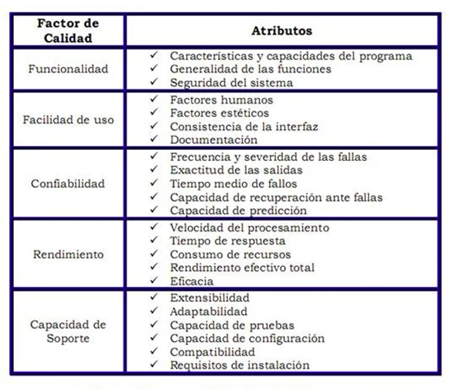

Slide 7
Las restricciones de diseño especifican o restringen el diseño del sistema.
Las restricciones de implementación especifican o restringen la codificación o construcción de un sistema.
Por su parte, las restricciones de interfaz especifican el comportamiento de los elementos externos con los que el sistema debe interactuar.
Por último, las restricciones físicas especifican ciertas propiedades que el sistema debe poseer, en términos de materiales, forma, peso, tamaño.

Slide 8
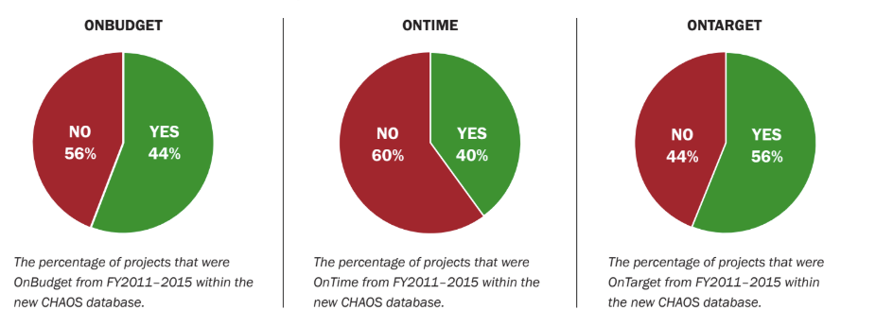

Slide 9
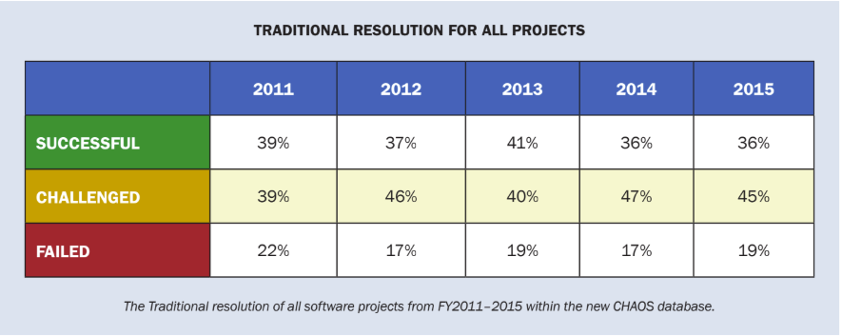

Slide 10
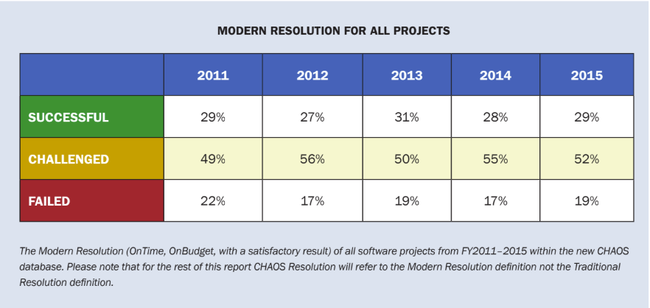

Slide 11
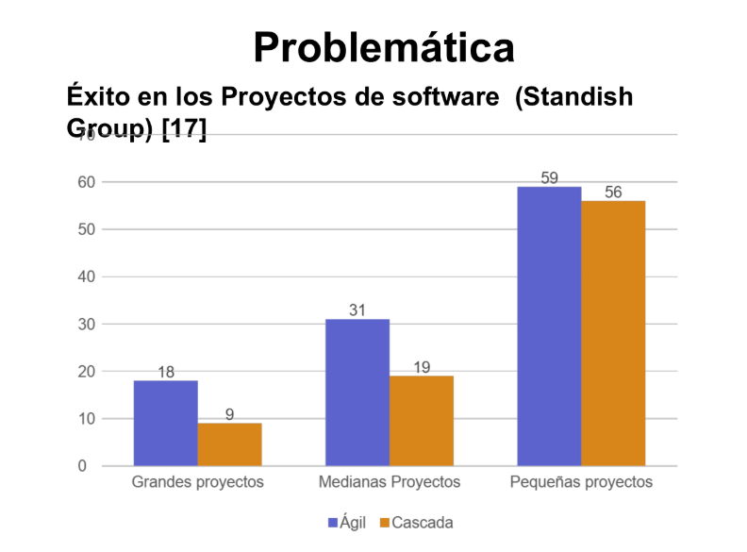
2017

Slide 12
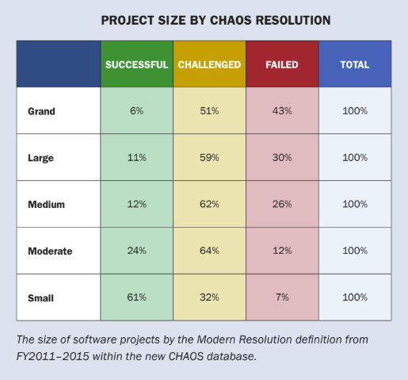

Slide 13
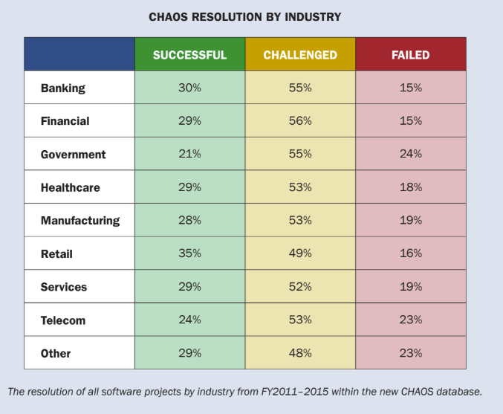

Slide 14
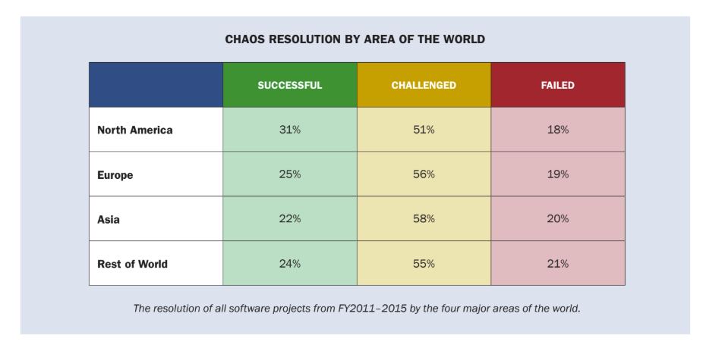

Slide 15
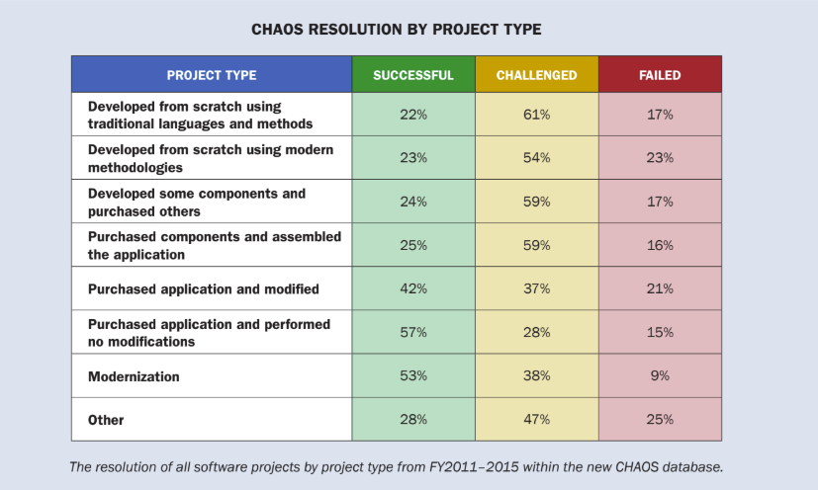

Slide 16
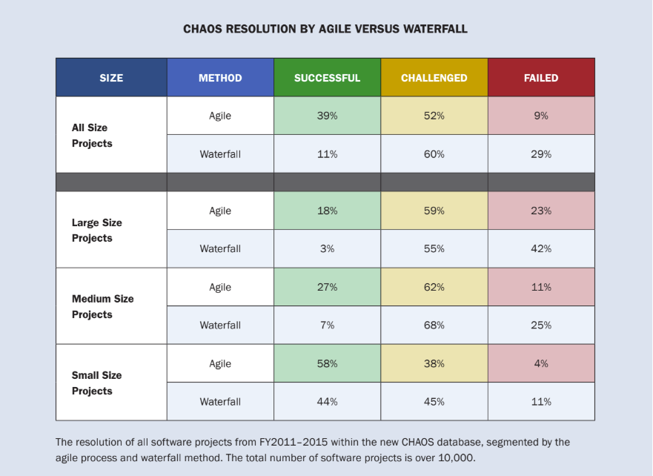

Slide 17
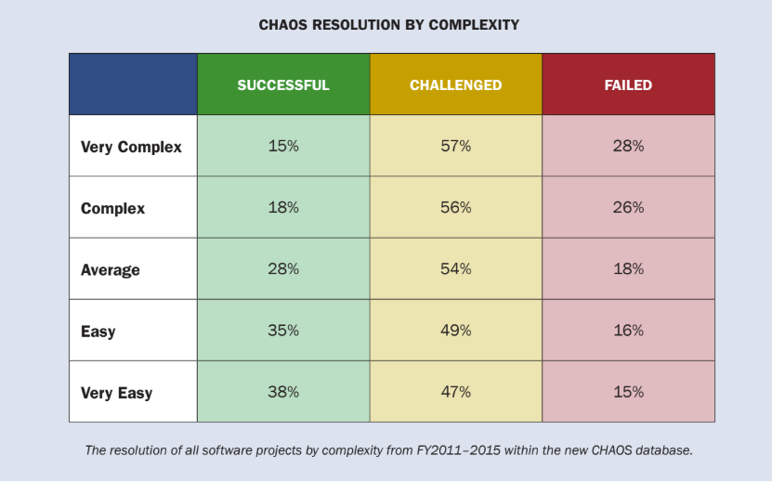

Slide 18
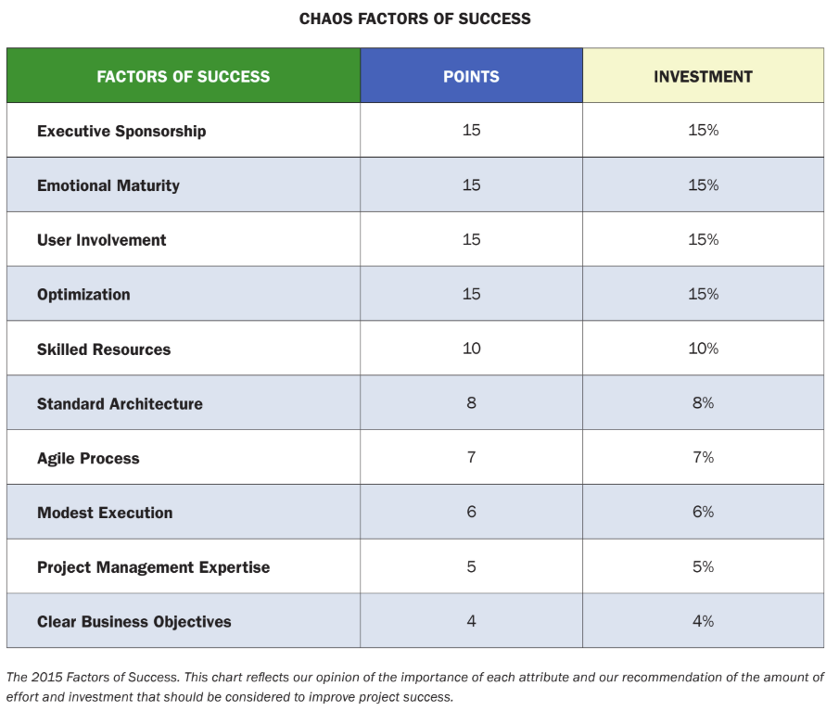

Slide 19
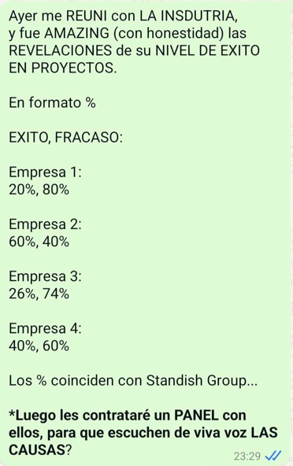
Industria Tijuana
13 Febrero, 2025

Slide 20
NO HAY TIEMPO PARA HACER INGENIERIA, NO HAY TIEMPO PARA PLANEAR, PERO SI HAY TIEMPO PARA “FALLAR”
A PEGAR LADRILLOS, SIN INGENIERIA

Slide 21
Causas del fracaso
Según Marinho los proyectos de desarrollo de software son notoriamente víctimas de desastres, debido al alto grado de incertidumbres que manejan [10].
Las causas de los fracasos de los proyectos son varias podemos citar:
Requerimiento “pobres”.
El alto grado de incertidumbre [10].
El tamaño de los proyectos [13]
El nivel de experiencia de los miembros del equipo.
Falta de apoyo de la gerencia.
Falta de involucramiento de los usuarios.

Slide 22
QUALITY OF REQUIREMENTS

Slide 23
Characteristic | Explanation
Unitary (Cohesive) | The requirement addresses one and only one thing.
Complete | The requirement is fully stated in one place with no missing information.
Consistent | The requirement does not contradict any other requirement and is fully consistent with all authoritative external documentation.
Non-Conjugated (Atomic) | The requirement is atomic, i.e., it does not contain conjunctions. E.g., "The postal code field must validate American and Canadian postal codes" should be written as two separate requirements: (1) "The postal code field must validate American postal codes" and (2) "The postal code field must validate Canadian postal codes".
Traceable | The requirement meets all or part of a business need as stated by stakeholders and authoritatively documented.
Current | The requirement has not been made obsolete by the passage of time.
Unambiguous | The requirement is concisely stated without recourse to technical jargon, acronyms (unless defined elsewhere in the Requirements document), or other esoteric verbiage. It expresses objective facts, not subjective opinions. It is subject to one and only one interpretation. Vague subjects, adjectives, prepositions, verbs and subjective phrases are avoided. Negative statements and compound statements are avoided.
Specify Importance | Many requirements represent a stakeholder-defined characteristic the absence of which will result in a major or even fatal deficiency. Others represent features that may be implemented if time and budget permits. The requirement must specify a level of importance.
Verifiable | The implementation of the requirement can be determined through basic possible methods: inspection, demonstration, test (instrumented) or analysis (to include validated modeling & simulation).
https://en.wikipedia.org/wiki/Requirement#Types_of_requirements

Slide 24
Necesario. Si se tiene alguna duda acerca de la necesidad del requerimiento, se pueden preguntar “¿Qué sería lo peor de no incluirlo?” Si no se encuentra una respuesta o cualquier consecuencia, entonces es probable que no sea un requerimiento necesario.
Completo. Un requerimiento esta completo si no necesita ampliar detalles en su redacción, es decir, si se proporciona la información suficiente para su comprensión.
Consistente. Un requerimiento es consistente si no es contradictorio con otro requerimiento.
Correcto. Acuerdo entre dos partes. Contiene una sola idea.
Factible. El requerimiento deberá de ser totalmente factible y dentro de presupuesto, calendario y otras restricciones, si se tiene alguna duda de su factibilidad, hay que investigar, generar pruebas de concepto para saber su complejidad y factibilidad, si aun así el requerimiento es no factible hay que revisar la visión del sistema y replantear el requerimiento.
Modificable. Que se pueda realizar alguna modificación sobre el requerimiento y esta sea sencilla, consistente y completa.
Priorizado. Categorizar el requerimiento nos ayuda a saber el grado de necesidad del mismo Esencial/Critico, Deseado, Opcional Verificable

Slide 25
¿Qué es la recopilación de requisitos?
¿Qué es la recopilación de requisitos?
¿Por qué es importante la recopilación de requisitos?
¿Qué es el proceso de recopilación de requisitos?
Técnicas de recopilación de requisitos
Mejores prácticas para la recopilación de requisitos
¿Cuáles son los desafíos al recopilar requisitos? ¿Cómo evitarlos?
El papel de la tecnología en la recopilación de requisitos
El concepto de recopilación de requisitos ágil
Conclusión
https://visuresolutions.com/es/gu%C3%ADa-de-trazabilidad-de-gesti%C3%B3n-de-requisitos/recopilaci%C3%B3n-de-requisitos/

Slide 26
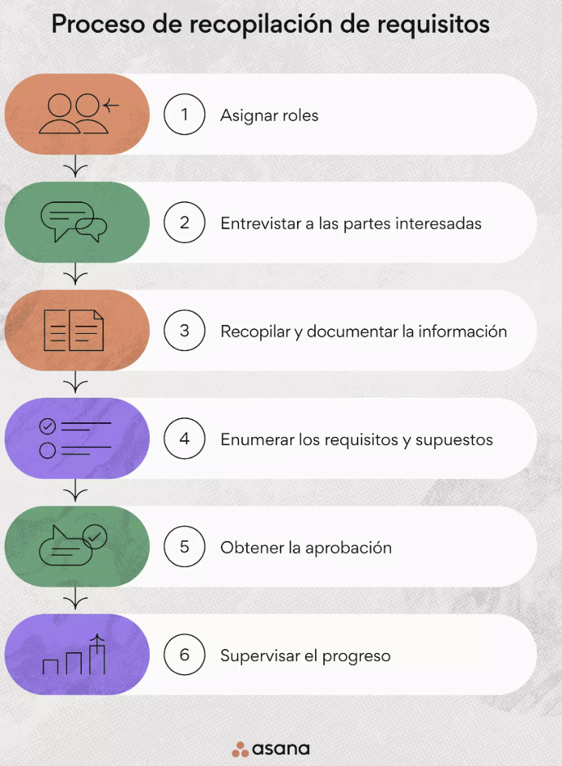
El proceso de 6 pasos para la recopilación de requisitos
https://asana.com/es/resources/requirements-gathering

Slide 27
Técnicas de levantamiento de requerimientos software
https://www.pmoinformatica.com/2016/08/tecnicas-levantamiento-requerimientos.html
Obtención de Requerimientos. Técnicas y Estrategia
https://sg.com.mx/revista/17/obtencion-requerimientos-tecnicas-y-estrategia

Slide 28
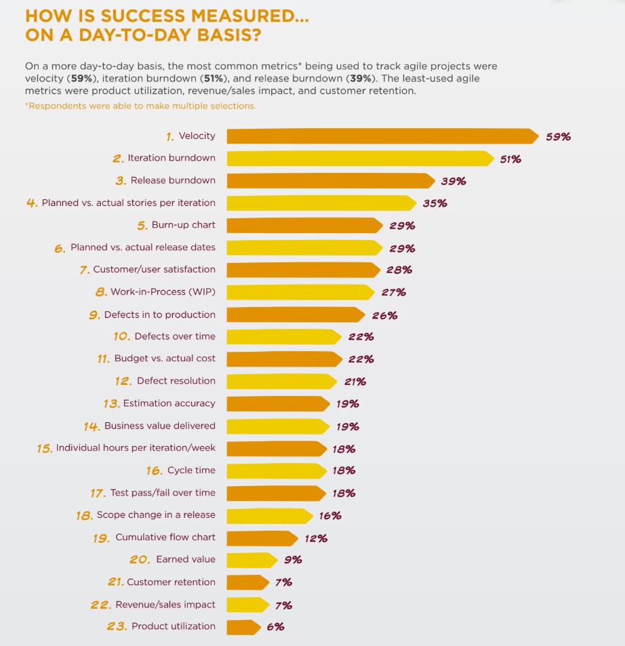

Slide 29
