Slide 1
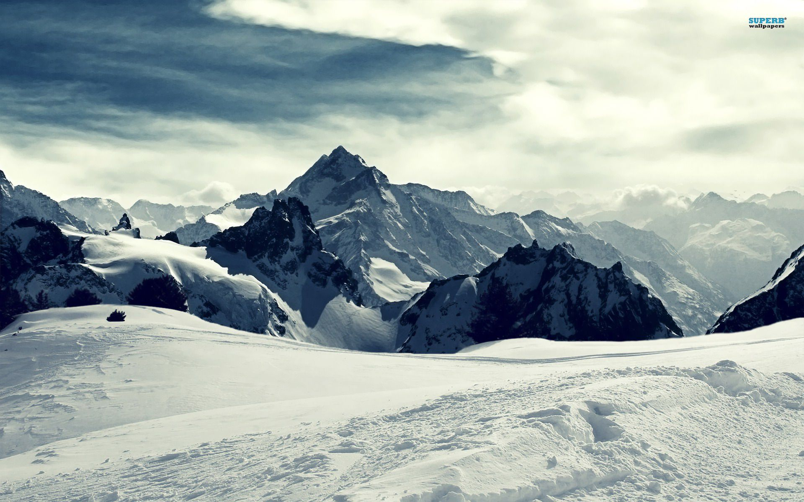
Big Mountant Resort
Pricing model
Erik Pak

Slide 2
Problem identification
Does the data support increase in the ticket price and/ or provide operational and investment strategy?
Define market segment
Organize Datasets
Define Analysis
Determine regression model
Optimize model

Slide 3
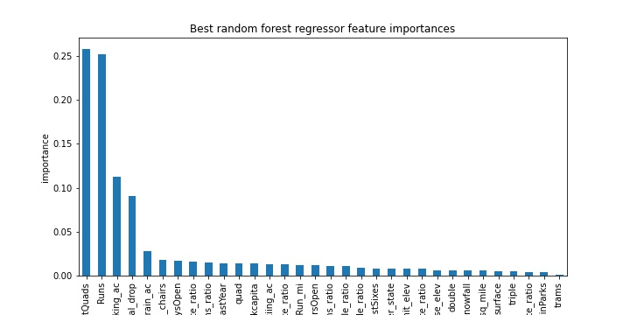
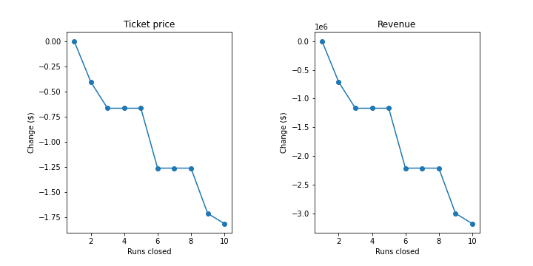
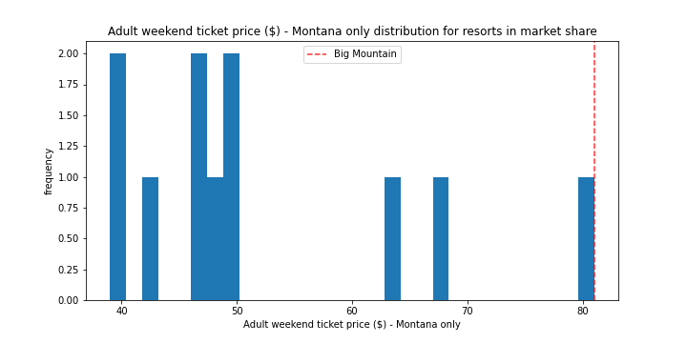
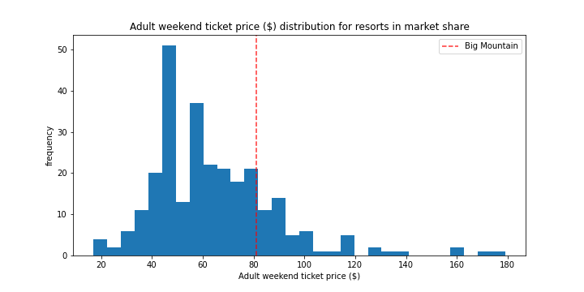
Fig 1: Feature importance according to analysis
Fig 2: Permanently closing down up to 10 of the least used runs
Fig 3: Montana ticket price
Fig 4: Entire market segment ticket price

Slide 4
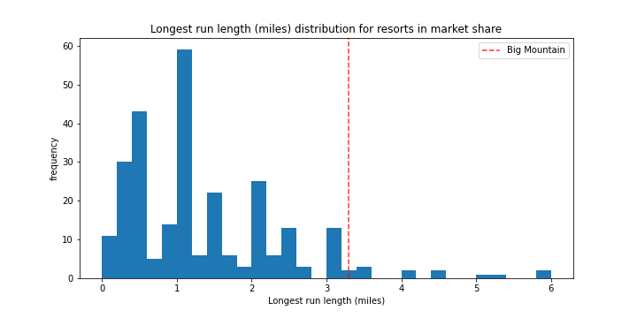
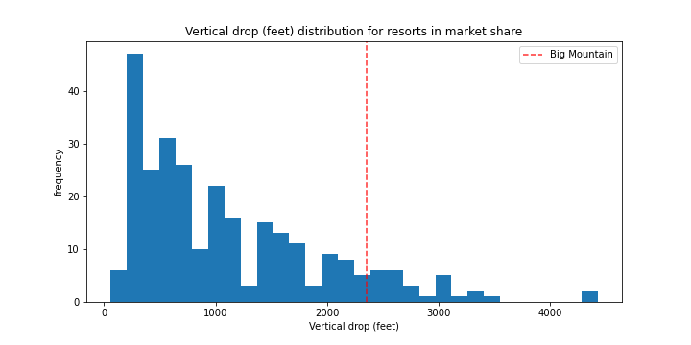
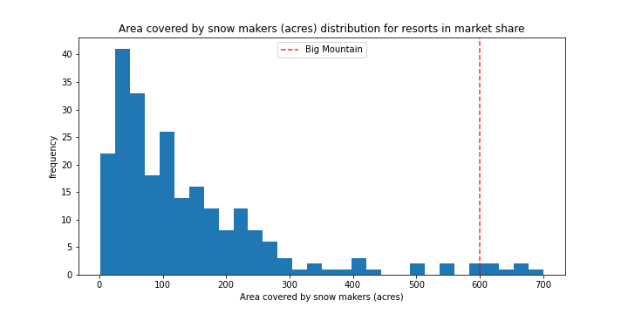
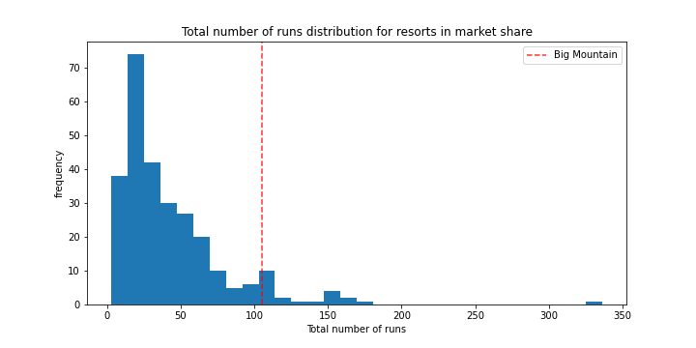
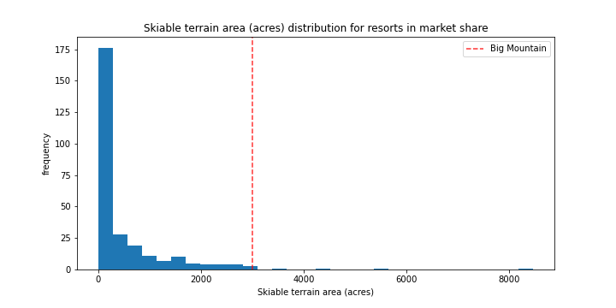
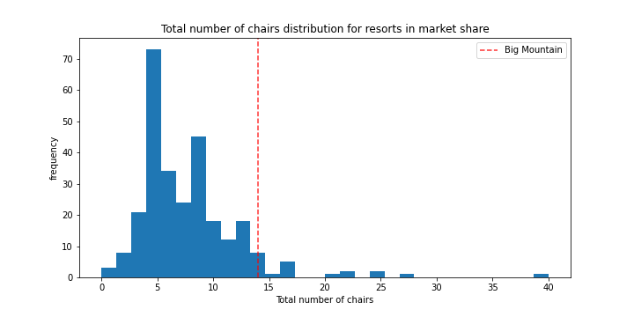
Fig 5: Longest run length (miles)
Fig 6: Vertical drop
Fig 7: Area covered by snow maker (acres)
Fig 8: Total Runs
Fig 9: Skiable area (acres)
Fig 10: Total chairs

Slide 5
Modeling Results
Features that came up as important in the modeling:
Vertical drop (feet)
Snow making (acres)
Total chairs
Runs & Longest runs (miles)
Trams
Skiable tartan (acres)

Slide 6
Recommendations
Our model predicted $95.87 as our new ticket price assuming that the other resorts accurately set their price according to what the market supports. The recommendation below used 350,00 visitors for five days.
According to for figure 2, the model says closing one run makes no difference. Closing 2 and 3 successively reduces support for the ticket price. If Big Mountain closes down three runs, it seems they may as well close down 4 or 5 as there's no further loss in the ticket price.
Big Mountain is adding a run, increasing the vertical drop by 150 feet, and installing an additional chair lift can add additional $3,474,638 annually.
In this scenario, you are repeating the previous one but adding 2 acres of snow making. This scenario increases additional $3,474,638 annually.

