Slide 1
reqtbox {who,why,what,when} [cird]
context – who ☺ | intentions – why ?
requirements – what ! | delivery – when @
https://github.com/lunduniversity/reqeng/tree/master/reqtbox

Slide 2
reqtbox/who:context ☺ [spsi]
stakeholders incl. human users | our product
other systems | interfaces and protocolls
https://github.com/lunduniversity/reqeng/tree/master/reqtbox

Slide 3
reqtbox/why:intentions ? [gprc]
goals +- | priorities ½
risks %*☹ | commitments §$
https://github.com/lunduniversity/reqeng/tree/master/reqtbox

Slide 4
reqtbox/what:requirements ! [fdqt]
functionality | data
quality | tests
https://github.com/lunduniversity/reqeng/tree/master/reqtbox

Slide 5
reqtbox/when:delivery @ [rrcr]
road-map and strategy | resources
constraints | release plan
https://github.com/lunduniversity/reqeng/tree/master/reqtbox

Slide 6
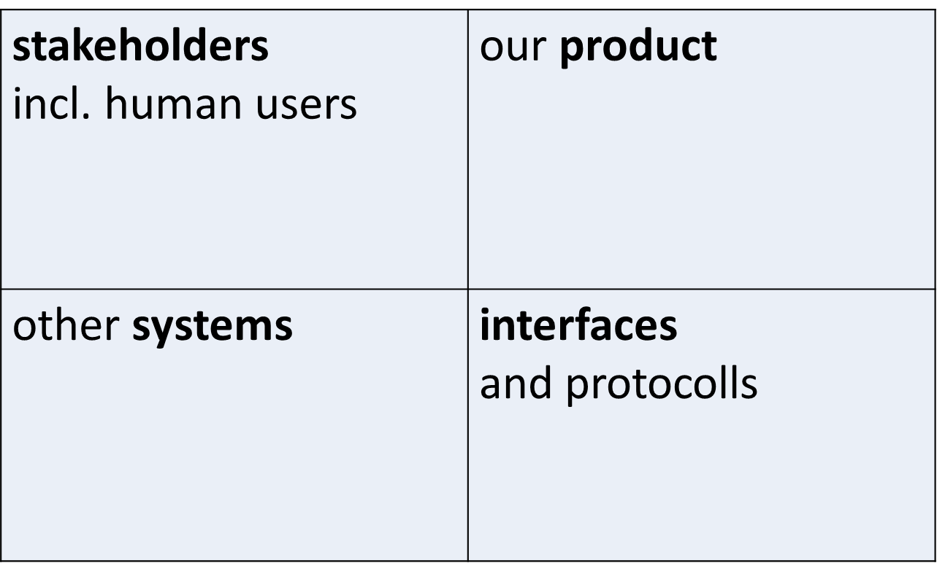
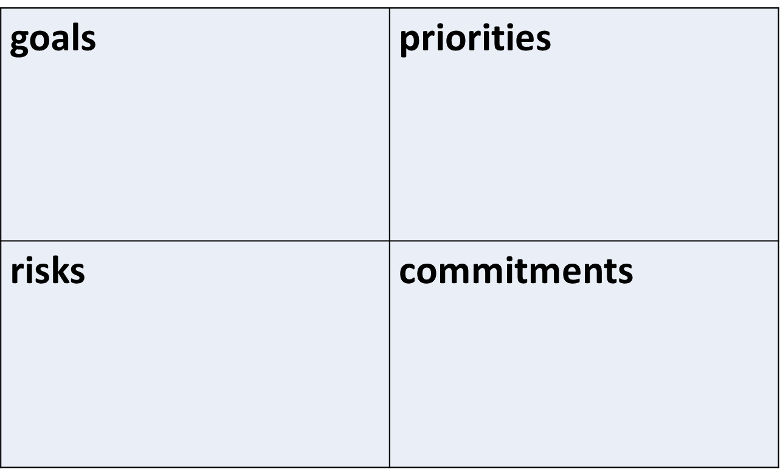
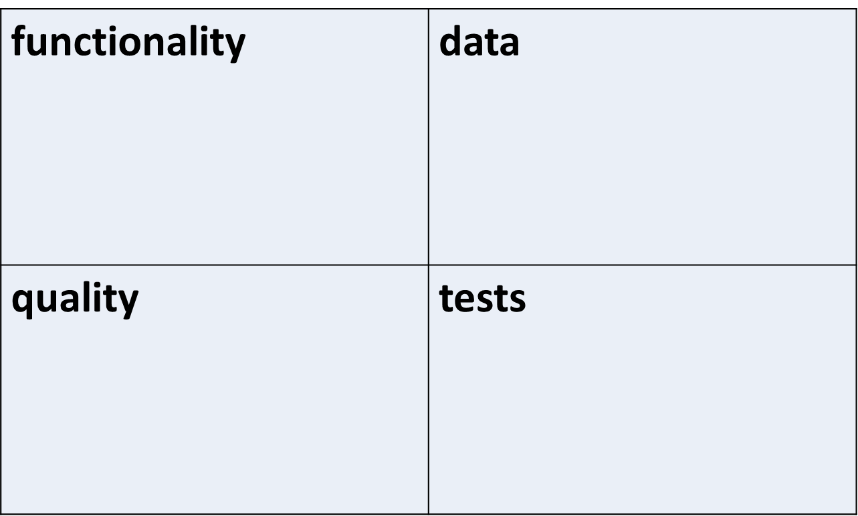
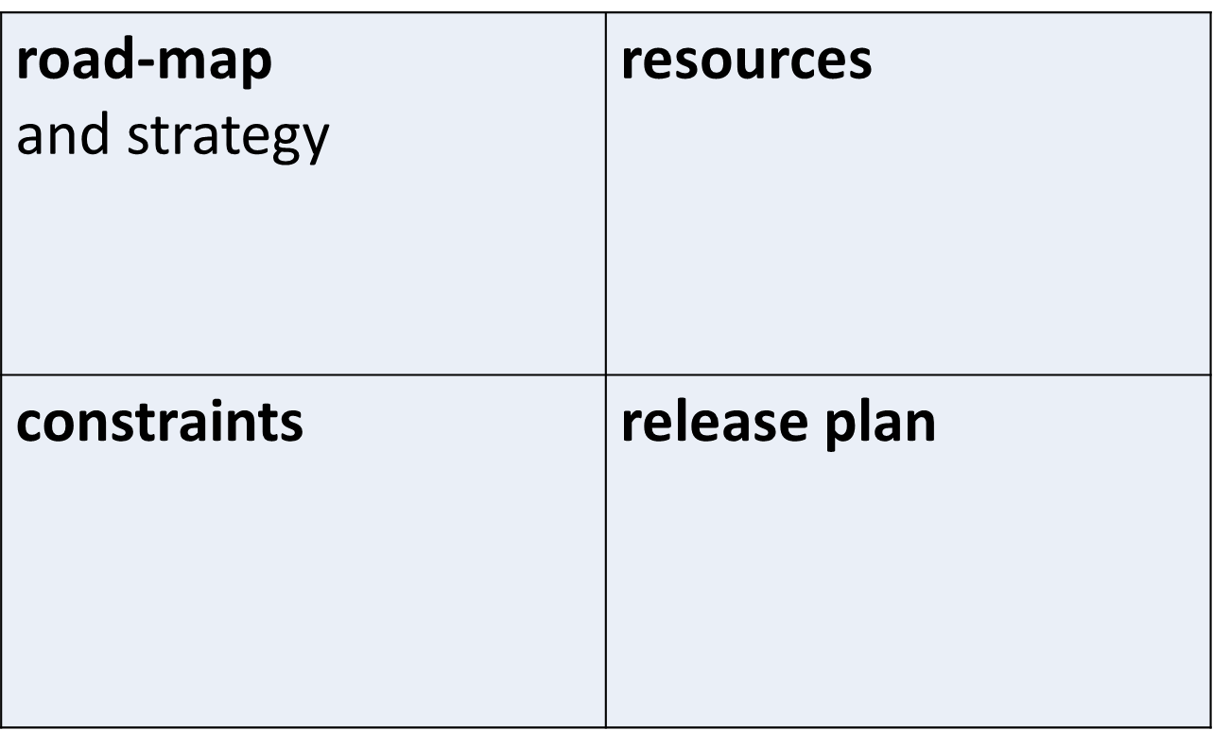
reqtbox/{who,why,what,when} ☺?!@ [cird/{spsi, gprc, fdqt, rrcr}]
context – who ☺ | intentions – why ?
requirements – what ! | delivery – when @
https://github.com/lunduniversity/reqeng/tree/master/reqtbox

Slide 7
reqt process box {learn, model, check, decide} [esvs]
elicitation – learn ☼ | specification – model 
validation – check √ | selection – decide 
https://github.com/lunduniversity/reqeng/tree/master/reqtbox

