Slide 1
Terrain Analysis in Realtime Strategy Games
Dave Pottinger
Ensemble Studios
Technical Director
2002.5.23
서승원

Slide 2
Contents
What is Terrain Analysis?
Terrain Analysis uses
Terrain Analysis tools
  Definitions
  Pathfinding
  Influence Maps
  Area decomposition

Slide 3
What is terrain analysis?
Supply information about the map to various systems in the game
  Abstract information about the map into chunks of data for game systems to make decisions
  Used in every RTS (RealTime Strategy) game
Can exist in many forms from simple pathfinding to advanced area decomposition

Slide 4
What’s it good for?
Can be utilized by several systems in RTS game
  Computer Player (CP) AI processing
  Pathfinding
  Random map generation

Slide 5
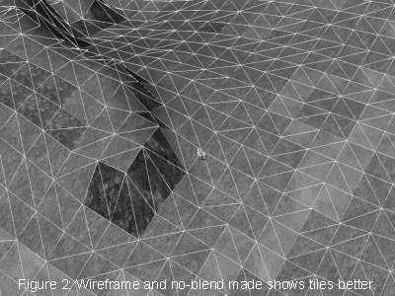
Definitions
Tile
Tile-based map
  2D heightfield map
  with varying heights
  in the upward direction
Arbitrary poly map
  A non-regular terrain system
Area
  Collection of terrain that shares similar properties
Area connectivity
  The link between two Areas
<Tile-based map>

Slide 6
Pathfinding
“CanPath” concept
Execution speed matters
Quality of the pathfinding algorithm is important
One of the slowest things most RTS games do
  Ex) Age of Empires 2 spends roughly 60 to 70% of simulation time doing pathfinding

Slide 7
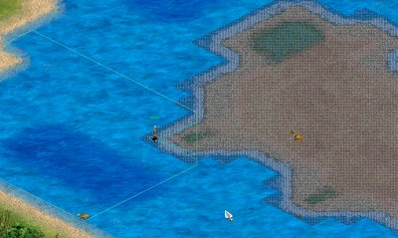
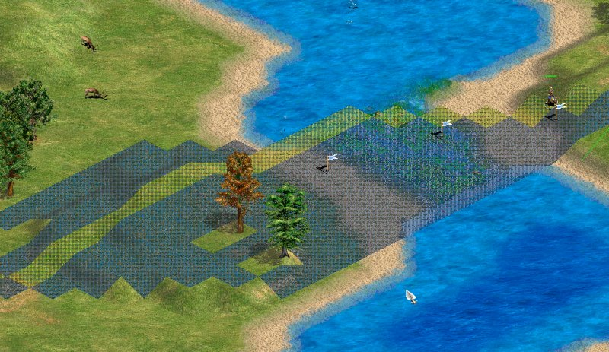
AGE 2 CanPath example

Slide 8
Influence Maps
2D arrays that represent some area of the terrain
Adds attractors and detractors, then iterates to find best-valued position
  ex) best place to gather resource
Brute force
Can be simply abstracted to 3D influence volumes

Slide 9
Area decomposition
Newer component of the terrain analysis
Classify the map to several area that has similar properties
  “Good place to gather resources”
  “Good place to build town”
Excellent at abstracting large areas of the map into easily usable chunks

Slide 10
AGE 1 Terrain Analysis
Pathfinding
Zone decomposition
Influence Maps

Slide 11
AGE 1 Terrain Analysis: Zones
A simple area system
No dynamic terrain made it a precalc
Calculated minimum distance between zones as an optimization
Unbounded size
No obstruction information

Slide 12
AGE 1 Terrain Analysis: Influence Maps
Single Layer
1 cell per tile
1 BYTE per cell
Initialized to a non-zero value
Dynamic influences (based on use)
Used for
  Building Placement
  Group Staging point determination
  “Back of the town” attacks

Slide 13
AGE 2 Terrain Analysis
Goal was reuse, ended up doing quite a bit of work
Many passes through influence map heuristic values
New pathfinding
Wall placement

Slide 14
AGE 2 Terrain Analysis: Pathfinding
3 different pathfinders
  Mip-map (long distance)
  Polygonal (short distance)
  Simplified Tile (medium distance/fallback)
Allowed specialized uses
  Faster
  More consistent execution times

Slide 15
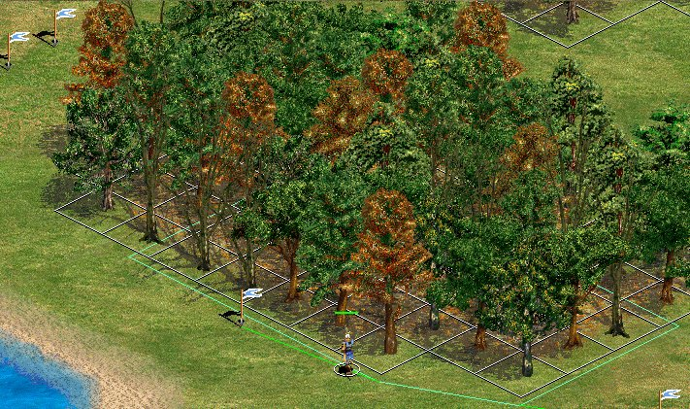
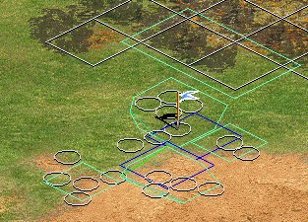
AGE 2 Terrain Analysis: Pathfinding Example

Slide 16
AGE 2 Terrain Analysis: Wall Placement
Placed walls at a variable distance from the player start location
  Used obstructions (e.g. trees, water) when possible
Did a mip-map path between impassabilities
CP AI rated/prioritized the wall sections and managed the building (when directed by scripts)

Slide 17
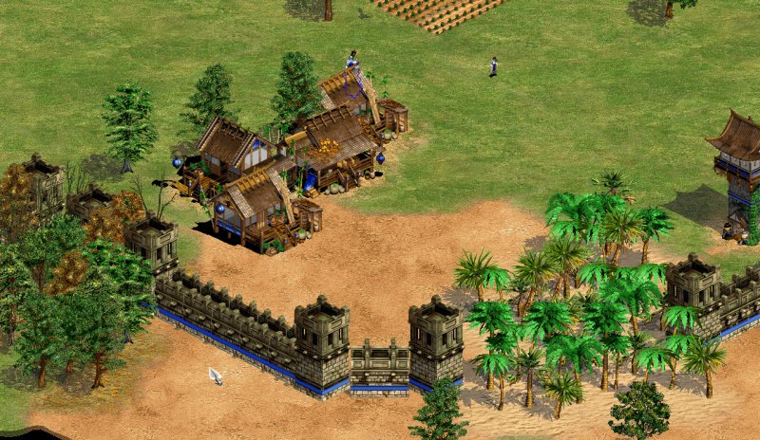
AGE 2 Terrain Analysis: Wall Placement Example

Slide 18
Useful Terrain Analysis Tidbits
It doesn’t need to be exact for the CP AI
Abstract the area representation away from the CP AI
Support dynamic terrain
Time-slice everything; then time-slice it again
Put area specification/hint-giving tools in the scenario editor

Slide 19
Useful Terrain Analysis Tidbits
Do good graphical debugging tools
Pass Random Map generation information on to the terrain analysis
Don’t use tiles as your measure of distance
If you can get away without using pattern recognition, do so

