Slide 1
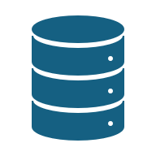
Modern SQL development with .NET 10
@ErikEJ

Slide 2
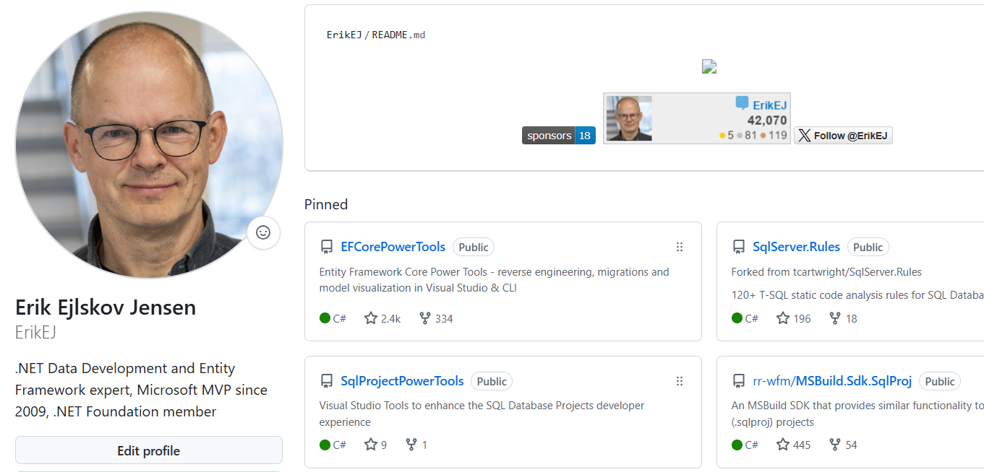
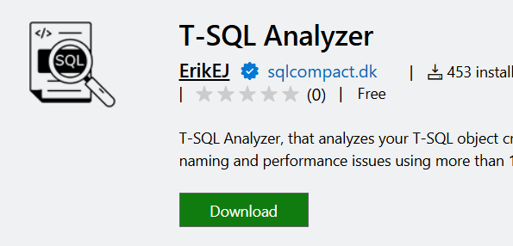
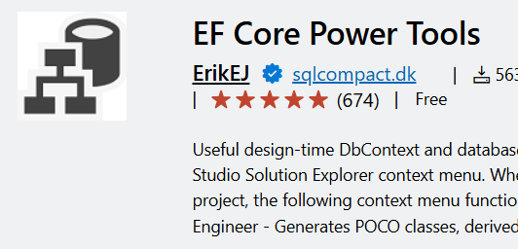
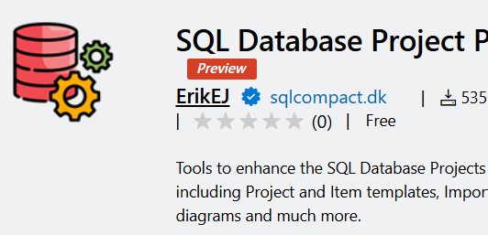

Slide 3
Agenda
Add database to source control
Improve with static code analysis
Understand better with a diagram
Build and deploy
Generate EF Core 10 DbContext
Use in .NET 10 Web API
Putting it all together in Aspire 13

Slide 4
Demo!

Slide 5

CTA
Add you database schema to source control
Enable code analysis locally and during automated build
Publish your data schema in your deployment pipeline
Take advantage of your SQL Project!

Slide 6
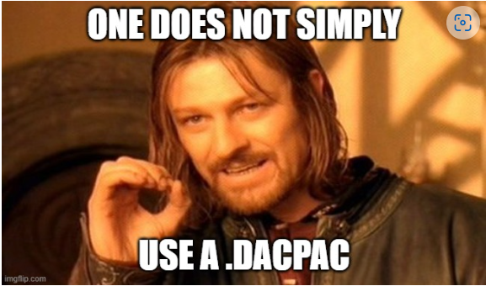
Q & A

Slide 7
Q & A
Handling destructive schema changes?
How do I ”seed data” to my database using a .dacpac?
This is a community project, what is MS doing?
I use Postgres / Oracle /MySQL – can I use this?
Does it work on Azure SQL Databases?
What if I just want to analyze a script on disk?

Slide 8
Q & A
Sharing parts of a database (f.ex. monitoring) ?
What if my db has dependencies on other database?
How would this work with EF Core?
How about .NET Aspire?

Slide 9
Classic .sqlproj vs MSBuild.SDK.SqlProj
 | .SQLPROJ (Legacy VS) | MSBuild.SDK.SqlProj
Create, build, publish a .dacpac | ✔ | ✔
Run Code Analysis | ✔ (15 rules) | ✔ (120+ rules)
Run custom rules | ✔ (admin only) | ✔
Run rules on hosted agent | ✔ | ✔
Run custom rules on hosted agent | ❌ | ✔
Build on Linux (dotnet build) | ❌ | ✔
Visual designers | ✔ | ❌
NuGet pack (.dacpac/rules) | ❌ | ✔
SQL CLR | ✔ | ❌ (workaround)

Slide 10
What is a dacpac and why should I care?

Slide 11
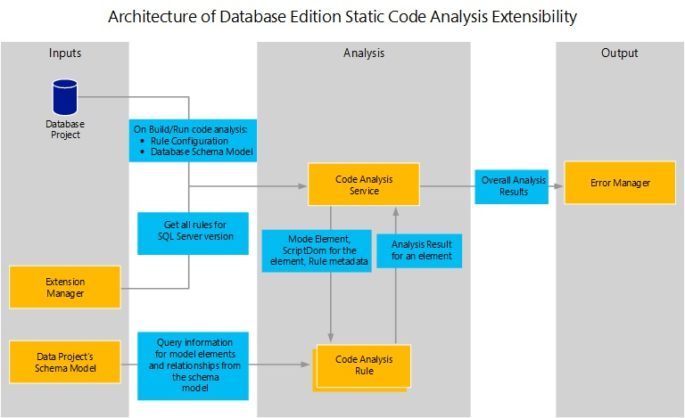

Slide 12
Why?
Data Tier Application Package
Get your database under source control
Ensure your .sql scripts ”build” – code validation
Ensure your .sql scripts follow business rules – code analysis
Deploy changes to the database schema with changes to your app
No more migration scripts – simply describe your desired state
Cross platform build and deployment support

Slide 13

Process
Create .sql scripts
Build
.dacpac
Deploy
Create .sqlproj

