Slide 1

Look, no passwords
Managed Identity with App Service and Azure SQL Database
Erik Ejlskov Jensen, Delegate A/S @ErikEJ (Twitter, GitHub)

Slide 2

Friendly Reminders Before Getting Started
This call and content is under Microsoft NDA; please do not share information publicly.
Please keep your mics muted for the best sound quality.
Feel free to unmute and ask questions or use the chat window.
Thank you all for joining! Please share your feedback on this session: https://aka.ms/acpwebcastfeedback

Slide 3
Topics
Managed Identity overview
Sample deployment – you can do it too!
Look under the hood

Slide 4
What is Managed Identity (formerly MSI)
Managed Identities is a feature of Microsoft Entra ID which automatically creates a service principal that is tied to the Azure service itself (or associated with)
Applications hosted on those services can generate tokens using this identity without a need to provide any credentials.
It is secure because only applications hosted on that service which has an associated managed identity enabled will be able to generate tokens
Allows centralized control of lifecycle and permissions, incl. revocation/disabling

Slide 5
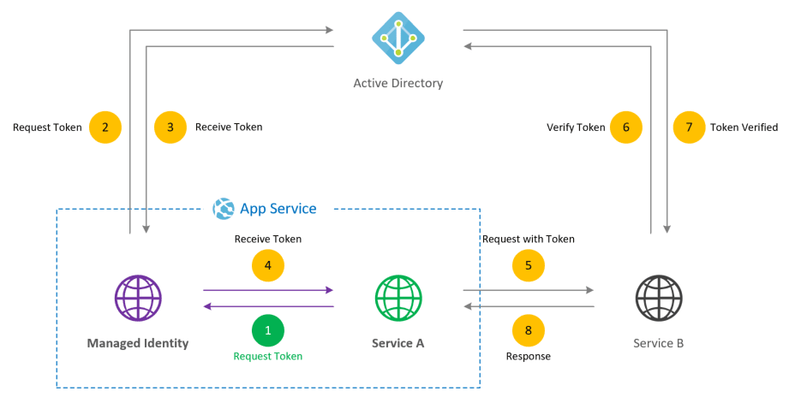

Slide 6
Managed Identity types
System assigned: Lifecycle same a associated ressource
User assigned: Standalone ressource that can be assoicated with multiple compute services
Issue with (accidential) deletion of managed identities
Use Locks – Microsoft also added soft delete recently

Slide 7
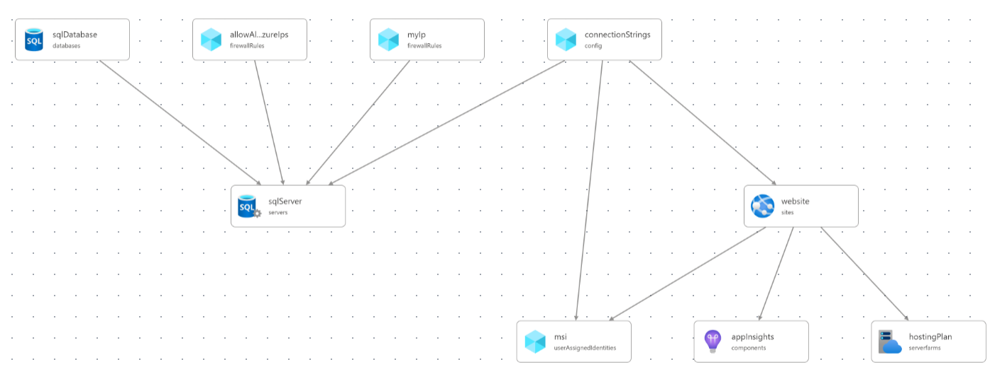
Sample deployment

Slide 8
Deployment parts
Goal:
create a web app
with passwordless minimal access to a Azure SQL DB

Slide 9
Deployment parts
Design goals: Minimal amount of ”code”
Infrastructure - .bicep (ARM)
App - .NET 8 minimal Web API published to Web App
Configuration (PS Core) (solving issue with limited Entra ID rights)

Slide 10
Preparations
winget install -e --id Microsoft.Bicep
Install-Module -Name SqlServer -Force
Connect-AzAccount
Set-AzContext -Subscription ”xxx”

Slide 11
DEMO!

Slide 12

Q & A
DO: Use User Assigned Managed Identity
DONT: Store passwords
DO: Sleep well at night

Slide 13
Q & A
GitHub repo: ErikEJ/CloudBurstDemo (github.com)
Azure Services with managed identities support - Azure AD - Microsoft Entra | Microsoft Learn

