Slide 1
Look ma, no passwords
Managed Identity with App Service and Azure SQL Database
Erik Ejlskov Jensen, Delegate A/S @ErikEJ

Slide 2
Topics
Managed Identity overview
Sample deployment – you can do it!
Look under the hood

Slide 3
What is Managed Identity (formerly MSI)
Managed Identities is a feature of Azure AD which automatically creates a service principal that is tied to the Azure service itself (or associated with)
Applications hosted on those services can generate tokens using this identity without a need to provide any credentials.
It is secure because only applications hosted on that service which has an associated managed identity enabled will be able to generate tokens.

Slide 4
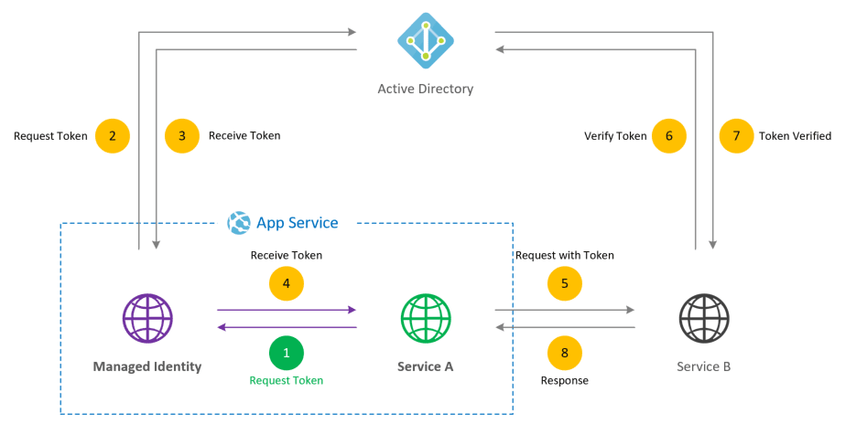

Slide 5
Managed Identity types
System assigned: Lifecycle same a associated ressource
User assigned: Standalone ressource that can be assoicated with multiple compute services
Issue with too broad rights to assign Azure roles – Azure AD Team is working on a solution
Issue with (accidential) deletion of managed identities

Slide 6
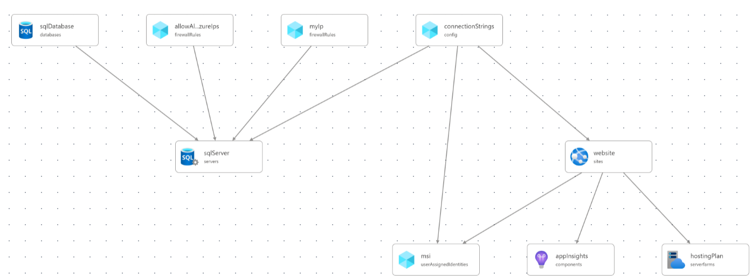
Sample deployment

Slide 7
Deployment parts
Goal: Provide a web app with passwordless access to a Azure SQL DB
Design goals: Minimal amount of ”code” to
Infrastructure - .bicep (ARM)
App - .NET 6 minimal Web API published to Web App
Configuration (PS Core) (solving issue with limited AAD rights)
DEMO!

Slide 8
Q & A
DO: Use User Assigned Managed Identity
DONT: Store passwords
DO: Enjoy!
GitHub repo: ErikEJ/CloudBurstDemo (github.com)
Azure Services with managed identities support - Azure AD - Microsoft Entra | Microsoft Learn

