Slide 1

STATIC CODE ANALYSIS
Catch it before it ships
From squiggles in VS Code to a red build in CI — applied to T-SQL.
github.com/ErikEJ/SqlServer.Rules

Slide 2
THE GAP
Your C# is analyzed. Your SQL probably isn't.
C#
T-SQL
Analyzers ship with the SDK. Squiggles in the editor, warnings at build, errors in CI. Nobody argues about it.
Reviewed by eye, if at all. Problems surface as a slow query or an incident — in production.
The database is the one place where a bad decision is hardest to undo.
Static code analysis for T-SQL
2

Slide 3
THE REFERENCE MODEL
What Roslyn analyzers got right
Same rules everywhere
Delivered as packages
Severity is a dial
Fixes, not just findings
Static code analysis for T-SQL
3

Slide 4
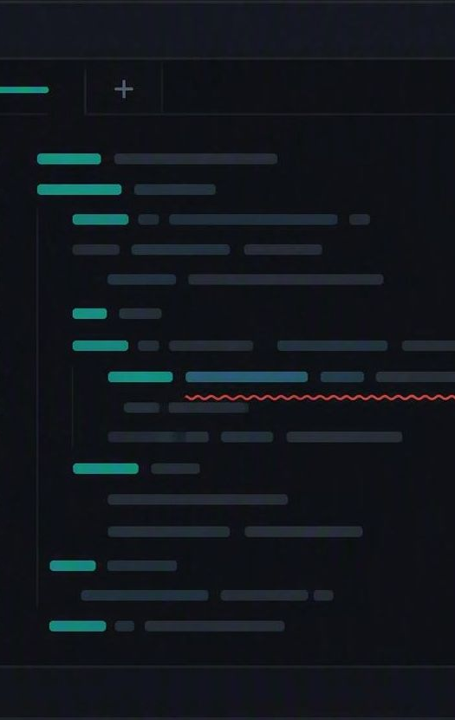
THE T-SQL EQUIVALENT
SqlServer.Rules, built on DacFx
140+
open-source T-SQL analysis rules
VS Code, Visual Studio, SSMS
Live feedback as you type
tsqlanalyze CLI
Any script, any pipeline
SQL database projects
Analysis at build time
MCP server
The same rules for AI agents
Static code analysis for T-SQL
4

Slide 5
STEP 1 — THE EDITOR
Squiggles while you type, no build required
Live analysis
Hover for the why
Zero configuration
Open any .sql file — a procedure, a migration, a one-off fix — and analysis starts on its own.
Every squiggle carries a rule id, a plain-English explanation, and a link to the docs.
Install the extension; the tooling downloads itself on first use, with sensible defaults.
TUNE IT IN SETTINGS
-SqlServer.Rules.SRD0004
-SqlServer.Rules.SRN*
+!SqlServer.Rules.SRN0005
turn one rule off
silence a whole family
promote it to an error
Static code analysis for T-SQL
5

Slide 6
WHAT IT CATCHES — 1 OF 3
Design and naming
Code that works today and surprises you later.
SRD0011
Compare with NULL
= NULL never matches. Use IS NULL — this one silently returns nothing.
SRD0006
Avoid SELECT *
Column order and count become an implicit contract you never agreed to.
SRD0071
CASE without ELSE
No matching WHEN quietly yields NULL instead of a default value.
SRN*
Naming conventions
Consistent object and column naming, enforced rather than reviewed.
Static code analysis for T-SQL
6

Slide 7
WHAT IT CATCHES — 2 OF 3
Performance
The anti-patterns that only hurt once the table gets big.
SRD0002
Missing primary key
A table with no primary key cannot be reliably updated, replicated or indexed.
SRD0003
Wide primary keys
GUIDs and wide VARCHAR keys bloat every non-clustered index that carries them.
SRD0004
Index on foreign key
Both sides of a foreign key should be indexed, or joins and deletes scan.
SRP0025
SELECT * in EXISTS
EXISTS (SELECT 1 …) states the intent without dragging in a column list.
Static code analysis for T-SQL
7

Slide 8
WHAT IT CATCHES — 3 OF 3
Security
The findings you would rather not read about in an incident report.
SRD0075
Hard-coded credentials
Literals assigned to @password, @secret or @apikey — in source control, forever.
SRD0074
Weak hashing
HASHBYTES with MD5 or SHA1. Still compiles. Still broken.
Dynamic SQL
Injection patterns
Concatenated EXEC strings, flagged where parameterized sp_executesql belongs.
SRD0017
DELETE without WHERE
One missing predicate between a routine fix and a very long evening.
Static code analysis for T-SQL
8

Slide 9

STEP 2 — THE BUILD
The same rules, now as a gate
PROJECT FILE
Violations become build output
<PropertyGroup>
<RunSqlCodeAnalysis>
True
</RunSqlCodeAnalysis>
<CodeAnalysisRules>
-SqlServer.Rules.SRN*;
+!SqlServer.Rules.SRD0006
</CodeAnalysisRules>
</PropertyGroup>
Promote what matters to errors
Suppress deliberately, in source
Runs wherever dotnet build runs
Editor and pipeline read the same configuration — so the build never tells a developer something the editor didn't.
Static code analysis for T-SQL
9

Slide 10
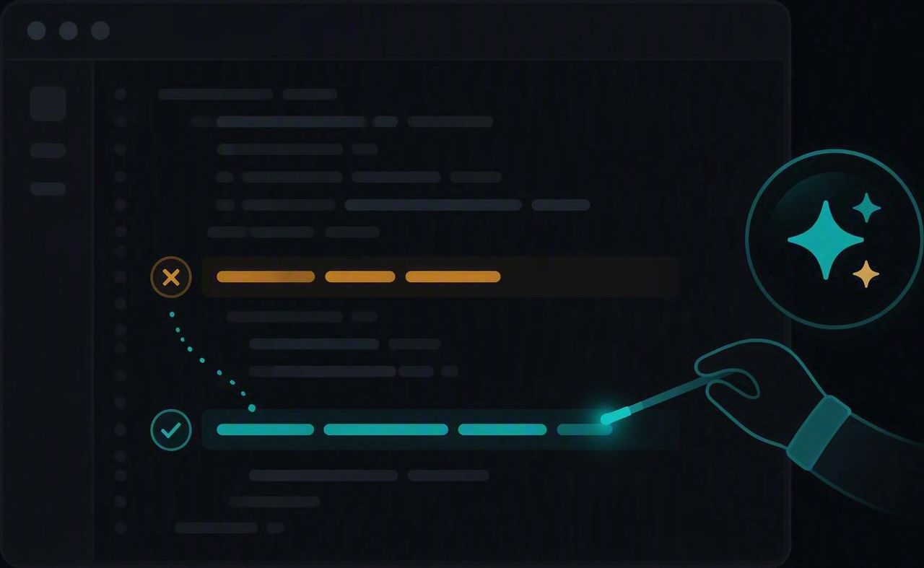
DEMO
Enable once, run everywhere
Run on dev PC
Build pipelines (CI)
Adjust as you progress
The analyzer supplies the deterministic judgment. You are in charge.
Static code analysis for T-SQL
11

Slide 11
DEMO
Copilot fixes what the analyzer found
A squiggle appears
Use the MCP Server
The fix, then the proof
The analyzer supplies the deterministic judgment. Copilot supplies the typing.
Static code analysis for T-SQL
11

Slide 12
TAKEAWAYS
Start where the cost is lowest
Install the extension (VS, VS Code, SSMS)
Turn it on at build
Two minutes, zero configuration, immediate feedback on every .sql file you open.
Add the rules package to the SQL project and set analysis to run. Warnings first.
Promote rules gradually
Let the agent close the loop
Warning, then error — once the codebase is clean. Never bulk-suppress.
A rule id and a rationale are the best prompt Copilot can get.
Rules and docs
github.com/ErikEJ/SqlServer.Rules
Extension
T-SQL Analyzer, on the VS Code Marketplace
Static code analysis for T-SQL
12

