Slide 1
Proteolytic selectivity (disassembly project)
Timeline and ideas
Erik Hartman

Slide 2
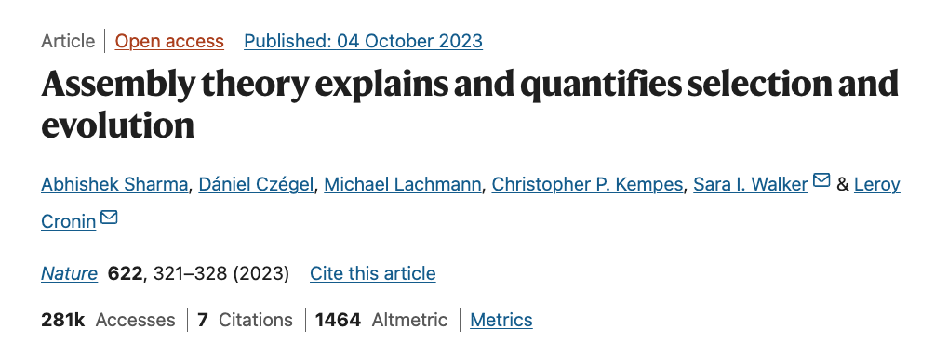
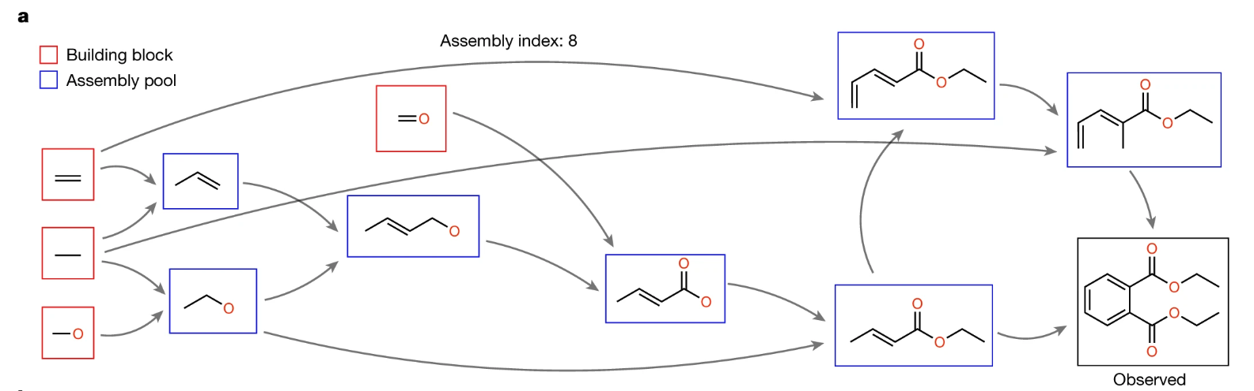


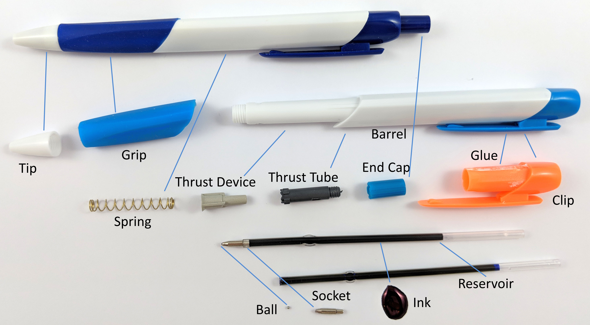



November
Read paper on assembly theory (AT) https://www.nature.com/articles/s41586-023-06600-9
Arrive on a new planet with a MS.
Use AT to estimate how much selection has occurred.
$$A=∑\left(e^{a_{i}}\right)(n_{i}−1)/N_{T}$$
Can we have selection in assembly but backwards? Disassembly.
Instead of assembling building blocks, we disassemble from a starting macro-block.
This got me thinking about selection of peptides.
Adding a bacteria changes to proteolyitc pattern with increased selectivity towards certain products (???)

Slide 3
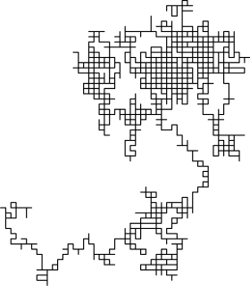
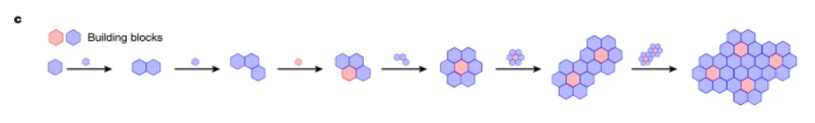

December
This figure got me thinking about sequential Monte Carlo
So I talked to Jonas (a.k.a. Mr Monte Carlo)
Specifically, estimating the length of random walks
https://en.wikipedia.org/wiki/Random_walk

Slide 4
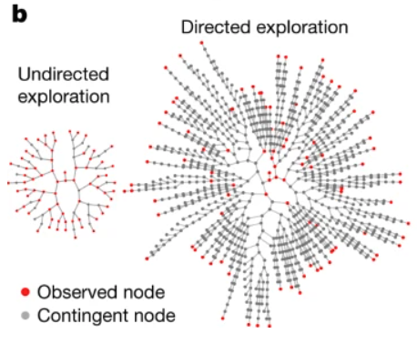
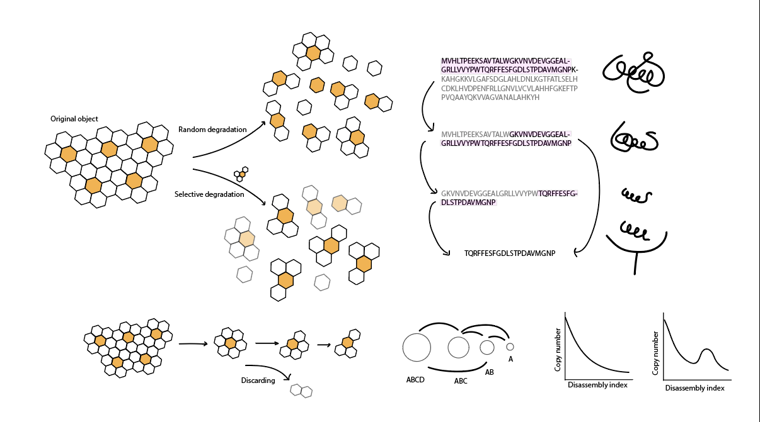
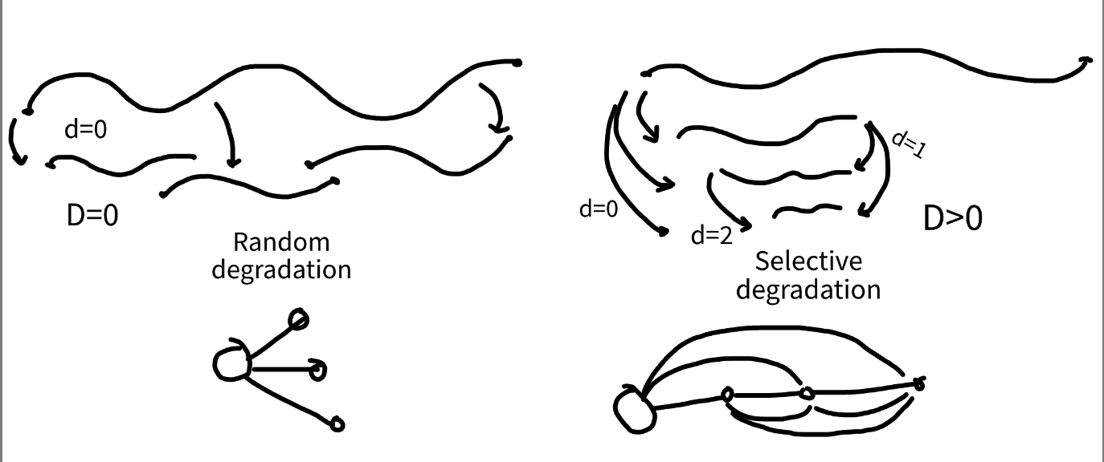
December
Theorizing
Realized that the shortest path is always very short in disassembly (and depends on the number of bonds). We’re only interested in the actual path.
How can we get the actual path taken, just from molecules (end product)?

Slide 5



December
And even more theorizing
Protein
We can kind of simulate this
selection
We see this
We don’t know how this works (I asked around)
selection
This is somewhat unclear as well
Value of peptide < value of sum of parts

Slide 6

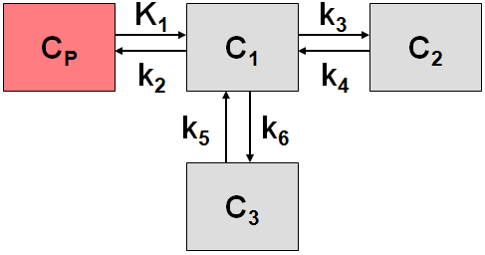


December
(this is contrary to the survivors bias interpretation)
WYSIATI – what you see is all there is. I.e., we’re getting a representative sample of the complete distribution.
Thinking of protein degradation as a compartment model.
Game:
- All players start in Lund.
- Players travel on a railway down Europe.
- Players report when they arrive at their final destination.
Goal: Guess the rail-way system.

Slide 7
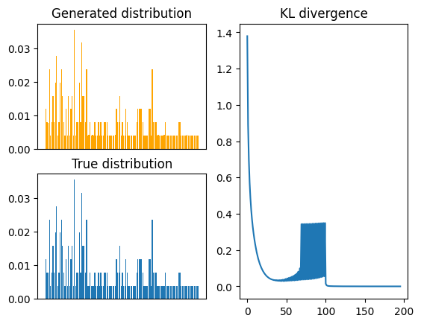
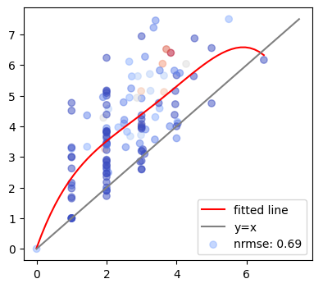




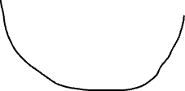









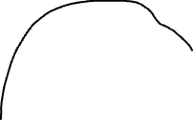
December
This is now a graph problem.
Jonas idea: Find a graph which results in the desired molecule distribution.
Over christmas I implemented:
Proteolysis simulation.
Weight-estimator using a simple algorithm to minimize the difference between the wanted molecule amount and the estimated.
Each node also has an absorbind state (self-edge)
Protein
Peptides
Once we have this graph, we can compute the estimated path length analytically. However, this was too computationally expensive for reasonable graphs because of combinatorial explosions. I made a Monte Carlo estimator of it instead.

Slide 8
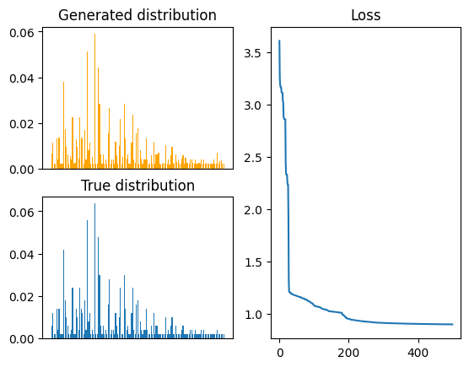
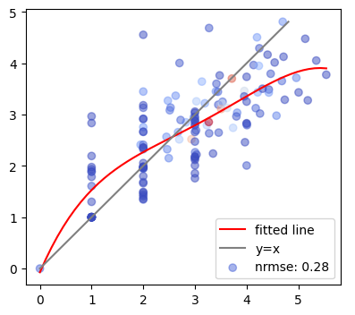


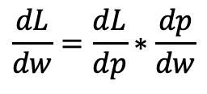
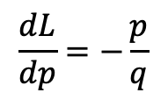
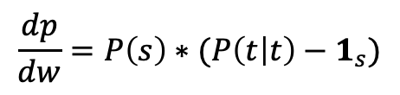
January
My implementation was not formal, and difficult to work with. Couldn’t really expand on it to make it better.
New idea: implement a classic optimizer with a loss function. Then we can use all the theory from optimization.
Essentially the same thing as in a graph neural network.
- Create a loss function.
- Calculate it’s derivatives.
- Update weights using gradient descent.
$$L=D_{KL}(p||q)$$
$$\frac{dL}{dw}=\frac{dL}{dp}∗\frac{dp}{dw}$$
$$\frac{dL}{dp}=−\frac{p}{q}$$
$$\frac{dp}{dw}=P\left(s\right)∗(P\left(t | t\right)−1_{s})$$

Slide 9
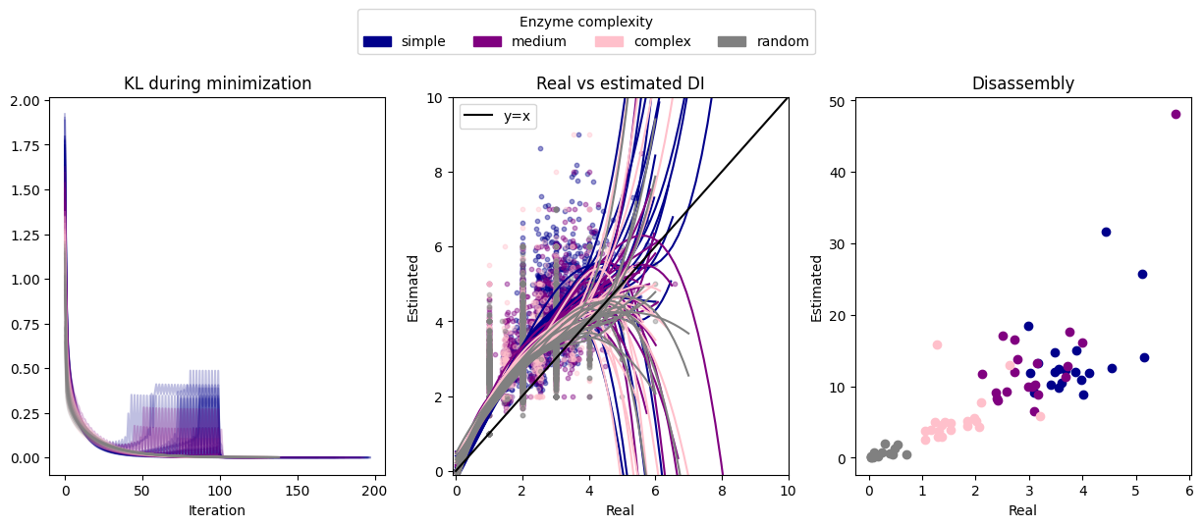
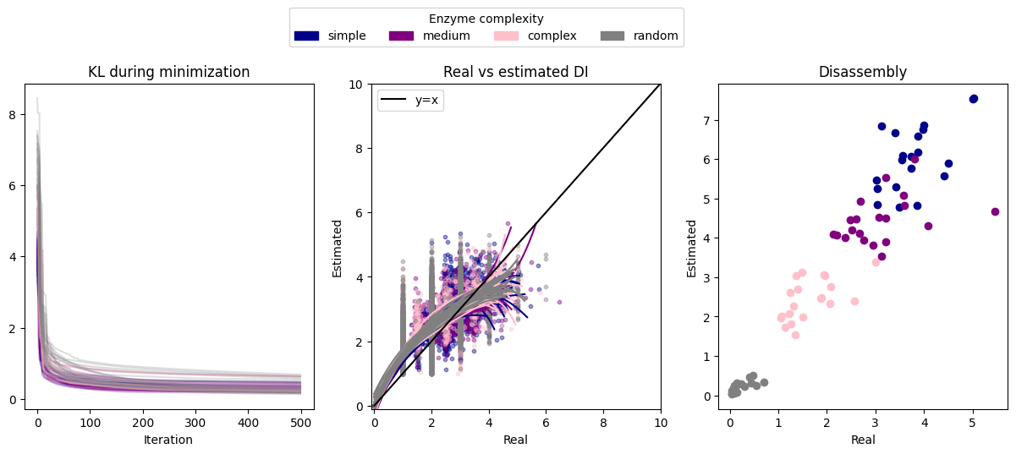
January
This works better! Some benchmarking. Simulate proteolysis with enzymes of different “complexity”. Here, compelxity means cleavage specificity.
Old method
New method

Slide 10

January
This is over-parametrized, i.e., there are many weight-configurations that satisfy the final distribution.
How can we put contraints to relevant solutions?
Ideas:
Regularizers: L1 (Lasso), L2 (Ridge), or both (elastic net).
$$L=D_{KL}(p|\left|q\right)+λ∗∑|w|+ρ∗∑w^{2}$$
This kinda works, but is not optimal since we’re dealing with probabilities.
Here, we’re penalizing spreading out weights. This forces the solution to settle on few sets of paths.
Re-parametrization (next slide)

Slide 11
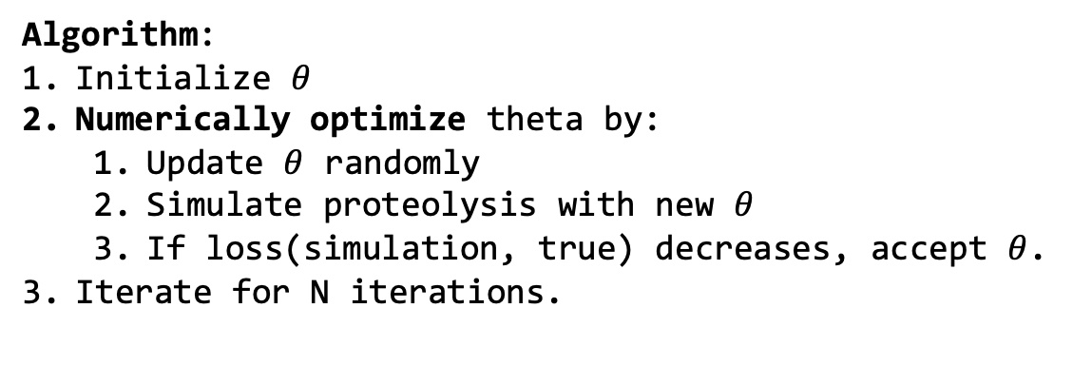
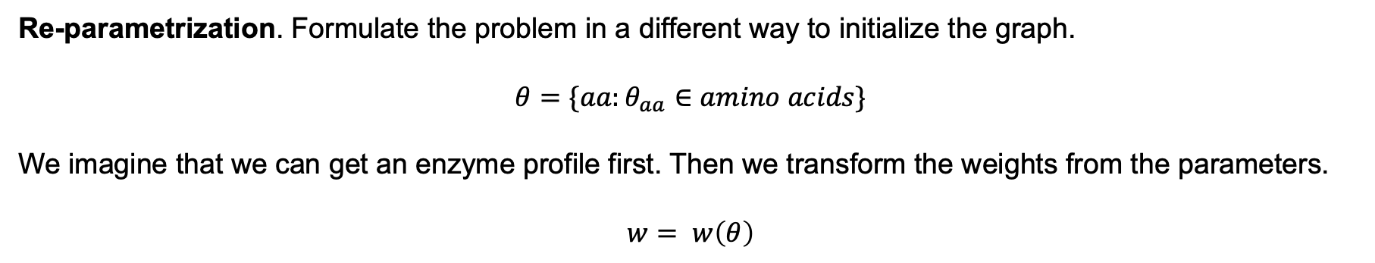
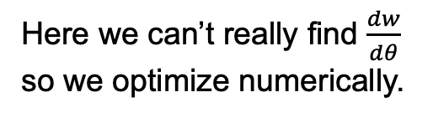
January / february
Re-parametrization. Formulate the problem in a different way to initialize the graph.
$$θ=\{aa:θ_{aa}∈amino acids\}$$
We imagine that we can get an enzyme profile first. Then we transform the weights from the parameters.
$$w= w\left(θ\right)$$
Algorithm:
Initialize $θ$
Numerically optimize theta by:
Update $θ$ randomly
Simulate proteolysis with new $θ$
If loss(simulation, true) decreases, accept $θ$.
Iterate for N iterations.
Here we can’t really find $\frac{dw}{dθ}$ so we optimize numerically.

Slide 12
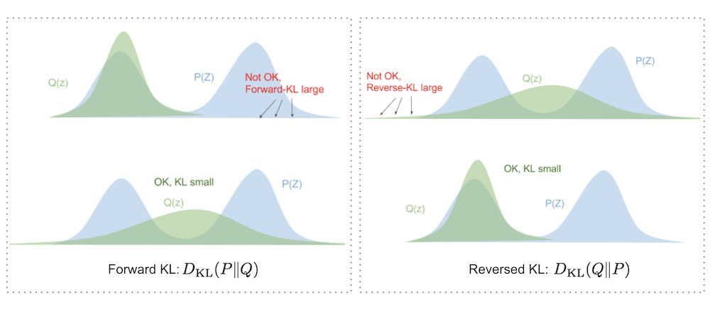
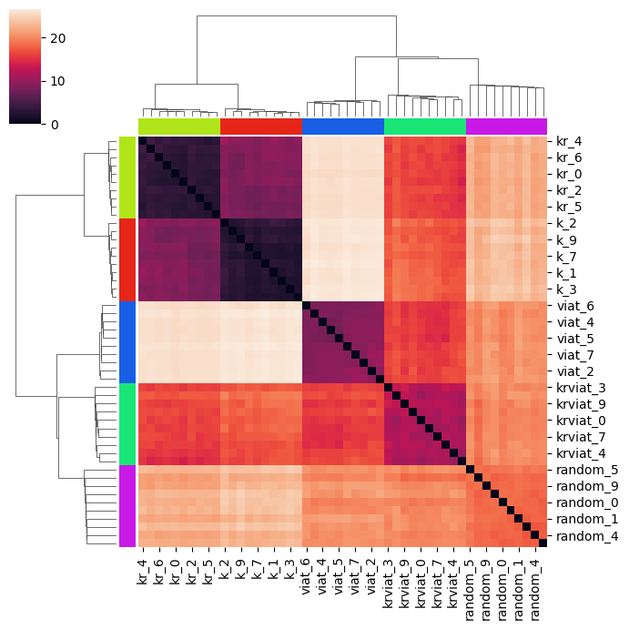
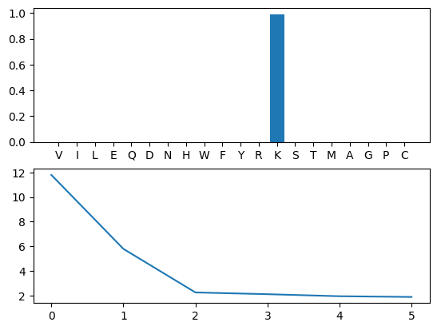
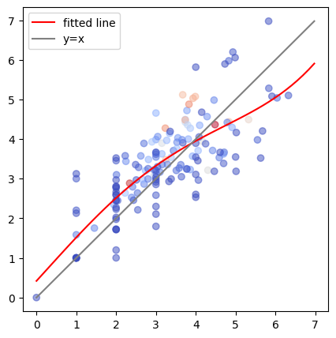
January / february
With this I devised a new loss function, as the sum of KL-backwards and KL-forwards (as far as I can find, this has never been done before).
This has several benefits here (and maybe elsewhere).
Doing this for K-specific enzyme
In silico degradation peptidome similarities.

Slide 13
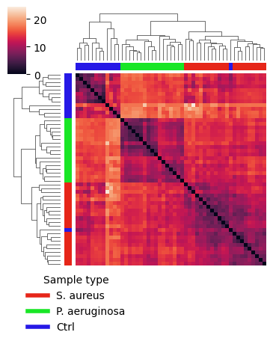
January / february
In silico
In vitro samples from Di
In vivo
Tryspin
Chymotrypsin
LysC+pepsin
Elastase
(huh, new way of clustering peptidomics data)

Slide 14
Current status
Feels like this is going towards a ”estimating selectivity in the peptidome”-ish.
Maybe something about enzyme complexity/specificity.
Want to be done soon.
Future plans: string everything together. Benchmark everything. Run on real samples. Done. Write it up real quick. Not high impact.

