Slide 1
Safe regression test selection for Modelica
By Erik Hedblom and Kasper Rundquist
Notes:
Presentera oss och projektet

Slide 2
Goal
Problem
Running tests for Modelica projects takes a long time
Goal
Reduce test times for Modelica projects in a safe way
Notes:
Animera fram Solution
Berätta om modelica, exempel, osv,
Förklara vad safe betyder = ej missa test-fel

Slide 3
Goal
Problem
Running tests for Modelica projects takes a long time
Goal
Reduce test times for Modelica projects in a safe way
Solution
Safe test selection
  Selecting a subset of all tests
  Using static analysis
Notes:
Animera fram Solution
Berätta om modelica, exempel, osv,
Förklara vad safe betyder

Slide 4
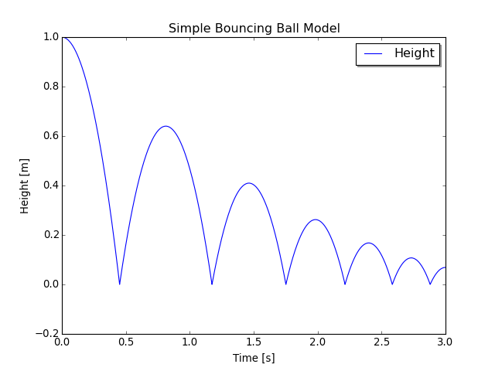
Modelica Bouncing Ball example
Modelica is a modeling language for complex models
model BouncingBall
parameter Real e = 0.8;
parameter Real g = 9.81;
Height h(start=1);
Velocity v(start=0);
equation
der(h) = v;
der(v) = -g;
when h <= 0 then
reinit(v, -e*pre(v));
end when;
end BouncingBall;
Notes:
Beskriv Modelica
Deklarativt, objektorienterat
Vad används Modelica till?
Modellera komplexa fysikaliska system.
Modeller beskrivs mha ekvationer
Beskriv exemplet

Slide 5


Modelon
Our solution implemented in:
OPTIMICA Compiler Toolkit
Model Testing Toolkit
Notes:
Modelon
OCT (nämn jmodelica)
MTT

Slide 6
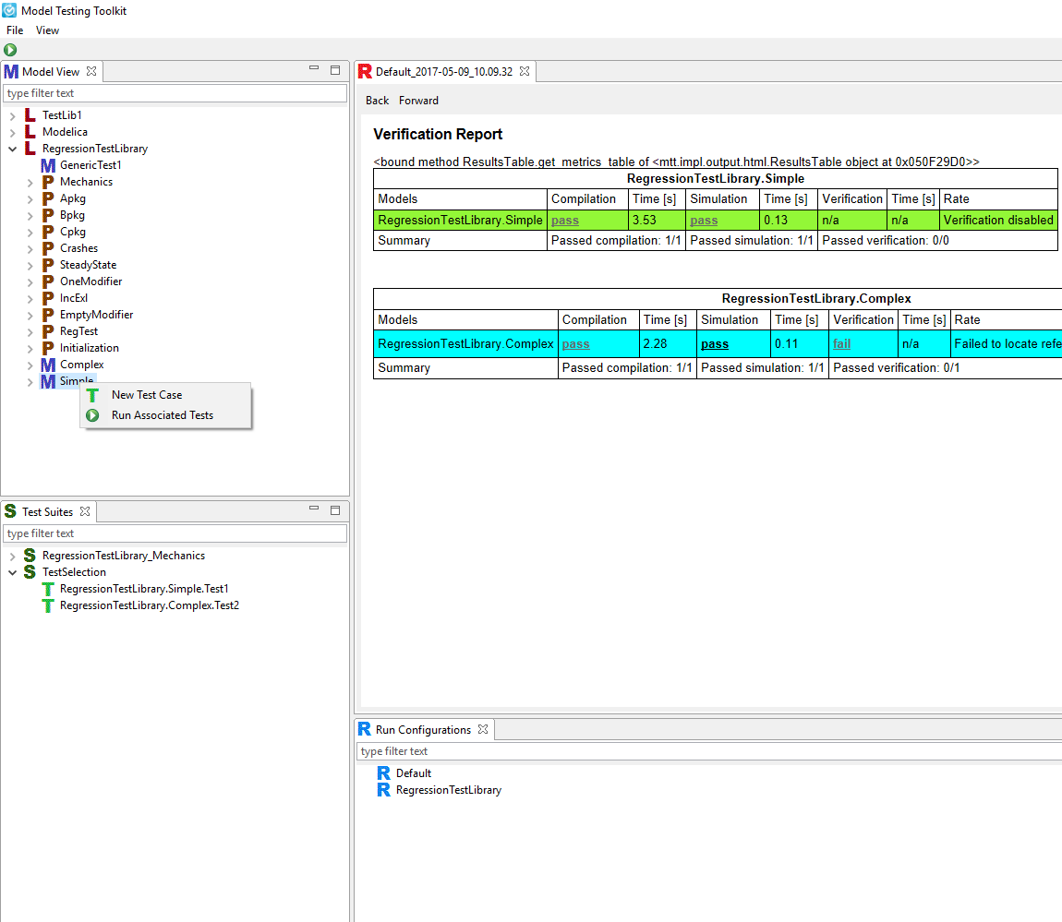
Results: test selection implemented in
Model Testing Toolkit
Notes:
External functions
Change detection

Slide 7
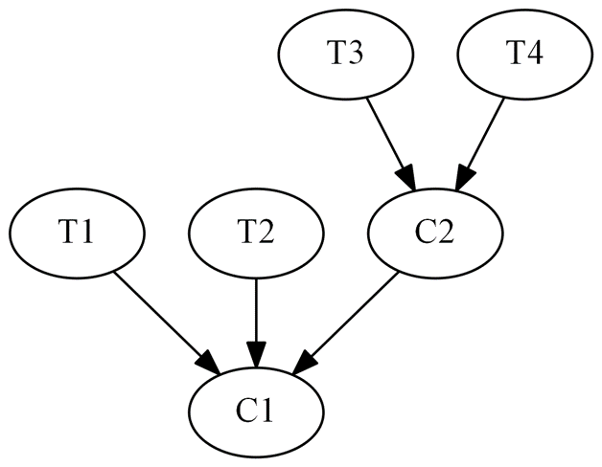
Safe test selection
Select tests based on how tests depend on classes
Tests: T1, T2, T3, T4
Classes: C1, C2
Dependency graph
Notes:
Safe: garantera att alla tester som skulle kunna misslyckas faktiskt körs
Naiv metod: kör alla tester
Lång tid att köra alla tester
Ge exempel: om man ändrar C1 så får man köra XXX, ... Om man ändrar C2 så får man köra YYY

Slide 8
Simplified Dependency Rules
A class depends on all classes referenced by resolvable accesses within it, not including accesses within paths.
A class depends on its enclosing class.
Due to current compiler limitations
A class depends on all classes referenced by access paths within it. A unresolvable access can still contain resolvable accesses within its path.
A class depends on all classes enclosed by an accessed class.
Exception to Rule 4: Rule 4 is not applicable to import statements.
Notes:
Vi har utvecklat 5(4) regler för att skapa en beroende graf.

Slide 9
Dependency rule 1
1).A class depends on all classes referenced by accesses within it.
model A
...
end A;
model B
A a;
end B;
Dependency graph
Notes:
Beskriv regel 1
Visa att vi inte kan slå upp m1.k1 till höger
Säg något om namnuppslagning

Slide 10
Dependency rules
A class depends on all classes referenced by resolvable accesses within it.
package P
model M1
constant k1 = 0;
end M1;
model M2
M1 m1;
end M2;
end P;
package P
model M1
constant k1 = 0;
end M1;
model M2
M1 m1;
constant k2 = m1.k1;
end M2;
end P;
Notes:
Beskriv regel 1
Visa att vi inte kan slå upp m1.k1 till höger
Säg något om namnuppslagning

Slide 11
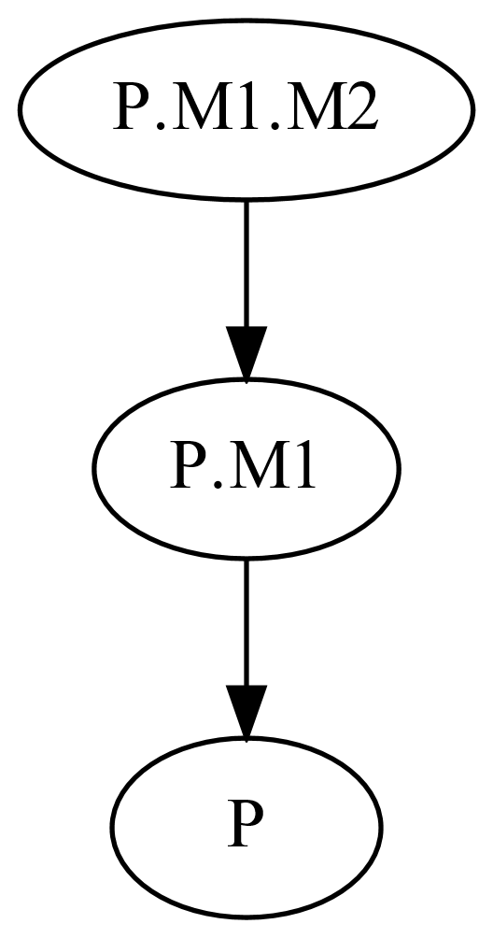
Dependency rule 2
2. A class depends on its enclosing class.
package P
constant Real k = 1;
model M1
model M2
Real x = k;
end M2;
end M1;
end P;
If we add k in M1 too?
Notes:
Regel 2

Slide 12
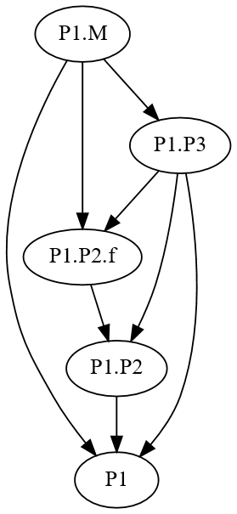
Dependency rule 3
3. A class depends on all classes referenced by access paths within it. A unresolvable access can still contain resolvable accesses within its path.
package P1
package P2
function f
input Real x;
output Real y;
algorithm
y := x;
end f;
end P2;
package P3
extends P2;
end P3
model M
Real x = P3.f(0);
end M;
end P1;

Slide 13
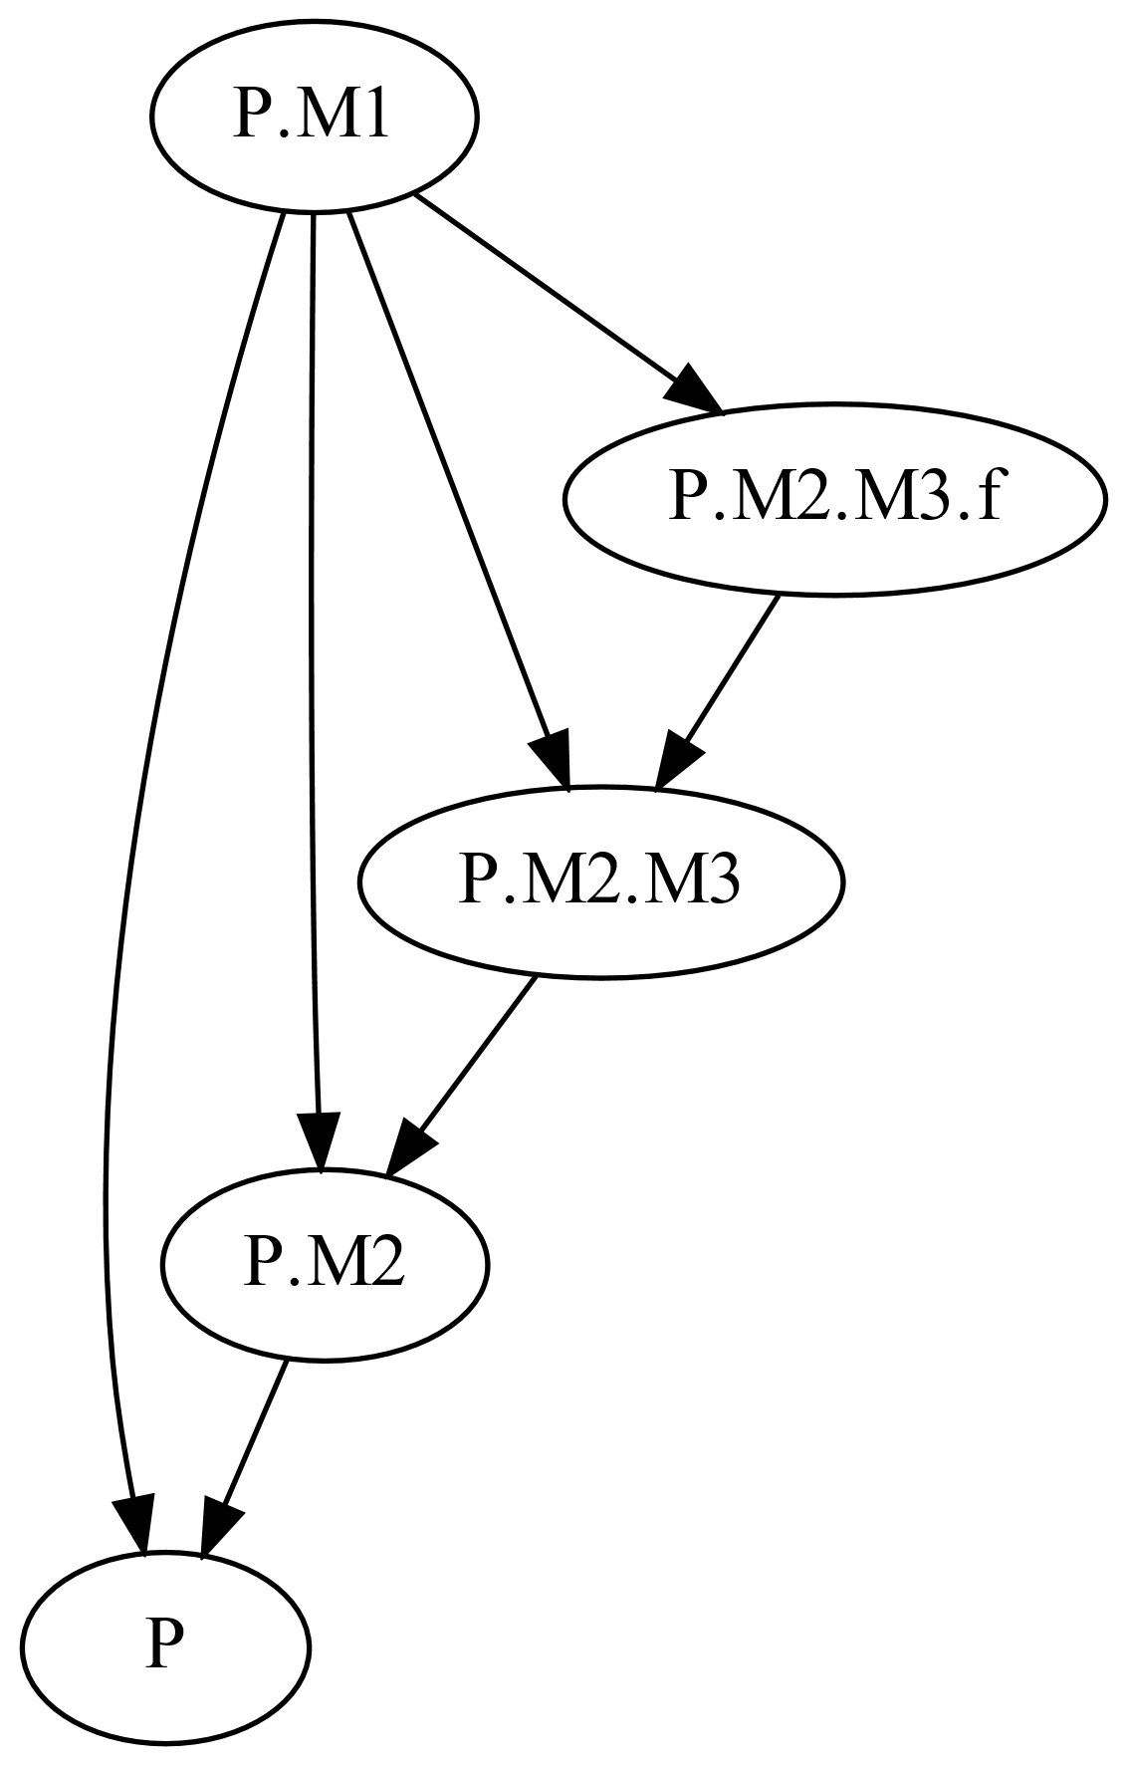
Dependency rule 4
4. A class depends on all classes enclosed by an accessed class.
package P
model M1
M2 m;
Real r = m.M3.f(1);
end M1;
model M2
model M3
function f
input Real x;
output Real y;
algorithm
y := x;
end f;
end M3;
end M2;
end P;
Notes:
Säg att regel 5 begränsar beroenden från denna regeln (blir många annars)

Slide 14
Evaluation
Evaluated in two ways:
One file is changed
  Measured for all files
Commit history for changed files

Slide 15
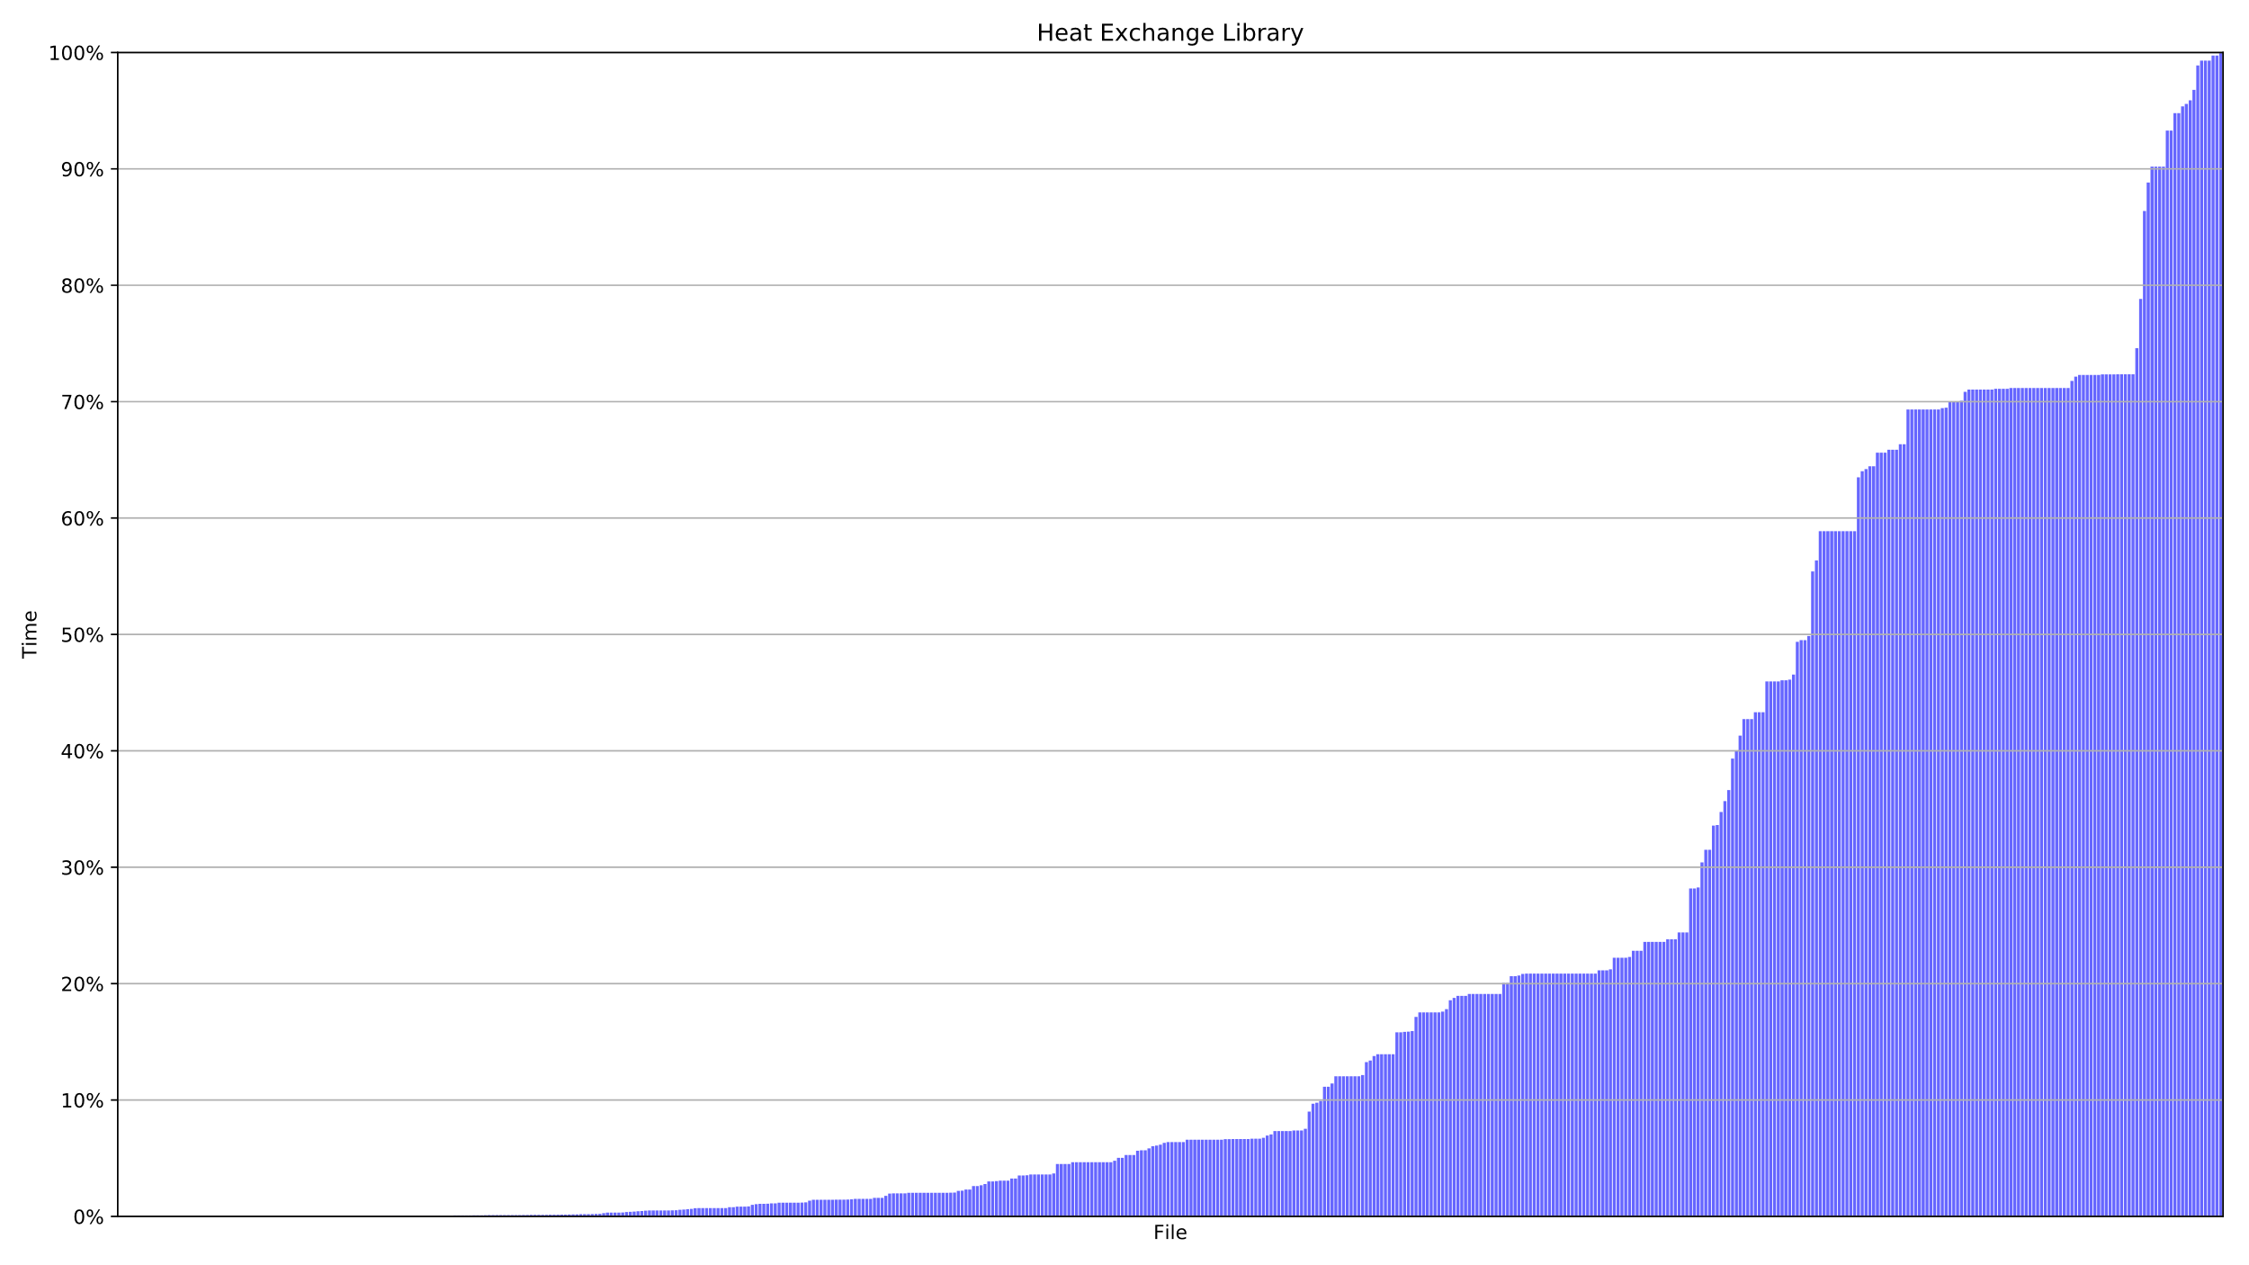
One file – Heat Exchange Library
68% time saved in average!
File

Slide 16
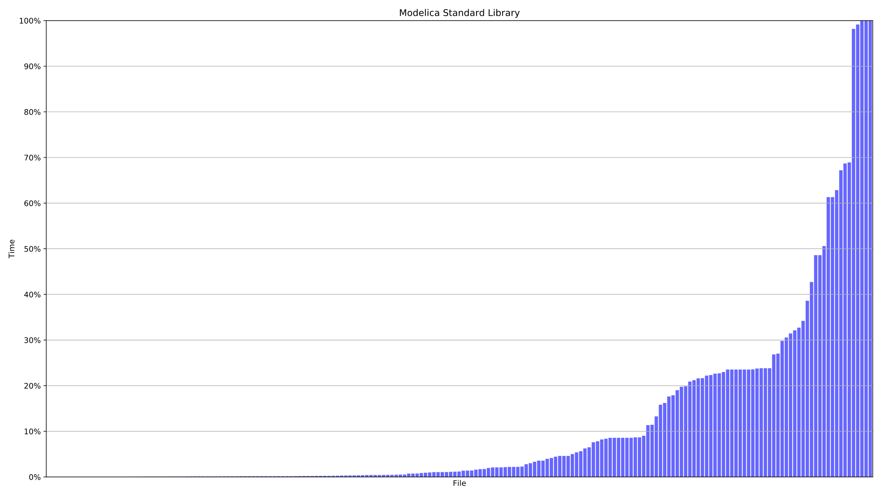
One file – Modelica Standard Library
88% time saved in average!
File

Slide 17
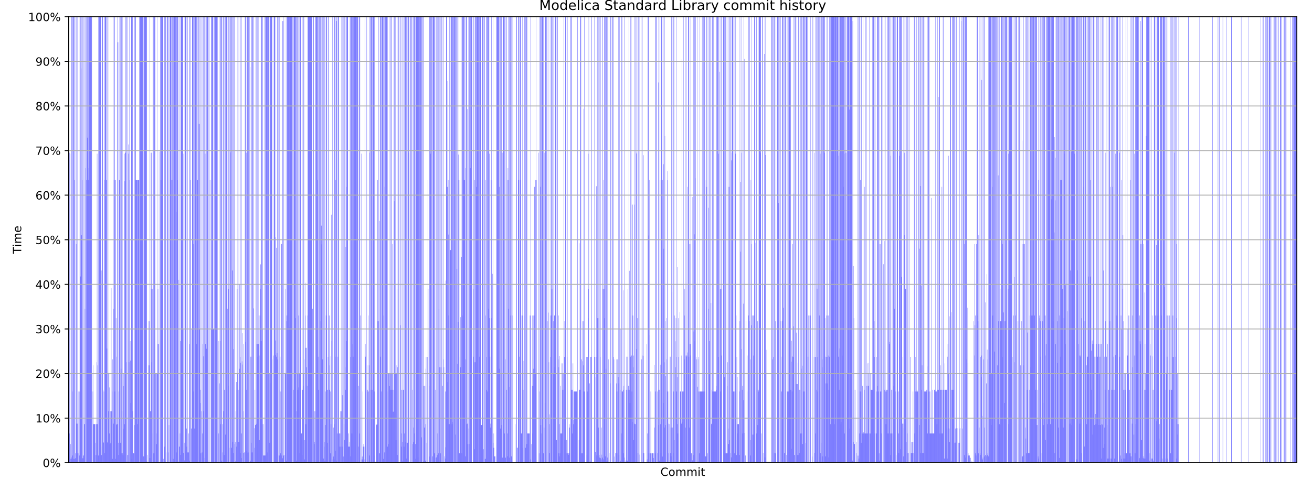
Commit history – Modelica Standard Library
56% time saved in average!
Notes:
Beskriv grafen, ett mer realistiskt användingsfall
En approximation
Vi har inte kört om analysen för varje kommit
Inkluderar inte analys tiden

Slide 18
Evaluation
 | Units | Complete testsuite execution time | Dependency analysis exectution time | Average time savings
Heat | 552 files | 3h 1m 51s | 6.7s | 68%
MSL | 197 files | 2h 26m 36s | 18.8s | 88%
 | 4341 commits |  |  | 56%
Notes:
Sammanfatta våra resultat

Slide 19
Conclusion
Conclusion
Implemented
Dependency rules
Future work
Run testselection in paralell with complete testsuite
Mutation testing
Create dependency graph in later compilation phase (instance tree)
Notes:
Validering
Vi har utvecklat en test svit, delvis genom att köra analysen på MSL och manuellt jämföra resultatet
Vi har kontinuerligt under arbetets gång diskuterat vår analys med Jesper och Jonathan på Modelon.
Future work
More validation
Instance tree – varför?

Slide 20
Questions?

