Slide 1
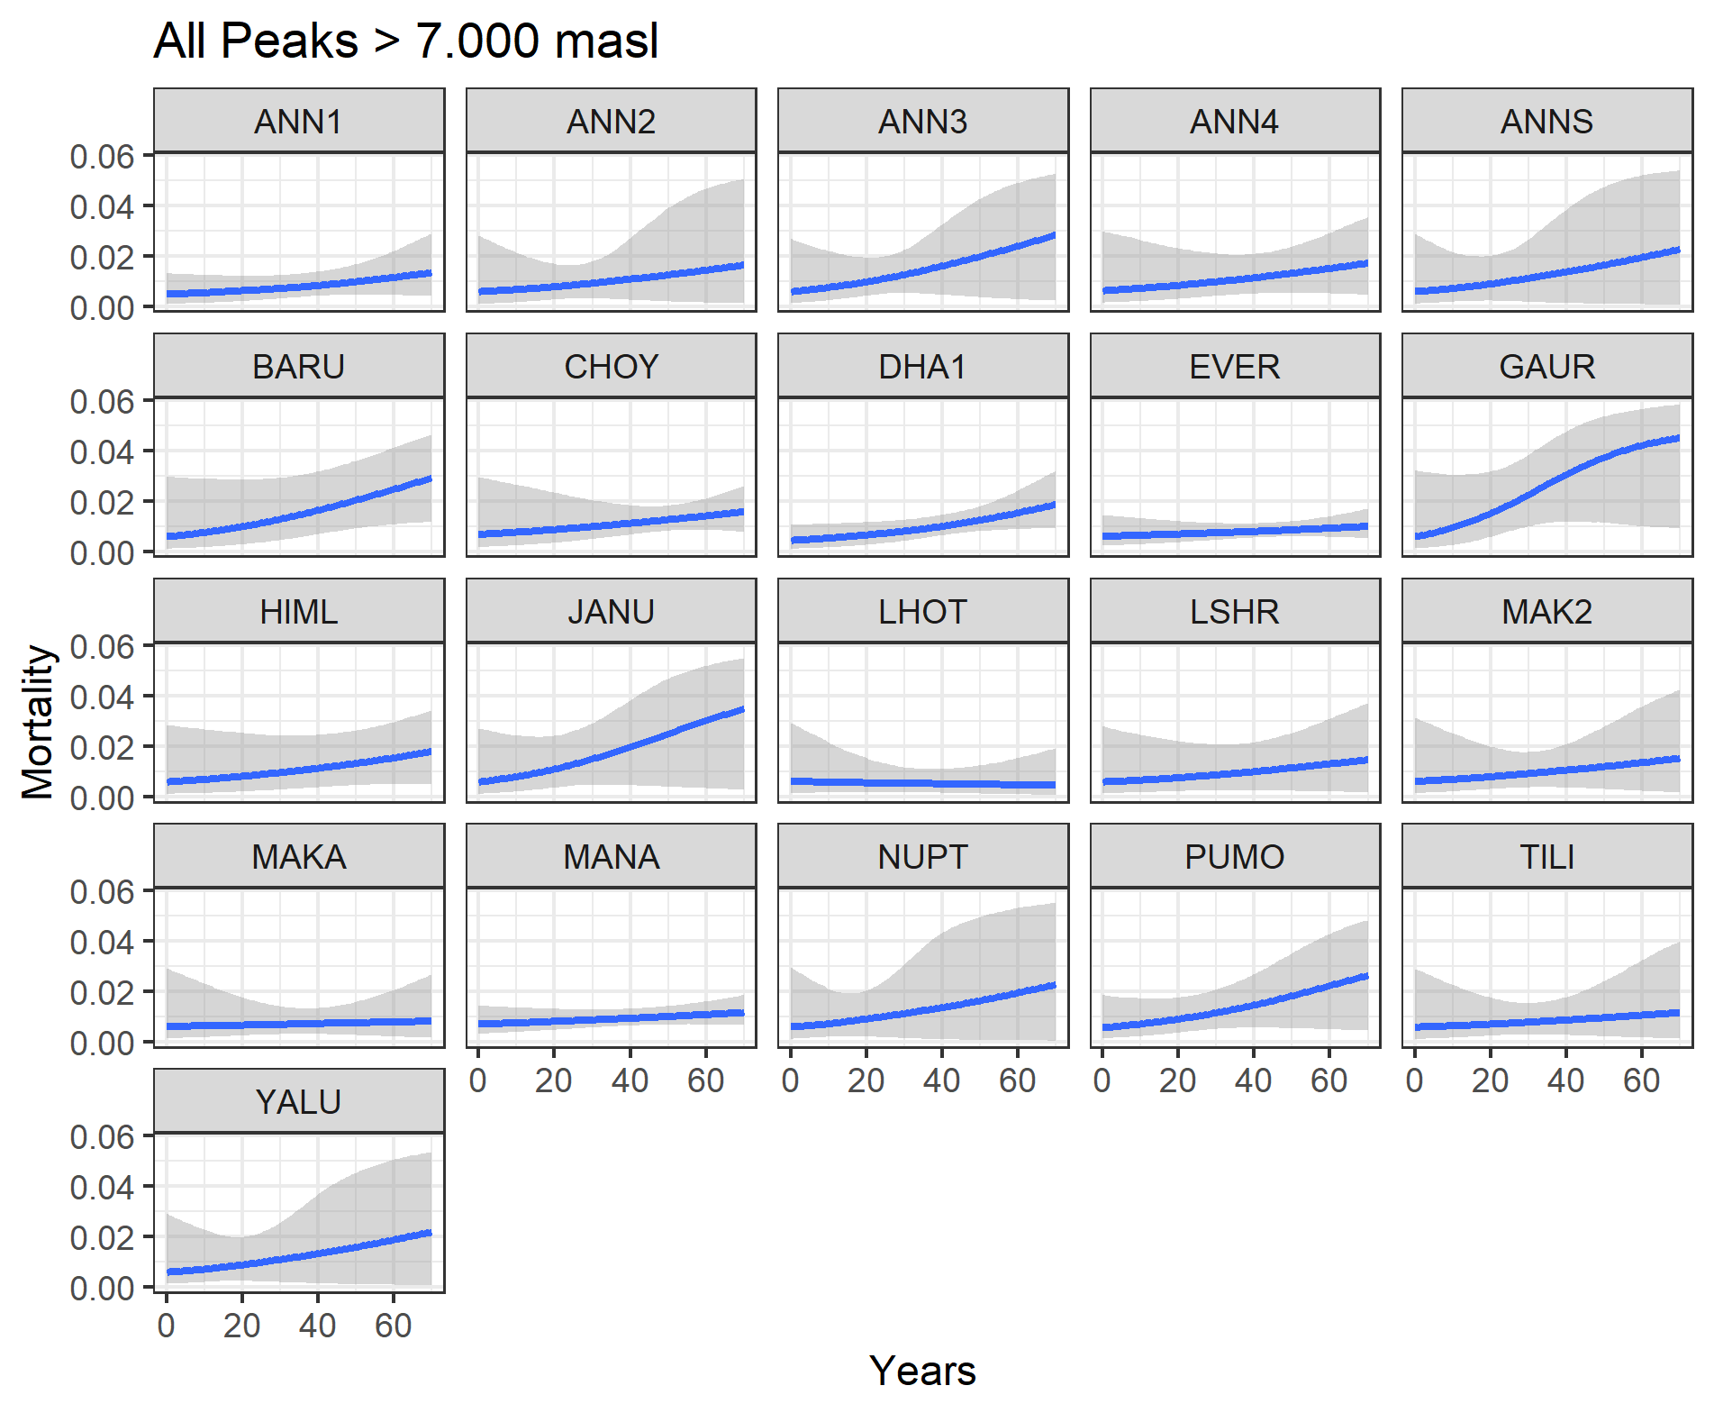
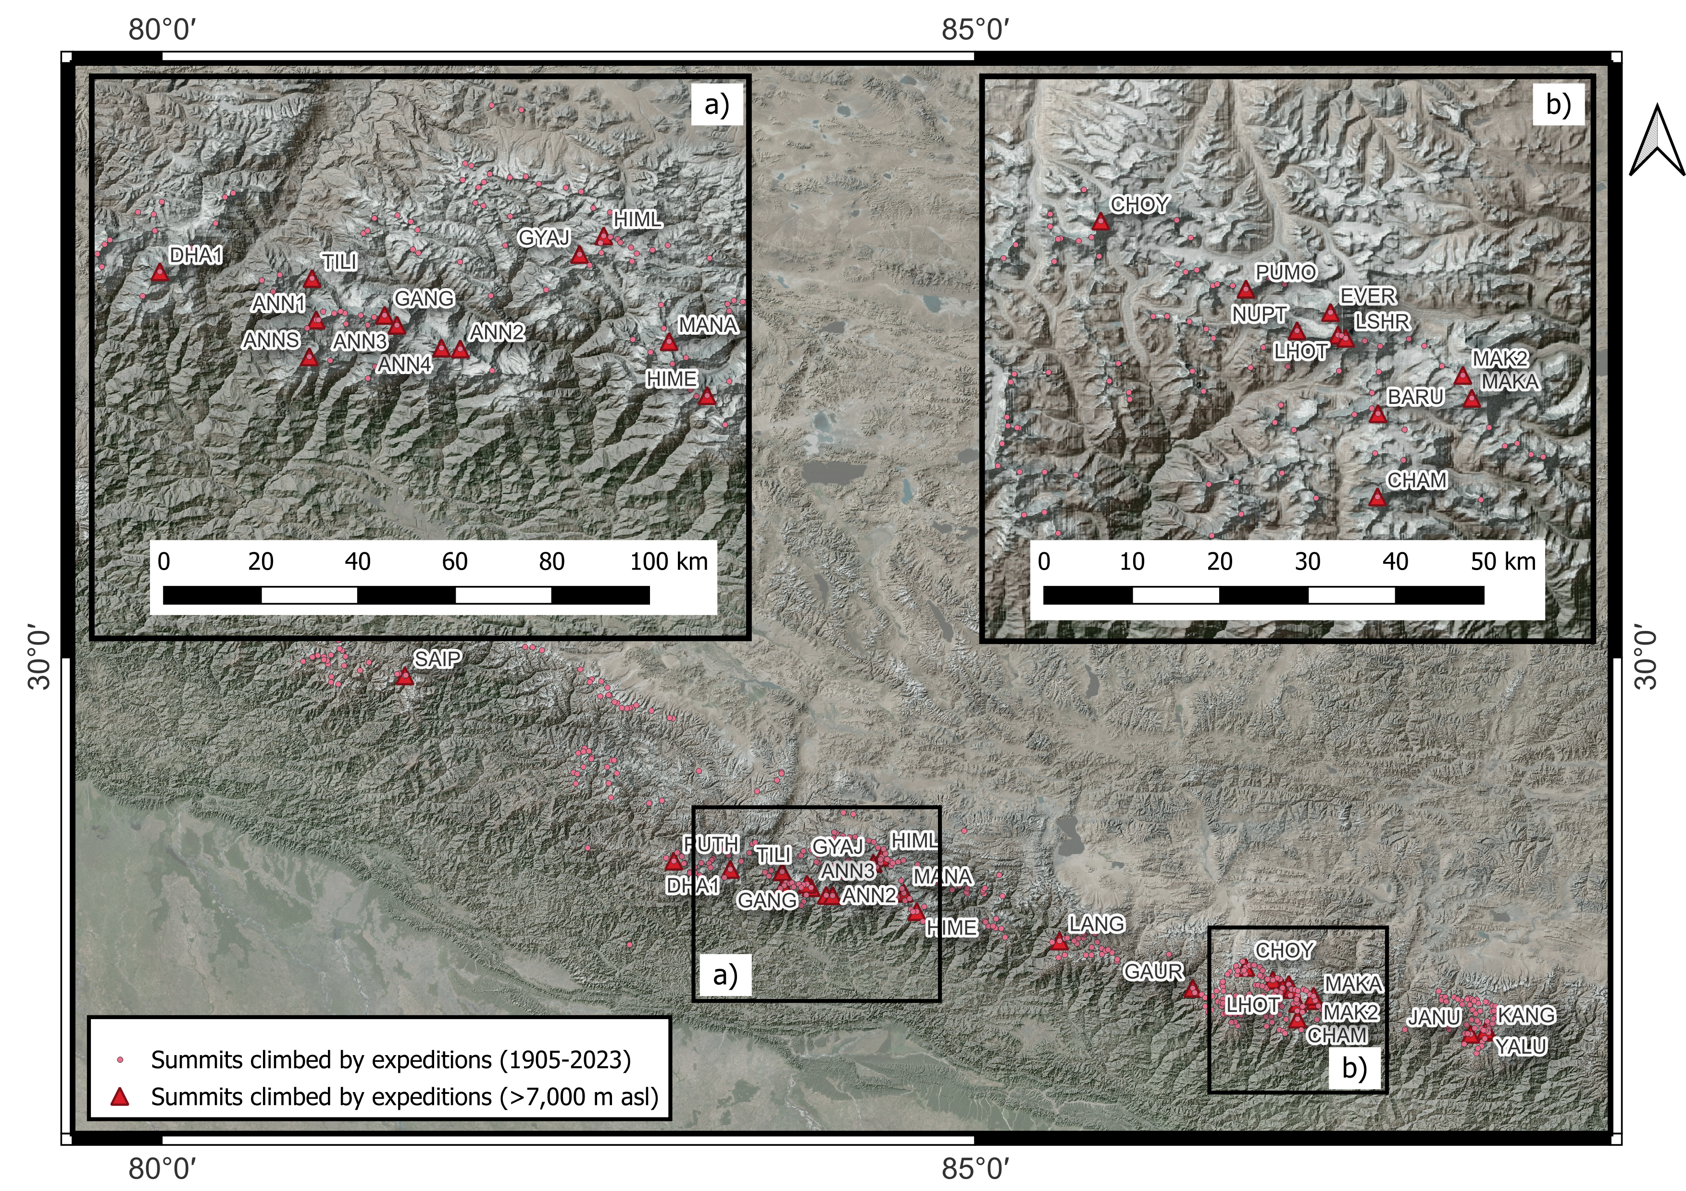
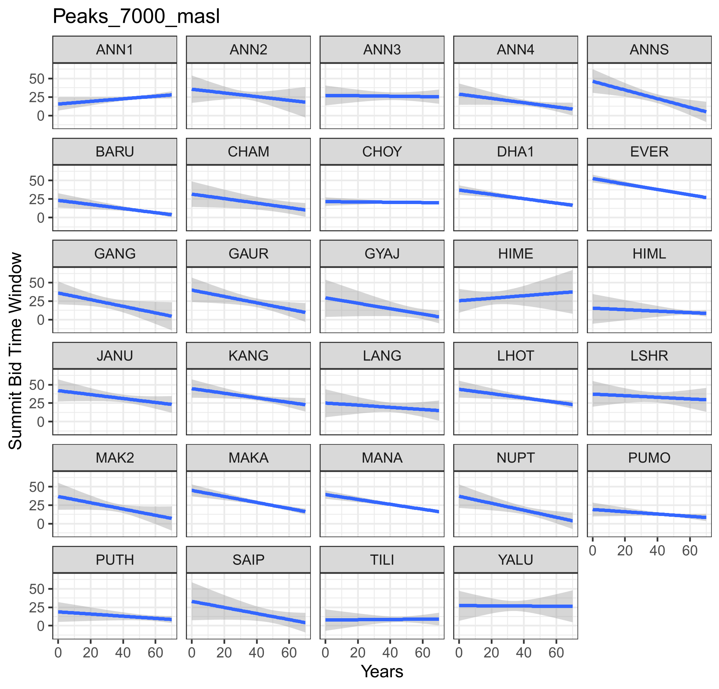

Slide 2
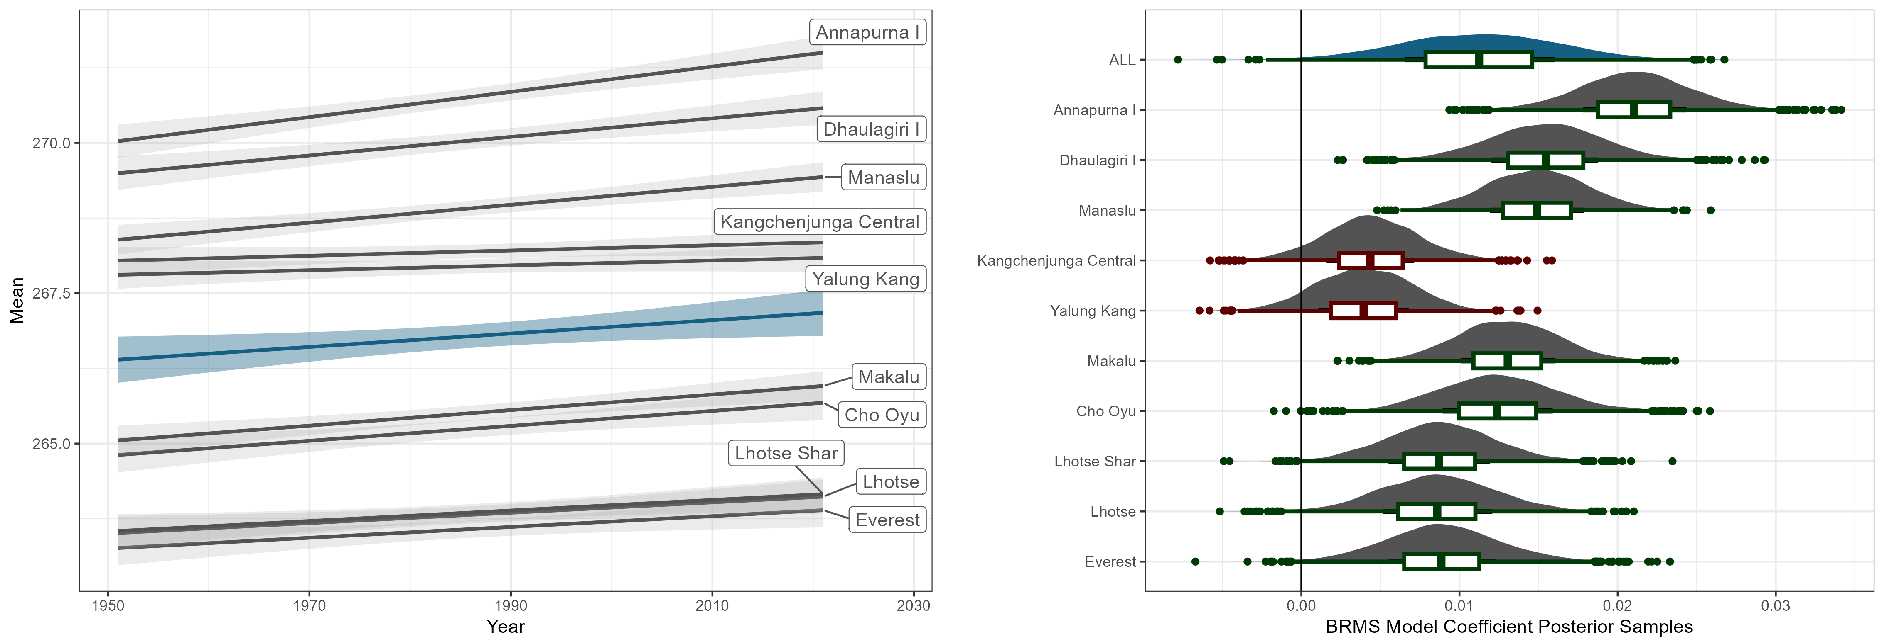
Also for:
wind-speed
snow-depth
→ Break down per season in each panel
FOR SUPP ONLY:
For all other variables:
climate change
extremes

Slide 3
extremes for
temperature
Wind speed
Snow depth
→ Break down per season in each panel
FOR SUPP ONLY:
For all other variables:
climate change
extremes

Slide 4
