Slide 1


BB
BW
WW
Second Side Facing Up
First Side Facing Up
START HERE

Slide 2
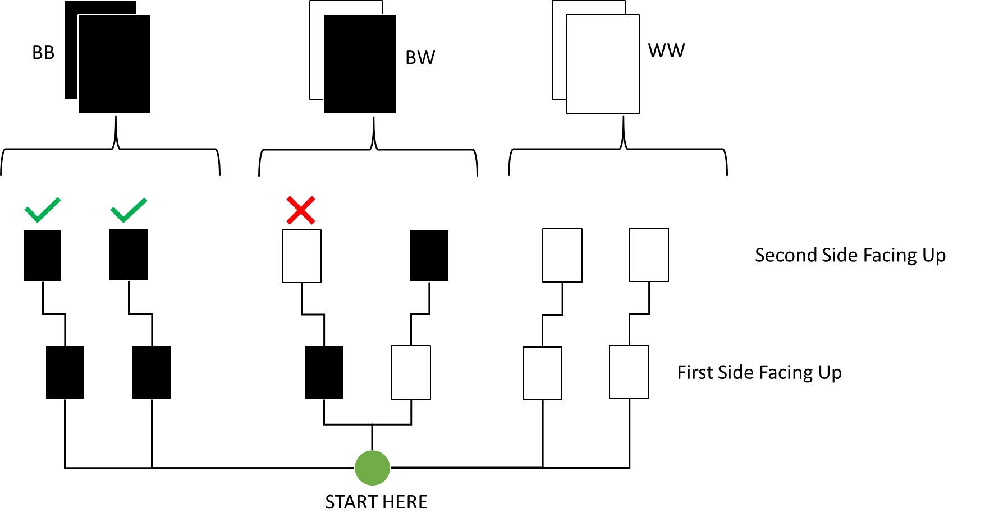

Slide 3
2xBB
BW
WW
Second Side Facing Up
First Side Facing Up
START HERE

Slide 4
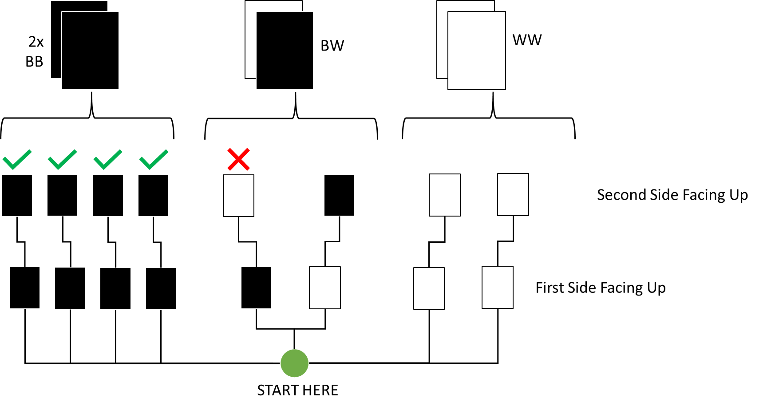

Slide 5
1xBB
2x
BW
3x
WW
Second Side Facing Up
First Side Facing Up
START HERE

Slide 6
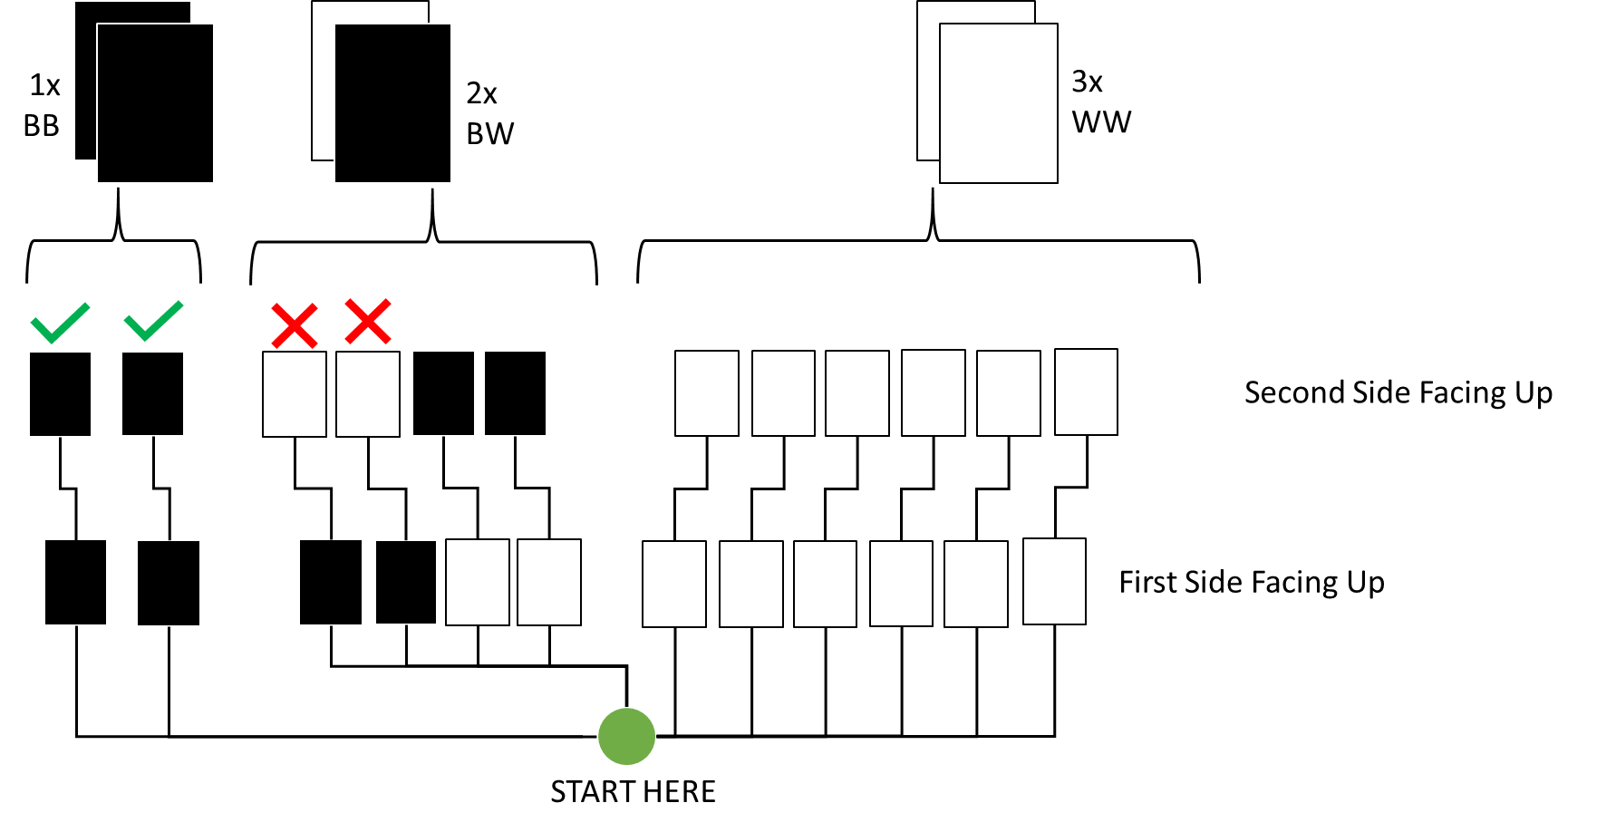

Slide 7
Second Side Facing Up
First Side Facing Up
START HERE

Slide 8
