Slide 1
Mobile sensing for everyday activities

Slide 2
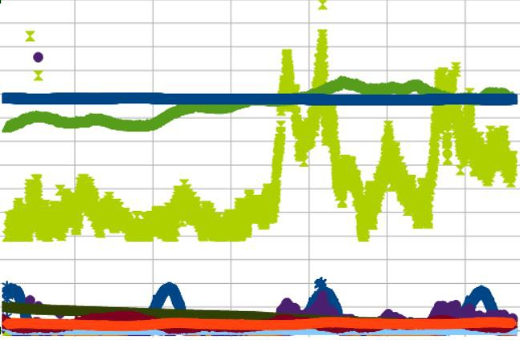
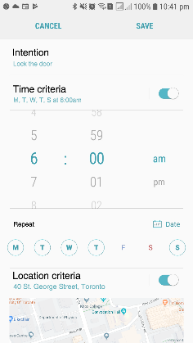
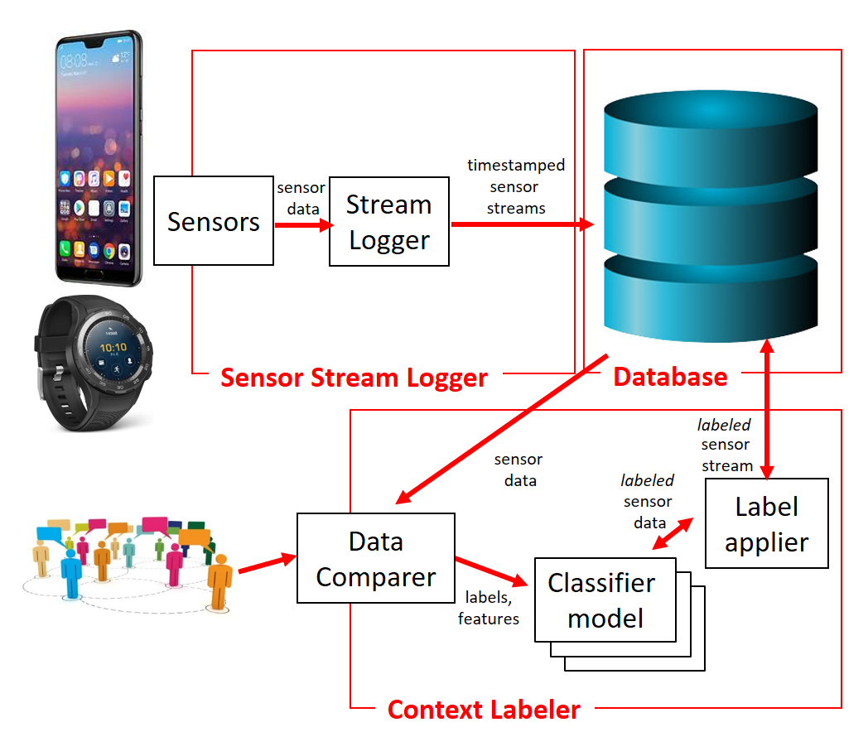
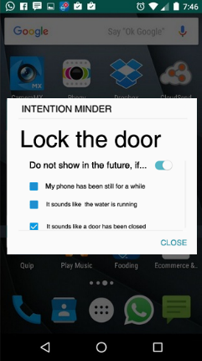
Progress on implementation…
Similar
Context Miner
(Context
, Intention)
labeled streams
Intention classifier model
Intention classifier model
Intention classifier model
UI: Learner
current sensor data
Intention detector
UI: Notifier

Slide 3

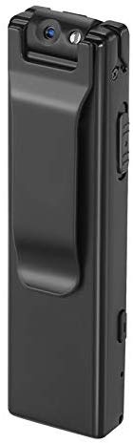
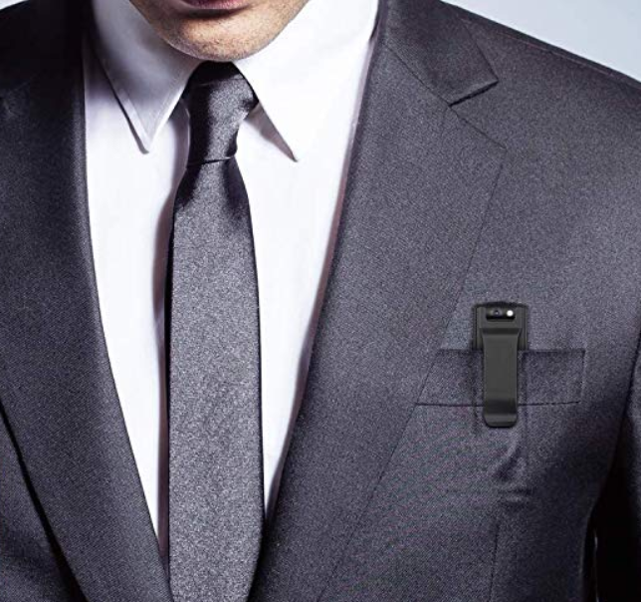
Progress on implementation…
Similar
Context Miner
(Context
, Intention)
labeled streams
Intention classifier model
Intention classifier model
Intention classifier model
Completed
Collecting data for 2 people currently (~3hr/day)
Using body worn camera to collect video
Hope to scale to 8-10 people for 1-3 months
UI: Learner
+
current sensor data
Intention detector
UI: Notifier

Slide 4
Progress on implementation…
Similar
Context Miner
(Context
, Intention)
labeled streams
Intention classifier model
Intention classifier model
Intention classifier model
UI: Learner
+
current sensor data
Intention detector
Completed
UI has been developed
…just need everything else to be completed to test it
UI: Notifier

Slide 5
Progress on implementation…
Similar
Context Miner
(Context
, Intention)
labeled streams
Intention classifier model
Intention classifier model
Intention classifier model
UI: Learner
current sensor data
Intention detector
UI: Notifier

Slide 6

Progress on implementation…
Similar
Context Miner
(Context
, Intention)
labeled streams
Intention classifier model
Intention classifier model
Intention classifier model
UI: Learner
current sensor data
Intention detector
Data comparer has been implemented and is being tested on video data
Still to be done:
Developing & testing classifier models out of the results
Designing equivalence for mobile sensor data
Testing it with mobile sensor data
UI: Notifier

Slide 7
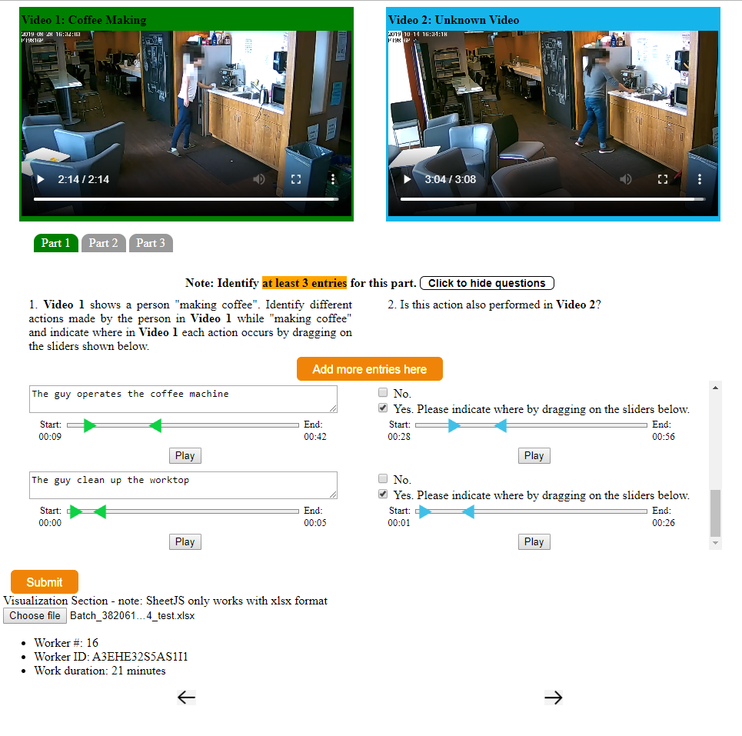

Slide 8
Progress on implementation…
Similar
Context Miner
(Context
, Intention)
labeled streams
Intention classifier model
Intention classifier model
Intention classifier model
UI: Learner
current sensor data
Intention detector
UI: Notifier

Slide 9
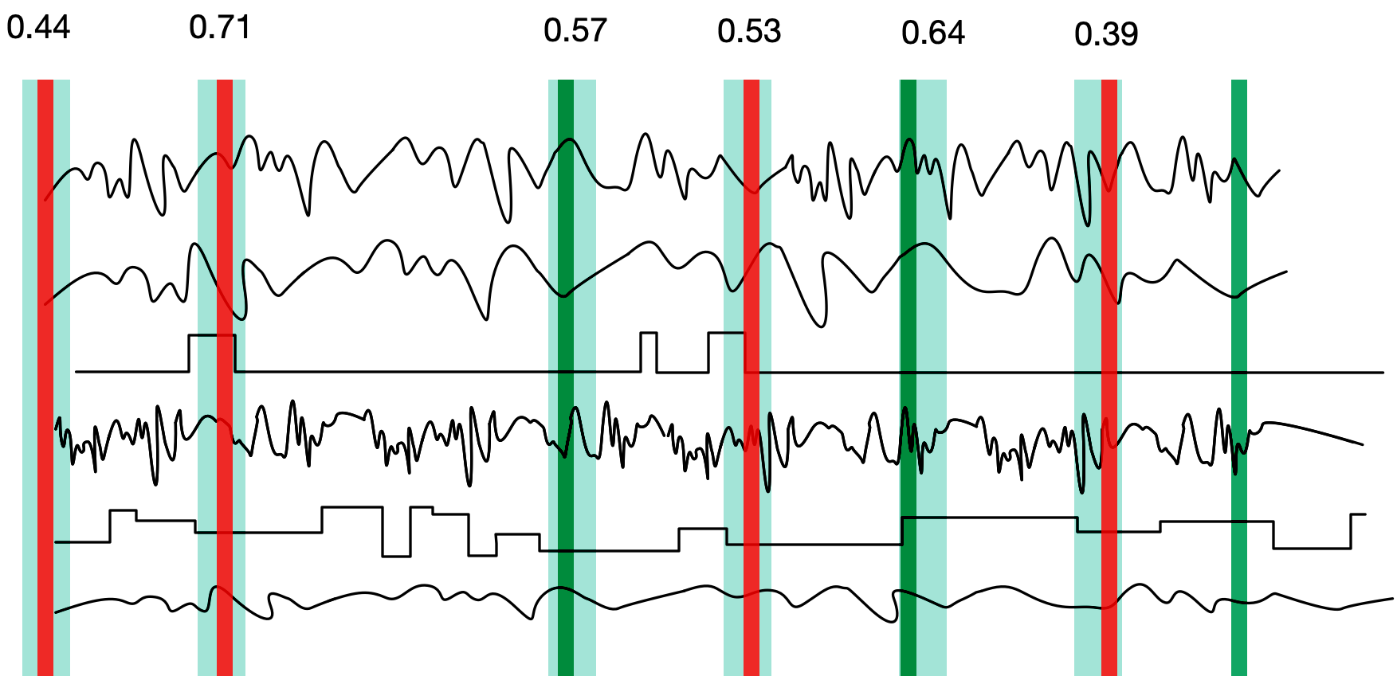
IntentionMinder
Semi-supervised approach (Refinement)
Refinement: find the most similar sequence in each interval
Seed sample
Impostor sample

Slide 10
Progress on implementation…
Similar
Context Miner
(Context
, Intention)
labeled streams
Needs labeled stream data
Exploring how to mine similar context (find similar sequences)
Developing a visualization tool to help him interact with the sensor data better
Intention classifier model
Intention classifier model
Intention classifier model
UI: Learner
+
current sensor data
Intention detector
UI: Notifier

Slide 11
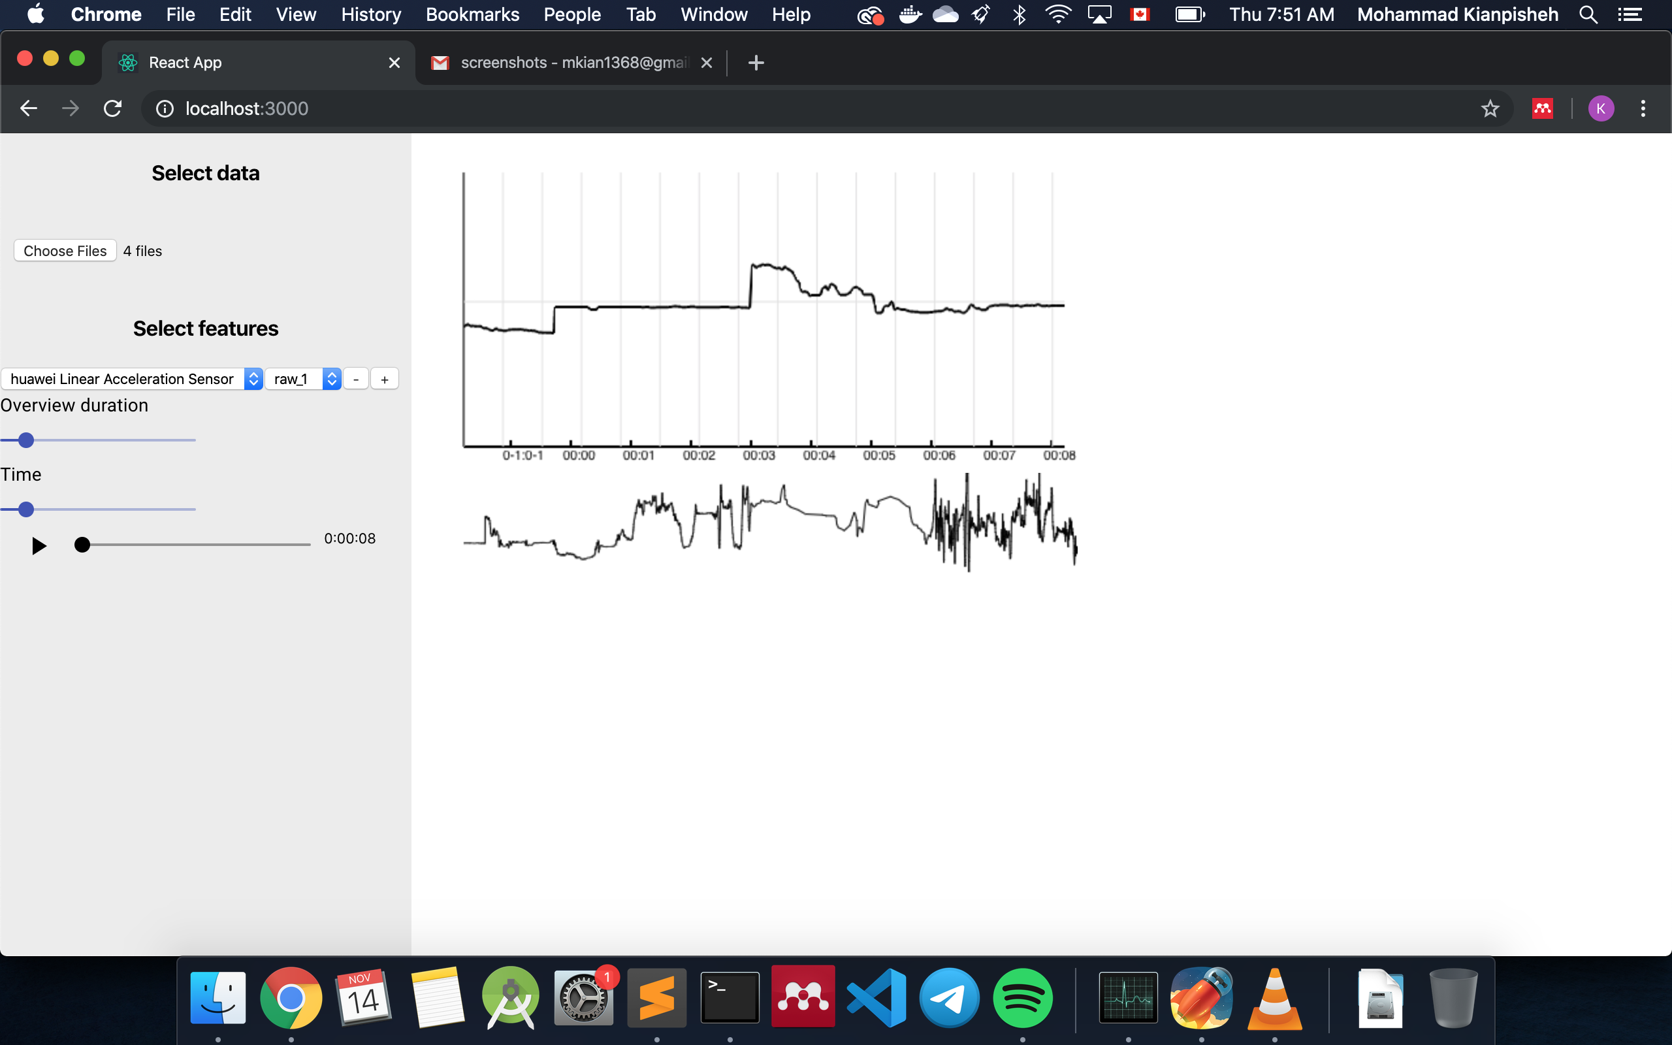
SCREENSHOTS

