Slide 1
Stakeholder Presentation

Slide 2
Dataset
- About 300 records of patients
- age: the subject's age - sex: gender - cp: chest pain type (types = [1:4]) - trtbps: Resting blood pressure (in mm Hg) - chol: cholesterol in mg/dl (via BMI sensor) - fbs: fasting blood sugar > 120mg/dl (1=true, 0=false) - rest_ecg : resting electrocardiographic results (types = [0:2]) - thalachh : maximum heart rate achieved - exng: exercise induced angina (1=true, 0=false) - oldpeak: previous peak blood pressure - slp: slope - caa: number of major vessels (0-3) - thall: Thal rate - label: High/Low likelihood of heart attack (0: Low, 1: High)

Slide 3
Use case
Annie, 54 years old, visits a hospital for her yearly health checkup
Received by her family doctor, who proceeds to take measurements and ask questions related to how Annie has been feeling, eventual pains etc
The doctor fills out the answers and measurements into a form on her computer. When she has filled everything in, she submits the form, and within a second a machine learning model deployed on the cloud has determined whether Annie has a higher risk of having a heart attack or not
This could save lives if it works accurately enough!
Could also be used at home if the patient is willing to make the measurements and fill in a form on his/her mobile phone

Slide 4
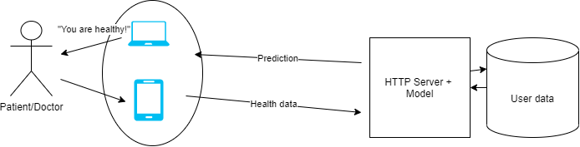
Solution
I have evaluated several machine learning models, including Deep Neural Networks, and other machine learning
Best model:
Support Vector Machine (SVM) with a polynomial kernel, 2 degrees
Achieves a cross-validated test accuracy of 83%
Implemented a solution where the model is deployed onto a server, predictions can requested via HTTP Post requests

Slide 5
Technical Presentation

Slide 6
Architectural Choices
Model needs to be as accurate as possible
Potentially handle a lot of requests -> model needs to be fast as well
Potentially be able to reside inside IOT devices?
-> Lightweight model desired
Binary Classification task -> some models should perform well
Neural Networks, SVM:s, Logistic Regression, Decision Trees
Have decided to deploy the model onto a Flask server
Simplicity (model is in same language as server)
Can still be used in production and scaled with some configurations

Slide 7
Architectural Choices
Language: Python
Pytorch
Familiar with the framework
Offers flexibility
High-performance, possibility to deploy models onto cloud
Pandas & Numpy
Powerful for data manipulation
Matplotlib
Great for visualization
Scikit-learn
Simple
Good functionality for model evaluation, cross-validation, training/test split, a lot of ML models available

Slide 8
Extract, Transform, Load/Feature Engineering
Downloaded the dataset
Since model is deployed online, data could theoretically be added and trained on via http requests
Continue to improve performance!
Only ~300 values -> challenging! Could add more data later on
Some values were categorical -> one-hot encoded
Normalized the data to prevent “overpowered” features
Saved as a pandas dataframe for the next step (feature engineering)

Slide 9
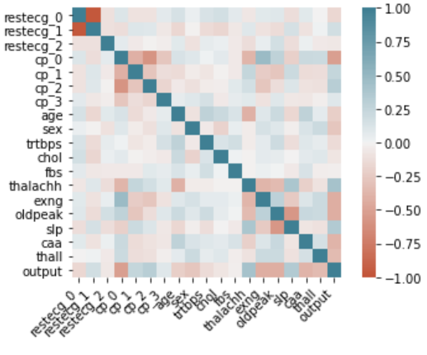
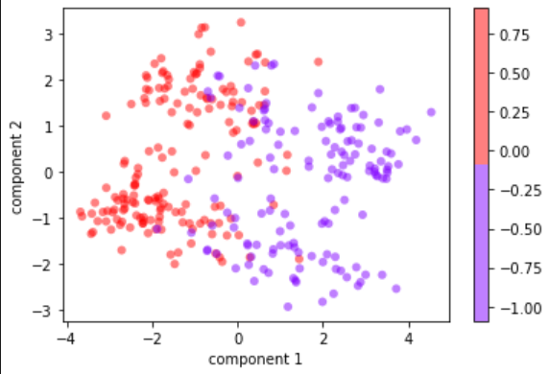
Extract, Transform, Load/Feature Engineering
Corrplot and PCA plot
Remove uncorrelated features
Fasting blood sugar
Add bias term

Slide 10
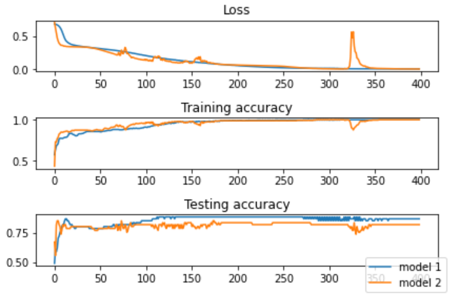
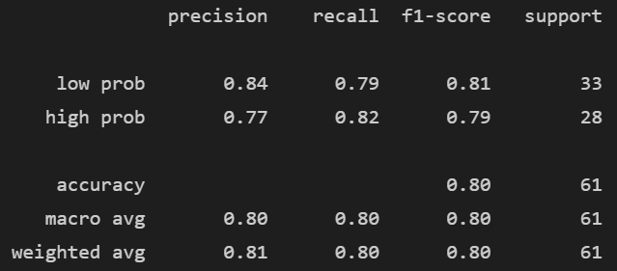
Performance indicators
Test accuracy from cross-validation
Small dataset – important to use cross-validation
10-fold CV applied to all 8 different models
Test accuracy is a metric that can be applied to all models
Select the most accurate model
Other metrics used:
Loss function (deep learning)
F1-score, confidence intervals etc...

Slide 11
Model selection algorithm
Model | 10-fold CV Test-score
Neural net 1 | ~80%
Neural net 2 | ~80%
Logistic Regression | ~81%
SVM (rbf kernel) | ~80.5%
SVM (polynomial kernel) | ~83% (best-in-class)
SVM (sigmoid kernel) | ~77%
Decision tree (gini criterion) | ~76%
10-fold cross-validation:
Without one-hot coding
Categorical features:
Performance dropped 2%
Without scaling the data:
Performance dropped 1%

