Slide 1
Advanced programming 2024
Joao Filipe de Carvalho Ferreira Erik Milsencik Tobias Schwarz Ana Marta Martins dos Santos Dias Torres

Slide 2
AGENDA
Basic functions and operations
Use of structs
REWL
Reflection
Metaprogramming

Slide 3
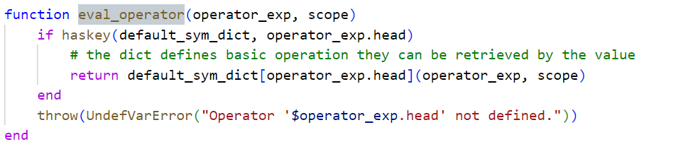
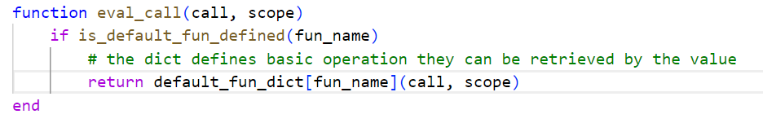
Basic functions and operations
We separated the most basic calls in other files. So, a dict defines for basic operations which action should be performed.
This leads to a clean design and better maintainability.

Slide 4
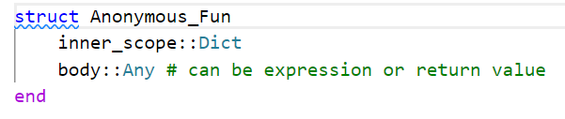
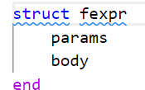
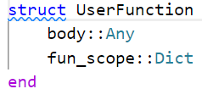
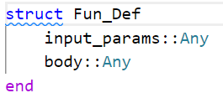
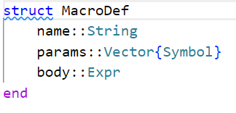
Use of structs
For better chance of reuse and cleaner code we introduced different structs.
In the most cases it was not possible to narrow down the datatype because the inputs can be so different
4

Slide 5
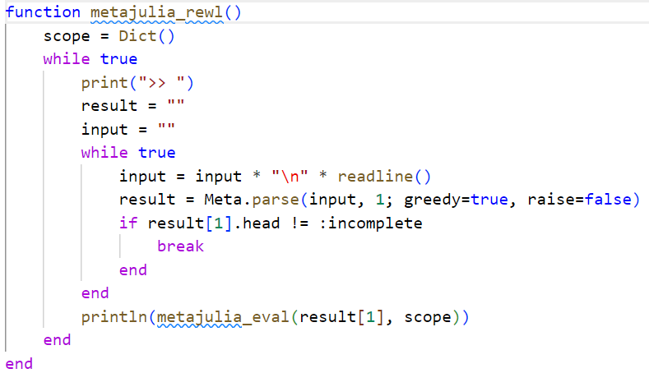
REWL
Here you could say something about scoping anf why you choosed thos params for parse

Slide 6
Refelction
Im not sure whats importnat for the next two topics

Slide 7
Metaprogramming

Slide 8
THANK YOU
Joao Filipe de Carvalho Ferreira Erik Milsencik Tobias Schwarz Ana Marta Martins dos Santos Dias Torres

