Slide 1
Advanced programming 2024
Joao Filipe de Carvalho Ferreira Erik Milsencik Tobias Schwarz Ana Marta Martins dos Santos Dias Torres

Slide 2
AGENDA
Basic functions and operations
Use of structs
REPL
Reflection
Metaprogramming
Auxiliary Functions

Slide 3
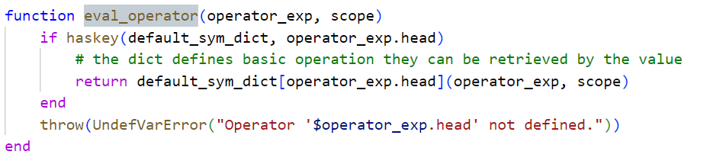
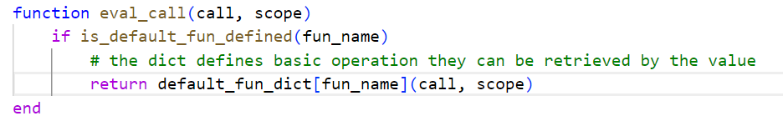
Basic functions and operations
We separated the most basic calls in other files. So, a dict defines for basic operations which action should be performed.
This leads to a clean design and better maintainability.

Slide 4
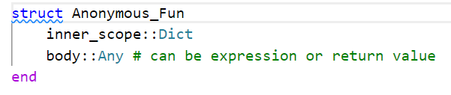
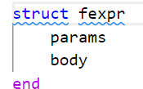
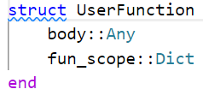
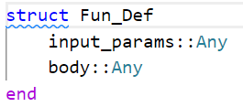
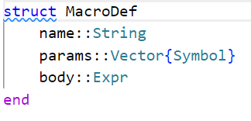
Use of structs
For better chance of reuse and cleaner code we introduced different structs.
In the most cases it was not possible to narrow down the datatype because the inputs can be so different

Slide 5
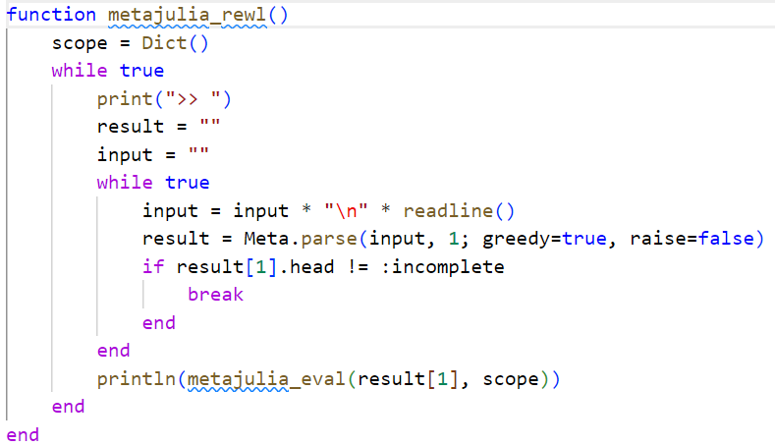
REPL
Here you could say something about scopping and why you chose those params for parse

Slide 6
ReflEction
Im not sure whats importnat for the next two topics

Slide 7
Metaprogramming

Slide 8
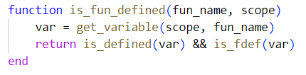





Use of check functions
For better a better comprehension and to avoid code duplication, we created various check functions

Slide 9

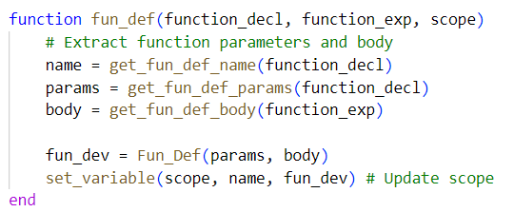
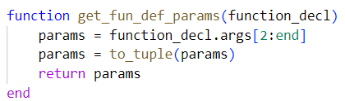

Getters
We use getters in specific cases to extract elements of an expression.
This leads to a clean design and better maintainability.

Slide 10
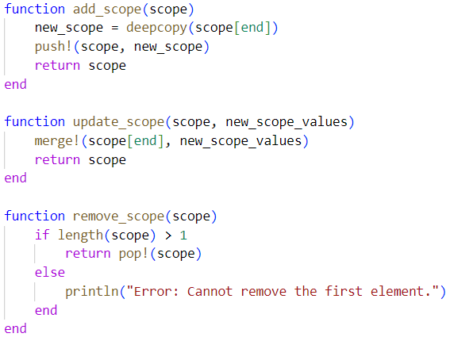

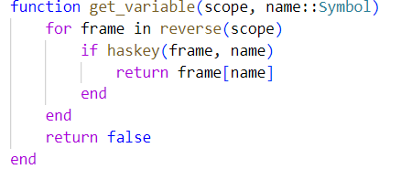
Use of environment handlers
For better a better comprehension and to avoid code duplication, we created helper functions to handle the environments

Slide 11
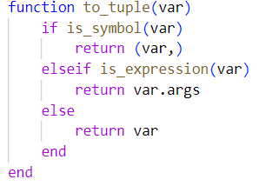

Miscellaneous
These were created to avoid code duplication

Slide 12
THANK YOU
Joao Filipe de Carvalho Ferreira Erik Milsencik Tobias Schwarz Ana Marta Martins dos Santos Dias Torres

