Slide 1
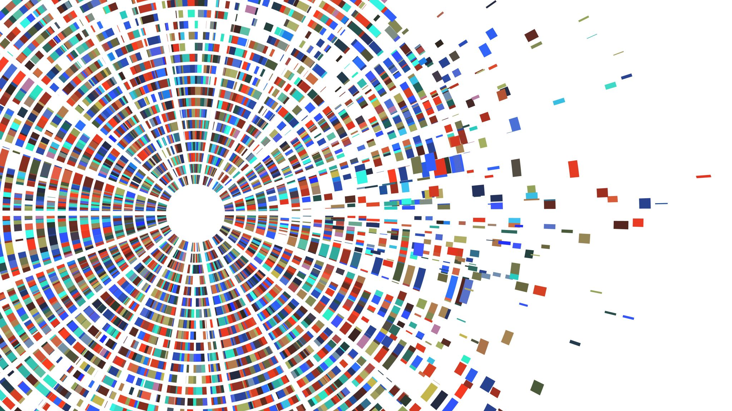
NServiceBus & Sagas
with Erik Muir

Slide 2
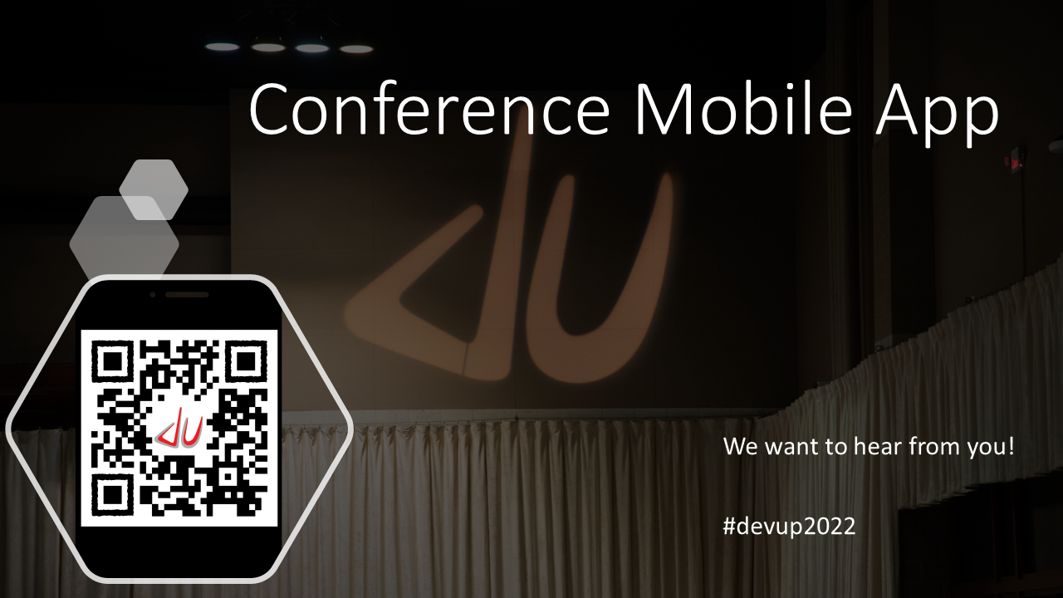

Slide 3
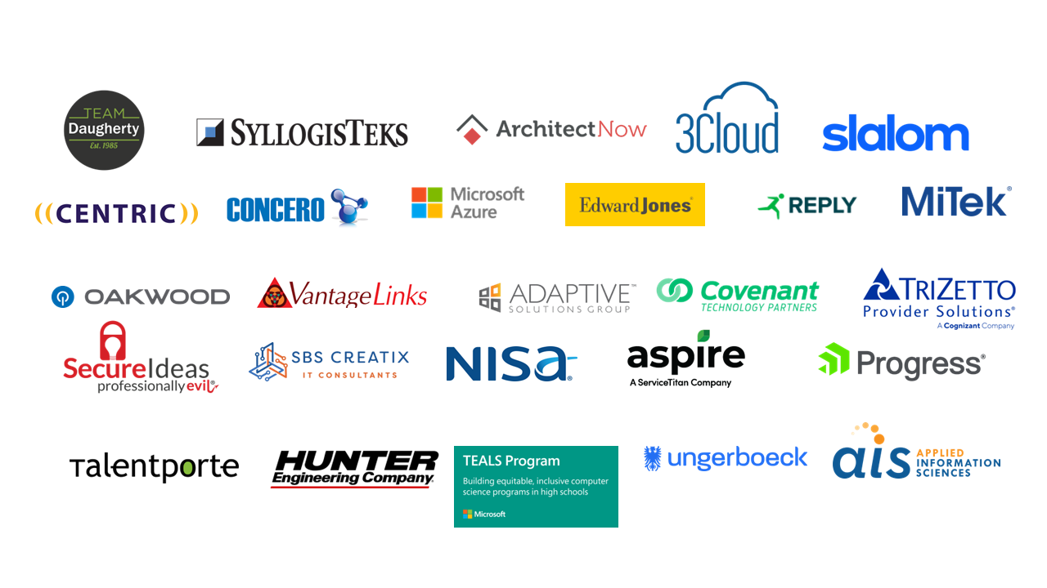

Slide 4








A Web3 Managed Service Provider
Inquire
Search
Sentinel
Notify
Deduce
Analytics
Replay
Develop
Perceive Metrics
Explore
Accelerating enterprise adoption of public ledgers
Hedera
Hashgraph
™

Slide 5


What is NServiceBus?
NServiceBus is a .NET based framework for implementing the Enterprise Service Bus pattern.
As a developer, it helps you create decoupled applications that are easier to maintain, extend, and scale.

Slide 6


Message Types
IMessage
ICommand
IEvent
Command
Event
Tell a service to do something
One-to-one
Fire-and-forget
Announce that something happened
One-to-many
Publish/subscribe

Slide 7
Configuration Considerations
Transport
Persistence
A transport is an implementation of an underlying queuing technology.
Persistence is essentially data storage, such as for long-running stateful processes or certain transport implementations.
Learning
MSMQ
Azure Service Bus
Azure Storage Queues
SQL Server
RabbitMQ
Amazon SQS
Learning
SQL Server
NHibernate
Cosmos DB
MongoDB
Azure Table
RavenDB
Service Fabric
MSMQ
Non-Durable

Slide 8



What are Sagas? And why do we need them?
Long-running business processes exist in many systems.
Whether the steps are automated, manual, or a combination, effective handling of these processes is critical.
Sagas are a way to orchestrate these business processes, keeping in mind fault-tolerance and scalability.

Slide 9
How to Create a Saga
Long-running means stateful, so we need a saga data class that stores the state.
A saga is a class that inherits from Saga<T>, where T is the saga data class.
Implement IAmStartedByMessages<T> and IHandleMessages<T> interfaces.
Notes:
Saga data class – just a POCO that inherits ContainSagaData
Generic Saga class – the base class contains features to assist implementing long-running processes
Register message types – every message type requires a handler

Slide 10
Saga Do’s and Don’ts
DO
have a handler method for every type of message the saga should handle.
DON'T
assume messages will come in the expected order.
DO
freely update the state (saga data) as needed.
DON'T
do anything external directly in the saga (database, email, excel). Instead, send a message to be handled externally.

Slide 11
Demo: Workflow Stages
Workflow Creation
Requisition Form
Governance Review
Design Phase
Implementation Phase
Workflow Completion

Slide 12

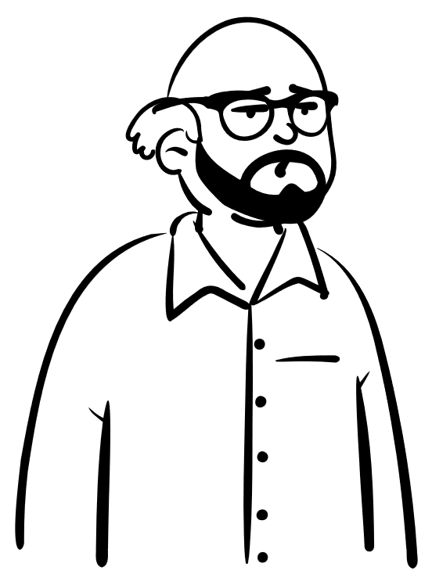
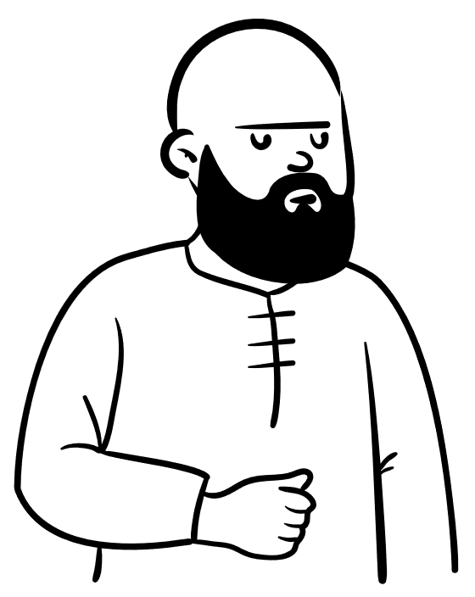





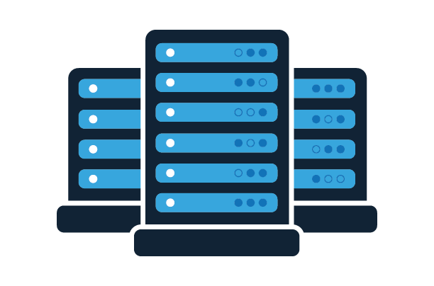

Fill out this Excel doc and email it to me when you’re done.
I need some servers!
Denied!
Approved!
Linda
Bob
Governance
Hardware
Manual Workflow Scenario
Data Center
Networking

Slide 13



Demo: Workflow Scenarios
Return to previous stage
Parallel steps
SLA alerts

Slide 14





Thank You!
This Photo by Unknown Author is licensed under CC BY
erikdmuir@gmail.com
@erikdmuir
muirdev.com
github.com/ErikMuir/NServiceBusDemo
This Photo by Unknown Author is licensed under CC BY-NC

